Slide 2


Slide 3


Slide 4


Slide 5

WILDCAT
MENTORS
Give a little time, Get a lot in return. Be one!
Time Commitment:
2 hours a month
Location:
School campuses
If you would like more information:
Pick up a brochure at the Children’s Ministry Desk or
fill out the information below and drop in an
offering box for Casey Burke

Slide 6


Slide 7


Slide 8


Slide 9


Slide 10

Movement #1
Jesus was moved with Sorrow and to find a quiet place at the news of john the baptists death

Slide 11

Movement
The progress of events in a
narrative or drama
A self-contained section
of an extended composition

Slide 12
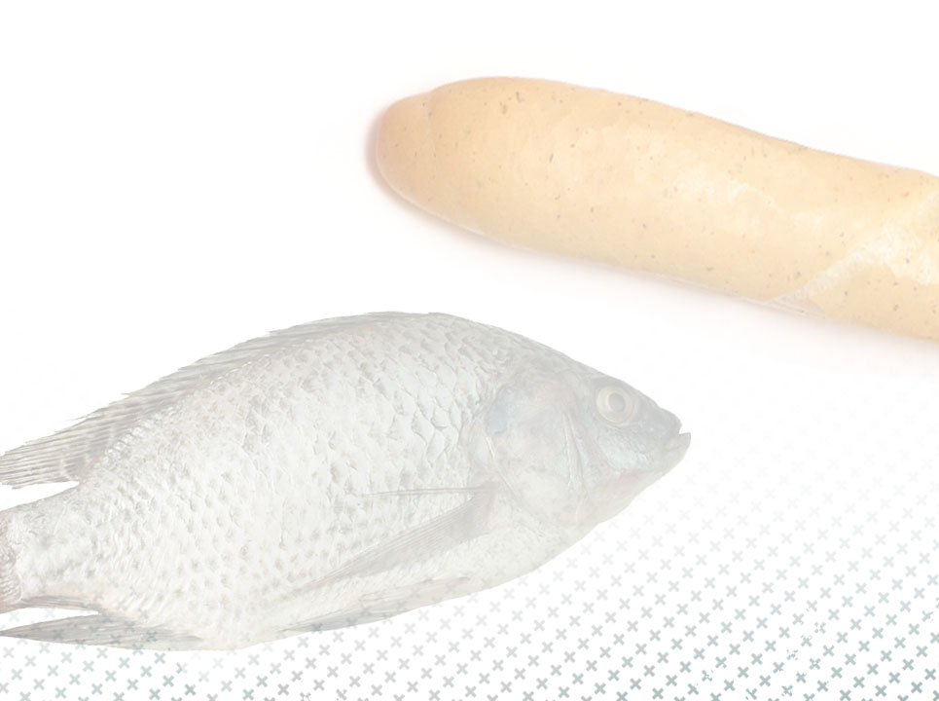
³⁰The apostles gathered around Jesus and reported to him all they had done and taught. ³¹Then, because so many people were coming and going that they did not even have a chance to eat, he said to them, “Come with me by yourselves to a quiet place and get some rest.” Mark 6:30,31

Slide 13
Movement #2
Jesus was moved with compassion at the sight of Sheep without a shepherd

Slide 14
³³But many who saw them leaving recognized them and ran on foot from all the towns and got there ahead of them. ³⁴When Jesus landed and saw a large crowd, he had compassion on them, because they were like sheep without a shepherd. so he began teaching them many things.
Mark 6:33,34

Slide 15

A feeling of deep sympathy and sorrow for another who is stricken by misfortune, Accompanied by a strong desire to alleviate the suffering

Slide 16
Movement #3
Jesus was moved To Meet the Practical needs of the mob

Slide 17

You Give Them Something To Eat!

Slide 18
Magnitude of The Movements
5,000 men plus women & Children were fed from 5 loaves & 2 Fish With 12 full baskets left over

Slide 19
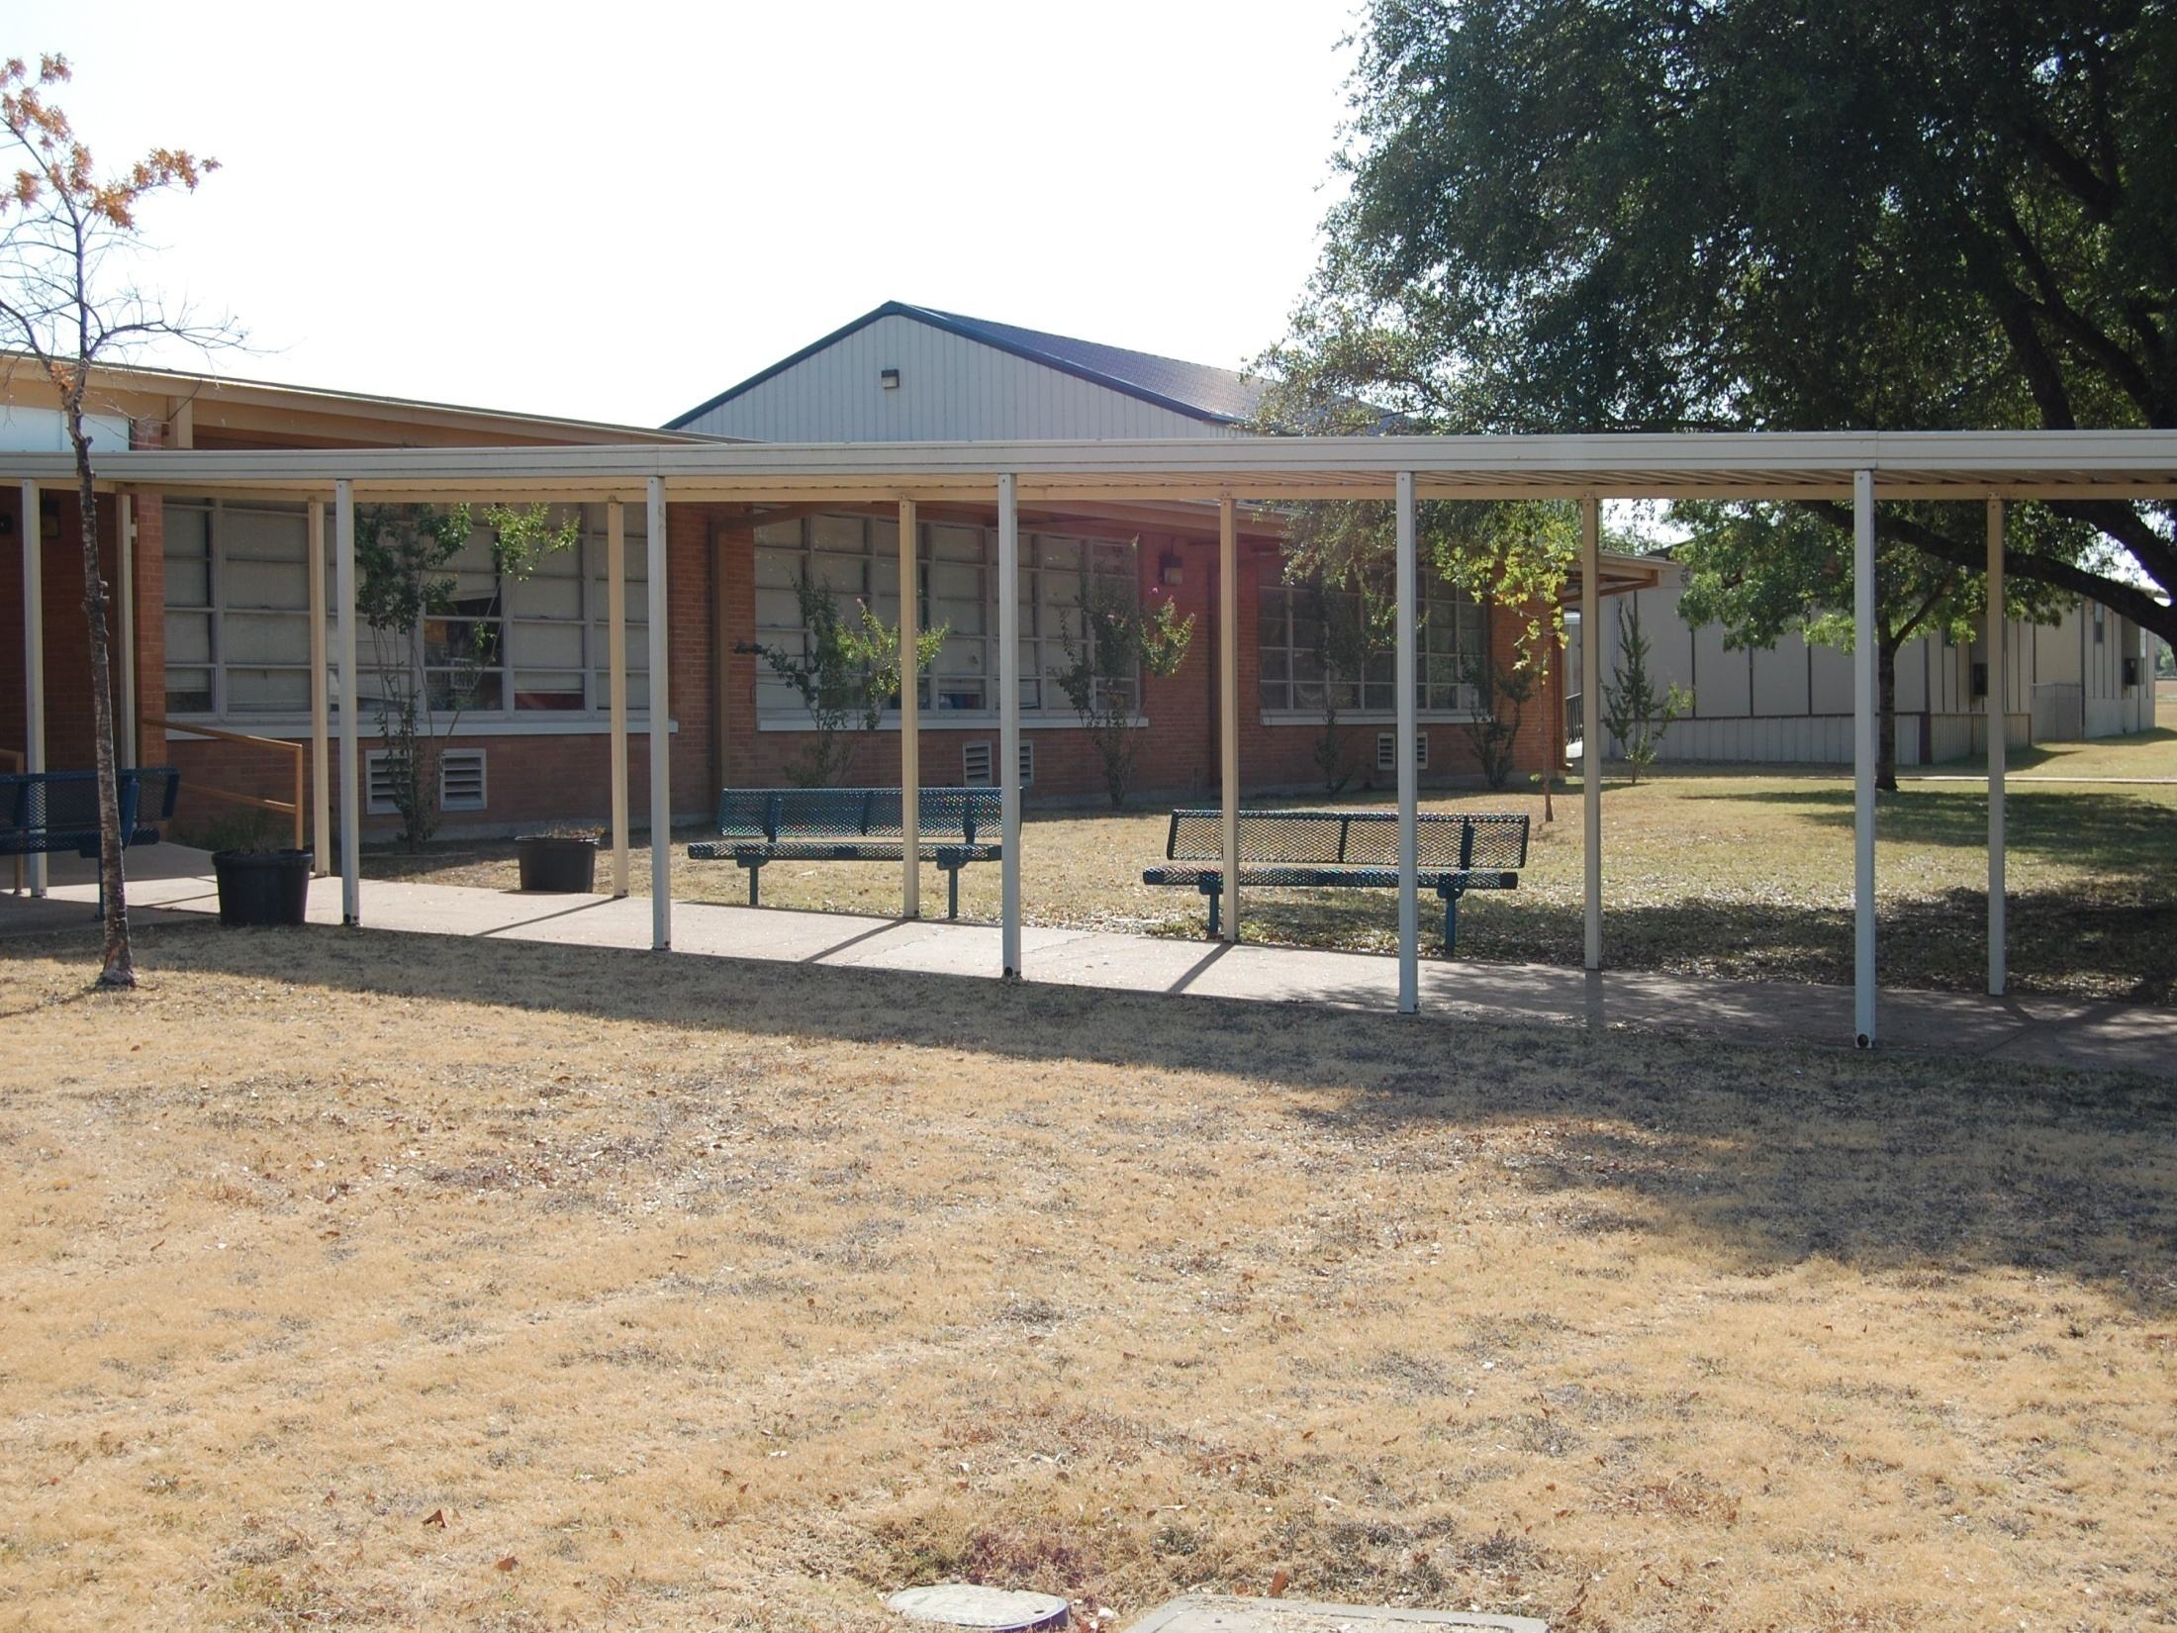
We have 3 different kids in 3 different sports…

Slide 20
We have 3 different kids in 3 different sports… You Give Them Something To Eat

Slide 21
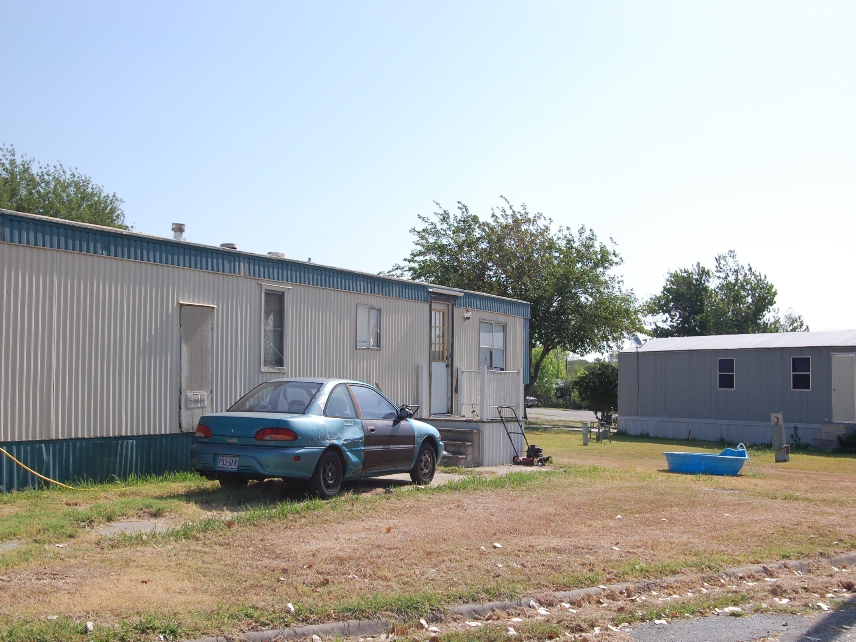
You don’t know how NEEDY my family is…

Slide 22
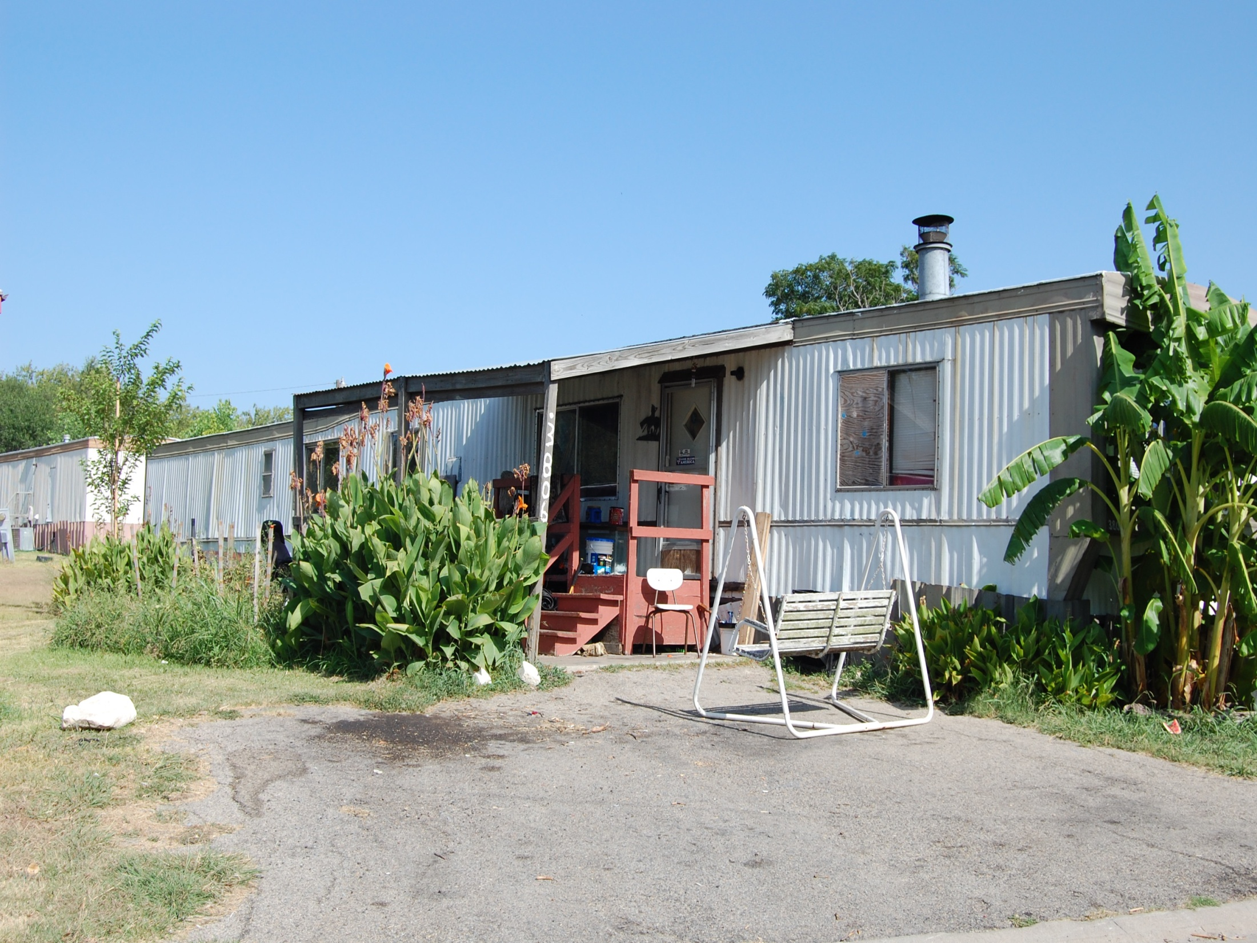
You don’t know how NEEDY my family is…
You Give Them Something To Eat

Slide 23
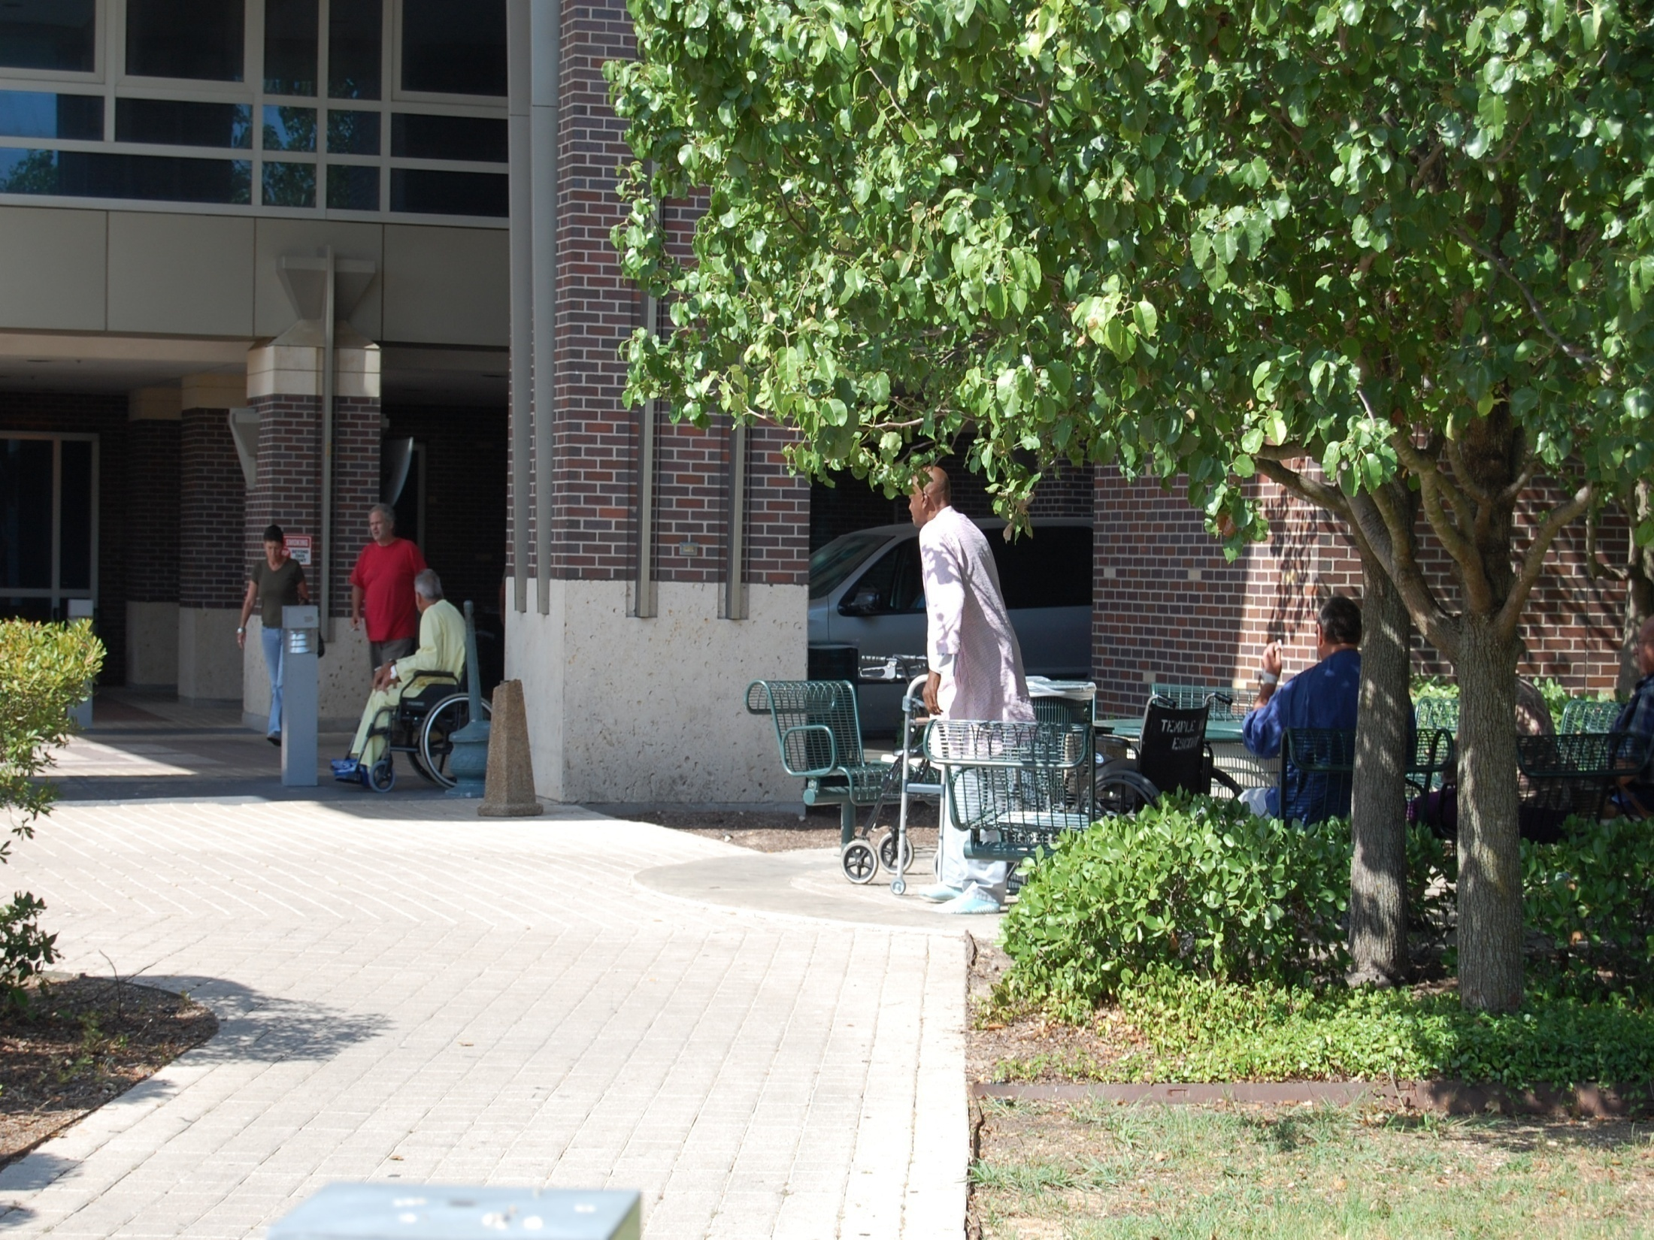
Caring for my kids takes all my time and energy…

Slide 24


Slide 25
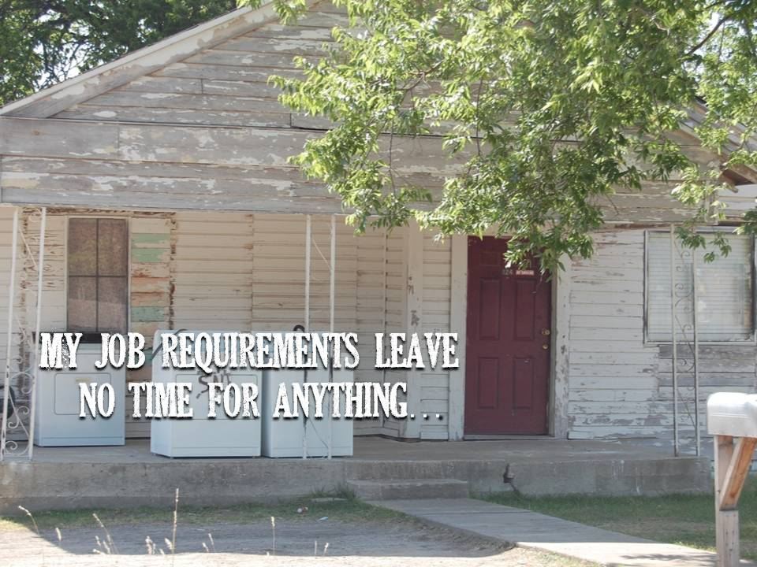

Slide 26
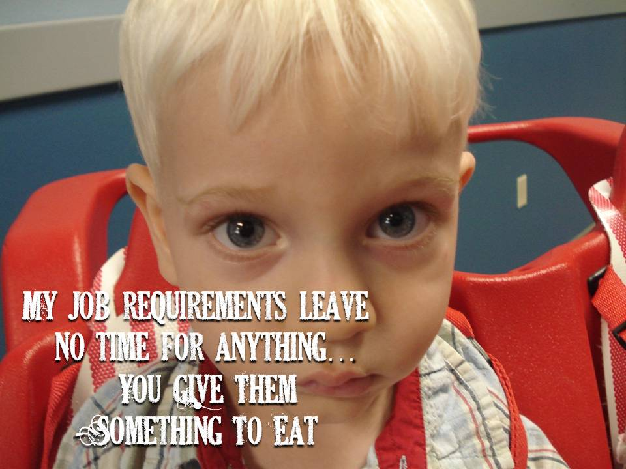

Slide 27
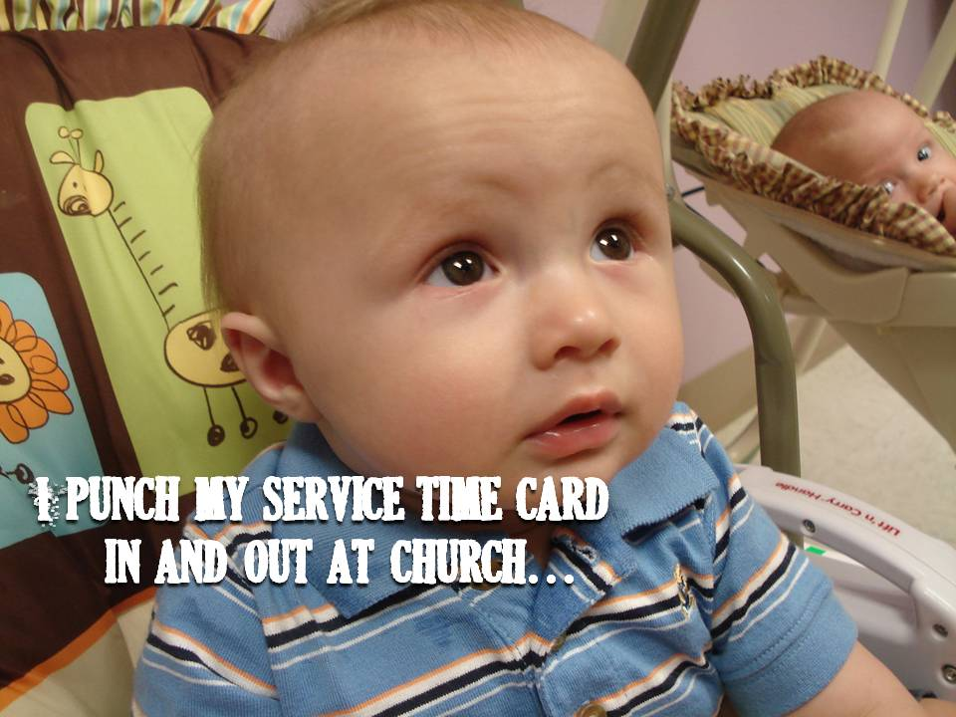

Slide 28
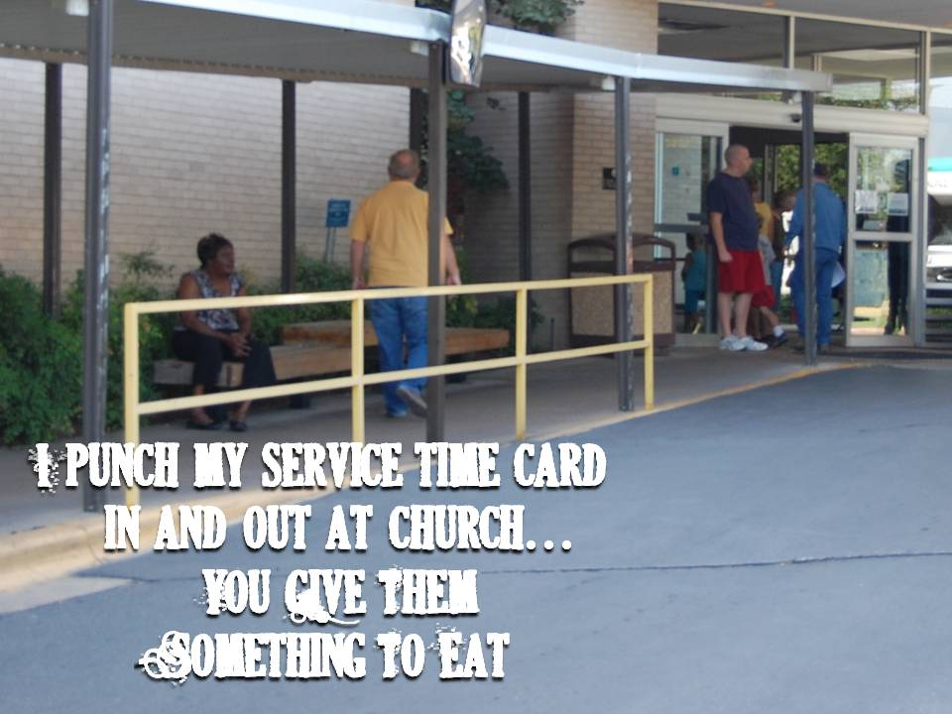

Slide 29
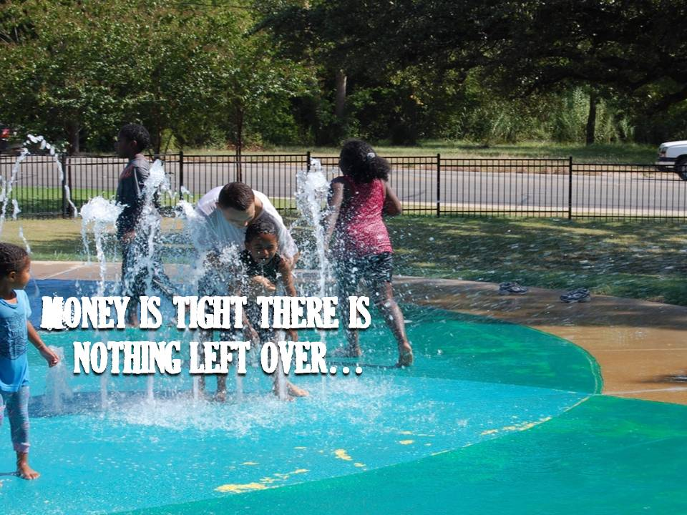

Slide 30
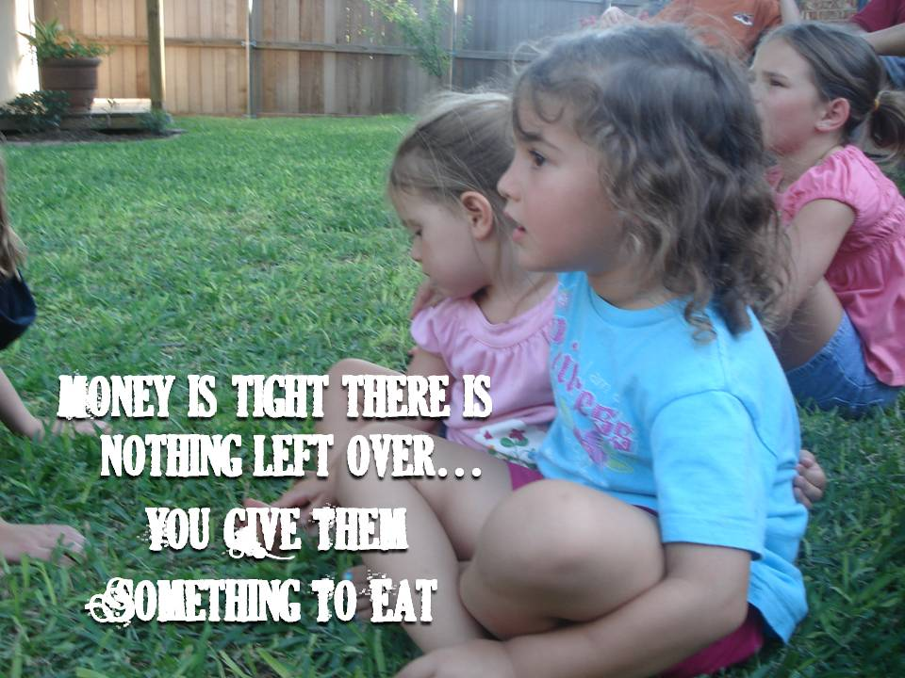

Slide 31
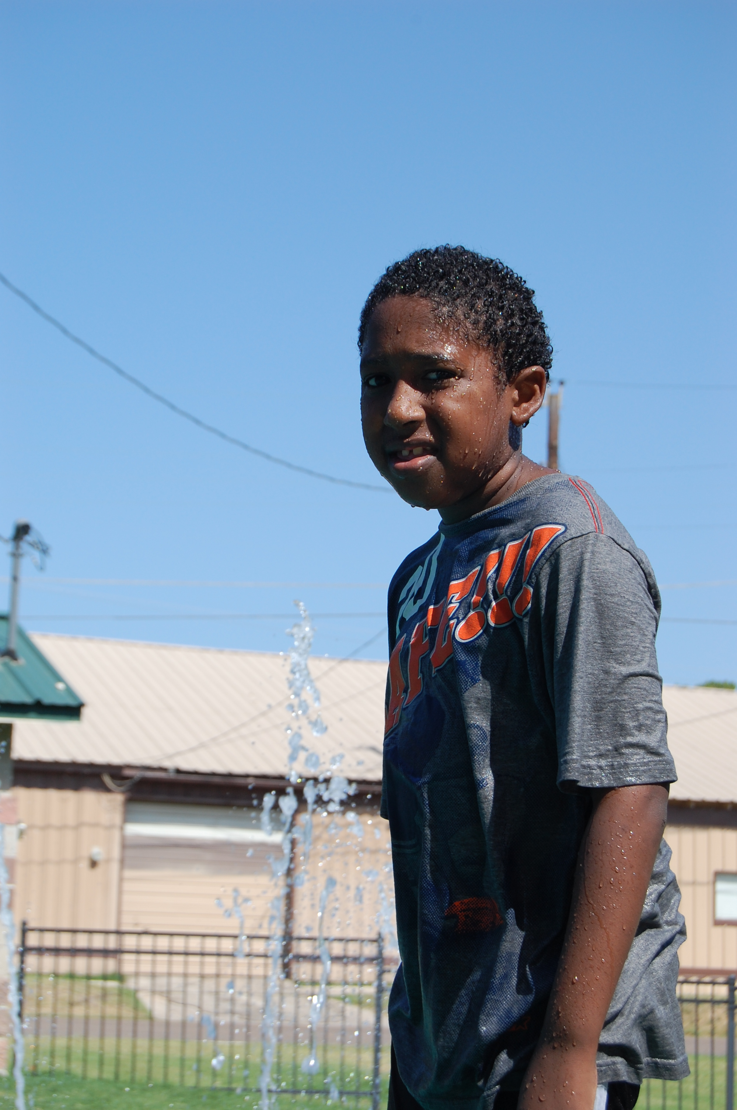
I don’t Know where to start or who I can help…

Slide 32
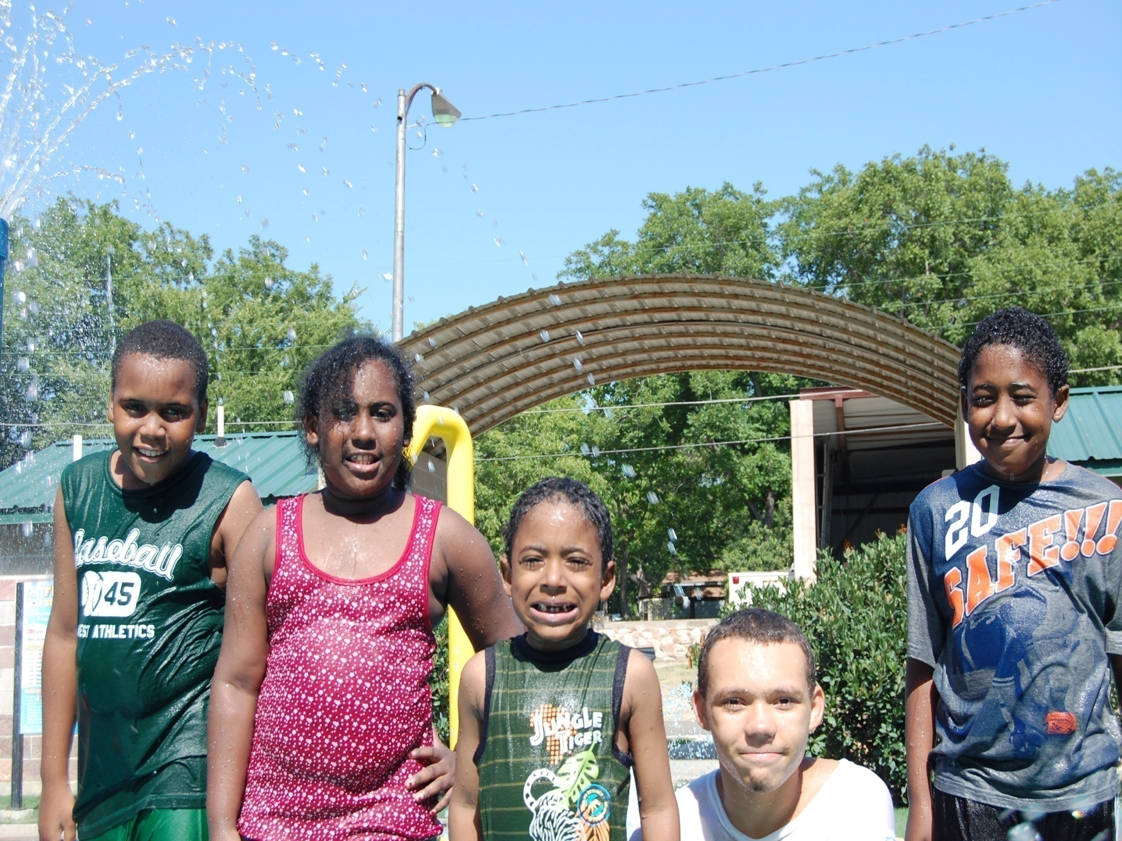
I don’t Know where to start or who I can help… You Give Them Something To Eat

Slide 33

Our schedules are so full We’re Just too Busy…

Slide 34
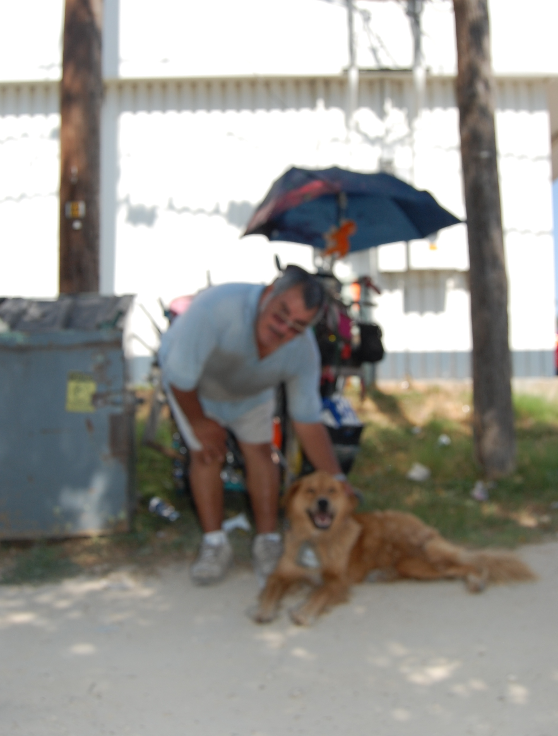
Our schedules are so full We’re Just too Busy… You Give Them Something To Eat

Slide 35
What will Be
Your Next Move?

