Slide 2
Majestic
O Lord our Lord how majestic is
Your name in all the earth O Lord our Lord how majestic is
Your name in all the earth

Slide 3
The heavens declare Your greatness The oceans cry out to You The mountains they bow down
before You So I'll join with the earth
and I'll give my praise to You

Slide 4
O Lord our Lord how majestic is
Your name in all the earth O Lord our Lord how majestic is
Your name in all the earth

Slide 5
The heavens declare Your greatness The oceans cry out to You The mountains they bow down
before You So I'll join with the earth
and I'll give my praise to You

Slide 6
I will worship You
I will worship You
I will worship You
I will worship You
We will worship You
We will worship You

Slide 7
The heavens declare Your greatness The oceans cry out to You The mountains they bow down
before You So I'll join with the earth
and I'll sing

Slide 8
The heavens declare Your greatness The oceans cry out to You The mountains they bow down
before You So I'll join with the earth
and I'll give my praise to You
TEMPLE BIBLE CHURCH Used by Permission CCLI #78316

Slide 9
SING TO THE KING
Sing to the King
who is coming to reign
Glory to Jesus
the Lamb that was slain

Slide 10
Life of salvation
His empire shall bring
Joy to the nations
when Jesus is King

Slide 11
So come let us sing a song
A song declaring we belong
To Jesus, He is all we need
Lift up a heart of praise
Sing now with voices raised
To Jesus, sing to the King

Slide 12
For He’s returning
We watch and we pray
We will be ready
The dawn of that day

Slide 13
We’ll join in singing
With all the redeemed
Satan is vanquished
And Jesus is King

Slide 14
So come let us sing a song
A song declaring we belong
To Jesus, He is all we need
Lift up a heart of praise
Sing now with voices raised
To Jesus, sing to the King
(repeat)
TEMPLE BIBLE CHURCH Used by Permission CCLI #78316

Slide 15
REIGN IN US
You thought of us
before the world began to breathe
You knew our names
Before we came to be

Slide 16
You saw the very day
We’d fall away from You
How desperately
we need to be redeemed

Slide 17
Lord Jesus
Come lead us
We’re desperate
For Your touch

Slide 18
Oh great and mighty One
With one desire we come
That You would reign
That You would reign in us

Slide 19
We’re offering up our lives
A living sacrifice
That You would reign
That You would reign in us

Slide 20
Spirit of the living God
Fall fresh again
Come search our hearts and
Purify our lives

Slide 21
We need Your perfect love
We need Your discipline
We’re lost unless You guide us
With Your light

Slide 22
Lord Jesus
Come lead us
We’re desperate
For Your touch

Slide 23
Oh great and mighty One
With one desire we come
That You would reign
That You would reign in us

Slide 24
We’re offering up our lives
A living sacrifice
That You would reign
That You would reign in us

Slide 25
We cry out for Your life to refine us
Cry out for Your love to define us
Cry out for Your mercy to keep us
Blameless until You return

Slide 26
Oh great and mighty One
With one desire we come
That You would reign
That You would reign in us

Slide 27
We’re offering up our lives
A living sacrifice
That you would reign
That You would reign in us
TEMPLE BIBLE CHURCH Used by Permission CCLI#78316

Slide 28
WHERE WE BELONG
There is no height or depth;
neither life nor death Can take me from all that I find Here now in Your glory Lord

Slide 29
No other pow'rs or love;
the things of now or to come There's nothing on earth in this life That could ever separate us Lord

Slide 30
Your love is never ending;
to Your hands we surrender Where all our sins are washed away Your grace beyond reason
has paid for our freedom We're made alive in You

Slide 31
We run to Your throne where we belong Every heart will sing that Jesus is Lord Casting all else aside
for the joy of our Christ Let Your glory fall Our hearts are filled with Your fire

Slide 32
No other pow'rs or love;
the things of now or to come There's nothing on earth in this life That could ever separate us Lord

Slide 33
Your love is never ending;
to Your hands we surrender Where all our sins are washed away Your grace beyond reason
has paid for our freedom We're made alive in You

Slide 34
We run to Your throne where we belong Every heart will sing that Jesus is Lord Casting all else aside
for the joy of our Christ Let Your glory fall Our hearts are filled with Your fire

Slide 35
We run to Your throne where we belong Every heart will sing that Jesus is Lord Casting all else aside
for the joy of our Christ Let Your glory fall Our hearts are filled with Your fire

Slide 36
We run to Your throne where we belong Every heart will sing that Jesus is Lord Casting all else aside
for the joy of our Christ Let Your glory fall Our hearts are filled with Your fire
TEMPLE BIBLE CHURCH Used by Permission CCLI #78316

Slide 37
IT IS WELL WITH MY SOUL
It is well
with my soul It is well, it is well with my soul

Slide 38
When peace like a river
attendeth my way When sorrows like sea billows roll Whatever my lot,
Thou hast taught me to say It is well, it is well with my soul

Slide 39
It is well
with my soul It is well, it is well with my soul

Slide 40
My sin, oh the bliss
of this glorious thought My sin, not in part, but the whole Is nailed to the cross
and I bear it no more Praise the Lord, praise the Lord,
oh my soul

Slide 41
It is well
with my soul It is well, it is well with my soul

Slide 42
And Lord, haste the day
when my faith shall be sight The clouds be rolled back
as a scroll The trump shall resound
and the Lord shall descend Even so, it is well with my soul

Slide 43
It is well
with my soul It is well, it is well with my soul
(repeat)
It is well, it is well with my soul
Temple Bible Church Used By Permission CCLI #78316

Slide 48
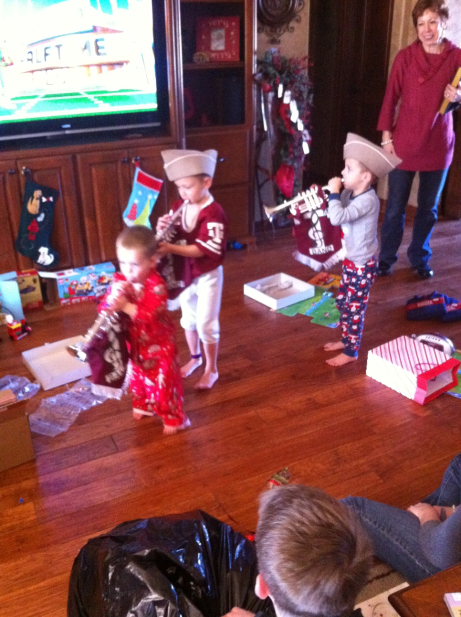

Slide 49
Resolutions

Slide 50
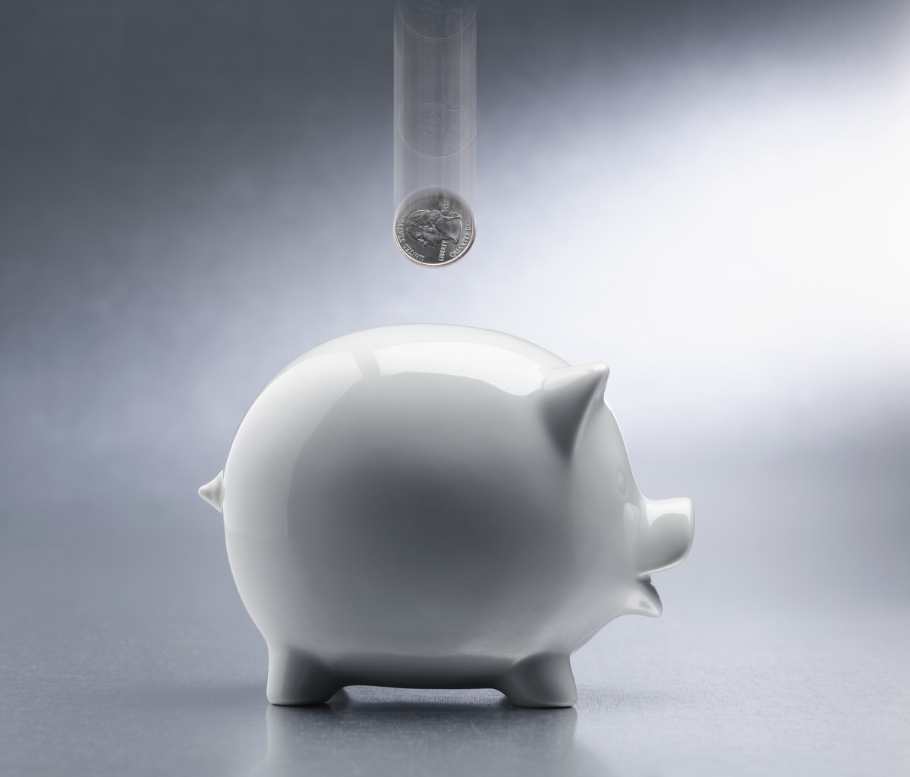

Slide 52
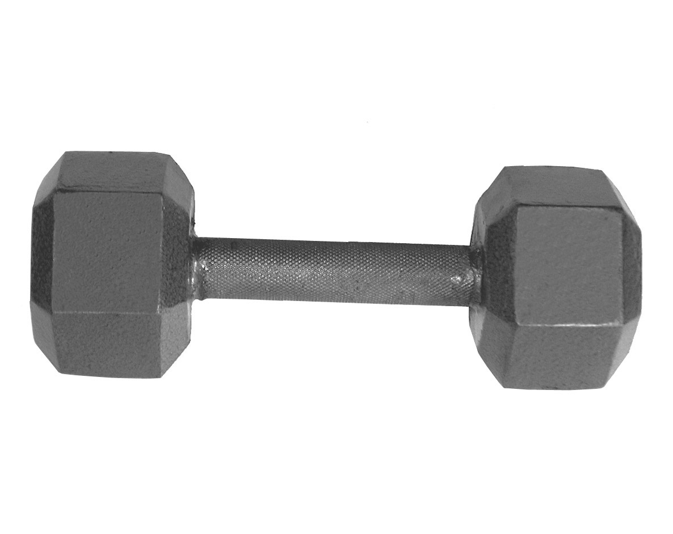

Slide 53
When sinful human beings aspire to the status and position of God, and refuse to acknowledge their dependence on Him. Mahaney

Slide 54
“Honestly assessing ourselves in light of God’s holiness and our sinfulness.” Mahaney.
“Humility begins with a sense of subordination to God in Christ.” Piper

Slide 55
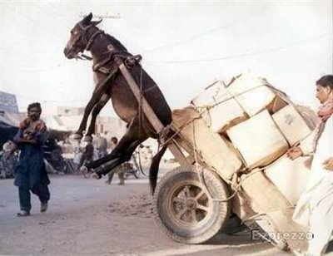
Paul is challenging us to do the IMPOSSIBLE!

Slide 56
1. Do nothing out of selfish ambition
2. Consider others more important than yourselves
3. Look out for the interests of others.

Slide 57
Jesus replied: Love the Lord your God with all your heart and with all your soul and with all your mind. This is the first and greatest commandment. And the second is like it: Love your neighbor as yourself.
Matthew 22:37-39

Slide 58
““…we have preferred the wide, fast road of self-esteem instead of the narrow, slow road of self-denial that comes from humility.”
Brian Sanders

Slide 59
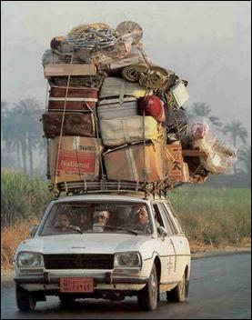
The IMPOSSIBLE
becomes POSSIBLE

Slide 61
Not so with you. Instead, whoever wants to become great among you must be your servant, and whoever wants to be first must be slave of all. For even the Son of Man did not come to be served, but to serve, and to give his life as a ransom for many. Mark 10:43-45

Slide 63
Therefore, God exalted Him to the highest place and gave Him the name that is above every name, that at the name of Jesus every knee should bow, in heaven and on earth and under the earth, and every tongue confess that Jesus Christ is Lord, to the glory of God the Father.
Philippians 2:9-11

Slide 64
I tell you the truth, unless a kernel of wheat falls to the ground and dies, it remains only a single seed. But if it dies, it produces many seeds.
John 12:24

Slide 65
Jesus Resolutions

Slide 68
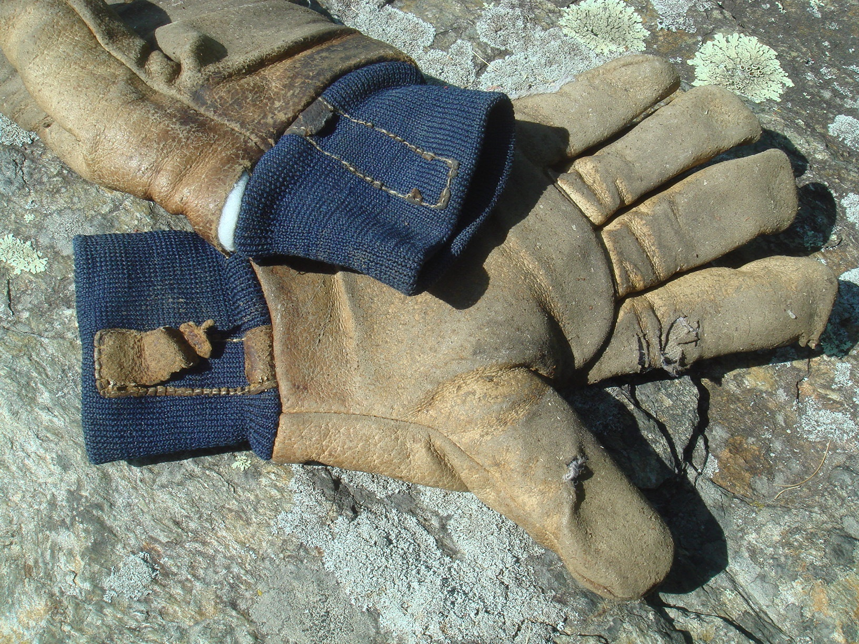

Slide 69
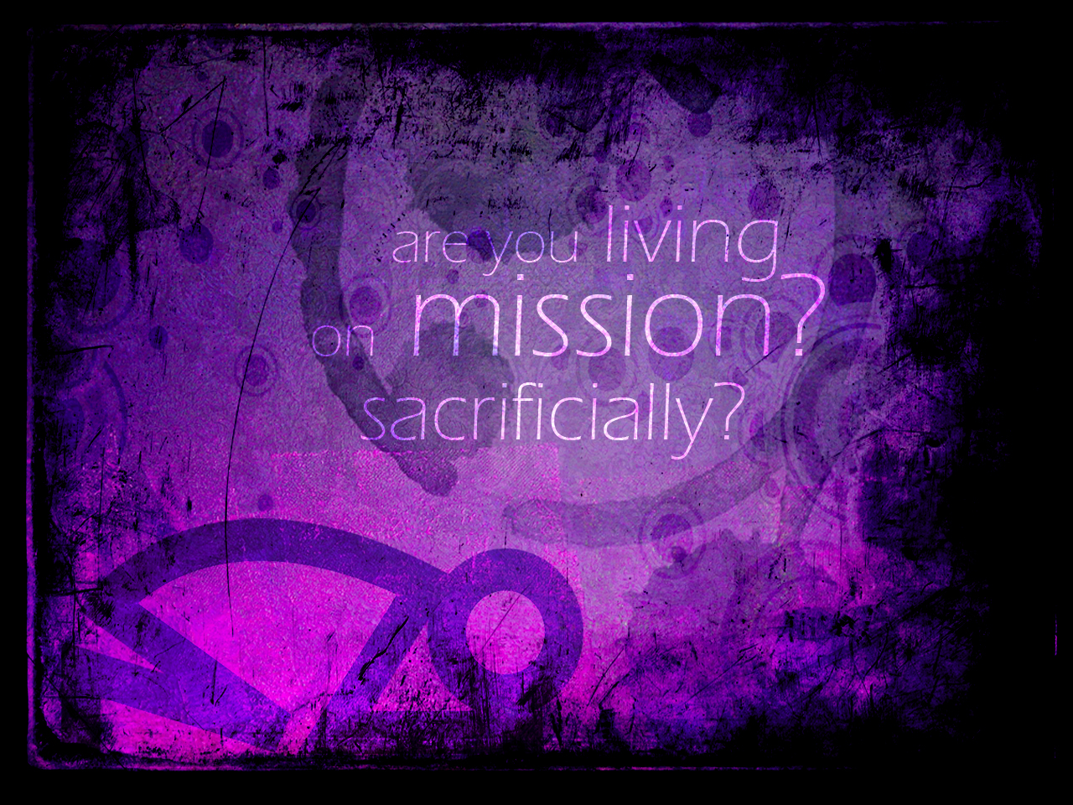
What things can you do this week/year that aren’t so pleasant so others don’t have to?

Slide 70
Surrender
I’m giving You my heart
And all that is within
I lay it all down
For the sake of You, my King

Slide 71
I’m giving You my dreams
I’m laying down my rights
I’m giving up my pride
For the promise of new life

Slide 72
And I surrender
All to You, All to You
And I surrender
All to You, All to You

Slide 73
I’m singing You this song
I’m waiting at the cross
And all the world holds dear
I count it all as loss

Slide 74
For the sake of knowing You
The glory of Your name
To know the lasting joy
Even sharing in Your pain

Slide 75
And I surrender
All to You, All to You
And I surrender
All to You, All to You

