Slide 1


Slide 2

Only One For Me
By Your blood, You have saved me With Your love,
You have brought me close to You By Your hands,
You have made me With one word,
You amaze me

Slide 3
Forever I will sing Your praise And worship You alone
until the day I die I live my life for You
with every breath I take I bless Your name
and want You more And now I'm running to You,
O Lord

Slide 4
You are the reason my heart
can go on and on You are the life inside of me You are the answer to my cries You're all that I
could ever need You are the only
One for me

Slide 5
With one breath, You sustain me By Your grace,
You have given me a hope To dream of Your intentions to be more like You

Slide 6
Forever I will sing Your praise And worship You alone
until the day I die I live my life for You
with every breath I take I bless Your name
and want You more And now I'm running to You,
O Lord

Slide 7
You are the reason my heart
can go on and on You are the life inside of me You are the answer to my cries You're all that I could ever need You are the
only One for me
(repeat 2x)

Slide 8
You are the only One for me You are the only One for me You are the only One for me
TEMPLE BIBLE CHURCH Used by Permission CCLI #78316

Slide 9
Hosanna
Praise is rising,
eyes are turning to You,
we turn to You
Hope is stirring,
hearts are yearning for You,
we long for You

Slide 10
'Cause when we see You,
we find strength to face the day
In Your Presence all our fears
are washed away,
washed away

Slide 11
Hosanna, hosanna
You are the God Who saves us,
worthy of all our praises
Hosanna, hosanna
Come have Your way
among us, We welcome You
here, Lord Jesus

Slide 12
Hear the sound of hearts returning to You, we turn to You
In Your Kingdom
broken lives are made new,
You make us new

Slide 13
'Cause when we see You,
we find strength to face the day
In Your Presence all our fears
are washed away, washed away

Slide 14
Hosanna, hosanna
You are the God Who saves us,
worthy of all our praises
Hosanna, hosanna
Come have Your way
among us, We welcome
You here, Lord Jesus

Slide 15
'Cause when we see You,
we find strength to face the day
In Your Presence
all our fears are washed away

Slide 16
Hosanna, hosanna
You are the God Who saves us,
worthy of all our praises
Hosanna, hosanna
Come have Your way
among us
We welcome You
here, Lord Jesus
TEMPLE BIBLE CHURCH Used by Permission CCLI #78316

Slide 17
Lead Me To The Cross
Savior I come quiet my soul, remember
Redemptions hill where Your blood
was spilled for my ransom
Everything I once held dear
I count it all as lost

Slide 18
Lead me to the cross
where Your love poured out
Bring me to my knees
Lord I lay me down
Rid me of myself
I belong to You
Lead me,
lead me to the cross

Slide 19
You were as I tempted and trialed
You Are
The word become flesh
bore my sin and death
Now You're risen
Everything I once held dear
I count it all as lost

Slide 20
Lead me to the cross
where Your love poured out
Bring me to my knees
Lord I lay me down
Rid me of myself I belong to You
Lead me, lead me to the cross
(repeat)
USED BY PERMISSION CCLI#78316

Slide 21

YOUR NAME
As morning dawns
and evening fades
You inspire songs of praise
That rise from earth
to touch Your heart
And glorify Your Name

Slide 22
Your Name, is a strong
and mighty tower
Your Name, is a shelter
like no other

Slide 23
Your Name, let the nations
sing louder
‘Cause nothing has
the power to save
But Your Name

Slide 24
Jesus, in Your Name we pray
Come and fill our hearts today
Lord, give us strength
to live for You
And glorify Your Name

Slide 25
Your Name, is a strong
and mighty tower
Your Name, is a shelter
like no other

Slide 26
Your Name, let the nations
Sing louder
‘Cause nothing has
the power to save
But Your Name

Slide 27
Your Name, is a strong
and mighty tower
Your Name, is a shelter
like no other

Slide 28
Your Name, let the nations
Sing louder
‘Cause nothing has
the power to save
But Your Name
TEMPLE BIBLE CHURCH Used by Permission CCLI #78316

Slide 29
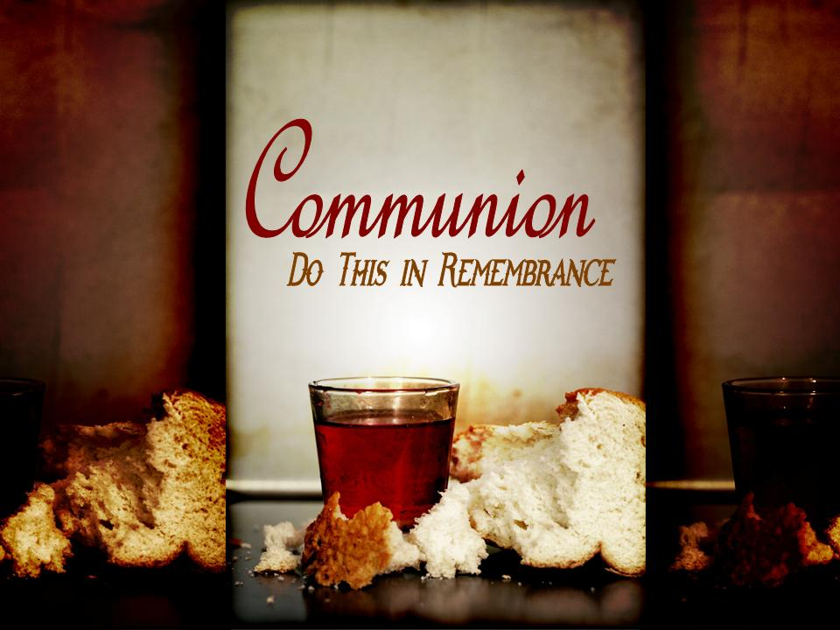

Slide 30
In Christ Alone
In Christ alone my hope is found
He is my light, my strength, my song
This Cornerstone, this solid ground
Firm through the fiercest drought
And storm

Slide 31
What heights of love
What depths of peace
When fears are stilled
When strivings cease
My comforter, my all in all
Here in the love of Christ I stand

Slide 32
In Christ alone, who took on flesh
Fullness of God and helpless babe
This gift of love and righteousness
Scorned by the ones
He came to save

Slide 33
Till on that cross as Jesus dies
The wrath of God was satisfied
For every sin on Him was laid
Here in the death of Christ I live

Slide 34
There in the ground His body lay
Light of the world by darkness slain
Then bursting forth in glorious day
Up from the grave He rose again

Slide 35
And as He stands in victory
Sin’s curse has lost its grip on me
For I am His and He is mine
Bought with the precious
Blood of Christ

Slide 36
No guilt in life, no fear in death
This is the power of Christ in me
From life’s first cry to final breath
Jesus commands my destiny

Slide 37
No power of hell, no scheme of man
Can ever pluck me from His hand
‘till He returns or calls me home
Here in the power of Christ I’ll stand
(repeat)
TEMPLE BIBLE CHURCH Used By Permission CCLI #78316

Slide 38

TBC Core Values

Slide 39
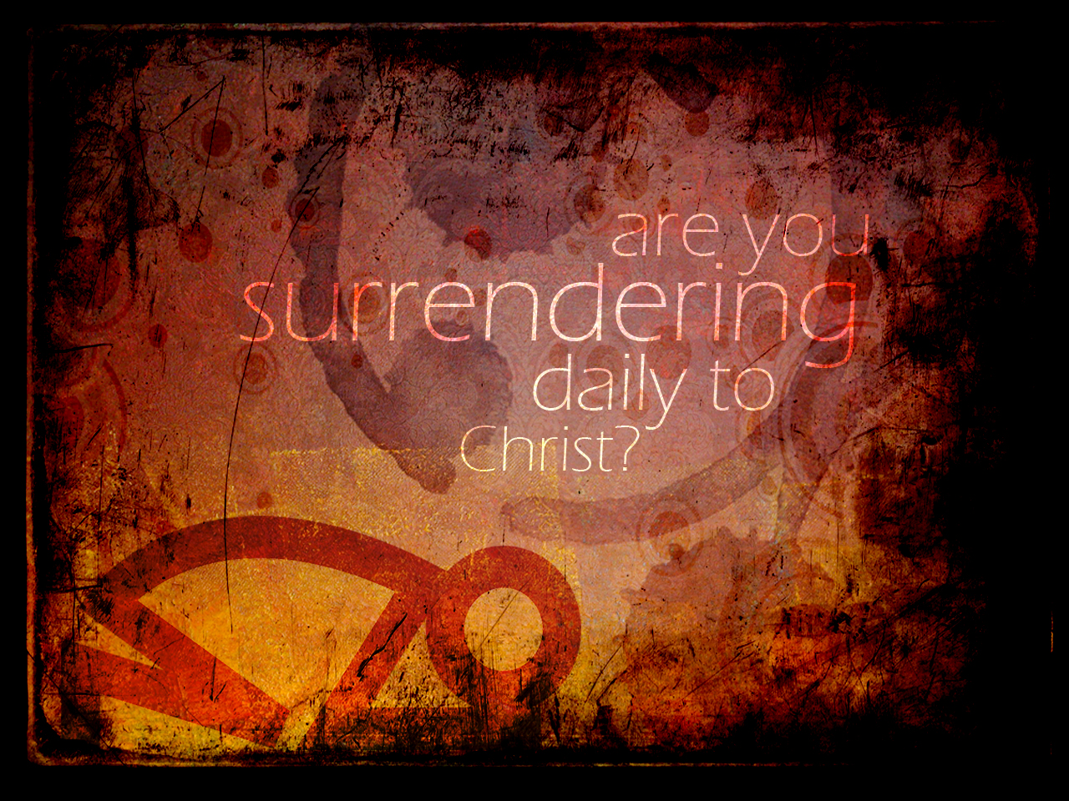

Slide 40
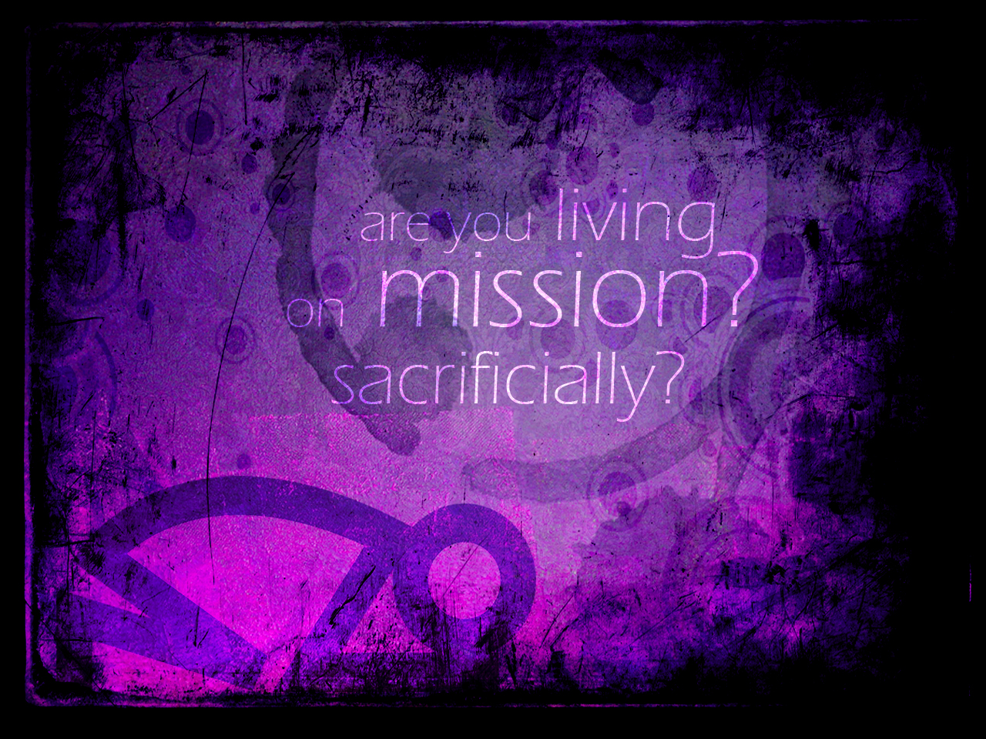

Slide 41
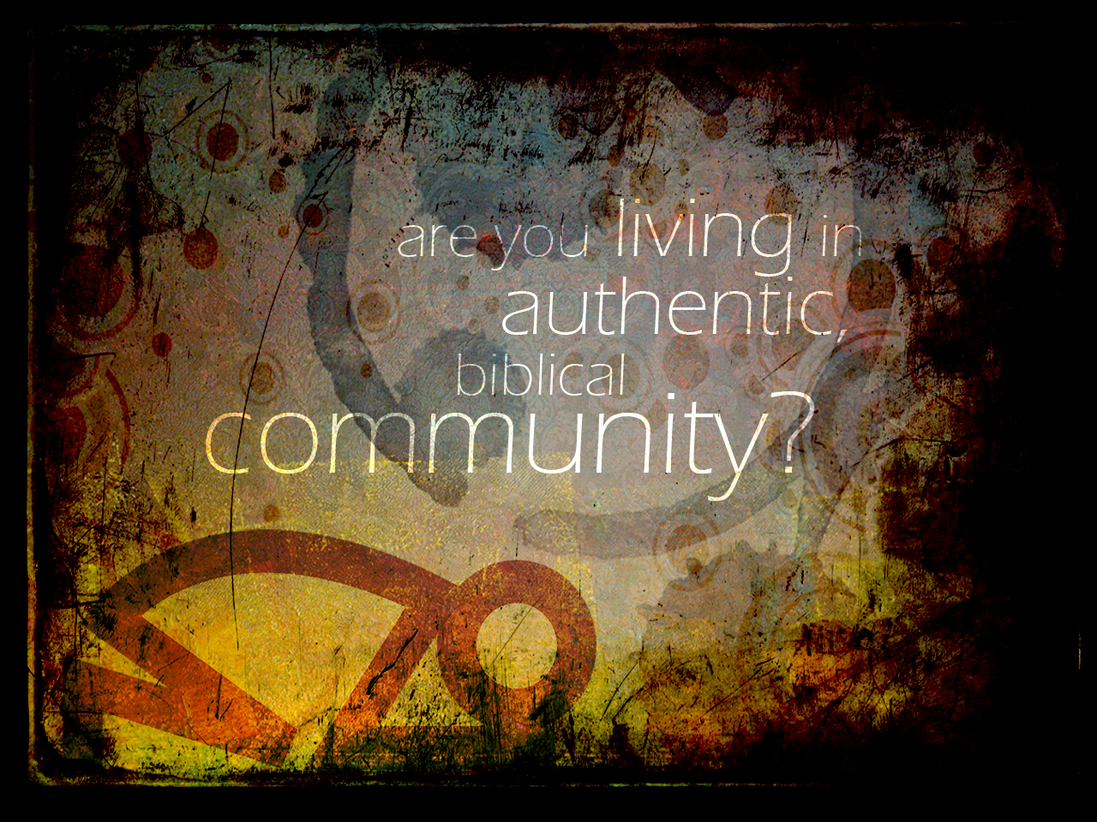

Slide 42
TBC Core Values

Slide 43

All alone video

Slide 44
authentic biblical
COMMUNITY

Slide 45
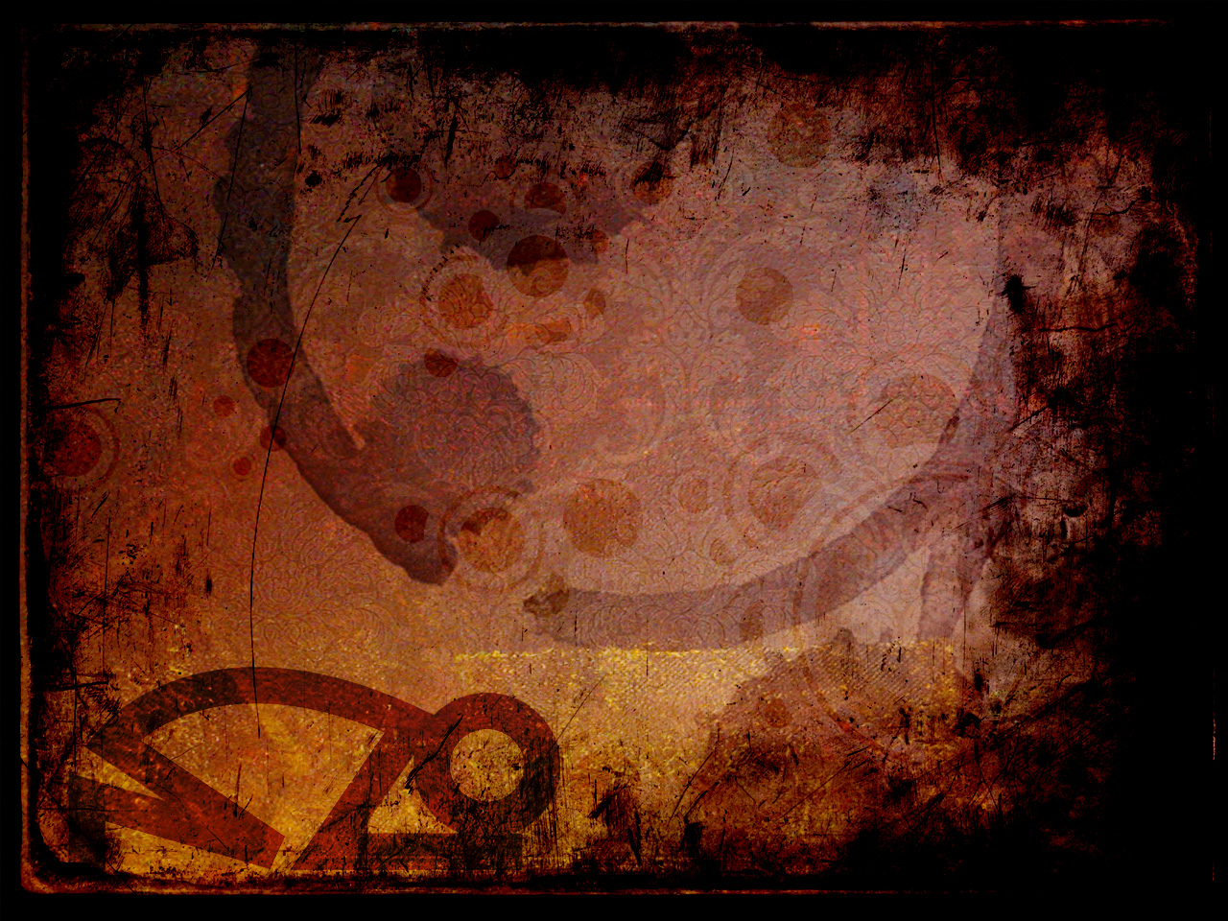
There is nothing more unchristian than a solitary Christian.
-John Wesley

Slide 46
The biggest disease today is not leprosy or tuberculosis, but rather the feeling of being unwanted, uncared for, and deserted by everybody.
The greatest evil is the lack of love.
-Mother Theresa

Slide 47
America is a wired community, connected electronically and economically but not personally and spiritually.
-Dr. Edward M. Hallowell
(Harvard Medical School)

Slide 48
We dial up, hook up, and log on, but we don’t really connect. We seek other ways to fill the hollow feeling inside. We turn to TV alcohol, sports, hobbies, drugs.

Slide 49
We push our 50 hour work week to 60 or 65 hours-anything to numb the pain of loneliness. But it doesn’t work does it? The results prove temporary and shallow. Like a dark shadow, loneliness follows us.
-Peter Pintus

Slide 50
The anthem of the lonely heart has a third verse: “No one needs me.”
“The kids used to need me, the business once needed me, my spouse never needs me.”
Lonely people fight feelings of insignificance.

Slide 51
What do you do with such thoughts as:
“No one knows me, no one is near me, no one needs me.”
How do you cope with such cries for significance?

Slide 52
Some stay busy; others stay drunk. Some buy pets; others buy lovers.
Some seek therapy;
and a few seek God.
--Max Lucado

Slide 53


Slide 54
the FOUNDATION of Community

Slide 55
The LORD God said, "It is not good for the man to be alone. I will make a helper suitable for him." -Gen 2:18

Slide 56
the FOUNDATION of Community
LOVE

Slide 57
A new command I give you: Love one another. As I have loved you, so you must love one another. By this all men will know that you are my disciples, if you love one another." -John 13:34-35

Slide 58

Bev turnbo video

Slide 59
the FOUNDATION of Community
LOVE
UNITY

Slide 60
I will remain in the world no longer, but they are still in the world, and I am coming to you. Holy Father, protect them by the power of your name—the name you gave me—so that they may be one as we are one. -John 17:11

Slide 61
My prayer is not for them alone. I pray also for those who will believe in me through their message, that all of them may be one, Father, just as you are in me and I am in you. May they also be in us so that the world may believe that you have sent me...
-John 17:20

Slide 62
the EXAMPLE of Community
counter cultural living

Slide 63
the ACTIVITY of Community
the “one-anothers”

Slide 64
You, my brothers, were called to be free. But do not use your freedom to indulge the sinful nature; rather, serve one another in love. -Gal 5:13

Slide 65
Carry each other's burdens,
and in this way you will
fulfill the law of Christ. -Gal 6:2

Slide 66
Be completely humble and gentle;
be patient, bearing with one another in love.…
Be kind and compassionate to one another, forgiving one other, just as in Christ God forgave you.
-Eph 4:2,32

Slide 67
Therefore confess your sins to each other and pray for one other so that you may be healed. The prayer of a righteous man is powerful and effective.
-James 5:16

Slide 68
the BARRIERS to Community
the porcupine dilemma

Slide 69
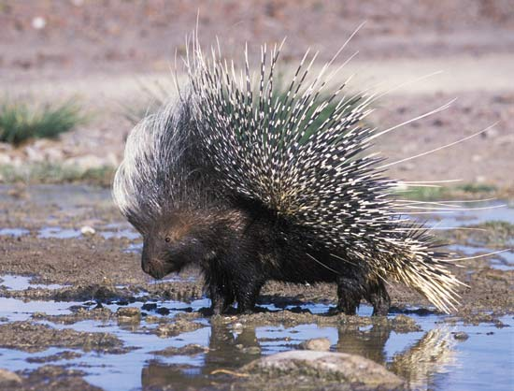

Slide 70
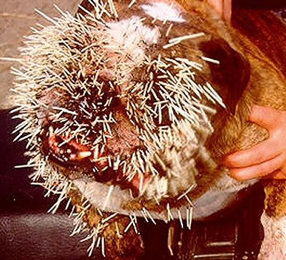

Slide 71
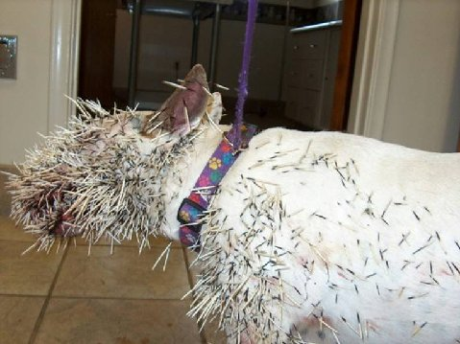

Slide 72
for Demas, because he loved this world, has deserted me and has gone to Thessalonica. Crescens has gone to Galatia, and Titus to Dalmatia.....
Alexander the metalworker did me a great deal of harm. The Lord will repay him for what he has done. -II Tim 4:10,14

Slide 73
for Demas, because he loved this world, has deserted me …
Alexander the metalworker did me a great deal of harm. The Lord will repay him for what he has done.
-II Tim 4:10,14

Slide 75
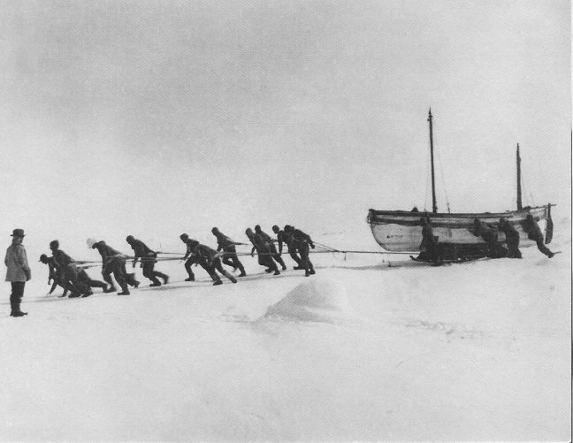

Slide 76
TBC Core Values

