Slide 2
Our God
Water You turned into wine
Opened the eyes of the blind
There’s no one like You, none like You

Slide 3
Into the darkness You shine
Out of the ashes, we rise
There’s no one like You, none like You

Slide 4
Our God is greater
Our God is stronger
God You are higher than any other
Our God is healer, awesome in power
Our God, our God

Slide 5
Into the darkness You shine
Out of the ashes, we rise
There’s no one like You, none like You

Slide 6
Our God is greater
Our God is stronger
God You are higher than any other
Our God is healer, awesome in power
Our God, our God

Slide 7
And if our God is for us
then who could ever stop us
and if our God is with us
then what could stand against
(repeat)

Slide 8
Our God is greater
Our God is stronger
God You are higher than any other
Our God is healer, awesome in power
Our God, our God

Slide 9
And if our God is for us
then who could ever stop us
and if our God is with us
then what could stand against
(repeat)

Slide 10
Our God is greater
Our God is stronger
God You are higher than any other
Our God is healer, awesome in power
Our God, our God
TEMPLE BIBLE CHURCH Used by Permission CCLI #78316

Slide 11
Mighty to Save
Everyone needs compassion
Love that’s never failing
Let mercy fall on me
Everyone needs forgiveness
The kindness of a Savior
The hope of nations

Slide 12
Savior
He can move the mountains
My God is mighty to save
He is mighty to save

Slide 13
Forever
Author of salvation
He rose and conquered the grave
Jesus conquered the grave

Slide 14
So take me as You find me
All my fears and failures
Fill my life again
I give my life to follow
Everything I believe in
Now I surrender

Slide 15
Savior
He can move the mountains
My God is mighty to save
He is mighty to save

Slide 16
Forever
Author of salvation
He rose and conquered the grave
Jesus conquered the grave

Slide 17
Savior
He can move the mountains
My God is mighty to save
He is mighty to save

Slide 18
Forever
Author of salvation
He rose and conquered the grave
Jesus conquered the grave

Slide 19
Savior
He can move the mountains
My God is mighty to save
He is mighty to save

Slide 20
Forever
Author of salvation
He rose and conquered the grave
Jesus conquered the grave
Temple Bible Church Used by permission #78316

Slide 21
Amazing Grace (my chains are gone)
Amazing grace how sweet the sound
That saved a wretch like me
I once was lost, but now am found
Was blind, but now I see

Slide 22
T’was grace that taught
my heart to fear
And grace my fears relieved;
How precious did that grace appear
The hour I first believed

Slide 23
My chains are gone,
I've been set free
My God my Savior has ransomed me
And like a flood His mercy rains
Unending love Amazing Grace

Slide 24
The Lord has promised good to me
His word my hope secures
He will my shield and portion be
As long as life endures

Slide 25
My chains are gone,
I've been set free
My God my Savior has ransomed me
And like a flood His mercy rains
Unending love Amazing Grace

Slide 26
The earth shall soon
dissolve like snow
The sun forbear to shine;
But God, who called me here below
Will be forever mine
Will be forever mine
You are forever mine

Slide 27
Stronger
There is love that came for us
Humbled to a sinner’s cross
You broke my shame and sinfulness
You rose again victorious

Slide 28
Faithfulness none can deny
Through the storm
and through the fire
There is truth that sets me free
Jesus Christ who lives in me

Slide 29
You are stronger
You are stronger
Sin is broken
You have saved me

Slide 30
It is written
Christ is risen
Jesus You are Lord of all

Slide 31
No beginning and no end
You’re my hope and my defense
You came to seek and save the lost
You paid it all upon the cross

Slide 32
You are stronger
You are stronger
Sin is broken
You have saved me

Slide 33
It is written
Christ is risen
Jesus You are Lord of all

Slide 34
So let Your name be lifted higher
So let Your name be lifted higher
Be lifted higher
Be lifted higher
(repeat)

Slide 35
You are stronger
You are stronger
Sin is broken
You have saved me

Slide 36
It is written
Christ is risen
Jesus You are Lord of all
TEMPLE BIBLE CHURCH Used by Permission CCLI #78316

Slide 38
Lead Me To The Cross
Savior I come quiet my soul,
remember Redemptions hill
where Your blood
was spilled for my ransom

Slide 39
Everything I once held dear
I count it all as loss

Slide 40
Lead me to the cross
where Your love poured out
Bring me to my knees
Lord I lay me down
Rid me of myself I belong to You
O Lead me,
Lead me to the cross

Slide 42
You were as I
tempted and tried, human
The word became flesh
bore my sin in death
Now You're risen

Slide 43
Everything I once held dear
I count it all as loss

Slide 44
Lead me to the cross
where Your love poured out
Bring me to my knees
Lord I lay me down
Rid me of myself
I belong to You
O Lead me, lead me to the cross
Lead me to the cross
Temple Bible Church Used by Permission CCL#78316
USED BY PERMISSION CCLI#78316

Slide 45
8:15 Service
Resumes
NEXT SUNDAY

Slide 46
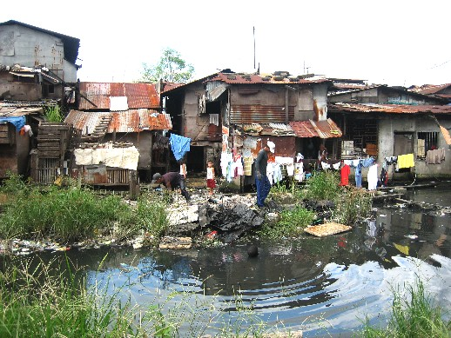

Slide 47
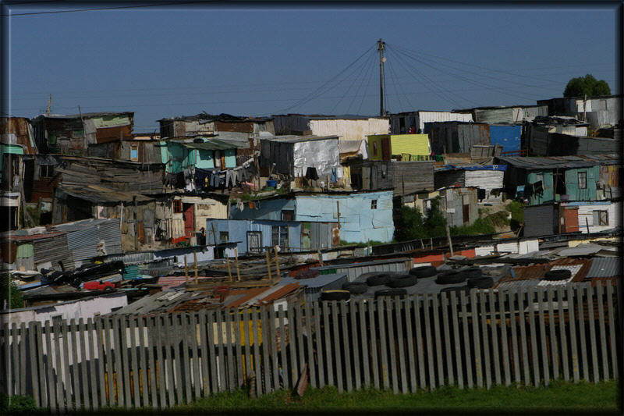

Slide 48
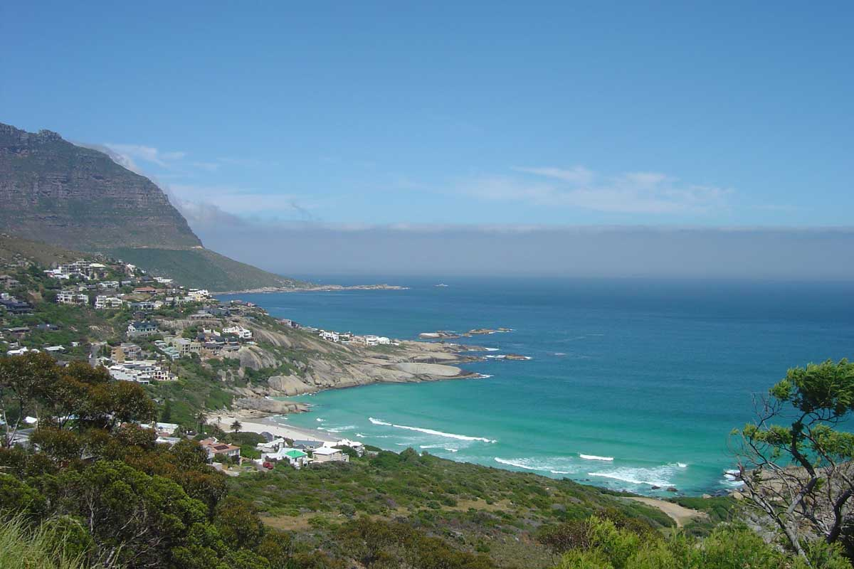

Slide 50
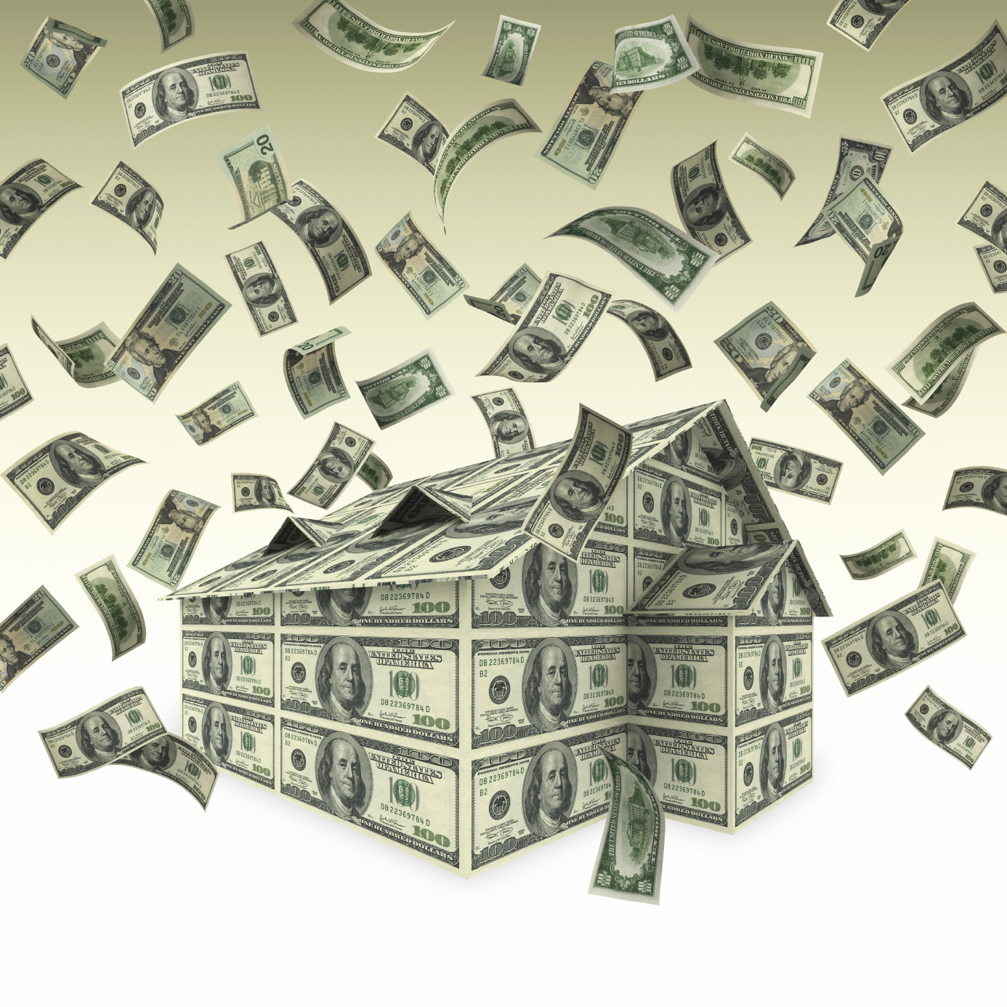
Till Debt Do Us Part
Ecclesiastes 5:10-18

Slide 51
To find a woman you need time and money:
Woman = Time x Money
A⁺
Time is money:
Time = Money
Woman = Money x Money:
Woman = (Money)²
Money is the root of all problems:
Money = Problems
Problems)
2
Woman = (
Woman =Problems

Slide 52
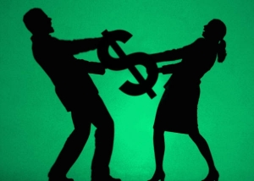
A successful husband is one who makes more money than his wife can spend.
A successful woman is one who can find such a man!

Slide 53
Till Debt Do Us Part
Ecclesiastes 5:10-18

Slide 54
the
CASH CLASH

Slide 55
Spenders vs Savers

Slide 56
Go to the ant, you sluggard; consider its ways and be wise!
It has no commander, no overseer or ruler,
yet it stores its provisions in summer and gathers its food at harvest.
Proverbs 6:6-8

Slide 57
A good man leaves an inheritance
for his children's children, but a sinner's wealth
is stored up for the righteous.
Proverbs 13:22

Slide 58
Spenders vs Savers
Cash vs Credit

Slide 59
The rich rule over the poor,
and the borrower
is servant to the lender.
Proverbs 22:7

Slide 60
Let no debt remain outstanding, except the continuing debt to love one another…
Romans 13:8a

Slide 61
Average credit card debt per household : $12,2OO
Average number of credit cards held by cardholders: 3.5
Average APR on new credit cards:
14.10%
Average APR on credit card with a balance: 14.67%

Slide 62
If you want to feel rich, just count all the things you have that money can’t buy.
*Our Daily Bread

Slide 63
If you don’t borrow money, you can’t get into debt.
If you stop borrowing money, you can’t get further into debt.
Larry Burkett

Slide 64
It is easier to make money
than to save it.
One is exertion;
the other, self denial.
Larry Burkett

Slide 65
Resentment
comes from looking at others,
Contentment
comes from looking to God.

Slide 66
Spenders vs Savers
Cash vs Credit
Generosity vs Greed

Slide 67
Honor the LORD with your wealth, with the first fruits of all your crops; then your barns will be filled to overflowing, and your vats will brim over with new wine.
Proverbs 3:9-10

Slide 68
Remember this:
Whoever sows sparingly
will also reap sparingly,
and whoever sows generously
will also reap generously.
Each man should give what he has decided in his heart to give,
not reluctantly or under compulsion, for God loves a cheerful giver.
II Corinthians 9:6-7

Slide 69
Command those who are rich in this present world not to be arrogant nor to put their hope in wealth, which is so uncertain, but to put their hope in God, who richly provides us with everything for our enjoyment.

Slide 70
Command them to do good, to be rich in good deeds, and to be generous and willing to share.
1 Timothy 6:17-18

Slide 71
a
RICH, WISE MAN’S
counsel on money!

Slide 72
Potential problems produced by prosperity:
Dissatisfaction

Slide 73
Potential problems produced by prosperity:
Dissatisfaction
Disillusionment

Slide 74
The solution to dissatisfaction:
ENJOY life

Slide 75
The solution to dissatisfaction:
ENJOY life
find FULFILLMENT
in your WORK

Slide 76
The solution to dissatisfaction:
ENJOY life
find FULFILLMENT
in your WORK
be CONTENT

Slide 77
don’t let
TEMPORAL STUFF
destroy your Marriage!

