Slide 2
Sing Sing Sing
We will sing, sing, sing
and make music with the heavens We will sing, sing, sing
grateful that You hear us When we shout Your praise;
lift high the name of Jesus
(repeat)

Slide 3
What's not to love about You
heaven and earth adore You Kings and kingdoms bow down
Son of God You are the One You are the One

Slide 4
You are the love that frees us
You are the light that leads us Like a fire burning
Son of God You are the One You are the One
we're living for

Slide 5
We will sing, sing, sing
and make music with the heavens We will sing, sing, sing
grateful that You hear us When we shout Your praise;
lift high the name of Jesus

Slide 6
You are the love that frees us
You are the light that leads us Like a fire burning
Son of God You are the One You are the One
we're living for

Slide 7
We will sing, sing, sing
and make music with the heavens We will sing, sing, sing
grateful that You hear us When we shout Your praise;
lift high the name of Jesus
(repeat)
TEMPLE BIBLE CHURCH Used By Permission CCLI #78316

Slide 8
You, You are God
Here I am, I’ve come to find You
Here I am, to see Your grace
To bring You an offering
I have to ask myself one thing
How can I do anything but praise
I praise

Slide 9
You, You are God, You are Lord
You are all I’m living for
You are King of everything
I want my life to praise you

Slide 10
Here I am, I've come to thank You
Here I am, a life You’ve changed
Because You gave Your life for me
You crucified You son for me
How can I do anything but praise
I praise

Slide 11
You, You are God, You are Lord
You are all I’m living for
You are King of everything
I want my life to praise you
(repeat)
TEMPLE BIBLE CHURCH Used by Permission CCLI #78316

Slide 12
We will sing, sing, sing
and make music with the heavens We will sing, sing, sing
grateful that You hear us When we shout Your praise;
lift high the name of Jesus
TEMPLE BIBLE CHURCH Used by Permission CCLI #78316

Slide 13
Its just sex video

Slide 14
In Christ Alone
In Christ alone my hope is found
He is my light, my strength, my song
This Cornerstone, this solid ground
Firm through the fiercest drought
And storm

Slide 15
What heights of love
What depths of peace
When fears are stilled
When strivings cease
My comforter, my all in all
Here in the love of Christ I stand

Slide 16
In Christ alone, who took on flesh
Fullness of God and helpless babe
This gift of love and righteousness
Scorned by the ones
He came to save

Slide 17
Till on that cross as Jesus dies
The wrath of God was satisfied
For every sin on Him was laid
Here in the death of Christ I live

Slide 18
There in the ground His body lay
Light of the world by darkness slain
Then bursting forth in glorious day
Up from the grave He rose again

Slide 19
And as He stands in victory
Sin’s curse has lost its grip on me
For I am His and He is mine
Bought with the precious
Blood of Christ

Slide 20
No guilt in life, no fear in death
This is the power of Christ in me
From life’s first cry to final breath
Jesus commands my destiny

Slide 21
No power of hell, no scheme of man
Can ever pluck me from His hand
‘till He returns or calls me home
Here in the power of Christ I’ll stand
TEMPLE BIBLE CHURCH Used by Permission CCLI #78316

Slide 22
Stronger
There is love that came for us
Humbled to a sinner’s cross
You broke my shame and sinfulness
You rose again victorious

Slide 23
Faithfulness none can deny
Through the storm
and through the fire
There is truth that sets me free
Jesus Christ who lives in me

Slide 24
You are stronger
You are stronger
Sin is broken
You have saved me

Slide 25
It is written
Christ is risen
Jesus You are lord of all

Slide 26
No beginning and no end
You’re my hope and my defense
You came to seek and save the lost
You paid it all upon the cross

Slide 27
You are stronger
You are stronger
Sin is broken
You have saved me

Slide 28
It is written
Christ is risen
Jesus You are lord of all

Slide 29
So let Your name be lifted higher
Be lifted higher
Be lifted higher
Be lifted higher
(repeat)

Slide 30
You are stronger
You are stronger
Sin is broken
You have saved me

Slide 31
It is written
Christ is risen
Jesus You are lord of all
TEMPLE BIBLE CHURCH Used by Permission CCLI #78316

Slide 32
Your Name
As morning dawns
and evening fades
You inspire songs of praise
That rise from earth
to touch Your heart
And glorify Your Name
(repeat)

Slide 33
Your Name, is a strong
and mighty tower
Your Name, is a shelter
like no other
Your Name, let the nations
sing louder
‘Cause nothing has
the power to save
But Your Name

Slide 34
Jesus, in Your Name we pray
Come and fill our hearts today
Lord, give us strength
to live for You
And glorify Your Name

Slide 35
Your Name, is a strong
and mighty tower
Your Name, is a shelter
like no other
Your Name, let the nations
Sing louder
‘Cause nothing has
the power to save
But Your Name
TEMPLE BIBLE CHURCH Used by Permission CCLI #78316

Slide 36
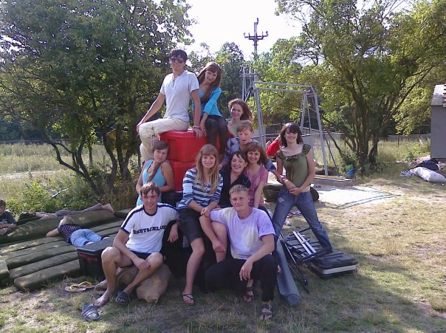
Ukraine Summer 2010 Part 2
Departing: July 26
Returning: August 5
Please Pray For:
Safe Travel
Enduring Fellowship with our Sister Church
Meetings and Worship with Young Adults
Meetings and Fellowship with Young Leaders

Slide 38
Myth
the
of
Greener
the
Grass
P R O V E R B S 5 - 7

Slide 39
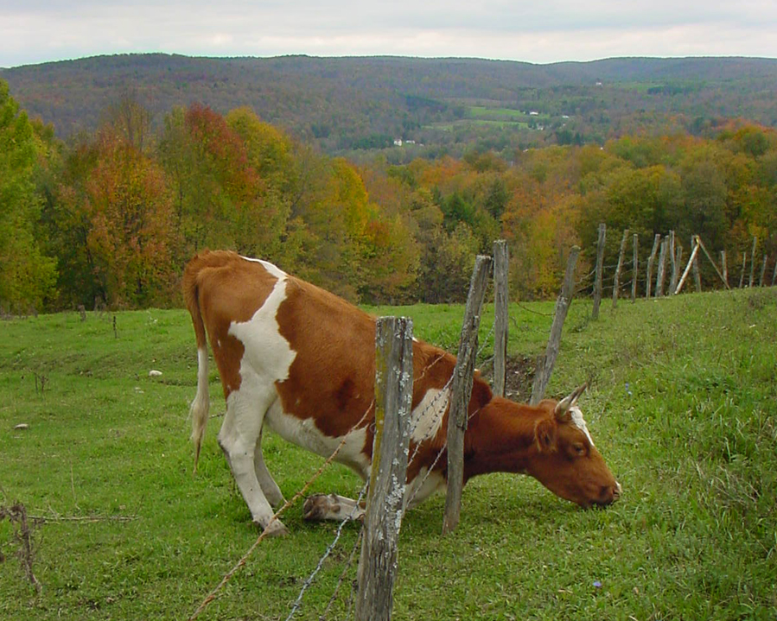

Slide 40
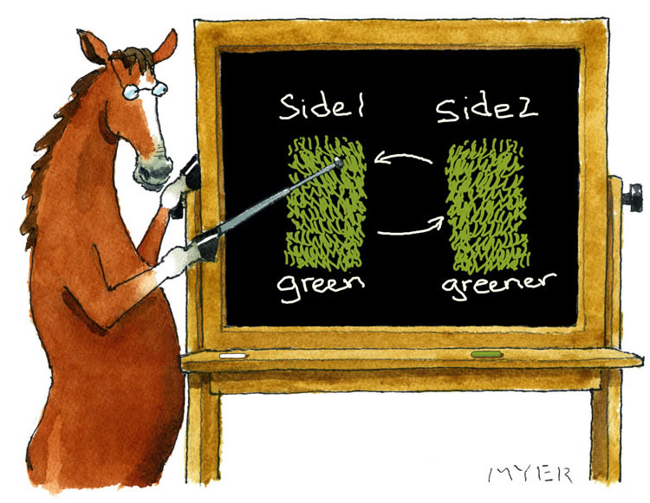

Slide 41
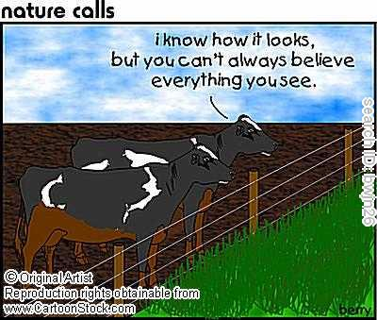

Slide 42
Myth
the
of
Greener
the
Grass
P R O V E R B S 5 - 7

Slide 43
PROTECT
your marriage
Warnings
from the
Wise

Slide 44
IMMORALITY
produces PAIN

Slide 45
Every act of sexual sin is, first and foremost, the choice to disobey God.
-Larry Crabb

Slide 46
IMMORALITY
produces PAIN

Slide 47
I hate divorce, says the LORD God of Israel… -Malachi 2:16a

Slide 48
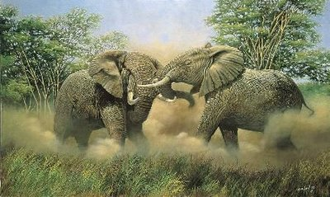
“When elephant’s fight, the grass is always the one that suffers.”

Slide 49
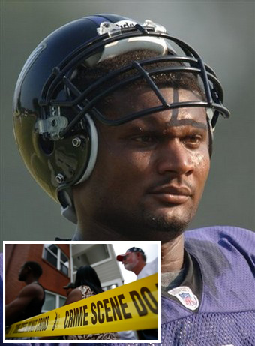
Steve McNair

Slide 50
Jesse James
Censored

Slide 51
Tiger Woods

Slide 52
IMMORALITY
produces PAIN
STEALS from your family and
ROBS you of fellowship with God

Slide 53
For this is the will of God, your sanctification; abstain from sexual immorality… -1 Thessalonians 4:3

Slide 54
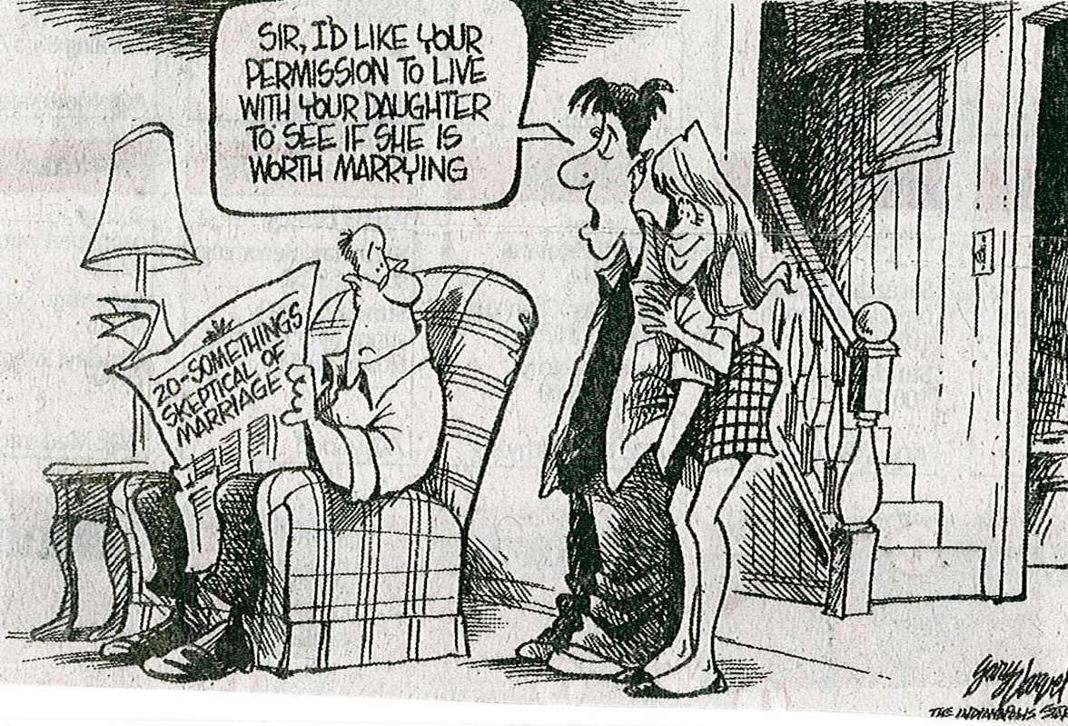

Slide 55
IMMORALITY
produces PAIN
STEALS from your family and
ROBS you of fellowship with God

Slide 56
IMMORALITY
begins with DISOBEDIENCE
and ends in DISGRACE

Slide 58
IMMORALITY
begins with DISOBEDIENCE
and ends in DISGRACE

Slide 59
IMMORALITY
begins with DISOBEDIENCE
and ends in DISGRACE
blinds us to TRUTH and the CONSEQUENCES of sinful behavior

Slide 60
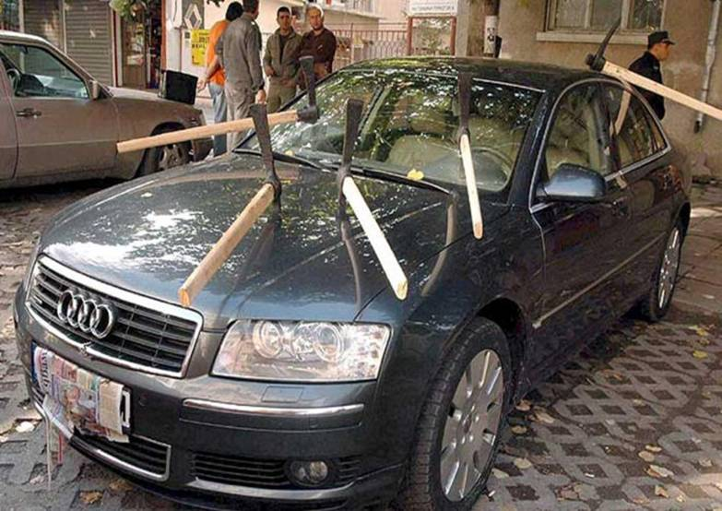

Slide 61
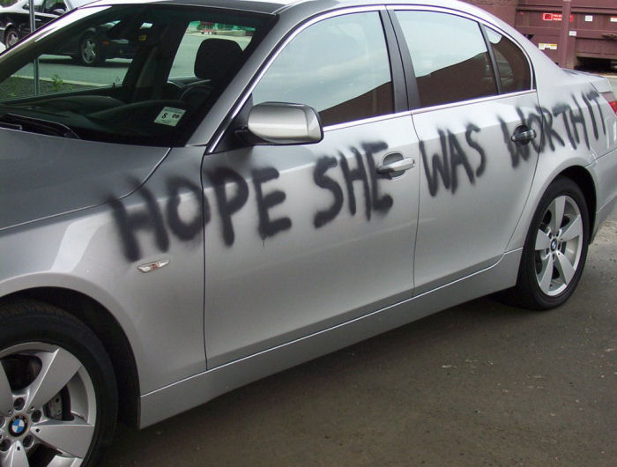

Slide 62
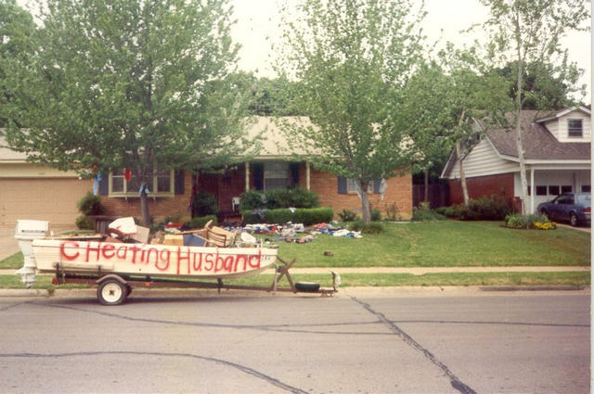

Slide 63
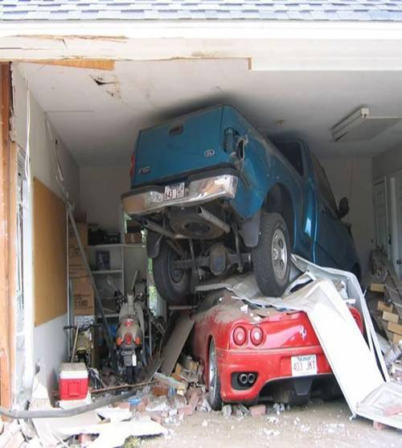
Hi Honey... had a little accident pulling into the garage today. Sorry! Love you! P.S. Your girlfriend called.

Slide 64
“Don’t you know that when you sleep with someone, your body makes a promise whether you do or not?” -Tom Cruise in Vanilla Sky

Slide 65
Do you not know that he who unites himself with a prostitute is one with her in body? For it is said, "The two will become one flesh."But he who unites himself with the Lord is one with him in spirit.

Slide 66
Flee from sexual immorality. All other sins a man commits are outside his body, but he who sins sexually sins against his own body. Do you not know that your body is a temple of the Holy Spirit, who is in you, whom you have received from God?

Slide 67
You are not your own; you were bought at a price. Therefore honor God with your body. - 1 Corinthians 6:16-20

Slide 68
DESTROYING
a family
Warnings
Ignored

Slide 69
PROMISCUITY in the palace
CONFRONTATION & CONFESSION in Camelot

Slide 70
putting the pieces back together

Slide 71
seeking FORGIVENESS
re-building TRUST
moving AHEAD

Slide 72
your home will become a…
if you ignore the warnings of God
regarding sexual purity!

