Slide 6
Into marvelous light I’m running Out of darkness, out of shame By the cross You are the truth You are the life, You are the way
Marvelous Light

Slide 7
I once was fatherless, A stranger with no hope; Your kindness wakened me, Awakened me, from my sleep

Slide 8
Your love it beckons deeply, A call to come and die. By grace now I will come And take this life, take Your life.

Slide 9
Sin has lost it's power, Death has lost it's sting. From the grave You've risen VICTORIOUSLY!

Slide 10
Into marvelous light I’m running Out of darkness, out of shame By the cross You are the truth You are the life, You are the way (repeat)

Slide 11
My dead heart now is beating, My deepest stains now clean. Your breath fills up my lungs. Now I'm free. Now I'm free! (2x)

Slide 12
Sin has lost it's power, Death has lost it's sting. From the grave You've risen VICTORIOUSLY!

Slide 13
Into marvelous light I’m running Out of darkness, out of shame by the cross You are the truth You are the life, You are the way (repeat)

Slide 14
Lift my hands and spin around, See the light that I have found. Oh the marvelous light Marvelous light (repeat)

Slide 15
Sin has lost it's power, Death has lost it's sting. From the grave You've risen VICTORIOUSLY!

Slide 16
Into marvelous light I’m running Out of darkness, out of shame By the cross You are the truth You are the life, You are the way
TEMPLE BIBLE CHURCH Used by Permission CCLI #78316

Slide 17
Hear our praises
May our homes
be filled with dancing
May our streets be filled with joy
May injustice bow to Jesus
As the people turn and pray

Slide 18
From the mountain to the valley
Hear our praises rise to You
From the heavens to the nations
Hear our singing fill the air

Slide 19
May our light shine in the darkness
As we walk before the cross
May Your glory fill the whole earth
As the water over the seas

Slide 20
From the mountain to the valley
Hear our praises rise to You
From the heavens to the nations
Hear our singing fill the air

Slide 21
Hallelujah, Hallelujah
Hallelujah, Hallelujah
Hallelujah, Hallelujah
Hallelujah, Hallelujah

Slide 22
From the mountain to the valley
Hear our praises rise to You
From the heavens to the nations
Hear our singing fill the air
TEMPLE BIBLE CHURCH Used by Permission CCLI #78316

Slide 23
Cannons
It’s falling from the clouds
A strange and lovely sound
I hear it in the thunder and the rain

Slide 24
It’s ringing in the skies
Like cannons in the night
The music of the Universe plays

Slide 25
You are holy
Great and mighty
The moon and the stars
Declare who You are

Slide 26
I’m so unworthy
But still You love me
Forever my heart
Will sing of how great You are

Slide 27
Beautiful and free
Song of galaxies
It’s reaching far beyond
The Milky Way

Slide 28
Let’s join in with the sound
Come on let’s sing it loud
As the music of the universe plays

Slide 29
You are holy
Great and mighty
The moon and the stars
Declare who You are

Slide 30
I’m so unworthy
But still You love me
Forever my heart
Will sing of how great You are

Slide 31
All Glory Honor Power
Is Yours
Amen
(repeat)

Slide 32
All Glory Honor Power
Is Yours Forever
Amen

Slide 33
You are holy
Great and mighty
The moon and the stars
Declare who You are

Slide 34
I’m so unworthy
But still You love me
Forever my heart
Will sing of how great

Slide 35
You are holy
Great and mighty
The moon and the stars
Declare who You are

Slide 36
I’m so unworthy
But still You love me
Forever my heart
Will sing of how great You are.
TEMPLE BIBLE CHURCH Used by Permission CCLI#78316
Words and Music by Phil Wickham

Slide 37
Holy, Holy, Holy
Holy, Holy, Holy, Lord God Almighty
Early in the morning
Our song shall rise to Thee
Holy, Holy, Holy, merciful and mighty!
God in three persons, blessed Trinity

Slide 38
Holy, Holy, Holy,
Though the darkness hide Thee
Though the eye of sinful man
Thy glory may not see
Only Thou art holy,
There is none beside Thee
Perfect in Pow’r, in love and purity

Slide 39
Holy, Holy, Holy, Lord God Almighty
All Thy works shall praise Thy name
In earth and sky and sea
Holy, Holy, Holy, merciful and mighty!
God in three persons, blessed Trinity
TEMPLE BIBLE CHURCH Used by Permission CCLI #78316

Slide 41
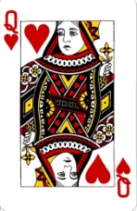
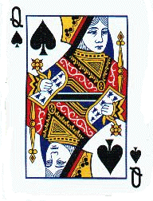
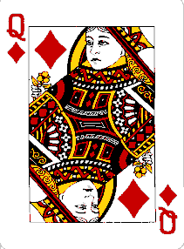
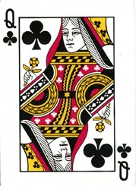
Queen’s 5 needs
UNCONDITIONAL LOVE
INTIMACY
SPIRITUAL LEADERSHIP
ENCOURAGEMENT
FRIENDSHIP

Slide 42
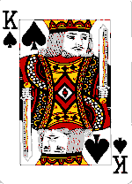
King’s 5 needs
SEX
SPORTS
SEX
FOOD
SEX

Slide 43
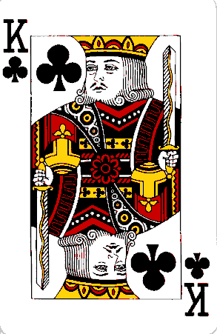
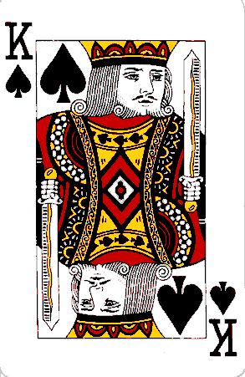
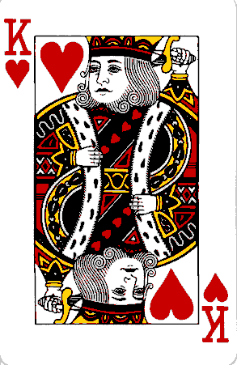
K
ings
Ephesians 5:22-24, 33

Slide 44
Because I’m a man,
when I lock my keys in the car,
I will fiddle with a coat hanger
long after hypothermia has set in.
Calling pop-a-lock is NOT an option.
I WILL win!

Slide 45
Because I’m a man,
I must hold the television remote control in my hand while I watch TV.
If the thing has been misplaced,
I may miss a whole show looking for it…though one time I was able to survive by holding a calculator.

Slide 46
Because I’m a man,
You don’t have to ask me
if I liked the movie.
Chances are, if you’re crying at the end,
I didn’t…
and if you’re feeling amorous afterwards… then I will certainly at least
remember the name and
recommend it to my buddies.

Slide 47
Because I’m a man,
I think what you’re wearing is fine.
I thought what you were wearing
5 minutes ago was fine, too.
Either pair of shoes is fine.
With the belt or without it, looks fine.
Your hair is fine.
You look fine…can we just go now?

Slide 48
Men’s Rules
If we ask what is wrong
and you say “nothing”
we believe you,
and will act like nothing’s wrong.

Slide 49
Men’s Rules
Ask for what you want.
Let us be clear on this one…
Subtle hints do not work.
Strong hints do not work.
Obvious hints do not work.
Please just say it.

Slide 50
Men’s Rules
Come to us with a problem
only if you want help solving it.
That’s what we do.
Sympathy is what
your girlfriends are for.

Slide 51
Men’s Rules
If something we said
can be interpreted two ways,
and one of the ways
makes you sad or angry,
we meant the other one.

Slide 52
Men’s Rules
Anything we said 6 months ago
is inadmissible in an argument.
In fact, all comments
become null and void after 7 days.

Slide 54
the need for
the desire of dudes
RESPECT

Slide 55
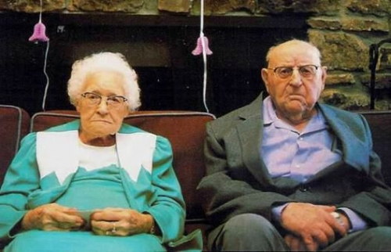

Slide 57
the need for
the desire of dudes
RESPECT
INTIMACY
…men spell intimacy: S-E-X

Slide 58
Do not deprive each other except by mutual consent and for a time, so that you may devote yourselves to prayer. Then come together again so that Satan will not tempt you because of your lack of self-control.
-1 Corinthians 7:5

Slide 59
The typical wife doesn’t understand
her husband’s deep need for sex any more than
the typical husband understands
his wife’s deep need for affection.
-Willard Harley(His Needs-HerNeeds)

Slide 60
Wives, what if your husband
didn’t talk to you for
3 weeks, 6 weeks, or 3 months?
You would think that abominable.
-Dr. Eggerichs (Love & Respect)

Slide 61
Purity
Passion
Priority
Pursuit

Slide 62
How To Treat A Woman
Wine her. Dine her. Call her. Hold her. Surprise her. Compliment her. Smile at her. Listen to her. Believe in her. Pray with her. Pray for her. Cuddle with her. Shop with her. Give her jewelry. Buy her flowers. Hold her hand. Write love letters to her. Go to the ends of the earth and back again for her.

Slide 63
How To Treat A Man
Show up naked.
Bring chicken wings.
Don’t block the TV.

Slide 64
the need for
the desire of dudes
RESPECT
INTIMACY
…men spell intimacy: S-E-X
AFFIRMATION

Slide 65
Better to live on a corner of the roof than
share a house with a quarrelsome wife.
Better to live in a desert than
with a quarrelsome and ill-tempered wife.
A quarrelsome wife is like
a constant dripping on a rainy day.
-Proverbs 21:9,19; 27:15

Slide 66
the need for
the desire of dudes
INTIMACY
…men spell intimacy: S-E-X
RESPECT
AFFIRMATION

Slide 67
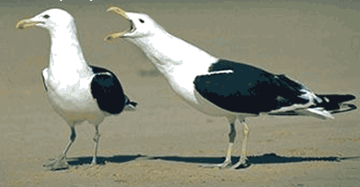

Slide 68
the need for
the desire of dudes
INTIMACY
…men spell intimacy: S-E-X
RESPECT
AFFIRMATION

Slide 69
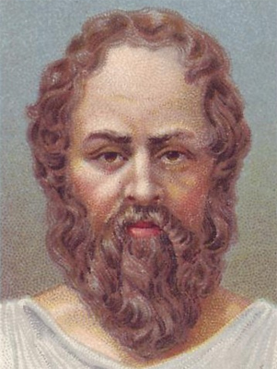
By all means marry; if you get a good wife, you’ll become happy. If you get a bad one, you’ll become a philosopher.
-Socrates

Slide 70
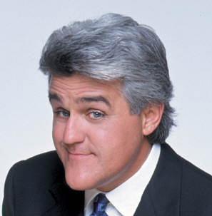
Why do men die before their wives?
Because they want to.
-Jay Leno

Slide 71
the need for
the desire of dudes
RESPECT
INTIMACY
…men spell intimacy: S-E-X
AFFIRMATION
RESPONSIVENESS

Slide 72
the need for
the desire of dudes
RESPECT
INTIMACY
…men spell intimacy: S-E-X
AFFIRMATION
RESPONSIVENESS
FRIENDSHIP

Slide 73
As iron sharpens iron, so one man sharpens another.
-Proverbs 27:17

Slide 74
Kings
Godly women
TREAT their husbands
like KINGS!!

Slide 75
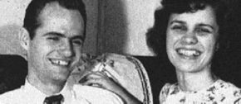
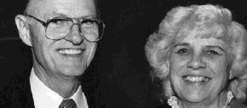
Robertson & Muriel McQuilkin

