Slide 1


Slide 2

Majestic
O Lord our Lord how majestic is
Your name in all the earth O Lord our Lord how majestic is
Your name in all the earth

Slide 3
The heavens declare Your greatness The oceans cry out to You The mountains they bow down
before You So I'll join with the earth
and I'll give my praise to You

Slide 4
O Lord our Lord how majestic is
Your name in all the earth O Lord our Lord how majestic is
Your name in all the earth

Slide 5
The heavens declare Your greatness The oceans cry out to You The mountains they bow down
before You So I'll join with the earth
and I'll give my praise to You

Slide 6
I will worship You
I will worship You
I will worship You
I will worship You
We will worship You
We will worship You

Slide 7
The heavens declare Your greatness The oceans cry out to You The mountains they bow down
before You So I'll join with the earth and I'll sing

Slide 8
The heavens declare Your greatness The oceans cry out to You The mountains they bow down
before You So I'll join with the earth
and I'll give my praise to You
TEMPLE BIBLE CHURCH Used by Permission CCLI #78316

Slide 9
ANCIENT OF DAYS
Blessing and honor,
glory and power
Be unto the Ancient of Days
From every nation, all of creation
Bow before the Ancient of Days

Slide 10
Every tongue in heaven and earth
Shall declare Your glory
Every knee shall bow
At Your throne, in Worship

Slide 11
You will be exalted, O God
And Your kingdom
Shall not pass away
O, Ancient of Days

Slide 12
Blessing and honor,
glory and power
Be unto the Ancient of Days
From every nation, all of creation
Bow before the Ancient of Days

Slide 13
Every tongue in heaven and earth
Shall declare Your glory
Every knee shall bow
At Your throne, in Worship

Slide 14
You will be exalted, O God
And Your kingdom
Shall not pass away
O, Ancient of Days

Slide 15
Every tongue in heaven and earth
Shall declare Your glory
Every knee shall bow
At Your throne, in Worship

Slide 16
You will be exalted, O God
And Your kingdom
Shall not pass away
O, Ancient of Days
TEMPLE BIBLE CHURCH Used by Permission CCLI #78316

Slide 17
FAMOUS ONE
You are the Lord the
famous One, famous One
Great is Your name in all the earth
The heavens declare
You’re glorious, glorious
Great is Your fame beyond the earth

Slide 18
And for all You’ve done and yet to do
With every breath I’m praising You
Desire of nations and every heart
You alone are God
You alone are God

Slide 19
You are the Lord the
famous One, famous One
Great is Your name in all the earth
The heavens declare
You’re glorious, glorious
Great is Your fame beyond the earth

Slide 20
The morning star is shining through
And every eye is watching You
Revealed by nature and miracles
You are beautiful, You are beautiful

Slide 21
You are the Lord the
famous One, famous One
Great is Your name in all the earth
The heavens declare
You’re glorious, glorious
Great is Your fame beyond the earth
Temple Bible Church Used by Permission CCLI #78316

Slide 22
Serving with FCA

Slide 23
Oh, For A Thousand Tongues
Oh, for a thousand tongues to sing
My great Redeemer’s praise
The glories of my God and King
The triumphs of His grace

Slide 24
My gracious Master and my God
Assist me to proclaim
To spread through all
The earth abroad
The honors of Thy name

Slide 25
Let the heavens rejoice
Let the earth be glad
Let the seas resound
And all creation dance

Slide 26
Let the fields cry out
And the forest will sing
This is our song
This is our King

Slide 27
He breaks the power of canceled sin
He sets the prisoner free
His blood can make the foulest clean
His blood avails for me

Slide 28
Let the heavens rejoice
Let the earth be glad
Let the seas resound
And all creation dance

Slide 29
Let the fields cry out
And the forest will sing
This is our song
This is our King

Slide 30
Let the heavens rejoice
Let the earth be glad
Let the seas resound
And all creation dance

Slide 31
Let the fields cry out
And the forest will sing
This is our song
This is our King
Temple Bible Church Used by permission #78316

Slide 32
Cannons
It’s falling from the clouds
A strange and lovely sound
I hear it in the thunder and the rain

Slide 33
It’s ringing in the skies
Like cannons in the night
The music of the universe plays

Slide 34
You are holy
Great and mighty
The moon and the stars
Declare who You are

Slide 35
I’m so unworthy
But still You love me
Forever my heart
Will sing of how great You are

Slide 36
Beautiful and free
Song of galaxies
It’s reaching far beyond
The Milky Way

Slide 37
Let’s join in with the sound
Come on let’s sing it loud
As the music of the universe plays

Slide 38
You are holy
Great and mighty
The moon and the stars
Declare who You are

Slide 39
I’m so unworthy
But still You love me
Forever my heart
Will sing of how great You are

Slide 40
All Glory Honor Power
Is Yours
Amen

Slide 41
All Glory Honor Power
Is Yours
Amen

Slide 42
All Glory Honor Power
Is Yours Forever
Amen

Slide 43
You are holy
Great and mighty
The moon and the stars
Declare who You are

Slide 44
I’m so unworthy
But still You love me
Forever my heart
Will sing of how great You are

Slide 45
You are holy
Great and mighty
The moon and the stars
Declare who You are

Slide 46
I’m so unworthy
But still You love me
Forever my heart
Will sing of how great You are
TEMPLE BIBLE CHURCH Used by Permission CCLI#78316
Words and Music by Phil Wickham

Slide 47
From The Inside Out
A thousand times I’ve failed
Still Your mercy remains
And should I stumble again
I’m caught in Your grace

Slide 48
Everlasting
Your light will shine when all else fades
Never ending
Your glory goes beyond all fame

Slide 49
In my heart and my soul
I give You control
Consume from the inside out Lord
Let justice and praise
become my embrace
To love You from the inside out

Slide 50
Your will above all else
My purpose remains
the art of losing myself
In bringing You praise

Slide 51
Everlasting
Your light will shine when all else fades
Never ending
Your glory goes beyond all fame

Slide 52
In my heart and my soul
I give You control
Consume me from the inside out Lord
Let justice and praise
Become my embrace
To love You from the inside out

Slide 53
Everlasting
Your light will shine when all else fades
Never ending
Your glory goes beyond all fame
And the cry of my heart
Is to bring You praise
From the inside out, Lord my soul cries out

Slide 54
My heart and my soul
I give You control
Consume me from the inside out Lord
let justice and praise
Become my embrace
To love You from the inside out

Slide 55
Everlasting
Your light will shine when all else fades
Never ending
Your glory goes beyond all fame
And the cry of my heart
Is to bring You praise
From the inside out, Lord my soul cries out
(repeat)

Slide 56
from the inside out, Lord my soul cries out
from the inside out, Lord my soul cries out
TEMPLE BIBLE CHURCH Used by Permission CCLI #78316

Slide 57
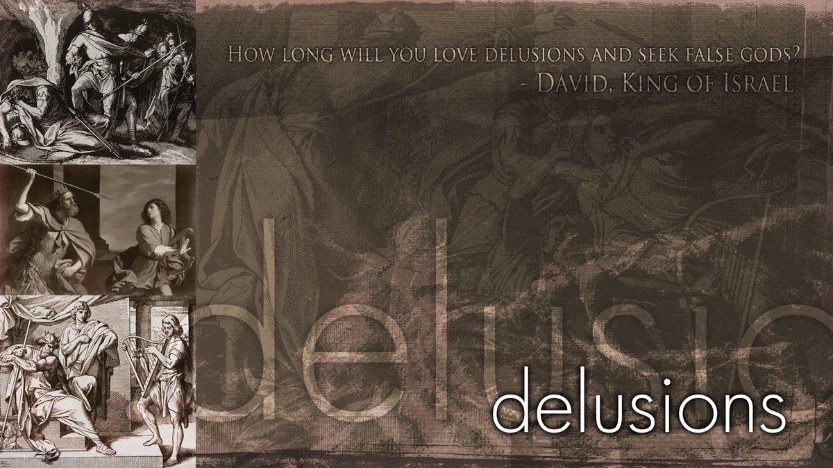

Slide 58

last
words
I Chronicles 28-29

Slide 59

Executed in electric chair in Oklahoma
James French 1966
How about this for
tomorrow’s paper…
French fries

Slide 60
Executed in electric chair in new York
George appel 1928
Well gentlemen, you are about to see a baked appel

Slide 61
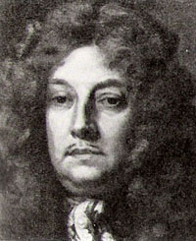
Sir Francis Newport

Slide 62
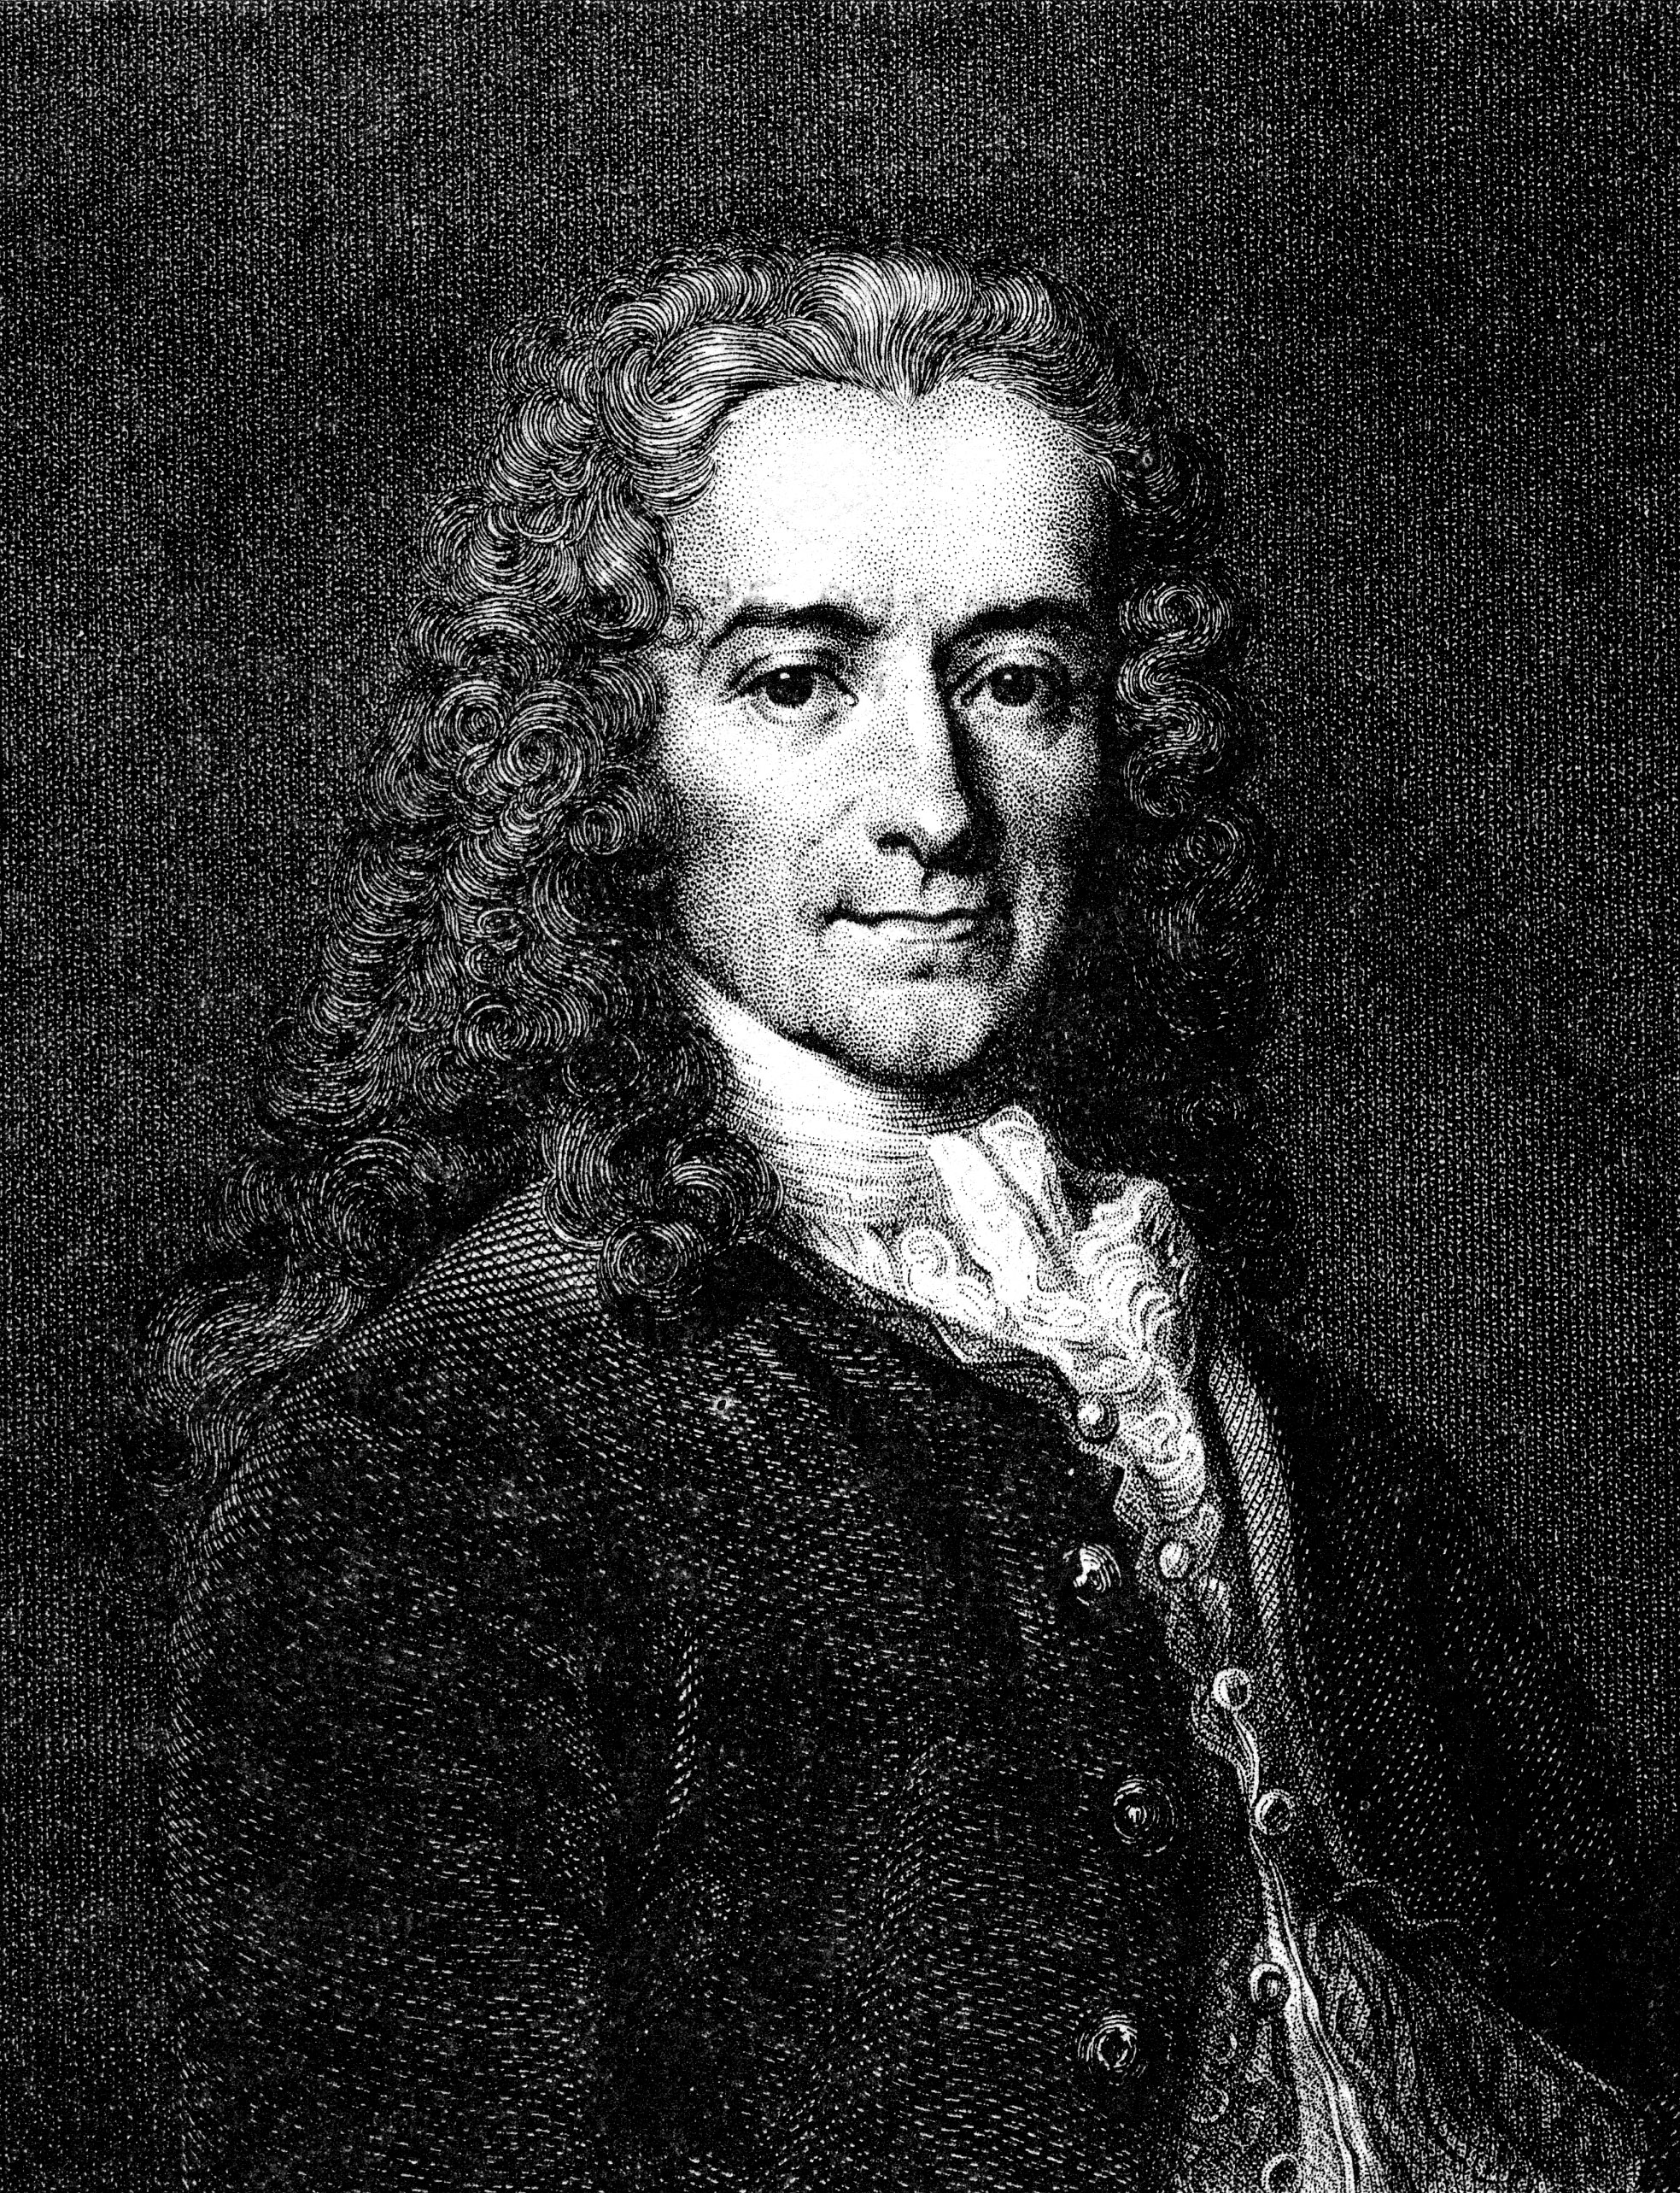
Voltaire

Slide 63
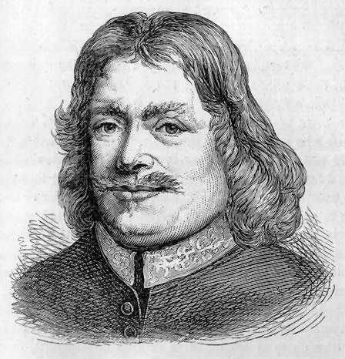
John Bunyan

Slide 64
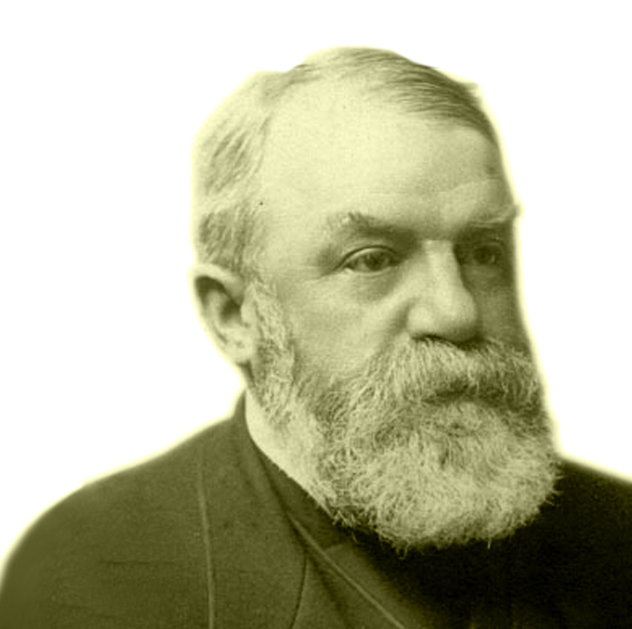
d. l. moody

Slide 65
last
words
I Chronicles 28-29

Slide 66

I Chronicles 28-29
Last
words
 FINAL WORDS from a FORGIVEN KING
 INSTRUCTIONS to the LEADERS…BUILD the TEMPLE

Slide 67
Though the fig tree does not bud and there are no grapes on the vines, though the olive crop fails and the fields produce no food, though there are no sheep in the pen and no cattle in the stalls, yet I will rejoice in the LORD, I will be joyful in God my Savior.
Habakkuk 3:17-18

Slide 68
I Chronicles 28-29
Last
words
 FINAL WORDS from a FORGIVEN KING
 INSTRUCTIONS to the LEADERS…BUILD the TEMPLE

Slide 69
I Chronicles 28-29
Last
words
 FINAL WORDS from a FORGIVEN KING
 INSTRUCTIONS to the LEADERS…BUILD the TEMPLE
 INSTRUCTIONS to his son…SOLOMON
 SEEK & SERVE GOD
 BUILD the TEMPLE

Slide 70
But if from there
you seek the LORD your God,
you will find him
if you seek him
with all your heart
and with all your soul.
Deuteronomy 4:29

Slide 71
Glory in his holy name; let the hearts of
those who seek the LORD
rejoice.
1 Chronicles 16:10

Slide 72
if my people,
who are called by my name,
will humble themselves
and pray
and seek my face
and turn from their wicked ways, then I will hear from heaven,
and I will forgive their sin
and will heal their land.
2 Chronicles 7:14

Slide 73
Glory in his holy name; let the hearts
of those who seek the LORD
rejoice. Look to the LORD
and his strength; seek his face always.
Psalm 105:3-4

Slide 74
Blessed are those
who keep his statutes and seek him
with all their heart.
Psalm 119:2

Slide 75
Seek the LORD
while he may be found; call on him
while he is near.
Isaiah 55:6

Slide 76
You will seek me
and find me
when you seek me
with all your heart.
Jeremiah 29:13

Slide 77
And without faith
it is impossible to please God,
because anyone who comes to him
must believe that he exists
and that he rewards those
who earnestly seek him.
Hebrews 11:6

Slide 78
I Chronicles 28-29
Last
words
 FINAL WORDS from a FORGIVEN KING
 INSTRUCTIONS to the LEADERS…BUILD the TEMPLE
 INSTRUCTIONS to his son…SOLOMON
 SEEK & SERVE GOD
 BUILD the TEMPLE
 INSTRUCTIONS to the PEOPLE…BUILD the TEMPLE

Slide 79
I Chronicles 28-29
Last
words
 FINAL ACTIONS from a GRATEFUL KING
 an EXAMPLE of PERSONAL WORSHIP
 an EXHORTATION to CORPORATE WORSHIP

Slide 80
I Chronicles 28-29
Last
words
are you more CONCERNED with LEAVING a
TEMPORAL or ETERNAL INHERITANCE?

Slide 81
GLORY IN THE HIGHEST
You are the first, You go before
You are the last, Lord
You’re the encore
Your name’s in lights for all to see
The starry hosts declare Your glory

Slide 82
Glory in the highest,
Glory in the highest
Glory in the highest, Yeah

Slide 83
Apart from You there is no god,
Light of the world,
The bright and morning star,
Your name will shine for all to see
You are the One,
You are my glory

Slide 84
Glory in the highest,
Glory in the highest
Glory in the highest

Slide 85
No one else could ever compare,
To You Lord
All the earth together declares

Slide 86
Glory in the highest,
Glory in the highest,
Glory in the highest, to You Lord
to You Lord
TEMPLE BIBLE CHURCH Used by Permission CCLI #78316

