Slide 5
Sing To The King
Sing to the King
Who is coming to reign. Glory to Jesus The Lamb that was slain.

Slide 6
Life and salvation His empire Shall bring, And joy to the nations when Jesus is King.

Slide 7
Come let us sing a song, A song declaring we belong to Jesus He's all we need. Lift up a heart of praise. Sing now with voices raised to Jesus Sing to the King.

Slide 8
For His returning we watch And we pray, We will be ready the dawn of that day. We'll join in singing

Slide 9
With all the redeemed, 'Cause Satan is vanquished And Jesus is King!

Slide 10
Come let us sing a song, A song declaring we belong to Jesus He's all we need. Lift up a heart of praise. Sing now with voices raised to Jesus Sing to the King.

Slide 11
Come let us sing a song, A song declaring we belong to Jesus He's all we need. Lift up a heart of praise. Sing now with voices raised to Jesus Sing to the King.
Billy Foote, Charles Horne
2003 worshiptogether.com songs, sixsteps Music
CCLI 78316

Slide 12
My Savior Lives
Our God will reign forever And all the world will know His Name Ev'ryone together sing the Song of the redeemed

Slide 13
I know that my Redeemer lives And now I stand on what He did My Savior, my Savior lives Ev'ry day a brand new chance to say Jesus You are the only way My Savior, my Savior lives

Slide 14
The King has come from heaven And darkness trembles at His Name Victory forever is the song of The redeemed

Slide 15
I know that my Redeemer lives And now I stand on what He did My Savior, my Savior lives Ev'ry day a brand new chance to say Jesus You are the only way My Savior, my Savior lives

Slide 16
My Savior lives, my Savior lives My Savior lives

Slide 17
I know that my Redeemer lives And now I stand on what He did My Savior, my Savior lives Ev'ry day a brand new chance to say Jesus You are the only way My Savior, my Savior lives
(repeat)
Jon Egan, Glenn Packiam
2006 Vertical Worship Songs
CCLI 78316

Slide 18
Our God
Water You turned into wine Opened the eyes of the blind There's no one like You,
none like You

Slide 19
Into the darkness, You shine Out of the ashes, we rise There's no one like You,
none like You

Slide 20
Our God is greater Our God is stronger God, You are higher than any other Our God is healer, awesome in power Our God, our God

Slide 21
Into the darkness, You shine Out of the ashes, we rise There's no one like You,
none like You

Slide 22
Our God is greater Our God is stronger God, You are higher than any other Our God is healer, awesome in power Our God, our God

Slide 23
And if our God is for us then Who could ever stop us And if our God is with us Then what could stand against
(repeat)

Slide 24
Our God is greater Our God is stronger God, You are higher than any other Our God is healer, awesome in power Our God, our God
(repeat)
Jonas Myrin, Matt Redman, Jesse Reeves, Chris Tomlin
2010 Jonas Myrin Publishing Designee, sixsteps Music, Vamos Publishing, worshiptogether.com songs, Thankyou Music, Said and Done Music
CCLI 78316

Slide 25
Start a Fire
Start a fire in me Let the flames run free Burn away the dross Holy fire of God
(repeat)

Slide 26
So let it begin. Let it be new
Let me be used for Your sake
Giving glory to Your name
I can live knowing that You
You reside in my heart
Oh Lord You are a fire
You’re the fire of God

Slide 27
Start a fire in me Let the flames run free Burn away the dross Holy fire of God
(repeat)

Slide 28
So let it begin. Let it be new
Let me be used for Your sake
Giving glory to Your name
I can live knowing that You
You reside in my heart
Oh Lord You are a fire
You’re the fire of God
Jason Harrison, Darin Sasser
1998 Shadow Rock Music
CCLI 78316

Slide 29
Here I Am To Worship
Here I am to worship Here I am to bow down Here I am to say that You're my God You're altogether lovely Altogether worthy Altogether wonderful to me.

Slide 32
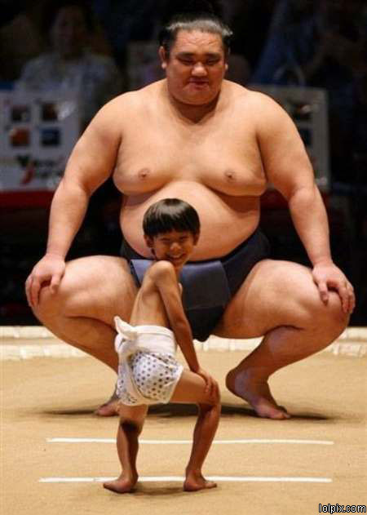

Slide 33
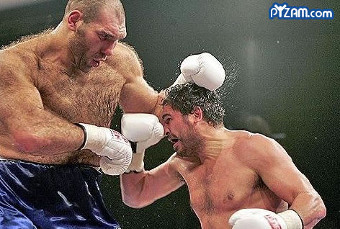

Slide 34
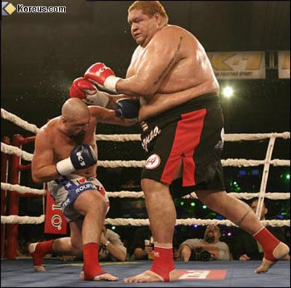

Slide 35
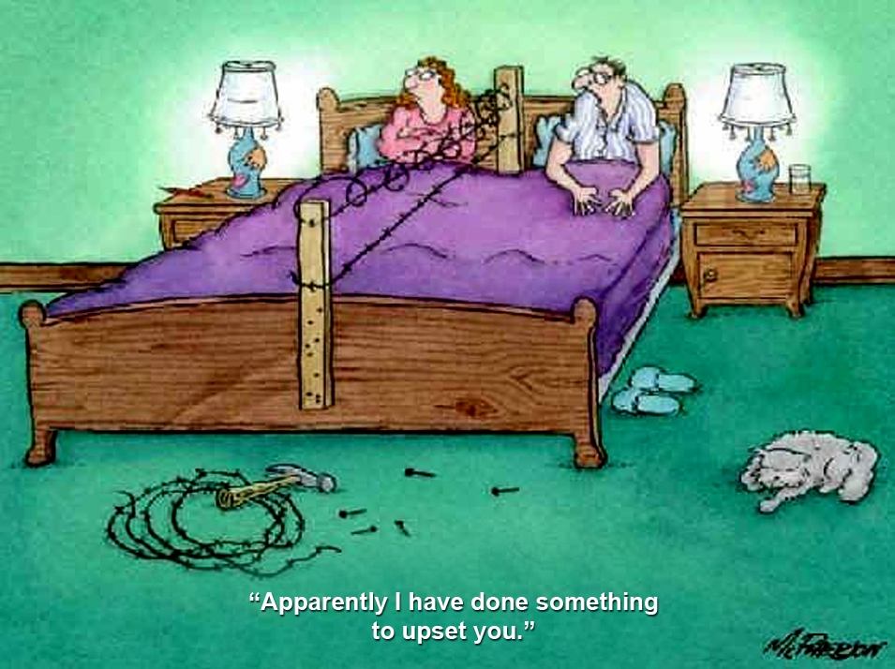

Slide 36
Marriage is adventure –
like going to war.
G. K. Chesterton

Slide 37
His mother should have thrown
him away and kept the stork.
Mae West

Slide 38
Marriage is the merciless revealer, the great white searchlight turned on the darkest places of human nature.
Katherine Anne Porter

Slide 40
Rule #1 …be TRUTHFUL
Rule #2 …be QUICK to RECONCILE

Slide 41
A fool gives full vent to his anger, but a wise man keeps himself under control.
Prov 29:11

Slide 42
An angry man stirs up dissension, and a hot-tempered one commits many sins.
Prov 29:22

Slide 43
Better a patient man than a warrior, a man who controls his temper than one who takes a city. Prov 16:32

Slide 44
A gentle answer turns away wrath, but a harsh word stirs up anger. Prov 15:1

Slide 45
Rule #1 …be TRUTHFUL
Rule #2 …be QUICK to RECONCILE
Rule #3 …be ENCOURAGING
Rule #4 …be NICE!

Slide 46
Marriage is not an INVENTION of MAN to make us HAPPY, but was INSTITUTED by God to make us HOLY!

Slide 47
Marriage is the merciless revealer, the great white searchlight turned on the darkest places of human nature.
Katherine Anne Porter

