Slide 1
Welcome
to Temple Bible
Church

Slide 2
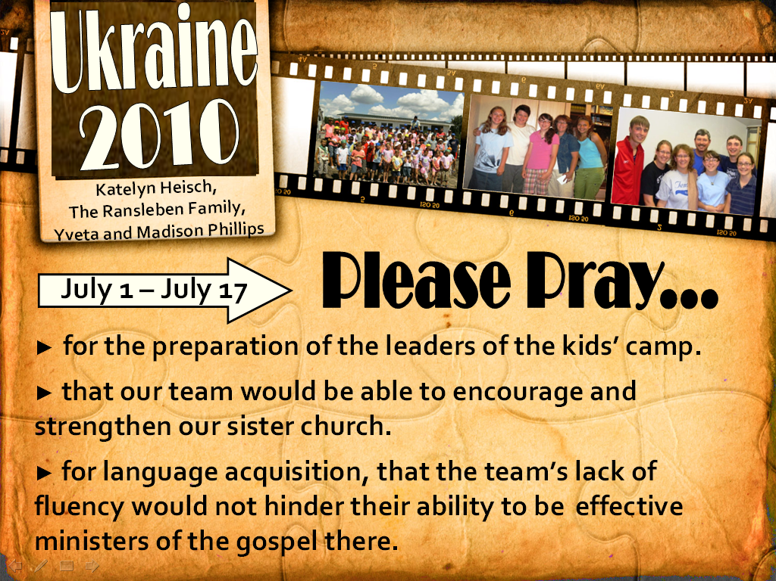
Welcome
to Temple Bible
Church

Slide 3
GOD OF WONDERS
Lord of all creation
Of water, earth and sky
The heavens are Your tabernacle
Glory to the Lord on high

Slide 4
God of wonders beyond our galaxy
You are holy, holy
The universe declares Your majesty
You are holy, holy
Lord of heaven and earth
Lord of heaven and earth

Slide 5
Early in the morning
I will celebrate the light
And when I stumble in the darkness
I will call Your name by night

Slide 6
God of wonders beyond our galaxy
You are holy, holy
The universe declares Your majesty
You are holy, holy
Lord of heaven and earth
Lord of heaven and earth

Slide 7
Hallelujah
To the Lord of Heaven and earth
Hallelujah
To the Lord of Heaven and earth
Hallelujah
To the Lord of Heaven and earth

Slide 8
You are holy, holy

Slide 9
God of wonders beyond our galaxy
You are holy, holy
The universe declares Your majesty
You are holy, holy
Lord of heaven and earth
Lord of heaven and earth
TEMPLE BIBLE CHURCH Used by Permission CCLI #78316

Slide 10
I BOW DOWN
Lord I stand in Your presence
Broken before You
My heart’s desire
is to love and adore You
With all of my heart
With all of my soul, forever

Slide 11
Lord I fall at Your altar
In sweet surrender
I’ve never known
A mercy so tender
It’s healing my heart
It’s healing my soul, forever

Slide 12
I bow down at Your feet
I bow down at Your feet
I bow down to worship You Jesus
My Savior, My King
(repeat)

Slide 13
Lord I stand in Your presence
Broken before You
My heart’s desire
is to love and adore You
With all of my heart
With all of my soul, forever

Slide 14
Lord I fall at Your altar
In sweet surrender
I’ve never known
A mercy so tender
It’s healing my heart
It’s healing my soul, forever

Slide 15
I bow down at Your feet
I bow down at Your feet
I bow down to worship You Jesus
My Savior, My King
(repeat)
TEMPLE BIBLE CHURCH Used by Permission CCLI#78316

Slide 16
Reign in Us
You thought of us
before the world began to breathe
You knew our names
Before we came to be

Slide 17
You saw the very day
We’d fall away from You
How desperately
we need to be redeemed

Slide 18
Lord Jesus
Come lead us
We’re desperate
For Your touch

Slide 19
Oh great and mighty One
With one desire we come
That You would reign
That You would reign in us

Slide 20
We’re offering up our lives
A living sacrifice
That You would reign
That You would reign in us

Slide 21
Spirit of the living God
Fall fresh again
Come search our hearts and
Purify our lives

Slide 22
We need Your perfect love
We need Your discipline
We’re lost unless You guide us
With Your light

Slide 23
Lord Jesus
Come lead us
We’re desperate
For Your touch

Slide 24
Oh great and mighty One
With one desire we come
That You would reign
That You would reign in us

Slide 25
We’re offering up our lives
A living sacrifice
That You would reign
That You would reign in us

Slide 26
We cry out for Your life to refine us
Cry out for Your love to define us
Cry out for Your mercy to keep us
Blameless until You return

Slide 27
Oh great and mighty One
With one desire we come
That You would reign
That You would reign in us

Slide 28
We’re offering up our lives
A living sacrifice
That You would reign
That You would reign in us
TEMPLE BIBLE CHURCH Used by Permission CCLI#78316

Slide 29
Mighty to Save
Everyone needs compassion
Love that’s never failing
Let mercy fall on me
Everyone needs forgiveness
The kindness of a Savior
The hope of nations

Slide 30
Savior
He can move the mountains
My God is mighty to save
He is mighty to save

Slide 31
Forever
Author of salvation
He rose and conquered the grave
Jesus conquered the grave

Slide 32
So take me as You find me
All my fears and failures
Fill my life again
I give my life to follow
Everything I believe in
Now I surrender

Slide 33
Savior
He can move the mountains
My God is mighty to save
He is mighty to save

Slide 34
Forever
Author of salvation
He rose and conquered the grave
Jesus conquered the grave

Slide 35
Shine Your light
And let the whole world see
We’re singing for the Glory
of the risen King
(repeat)

Slide 36
Savior
He can move the mountains
My God is mighty to save
He is mighty to save

Slide 37
Forever
Author of salvation
He rose and conquered the grave
Jesus conquered the grave
Temple Bible Church Used by permission #78316

Slide 38
YOU SAID
You said,
“Ask and you will receive
Whatever you need.”
You said, “Pray and I’ll hear
From heaven
And I’ll heal your land.”

Slide 39
You said Your glory will fill the earth
Like water the sea
You said, “Lift up your eyes;
The harvest is here,
The kingdom is near

Slide 40
You said, Ask and I’ll give
The nations to you
Oh Lord, that’s the cry of my heart
Distant shores and
The islands will see
Your light as it rises on us

Slide 41
You said,
“Ask and you will receive
Whatever you need.”
You said, “Pray and I’ll hear
From heaven
And I’ll heal your land.”

Slide 42
You said Your glory will fill the earth
Like water the sea
You said, “Lift up your eyes;
The harvest is here,
The kingdom is near

Slide 43
You said, “Ask and I’ll give
The nations to you.”
Oh Lord, that’s the cry of my heart
Distant shores and
The islands will see
Your light as it rises on us
(Repeat)

Slide 44
Oh Lord I ask for the nations
Oh Lord I ask for the nations
TEMPLE BIBLE CHURCH Used by Permission CCLI #78316

Slide 45
LORD I GIVE YOU MY HEART
Lord I give You my heart
I give You my soul
I live for You alone
Every breath that I take
Every moment I’m awake
Lord, have Your way in me
TEMPLE BIBLE CHURCH Used by Permission CCLI #78316

Slide 46


Slide 47
Genesis 2:18-25

Slide 48
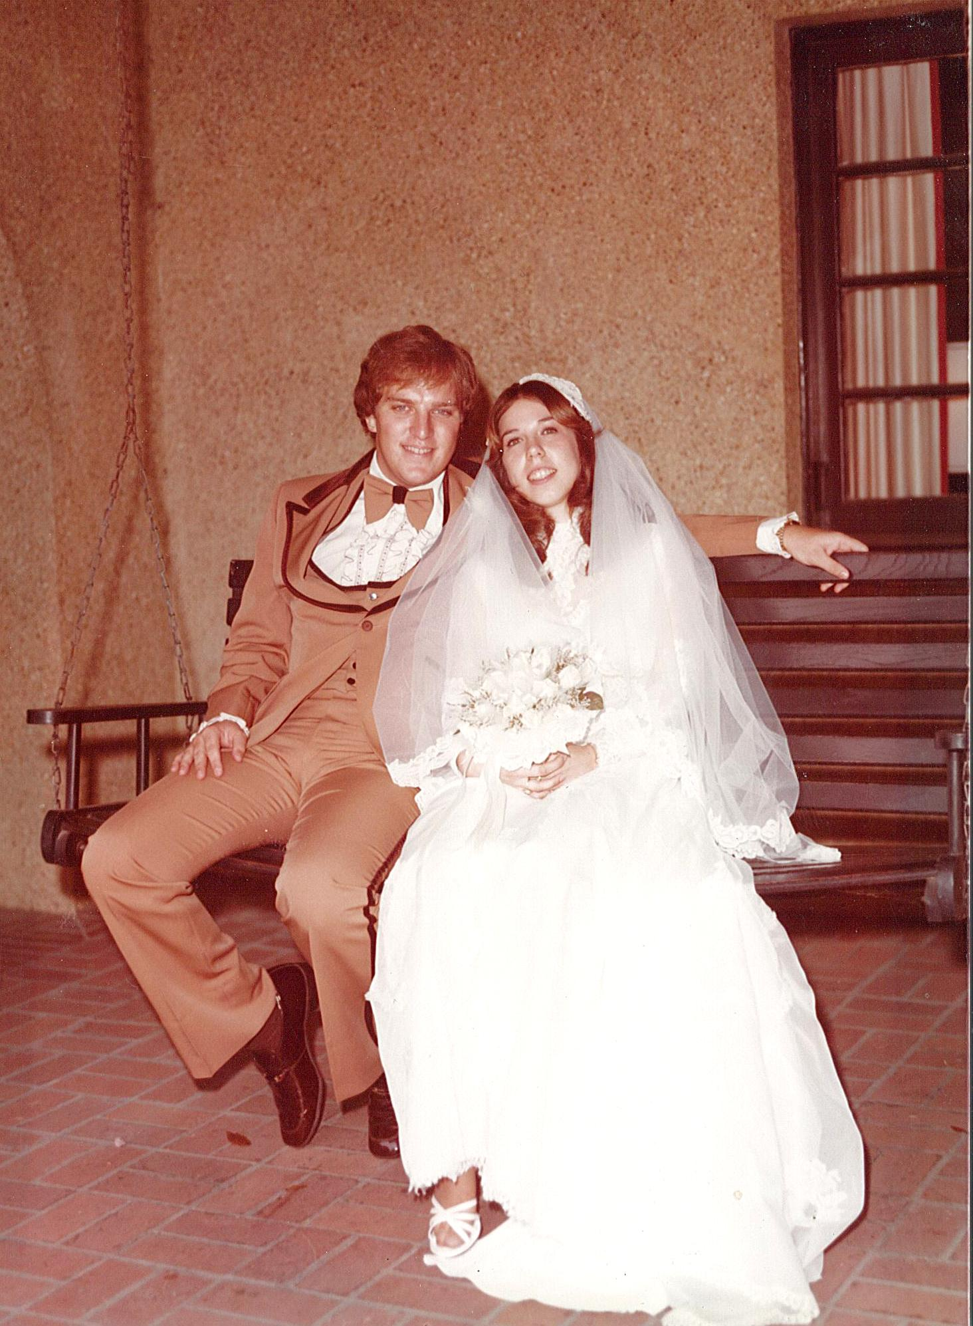

Slide 50
God’s Provision
Firm

Slide 51
Adam’s Response
Firm

Slide 52
God’s Response
Firm

Slide 53
God’s Command

CLEAVE
LEAVE
BECOME ONE
Firm
Timeless Triangle

Slide 54
Adam & Eve’s
Condition
Firm

Slide 55
Your
Home’s
Shaky
Or
strong
Firm
Or
Faulty
???

