Slide 5
YOUR GRACE IS ENOUGH
Great is Your faithfulness oh God
You wrestle with the sinner’s heart
You lead us by still waters into mercy
And nothing can keep us apart

Slide 6
So remember Your people
Remember Your children
Remember Your promise oh God

Slide 7
Your grace is enough
Your grace is enough
Your grace is enough for me

Slide 8
Great is Your love and justice, God
You use the weak to lead the strong
You lead us in the
Song of Your salvation
And all Your people sing along

Slide 9
So remember Your people
Remember Your children
Remember Your promise oh God

Slide 10
Your grace is enough
Your grace is enough
Your grace is enough for me
(repeat)

Slide 11
So remember Your people
Remember Your children
Remember Your promise oh God

Slide 12
Your grace is enough
Your grace is enough
Your grace is enough for me
TEMPLE BIBLE CHURCH Used by Permission CCLI #78316

Slide 13
Blessed be Your Name
Blessed be Your name
In the land that is plentiful
Where Your streams of abundance flow
Blessed be Your name

Slide 14
And blessed be Your name
When I’m found in the desert place
Though I walk through the wilderness
Blessed be Your name

Slide 15
Every blessing You pour out
I’ll turn back to praise
When the darkness closes in, Lord
Still I will say

Slide 16
Blessed be the name of the Lord
Blessed be Your name
Blessed be the name of the Lord
Blessed be Your glorious name

Slide 17
And blessed be Your name
When the sun’s shining down on me
When the world’s “all as it should be”
Blessed be Your name

Slide 18
And blessed be Your name
On the road marked with suffering
Though there’s pain in the offering
Blessed be Your name

Slide 19
Every blessing You pour out
I’ll turn back to praise
When the darkness closes in, Lord
Still I will say

Slide 20
Blessed be the name of the Lord
Blessed be Your name
Blessed be the name of the Lord
Blessed be Your glorious name

Slide 21
You give and take away
You give and take away
My heart will choose to say
Lord blessed be Your name

Slide 22
Blessed be the name of the Lord
Blessed be Your name
Blessed be the name of the Lord
Blessed be Your glorious name
TEMPLE BIBLE CHURCH Used by Permission CCLI #78316
TEMPLE BIBLE CHURCH Used by Permission CCLI #78316

Slide 23
YOU SAID
You said,
“Ask and you will receive
Whatever you need.”
You said, “Pray and I’ll hear
From heaven
And I’ll heal your land.”

Slide 24
You said Your glory will fill the earth
Like water the sea
You said, “Lift up your eyes;
The harvest is here,
The kingdom is near

Slide 25
You said, Ask and I’ll give
The nations to you
Oh Lord, that’s the cry of my heart
Distant shores and
The islands will see
Your light as it rises on us

Slide 26
You said Your glory will fill the earth
Like water the sea
You said, “Lift up your eyes;
The harvest is here,
The kingdom is near

Slide 27
You said, “Ask and I’ll give
The nations to you.”
Oh Lord, that’s the cry of my heart
Distant shores and
The islands will see
Your light as it rises on us
(Repeat)

Slide 28
Oh Lord I ask for the nations
Oh Lord I ask for the nations
TEMPLE BIBLE CHURCH Used by Permission CCLI #78316

Slide 30
BLESSED ASSURANCE
Blessed assurance, Jesus is mine
O what a foretaste of glory divine
Heir of salvation, purchase of God
Born of His spirit, washed in His blood

Slide 31
This is my story, this is my song
Praising my Savior all the day long
This is my story, this is my song
Praising my Savior all the day long

Slide 32
Perfect submission, all is at rest
I in my Savior am happy and blessed
Watching and waiting, looking above
Filled with His goodness, lost in His Love

Slide 33
This is my story, this is my song
Praising my Savior all the day long
This is my story, this is my song
Praising my Savior all the day long

Slide 34
Perfect submission, perfect delight
Visions of rapture
Now burst at my sight
Angels descending
They bring from above
Echoes of mercy
sweet whispers of love

Slide 35
This is my story, this is my song
Praising my Savior all the day long
This is my story, this is my song
Praising my Savior all the day long
TEMPLE BIBLE CHURCH Used by Permission CCLI #78316
Words: Fanny Crosby Music: Phoebe Knapp

Slide 36
Here in Your Presence
Found in Your hands, fullness of joy
Every fear suddenly wiped away
In Your presence
All of my gains now fade away
Every crown no longer on display
Here in Your presence

Slide 37
Heaven is trembling
In awe of Your wonder
Kings and their kingdoms
Are standing amazed

Slide 38
Here in Your presence
We are undone
Here in Your presence
Heaven and earth become one
Here in Your presence
All things are new
Here in Your presence
Everything bows before You

Slide 39
Found in Your hands, fullness of joy
Every fear suddenly wiped away
Here in Your presence
All of my gains no fade away
Every crown no longer on display
Here in Your presence

Slide 40
Heaven is trembling
In awe of Your wonder
Kings and their kingdoms
Are standing amazed

Slide 41
Here in Your presence
We are undone
Here in Your presence
Heaven and earth become one
Here in Your presence
All things are new
Here in Your presence
Everything bows before You

Slide 42
Wonderful, Beautiful, Glorious
Matchless in every way
Wonderful, Beautiful, Glorious
Matchless in every way
Wonderful, Beautiful, Glorious
Matchless in every way

Slide 43
Here in Your presence
We are undone
Here in Your presence
Heaven and earth become one
Here in Your presence
All things are new
Here in Your presence
Everything bows before You
TEMPLE BIBLE CHURCH Used by Permission CCLI #78316

Slide 44
CHINA
A COUNTRY OF CHAOS & CHANGE
Acts 1:8

Slide 46
耶 穌 對 他 們 說 ： 不 要 害 怕 ！ 你 們 去 告 訴 我 的 弟 兄 ， 叫 他 們 往 加 利 利 去 ， 在 那 裡 必 見 我 。 馬 太 福 音 28:18 (Chinese Union Version (Traditional))

Slide 47
但 聖 靈 降 臨 在 你 們 身 上 ， 你 們 就 必 得 著 能 力 ， 並 要 在 耶 路 撒 冷 、 猶 太 全 地 ， 和 撒 瑪 利 亞 ， 直 到 地 極 ， 作 我 的 見 證 。 使 徒 行 傳 1:8 (Chinese Union Version (Traditional))

Slide 49
CHINA
A COUNTRY OF CHAOS & CHANGE
Acts 1:8

Slide 50
Beijing

Slide 52
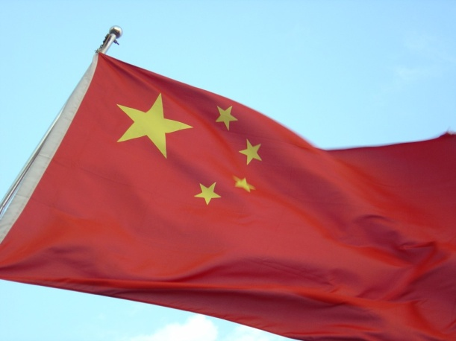

Slide 53
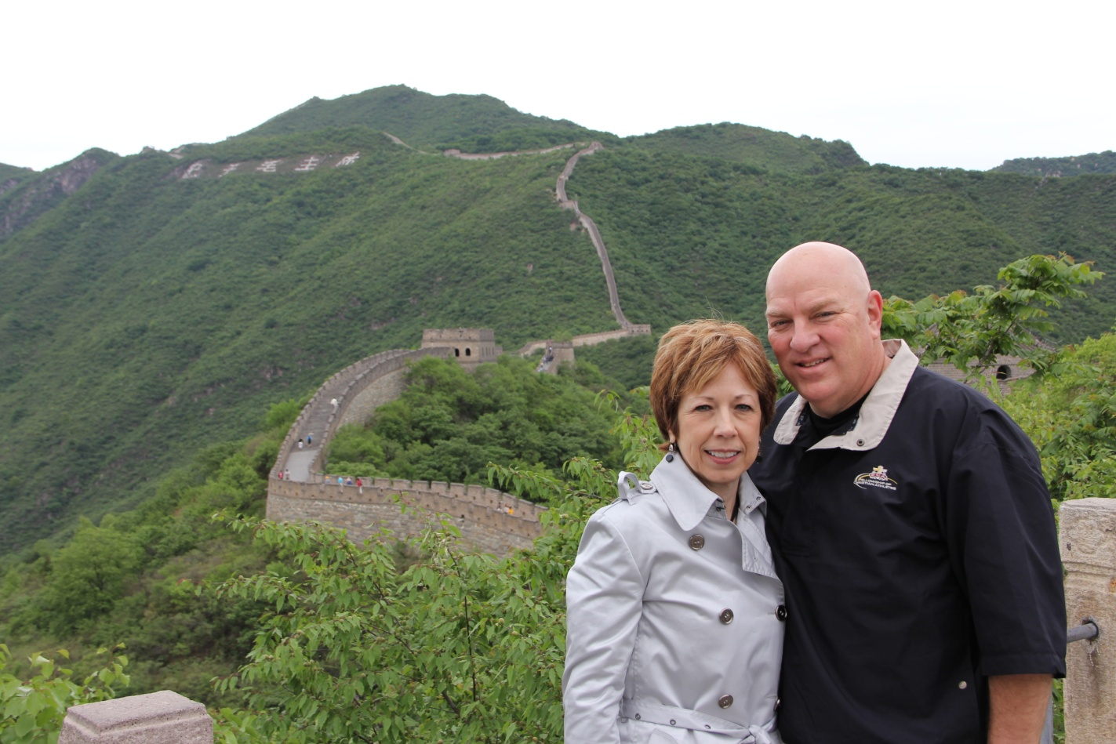
Great
Wall
of China

Slide 54
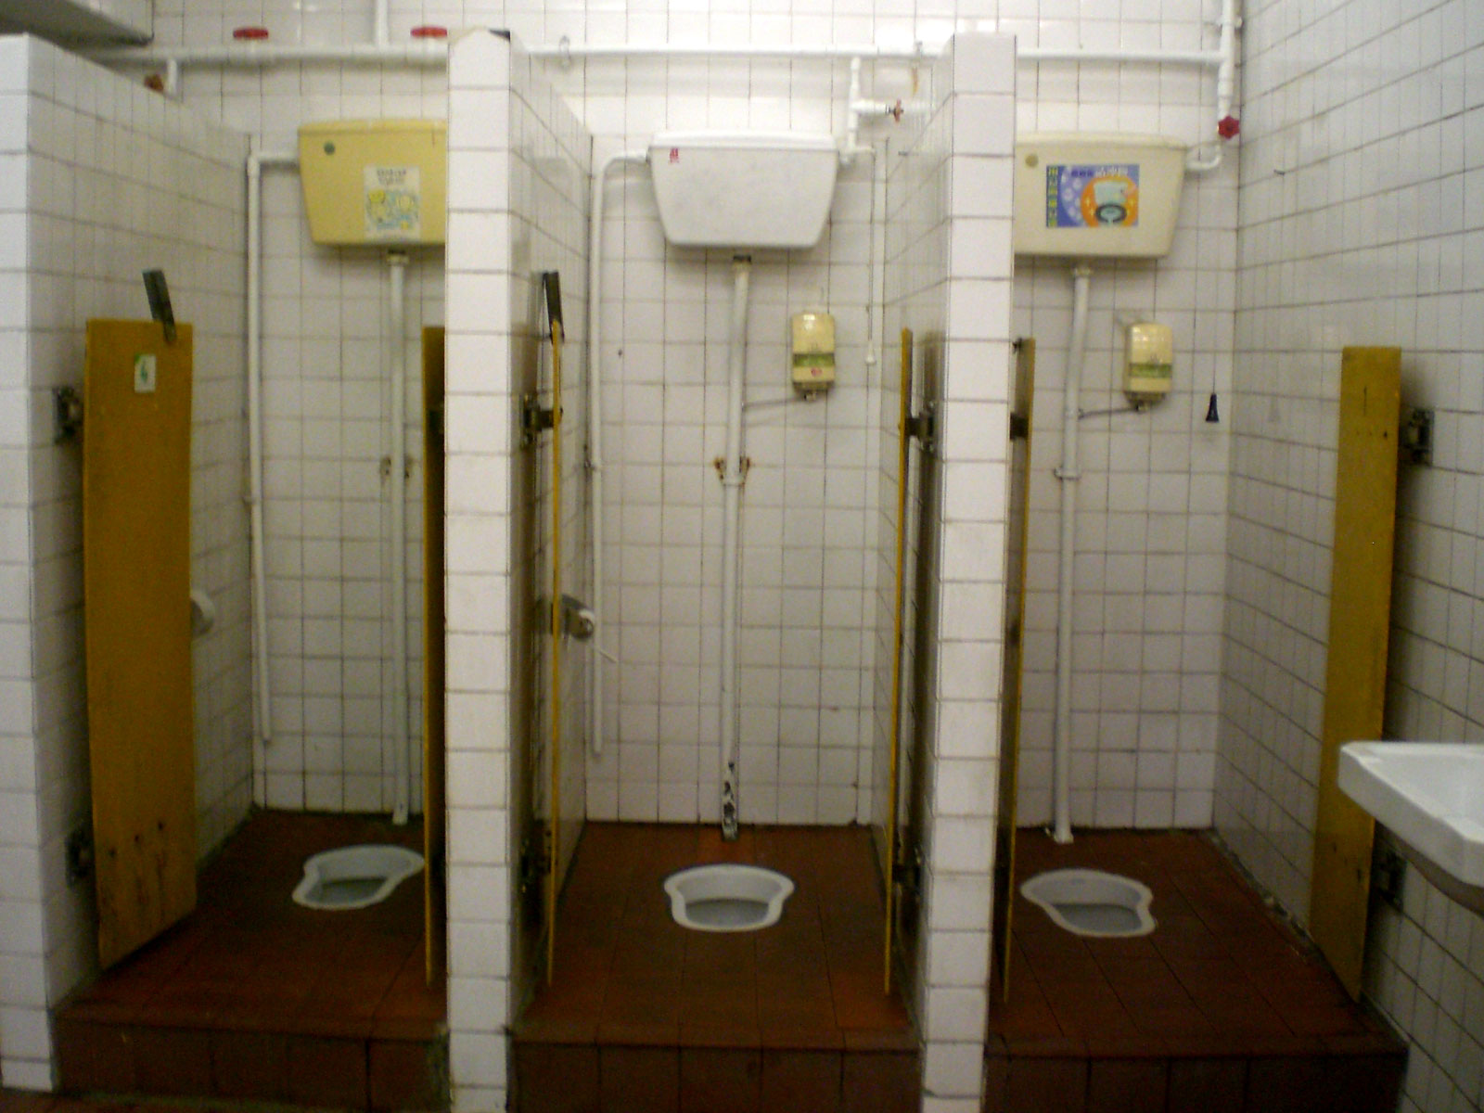

Slide 56
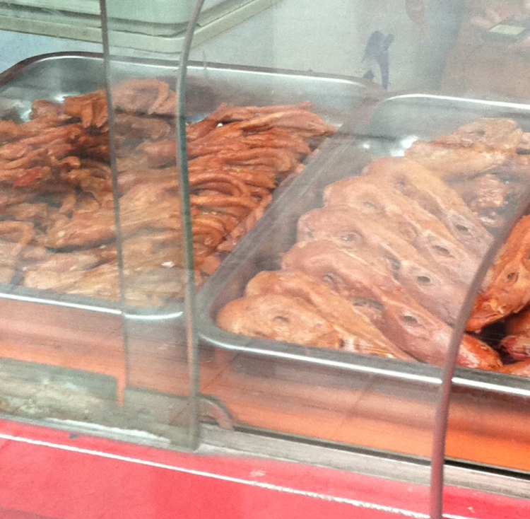
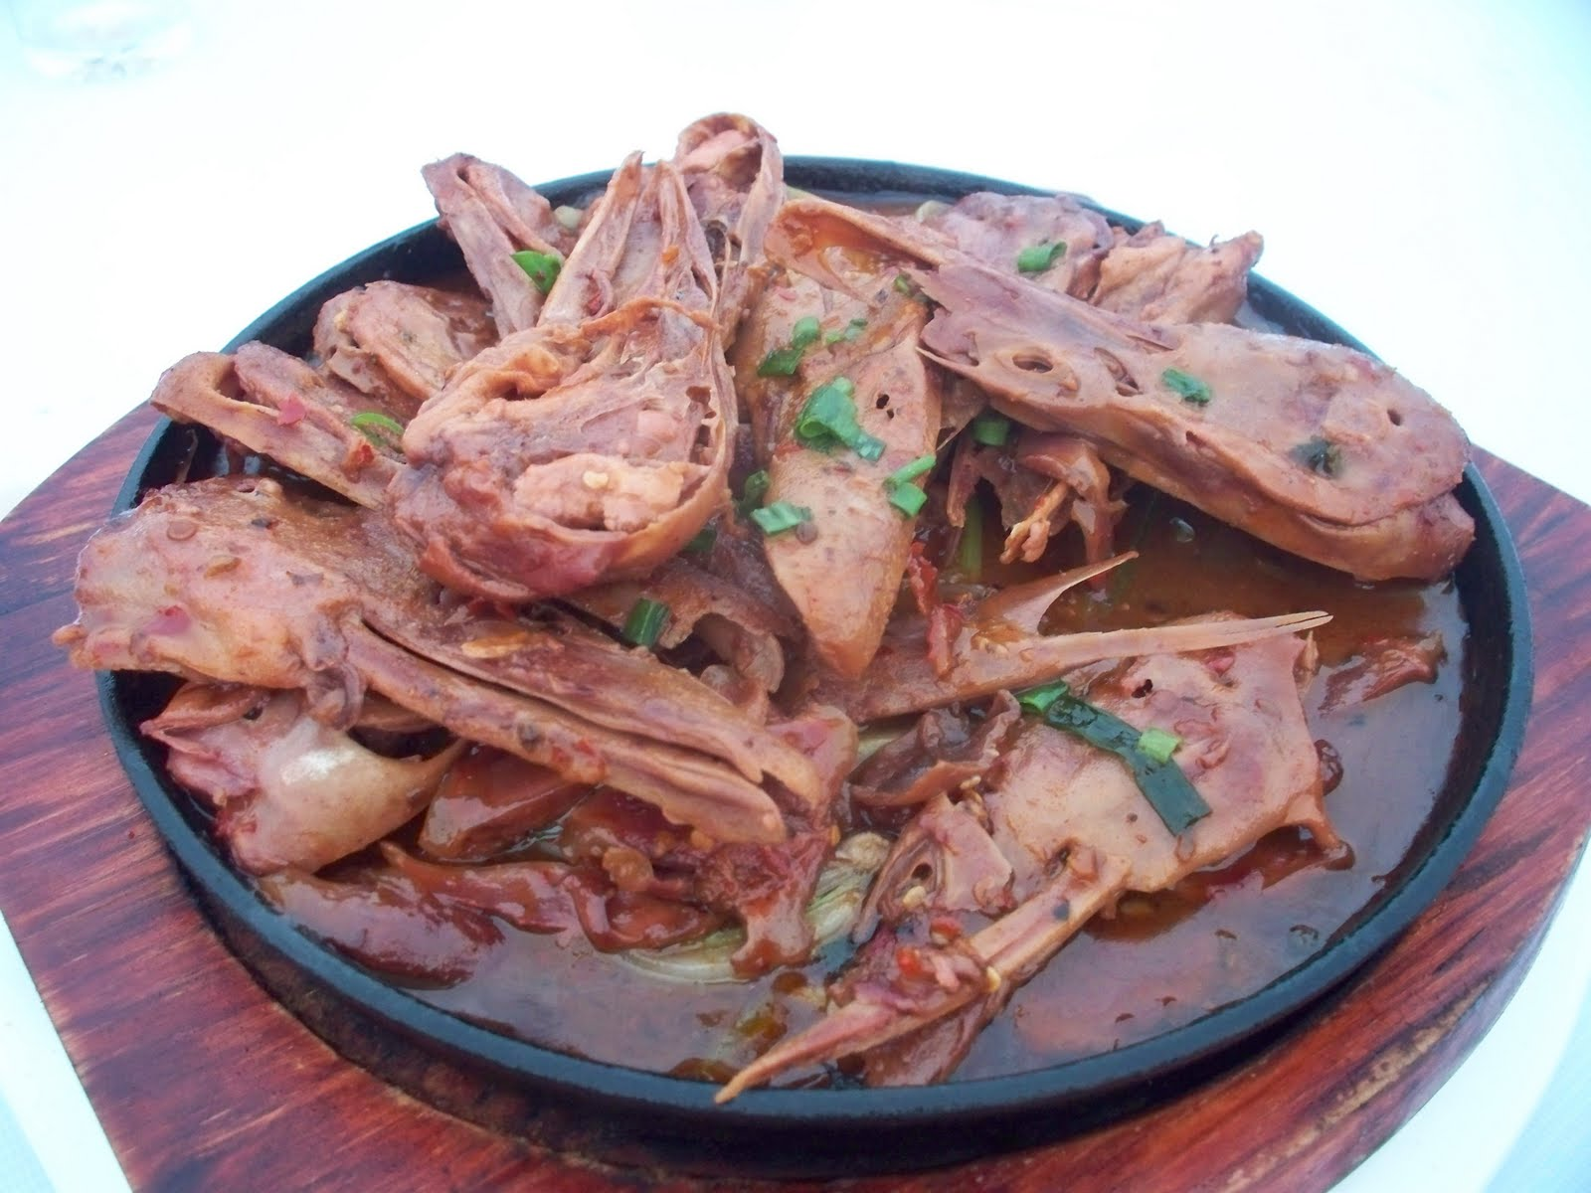

Slide 57
Reflections from China

Slide 58
DESTRUCTION and DEATH without HOPE

Slide 59
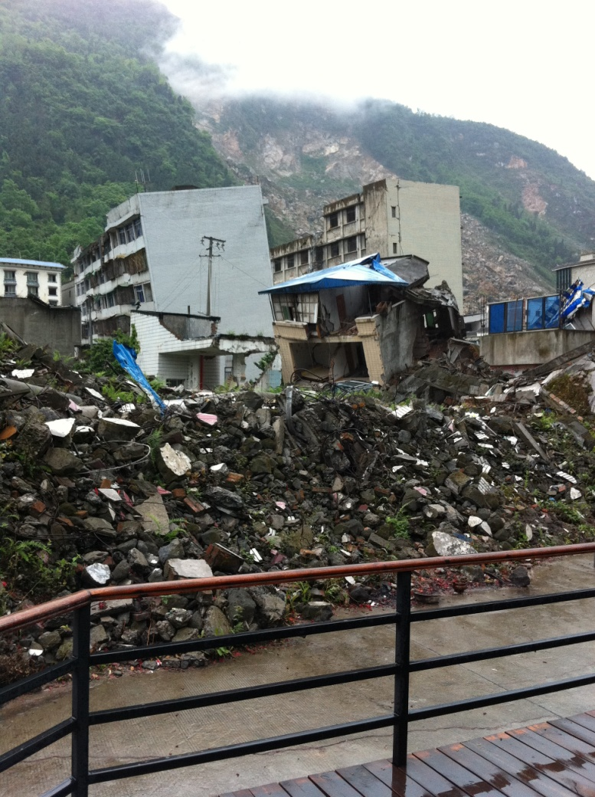
Beichuan

Slide 60
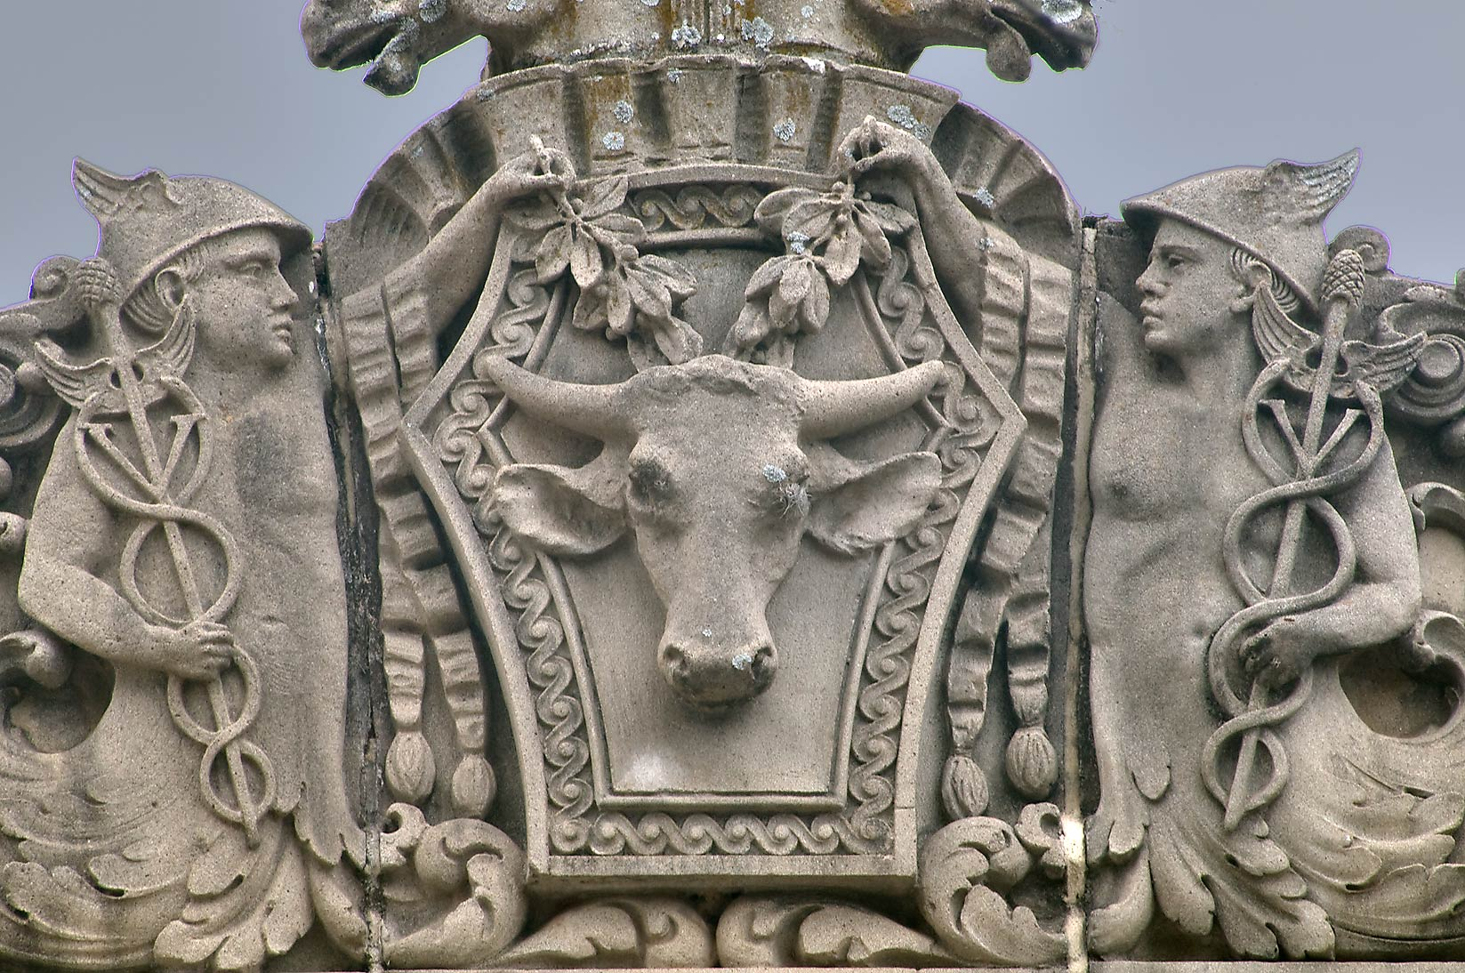

Slide 61
“With whom will you compare me or count me equal? To whom will you liken me that we may be compared? Some pour out gold from their bags and weigh out silver on the scales; they hire a goldsmith to make it into a god, and they bow down and worship it.

Slide 62
They lift it to their shoulders and carry it; they set it up in its place, and there it stands. From that spot it cannot move. Even though someone cries out to it, it cannot answer; it cannot save them from their troubles. -Isaiah 46:5-7

Slide 63
Brothers and sisters, we do not want you to be uninformed about those who sleep in death, so that you do not grieve like the rest of mankind, who have no hope. -1 Thess 4:13

Slide 64
When we allow anything apart from God to rule us or compel us, we have created an idol.

Slide 65
We may not physically kneel before the statue of Aphrodite, but many young women today are driven into depression and eating disorders by an obsessive concern over their body image. We may not actually burn incense to Artemis, but when money and career are raised to cosmic proportions, we perform a kind of child sacrifice, neglecting family and community to achieve a higher place in business and gain more wealth and prestige.

Slide 66
God is a missionary God. The Bible is a missionary book. The gospel is a missionary message. The church is a missionary institution. And when the church ceases to be missionary minded, it has denied its faith and betrayed trust.

Slide 67
DESTRUCTION and DEATH without HOPE

Slide 68
LIGHT in the midst of DARKNESS

Slide 69
“You are the light of the world. A town built on a hill cannot be hidden. Neither do people light a lamp and put it under a bowl. Instead they put it on its stand, and it gives light to everyone in the house. In the same way, let your light shine before others, that they may see your good deeds and glorify your Father in heaven. -Matt 5:14-16

Slide 70
How, then, can they call on the one they have not believed in? And how can they believe in the one of whom they have not heard? And how can they hear without someone preaching to them? And how can anyone preach unless they are sent? As it is written: “How beautiful are the feet of those who bring good news!” -Rom 10:14-15

Slide 71
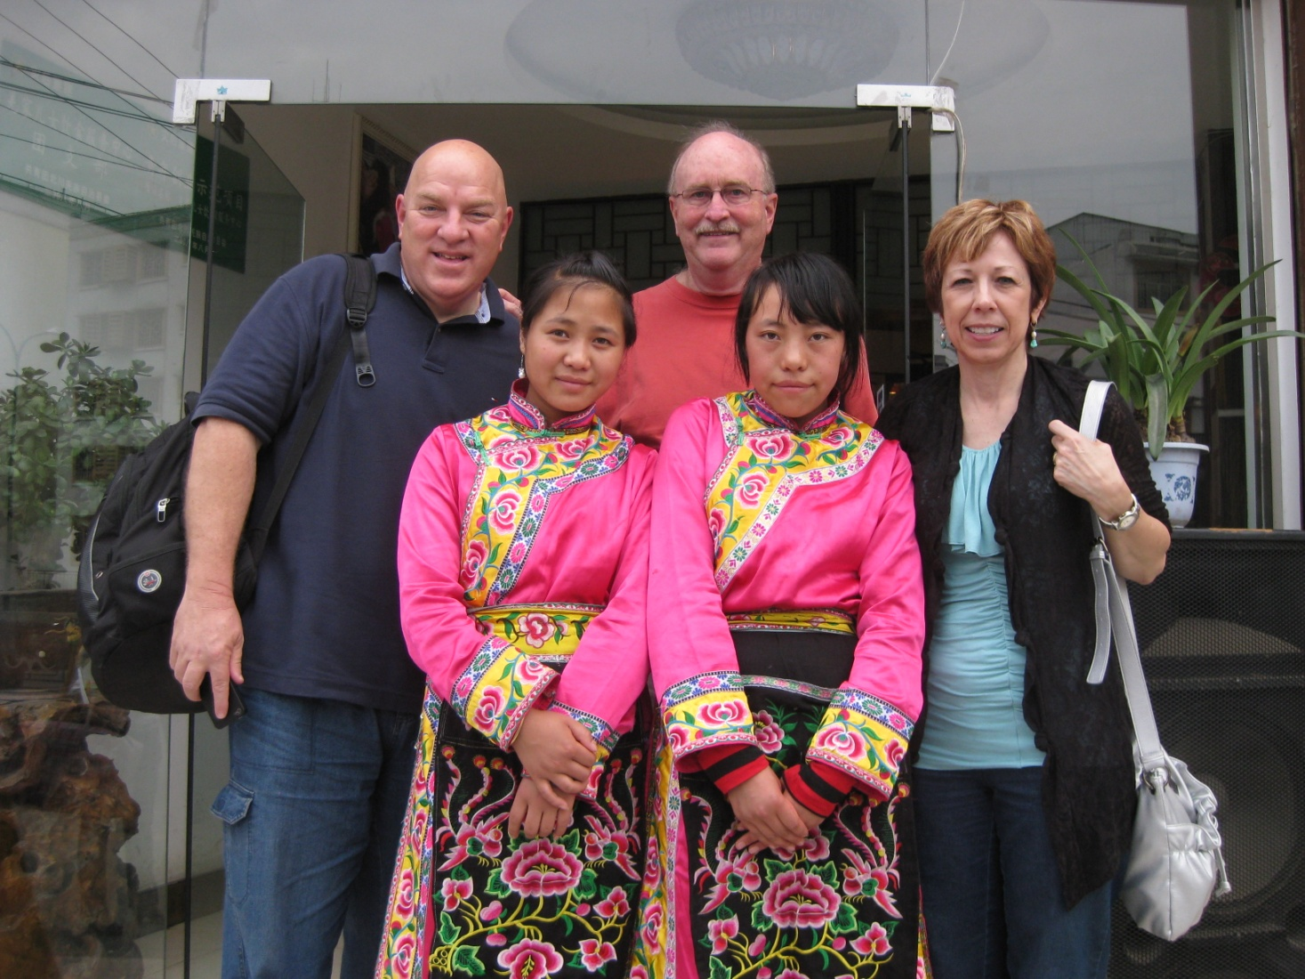

Slide 72
PROSPERITY
without GENEROSITY

Slide 73
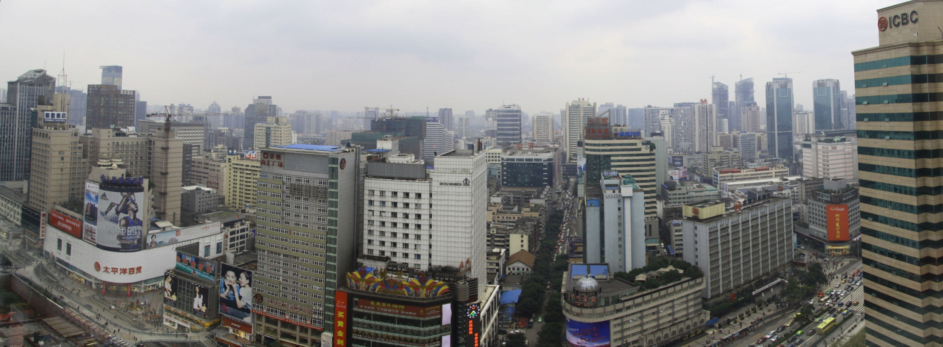
Chengdu

Slide 74
Beijing

Slide 75
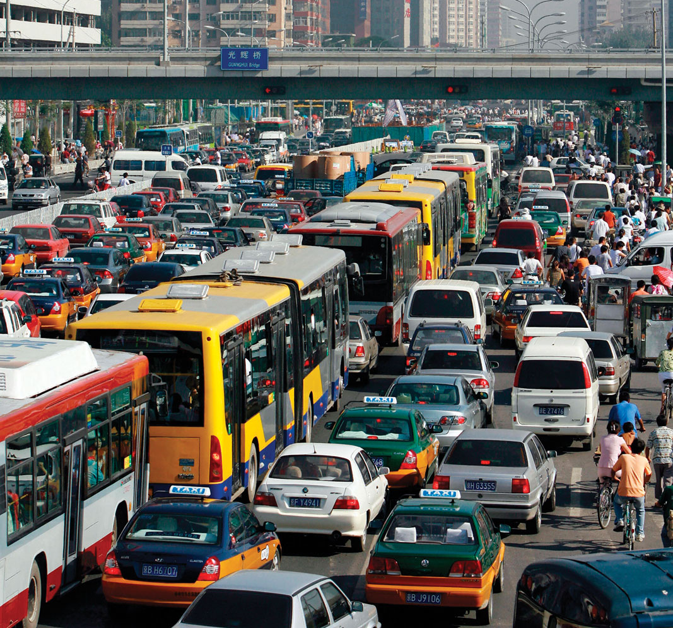
Beijing
Traffic

Slide 76
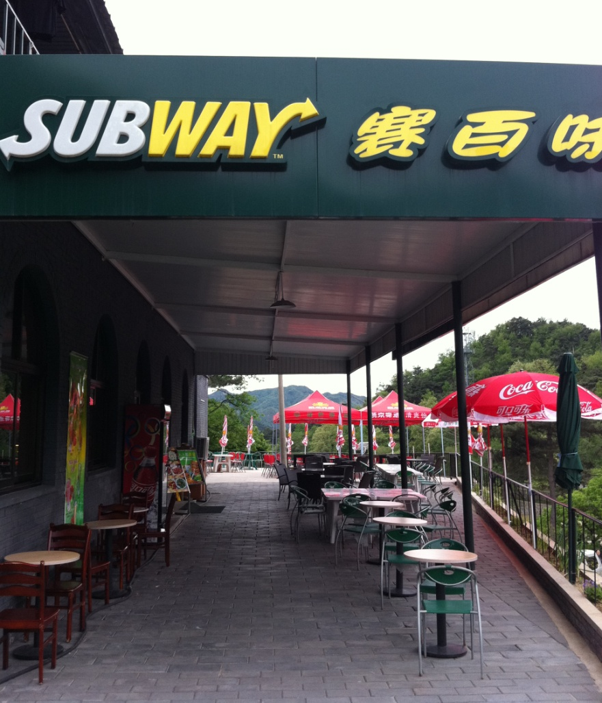

Slide 77
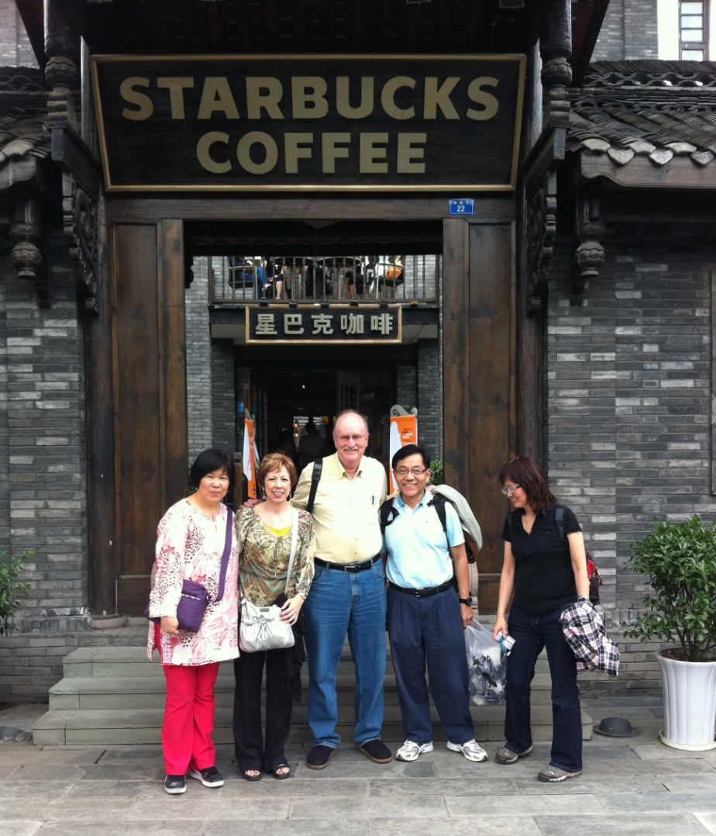

Slide 78
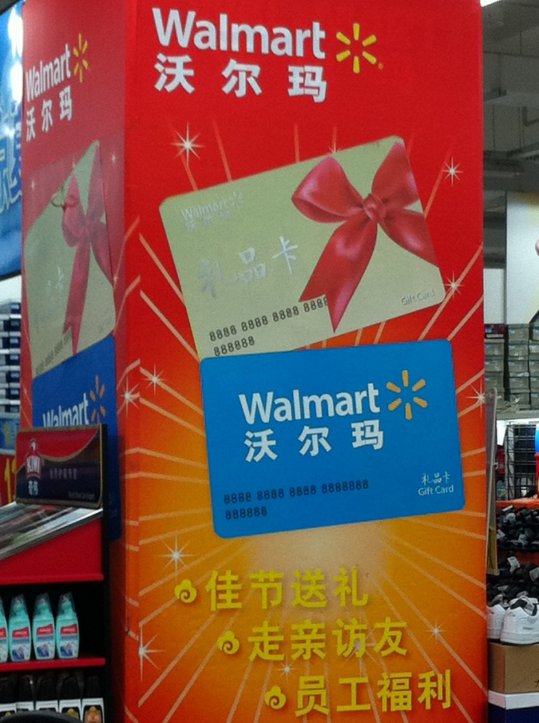

Slide 79
PROSPERITY
without GENEROSITY

Slide 80
SACRIFICE
rather than SECURITY

Slide 81
“Do not store up for yourselves treasures on earth, where moths and vermin destroy, and where thieves break in and steal. But store up for yourselves treasures in heaven, where moths and rust do not destroy, and where thieves do not break in and steal. For where your treasure is, there your heart will be also. -Matthew 6:19-21

Slide 82
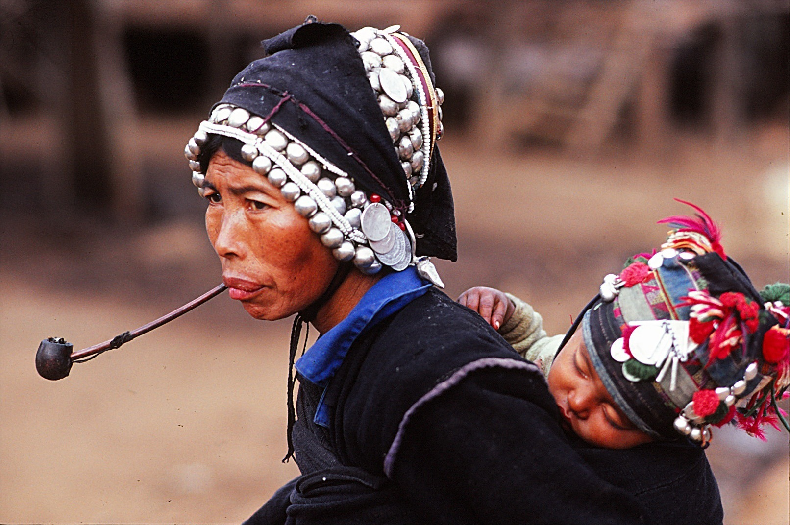

Slide 83
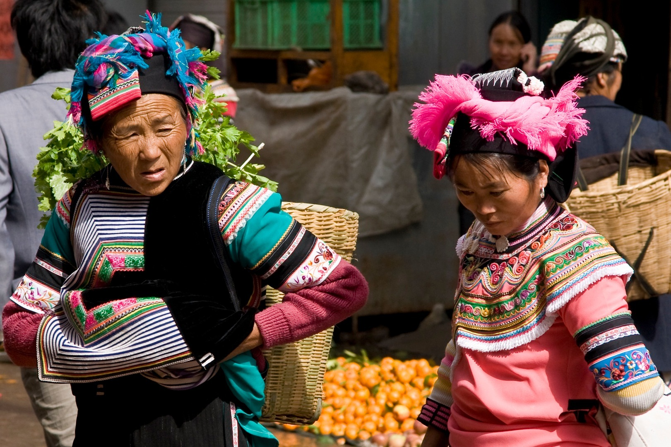

Slide 84
“He is no fool who
gives up what he cannot keep
to gain what he cannot lose.”
Jim Elliot

Slide 85
FREEDOM
is easy to take for GRANTED

Slide 86
It is for freedom that Christ has set us free. Stand firm, then, and do not let yourselves be burdened again by a yoke of slavery.
You, my brothers and sisters, were called to be free. But do not use your freedom to indulge the flesh; rather, serve one another humbly in love.
-Gal 5:1,13

Slide 87
RADICAL
LIVING LIFE INTENTIONALLY FOR THE GOSPEL

Slide 88
