Slide 3
____
_____
_______________

Slide 7
June 6th, 5:30pm
Four Oaks Retreat
(weather permitting)
Info Meeting
Thurs, May 20th 6:30pm @ TBC
Bring….
picnic dinner, drinks,
blankets, lawn chairs,
and bug spray!

Slide 8
impact

Slide 10
RIGHTING A WRONG
II Thessalonians 2:1-17

Slide 11
Conception of a Rumor
Correcting a Rumor

Slide 12
Now, friends, read these next words carefully. Slow down and don't go jumping to conclusions regarding the day when our Master, Jesus Christ, will come back and we assemble to welcome him.

Slide 13
Don't let anyone shake you up or get you excited over some breathless report or rumored letter from me that the day of the Master's arrival has come and gone. Don't fall for any line like that. 2 Thess 2:1-2 (Message)

Slide 14
Conception of a Rumor
Correcting a Rumor

Slide 15
I don’t believe Jesus is the only way to God. I don’t believe He rose from the dead as scientific fact. I don’t know whether those things happened. It’s an irrelevant question. -Bill Phipps: Moderator, United Church of Canada

Slide 16
Abraham, Isaac, Joseph, Mary, Buddha and Muhammad and all the prophets of old; they lead God’s people to God’s light. -Charles T.A. Flood

Slide 17
…the Bible is not the word of God in any literal or verbal sense. It never has been! The Gospels are not inerrant works, divinely authored…I would choose to loathe rather than worship a deity who requires a sacrifice of a son. -John Spong defrocked Episcopal Bishop

Slide 18
Berkeley church seeks minister for local nondenominational congregation. Position open to Christians and Non-Christians.

Slide 19
The best way to show a stick is crooked is not to argue about it or spend time denouncing it, but to lay a straight stick along side it. -Janani Luwum: Ugandad Archbishop

Slide 20
Be on guard for yourselves and for all the flock, among which the Holy Spirit has made you overseers, to shepherd the church of God which He purchased with His own blood.

Slide 21
I know that after my departure savage wolves will come in among you, not sparing the flock; and from among your own selves men will arise, speaking perverse things, to draw away the disciples after them. Acts 20:28-30 (NASB)

Slide 22
Conception of a Rumor
Correction of a Rumor
Rebellion
Correcting a Rumor

Slide 23
Anti-Christs
Each of his 3 names have
6 letters in it.
His zip code is 60606.
______________________________________________________________________________
His House # was 666
before he changed it to 668.
His limo is named The Beast.
______________________________________________________________________________
He was shot and wounded and recovered.
His 1st swearing in got botched and NO Bible was used during his 2nd.
______________________________________________________________________________
His 1st primary victory in Gov. race was in 6/66.
He has a lawless view of the constitution.
______________________________________________________________________________
His first film was the 666th released by Hollywood.
He didn’t cover his heart during the pledge of Allegiance.
______________________________________________________________________________
He played one of the
4 Horseman in a film.
He cancelled participation in the National Day of Prayer.

Slide 24
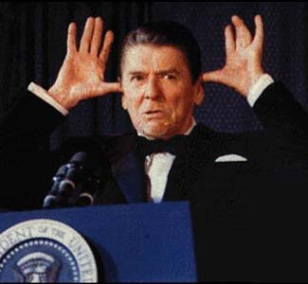
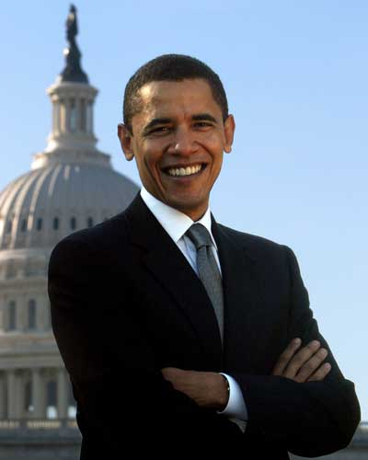
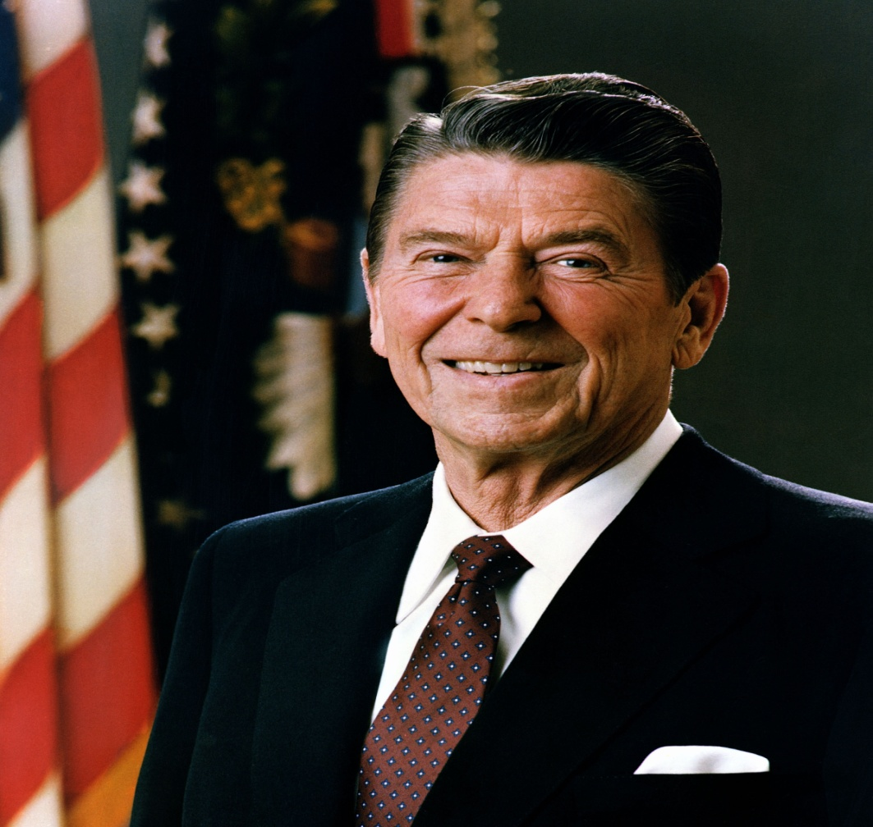
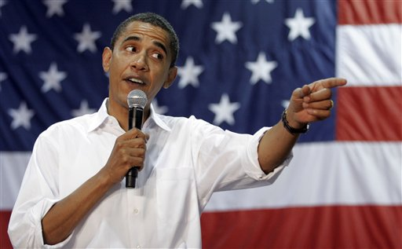

Slide 25
But mark this: There will be terrible times in the last days. 2Tim 3:1 (NIV)

Slide 26
Conception of a Rumor
Correction of a Rumor
Rebellion
Revelation
Correcting a Rumor

Slide 27
One of the heads of the beast seemed to have had a fatal wound, but the fatal wound had been healed. The whole world was astonished and followed the beast. Men worshiped the dragon because he had given authority to the beast…

Slide 28
and they also worshiped the beast and asked, "Who is like the beast? Who can make war against him?" … And he performed great and miraculous signs, even causing fire to come down from heaven to earth in full view of men. Rev 13:3-4,13(NIV)

Slide 29
For false Christs and false prophets will appear and perform great signs and miracles to deceive even the elect if that were possible. Matthew 24:24 (NIV)

Slide 30
Conception of a Rumor
Correction of a Rumor
Rebellion
Revelation
Rejection
Compassion
for the Concerned
Correcting a Rumor

Slide 31
Satan
is powerful but the
Lord is
ALL POWERFUL
II Thessalonians 2:1-17

