Slide 2
Come Thou Fount Come Thou King
Come, Thou Fount of every blessing Tune my heart to sing Thy grace Streams of mercy, never ceasing Call for songs of loudest praise

Slide 3
Teach me some melodious sonnet Sung by flaming tongues above Praise His Name, I'm fixed upon it Name of God’s redeeming love

Slide 4
I was lost in utter darkness 'til You came and rescued me I was bound by all my sin when Your love came and set me free

Slide 5
Now my soul can sing a new song Now my heart has found a home Now Your grace is always with me And I'll never be alone

Slide 6
Come, Thou Fount, come, Thou King Come, Thou precious Prince of Peace Hear Your bride, to You we sing Come, Thou Fount of our blessing

Slide 7
O, to grace, how great a debtor daily I'm constrained to be Let Thy goodness, like a fetter Bind my wand'ring heart to Thee

Slide 8
Prone to wander, Lord, I feel it Prone to leave the God I love Here's my heart, Lord Take and seal it
Seal it for Thy courts above

Slide 9
Come, Thou Fount, come, Thou King Come, Thou precious Prince of Peace Hear Your bride, to You we sing Come, Thou Fount of our blessing
Thomas Miller, Robert Robinson
2005 Gateway Create Publishing
CCLI 78316

Slide 10
SWEETLY BROKEN
At the cross You beckon me You draw me gently to my knees And I am Lost for words, so lost in love, I'm Sweetly broken, wholly surrendered

Slide 11
To the cross I look To the cross I cling Of it's suffering I do drink Of it's work I do sing

Slide 12
For on it my Savior,
Both bruised and crushed
Showed that God is love
And God is just

Slide 13
At the cross You beckon me You draw me gently to my knees And I am Lost for words, so lost in love, I'm Sweetly broken, wholly surrendered

Slide 14
What a priceless gift Undeserved life, Have I been given Through Christ crucified

Slide 15
You've called me out of death, You've called me into life And I was under Your wrath; Now through the cross I'm reconciled

Slide 16
At the cross You beckon me You draw me gently to my knees And I am Lost for words, so lost in love, I'm Sweetly broken, wholly surrendered

Slide 17
At the cross You beckon me You draw me gently to my knees And I am Lost for words, so lost in love, I'm Sweetly broken, wholly surrendered
Jeremy Riddle
2005 Mercy/Vineyard Publishing
CCLI 78316

Slide 18
Lead Me To The Cross
Saviour I come, quiet my soul Remember redemptions hill Where Your blood was spilled For my ransom

Slide 19
Everything I once held dear I count it all as loss

Slide 20
Lead me to the cross where Your love poured out Bring me to my knees Lord I lay me down

Slide 21
Rid me of myself, I belong to You O lead me Lead me to the cross

Slide 22
You were as I, tempted and tried Human The Word became flesh Bore my sin in death Now You're risen

Slide 23
Everything I once held dear I count it all as loss

Slide 24
Lead me to the cross where Your love poured out Bring me to my knees Lord I lay me down

Slide 25
Rid me of myself, I belong to You O lead me

Slide 26
Lead me to the cross where Your love poured out Bring me to my knees Lord I lay me down

Slide 27
Rid me of myself, I belong to You O lead me Lead me to the cross
CCLI 78316

Slide 28
At the Cross
Oh Lord, You've searched me You know my way Even when I fail You I know You love me

Slide 29
Your holy presence surrounding me In every season I know You love me
I know You love me

Slide 30
At the cross I bow my knee Where Your blood was shed for me There's no greater love than this You have overcome the grave

Slide 31
Your glory fills the highest place What can separate me now

Slide 32
You go before me, You shield my way Your hand upholds me I know You love me

Slide 33
And when the earth fades Falls from my eyes And You stand before me I know You love me I know You love me

Slide 34
At the cross I bow my knee Where Your blood was shed for me There's no greater love than this You have overcome the grave

Slide 35
Your glory fills the highest place What can separate me now

Slide 36
You tore the veil, You made a way When You said that it is done (repeat)

Slide 37
At the cross I bow my knee Where Your blood was shed for me There's no greater love than this You have overcome the grave

Slide 38
Your glory fills the highest place What can separate me now
CCl783176

Slide 41
WARNING… A FAULT-LINE WILL APPEAR

Slide 42
But Peter declared, “Even if I have to die with you, I will never disown you.” And all the other disciples said the same. …Matthew 26:35

Slide 43
FAULTS in the FOUNDATION… REJECTION …Luke 22:54-62

Slide 44
FAULTS in the FOUNDATION… REJECTION …Luke 22:54-62

Slide 45
Peter. The burly fisherman. Strong enough to yank a full net out of the sea. Brave enough to weather the toughest storm. The man who only hours before had bared his sword against the entire Roman guard. But now look at him weeping, no… wailing. Huddled in a corner with his face hidden in his calloused hands. - Max Lucado

Slide 46
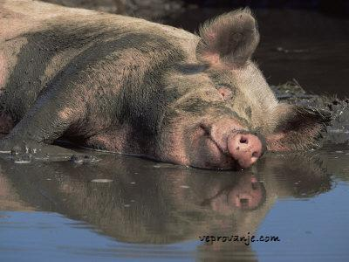

Slide 47
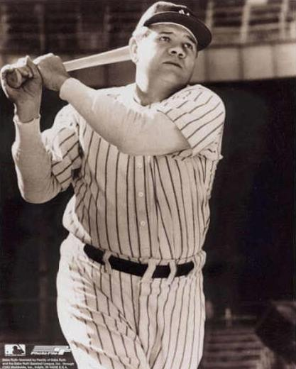
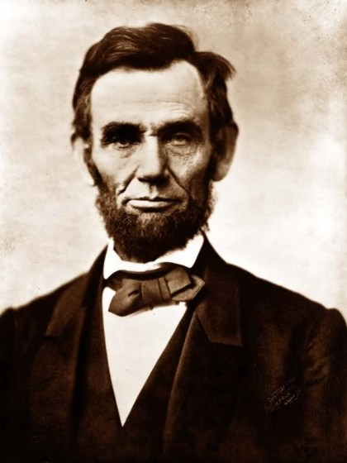

Slide 48
The FOUNDATION REPAIRED… RESTORATION …John 21:15-23

Slide 49
The FOUNDATION’S STRENGTH… COURAGE RESTORED …Acts 2:14-47

Slide 50
“The danger is not that we FALL… but that we should remain on the ground!” …John Chrysostom, 4th century AD

Slide 52
Your Grace Still Amazes Me
Your grace still amazes me Your love is still a mystery; Each day I fall on my knees, 'Cause Your grace still amazes me Your grace still amazes me
Shawn Craig, Connie Harrington
2001 Little Cricket Music, Ariose Music, PraiseSong Press (Admin. by EMI CMG), EMI April Music Inc.
CCLI 78316

