Slide 1
WELCOME TO WORSHIP AT TEMPLE BIBLE CHURCH

Slide 3
Wonder Of Your Love
Your love is higher
than the mountain peaks
It calls me out as deep calls to deep
Your love is stronger
than the weight of my sin
I am amazed again

Slide 4
Cause it’s higher, it’s deeper
It’s stronger than anything
I worship, You Jesus
For the wonder
Oh, the wonder of Your love

Slide 5
Your love it holds me
Through the darkest night
It calls me out into Your glorious light
I’m hidden in the shadow
of Your wings
Your love is saving me

Slide 6
Cause it’s higher, it’s deeper
It’s stronger than anything
I worship, You Jesus
For the wonder
Oh, the wonder of Your love
TEMPLE BIBLE CHURCH Used by Permission CCLI #78316

Slide 7
Our God is greater
Our God is stronger
God You are higher than any other
Our God is healer, awesome in power
Our God, our God

Slide 8
Into the darkness You shine
Out of the ashes we rise
There’s no one like You, none like You

Slide 9
Our God is greater
Our God is stronger
God You are higher than any other
Our God is healer, awesome in power
Our God, our God

Slide 10
And if our God is for us
then who could ever stop us
and if our God is with us
then what could stand against
(repeat)

Slide 11
Our God is greater
Our God is stronger
God You are higher than any other
Our God is healer, awesome in power
Our God, our God

Slide 12
And if our God is for us
then who could ever stop us
and if our God is with us
then what could stand against
(repeat)

Slide 13
Our God is greater
Our God is stronger
God You are higher than any other
Our God is healer, awesome in power
Our God, our God
TEMPLE BIBLE CHURCH Used by Permission CCLI #78316

Slide 14
Amazing Grace (my chains are gone)
Amazing grace how sweet the sound
That saved a wretch like me
I once was lost, but now I’m found
Was blind, but now I see

Slide 15
T’was grace that taught
my heart to fear
And grace my fears relieved;
How precious did that grace appear
The hour I first believed

Slide 16
My chains are gone,
I've been set free
My God my Savior has ransomed me
And like a flood His mercy rains
Unending love
Amazing Grace

Slide 17
The Lord has promised good to me
His word my hope secures
He will my shield and portion be
As long as life endures

Slide 18
My chains are gone,
I've been set free
My God my Savior has ransomed me
And like a flood His mercy rains
Unending love
Amazing Grace

Slide 19
The earth shall soon
dissolve like snow
The sun forbear to shine;
But God, who called me here below
Will be forever mine
Will be forever mine
You are forever mine
TEMPLE BIBLE CHURCH Used by Permission CCLI #78316

Slide 20
YOUR NAME
As morning dawns and evening fades
You inspire songs of praise
That rise from earth to touch Your heart
And glorify Your name
(repeat)

Slide 21
Your name
Is a strong and mighty tower
Your name
Is a shelter like no other
Your name
Let the nations sing it louder
Cause nothing has the power to save
But Your name

Slide 22
Jesus in Your name we pray
Come and fill our hearts today
Lord give us strength
To live for You
And glorify Your name

Slide 23
Your name
Is a strong and mighty tower
Your name
Is a shelter like no other
Your name
Let the nations sing it louder
Cause nothing has the power to save
But Your name
TEMPLE BIBLE CHURCH USED BY PERMISSION CCLI #78316

Slide 24
Stronger
There is love that came for us
Humbled to a sinner’s cross
You broke my shame and sinfulness
You rose again victorious

Slide 25
Faithfulness none can deny
Through the storm
and through the fire
There is truth that sets me free
Jesus Christ who lives in me

Slide 26
You are stronger
You are stronger
Sin is broken
You have saved me

Slide 27
It is written
Christ is risen
Jesus You are Lord of all

Slide 28
No beginning and no end
You’re my hope and my defense
You came to seek and save the lost
You paid it all upon the cross

Slide 29
You are stronger
You are stronger
Sin is broken
You have saved me

Slide 30
It is written
Christ is risen
Jesus You are Lord of all

Slide 31
So let Your name be lifted higher
Be lifted higher
Be lifted higher
(repeat)

Slide 32
You are stronger
You are stronger
Sin is broken
You have saved me

Slide 33
It is written
Christ is risen
Jesus You are Lord of all
TEMPLE BIBLE CHURCH Used by Permission CCLI #78316

Slide 35
VOLUNTEERS NEEDED! See bulletin insert for details

Slide 36
Israel with desalvo
JOURNEY TO
THE LAND OF THE BIBLE

Slide 38
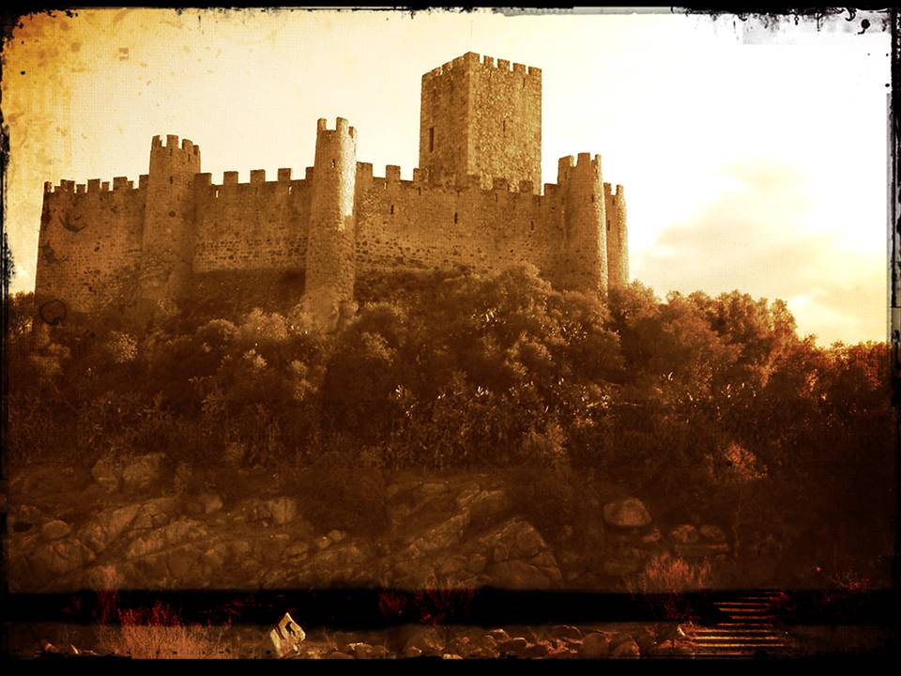
GRACE
in a barren place

Slide 39
Baron Rothschild

Slide 40
GRACE
in a barren place

Slide 41
DAVID
A PROMISE KEEPER

Slide 42
DAVID… a man of his word

Slide 43
Therefore each of you must put off falsehood and speak truthfully to his neighbor, for we are all members of one body. Ephesians 4:25

Slide 44
Do not lie to each other, since you have taken off your old self with its practices. Colossians 3:9

Slide 45
The LORD detests lying lips, but he delights in men who are truthful. Proverbs 12:22

Slide 46
DAVID… a man of his word
Mephibosheth… an object of grace
the LOST SOUGHT
the King’s GRACE EXTENDED

Slide 47
KING
OUR GRACIOUS

Slide 48
He SEARCHED for you

Slide 49
As it is written:
“There is no one righteous, not even one; there is no one who understands, no one who seeks God. All have turned away, they have together become worthless; there is no one who does good, not even one.” Romans 3:10-12

Slide 50
He SEARCHED for you
He ADOPTED you

Slide 51
“he predestined us to be adopted as his sons through Jesus Christ, in accordance with his pleasure and will”
Ephesians 1:5

Slide 52
But when the time had fully come, God sent his Son, born of a woman, born under law, to redeem those under law, that we might receive the full rights of sons. Because you are sons, God sent the Spirit of his Son into our hearts, the Spirit who calls out, “Abba, Father.” So you are no longer a slave, but a son; and since you are a son, God has made you also an heir. Galatians 4:4-7

Slide 53
He SEARCHED for you
He ADOPTED you
He is PREPARING a HOME for you

Slide 54
“Do not let your hearts be troubled. Trust in God; trust also in me. In my Father’s house are many rooms; if it were not so, I would have told you.
I am going there to prepare a place for you.
And if I go and prepare a place for you, I will come back and take you to be with me that you also may be where I am.
John 14:1-3

Slide 55
AMAZING
GRACE
an UNEARNED GIFT to an UNWORTHY SINNER

Slide 56
Table of Grace
Hear the good news,
you’ve been invited
No matter what others say
Your darkest sins will be forgiven
You will always have a place

Slide 57
At the table of grace
the cup’s never empty
The plate’s always full
and it’s never too late
So come and be filled
with love never ending
You’re always welcome
At the table of grace

Slide 58
So come weak and heavy hearted
Don’t try to hide your earthly scars
In His eyes, we all are equal
Don’t be afraid, come as you are

Slide 59
At the table of grace
the cup’s never empty
The plate’s always full
and it’s never too late
So come and be filled
with love never ending
You’re always welcome
At the table of grace

Slide 60
So let the first become the last
Let the poor put kings to shame
Their willing hearts
will be their treasure
By the power of Jesus’ name

Slide 61
At the table of grace
the cup’s never empty
The plate’s always full
and it’s never too late
So come and be filled
with love never ending
You’re always welcome
At the table of grace
TEMPLE BIBLE CHURCH Used by Permission CCLI #78316

