Slide 2
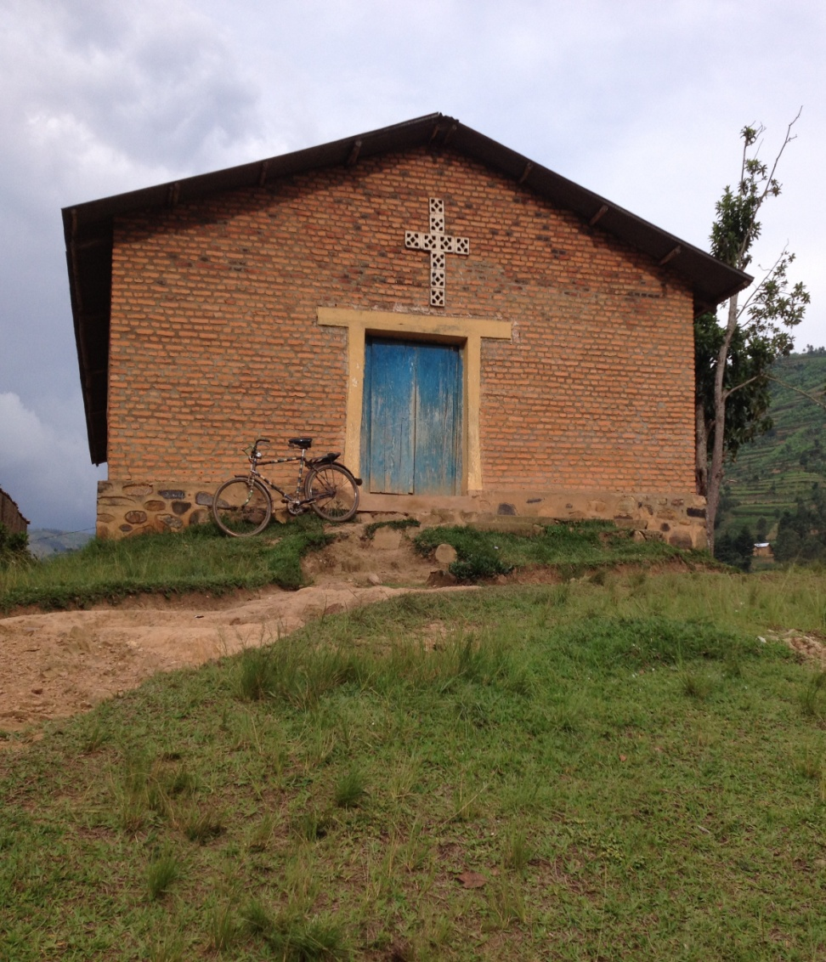
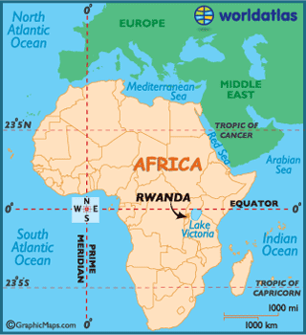

Slide 3
Rwanda ALARM/Sister Church Trip
Prayer Requests:
1)Pray for unity with our new sister Church.
2) Pray for wisdom in planning and protection over travel.
3)Pray that the team will be a reflection of God’s love to the people of Rwanda.

Slide 4
How Great Thou Art
O Lord, my God, when I In awesome wonder Consider all the worlds Thy Hands have made

Slide 5
I see the stars I hear the rolling thunder Thy power throughout the Universe displayed

Slide 6
Then sings my soul My Savior, God to Thee How great Thou art How great Thou art (repeat)

Slide 7
And when I think that God His Son not sparing Sent Him to die I scarce can take it in

Slide 8
That on the cross My burden gladly bearing He bled and died to take away my sin

Slide 9
Then sings my soul My Savior, God to Thee How great Thou art How great Thou art (repeat)
Stuart K. Hine
1949, 1953 Stuart Hine Trust
CCLI 78316

Slide 10
Majestic
O Lord our Lord how majestic Is Your name in all the earth O Lord our Lord how majestic Is Your name in all the earth

Slide 11
The heavens declare Your greatness The oceans cry out to You The mountains they bow down before You So I'll join with the earth
And I’ll give my praise to You

Slide 12
O Lord our Lord how majestic Is Your name in all the earth O Lord our Lord how majestic Is Your name in all the earth

Slide 13
The heavens declare Your greatness The oceans cry out to You The mountains they bow down before You So I'll join with the earth
And I’ll give my praise to You

Slide 14
I will worship You, I will worship You I will worship You, I will worship You We will worship You
We will worship You

Slide 15
The heavens declare Your greatness The oceans cry out to You The mountains they bow down before You So I'll join with the earth and I’ll sing

Slide 16
The heavens declare Your greatness The oceans cry out to You The mountains they bow down before You So I'll join with the earth
And I’ll give my praise to You

Slide 17
Amazing Grace
Amazing grace how sweet the sound That saved a wretch like me I once was lost but now I'm found Was blind but now I see

Slide 18
'Twas grace that taught my heart to fear
And grace my fears relieved How precious did that grace appear The hour I first believed

Slide 19
My chains are gone I've been set free My God my Savior has ransomed me And like a flood His mercy reigns Unending love amazing grace

Slide 20
The Lord has promised good to me His word my hope secures He will my shield and portion be As long as life endures

Slide 21
My chains are gone I've been set free My God my Savior has ransomed me And like a flood His mercy reigns Unending love amazing grace

Slide 22
The earth shall soon dissolve Like snow, The sun forbear to shine But God who called me here below

Slide 23
Will be forever mine Will be forever mine You are forever mine
Louie Giglio, John Newton, Chris Tomlin
2006 sixsteps Music, worshiptogether.com songs, Vamos Publishing
CCLI 78316

Slide 24
How He Loves
He is jealous for me Loves like a hurricane I am a tree, bending beneath The weight of His wind and mercy

Slide 25
When all of a sudden, I am unaware Of these afflictions eclipsed by glory I realize just how beautiful You are And how great Your affections
Are for me

Slide 26
Oh, how He loves us so Oh, how He loves us How He loves us so

Slide 27
He is jealous for me Loves like a hurricane I am a tree, bending beneath The weight of His wind and mercy

Slide 28
When all of a sudden, I am unaware Of these afflictions eclipsed by glory I realize just how beautiful You are And how great Your affections
Are for me

Slide 29
Yeah He loves us
Oh how He loves us Oh how He loves us Oh how He loves
(repeat)

Slide 30
We are His portion And He is our prize Drawn to redemption By the grace in His eyes If grace is an ocean, we're all sinking

Slide 31
So Heaven meets earth Like an unforseen kiss And my heart turns violently Inside of my chest I don't have time to maintain these regrets When I think about the way that

Slide 32
Yeah He loves us
Oh how He loves us Oh how He loves us Oh how He loves

Slide 33
Oh, how He loves us so Oh, how He loves us How He loves us so

Slide 34
Yeah He loves us
Oh how He loves us Oh how He loves us Oh how He loves
John Mark McMillan
2005 Integrity's Hosanna! Music
CCLI 78316

Slide 36
hope
for the hopeless

Slide 37
Don’t give up HOPE on the seemingly HOPELESS
*the HOPELESSNESS of SAUL

Slide 38
BLASPHEMER
VIOLENT
AGGRESSOR
FOREMOST of SINNERS
PERSECUTOR

Slide 39
But Saul began ravaging the church,
entering house after house,
and dragging off men and women,
he would put them in prison.
Acts 8:3

Slide 40
“So then, I thought to myself that I had to do many things hostile to the name of Jesus of Nazareth. And this is just what I did in Jerusalem; not only did I lock up many of the saints in prisons, having received authority from the chief priests, but also when they were being put to death I cast my vote against them.

Slide 41
And as I punished them often in all the synagogues, I tried to force them to blaspheme; and being furiously enraged at them, I kept pursuing them even to foreign cities.
_{Acts 26:9-11}

Slide 42
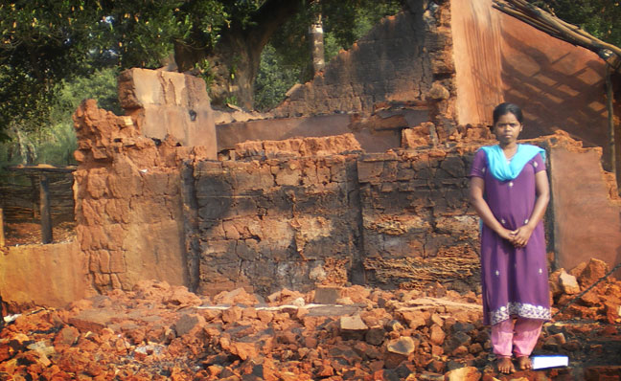

Slide 43
Today, the greatest danger to those who would follow Jesus is not overt persecution by our society, but subtle seduction by its values.
-Tony Campolo

Slide 44
BLASPHEMER
VIOLENT
AGGRESSOR
FOREMOST of SINNERS
PERSECUTOR

Slide 45
Don’t give up HOPE on the seemingly HOPELESS
*the HOPELESSNESS of SAUL
*the TRANSFORMATION to PAUL

Slide 46
ABSOLUTELY NO TRESPASSING
VIOLATORS WILL BE PROSECUTED TO
THE FULLEST EXENT OF THE LAW.
-The Sisters of Mercy

Slide 47
MERCY = not receiving something
we deserve
GRACE = receiving something we don’t deserve

Slide 48
Not just mercy, mind you, but grace.
Grace goes beyond mercy.
Mercy gave Ruth some food.
Grace gave her a husband and a home.
Mercy gave the prodigal son a second chance.
Grace threw him a party.

Slide 49
Mercy prompted the Samaritan to bandage the wounds of the victim.
Grace prompted him to leave his credit card as payment for the victim’s care.
Mercy forgave the thief on the cross.
Grace escorted him to paradise.
Mercy pardons us.
Grace woos and weds us.

Slide 50
All through human history, as far back as recorded time and doubtless before, kings, princes, tribal chiefs, presidents, and dictators have sent their subjects into battle to die for them.

Slide 51
Only once in human history has a king not sent his subjects to die for him, but instead, died for his subjects.
This is the King who introduces the Kingdom that cannot be shaken, because this King reigns eternally.

Slide 52
Don’t give up HOPE on the seemingly HOPELESS
*the HOPELESSNESS of SAUL
*the TRANSFORMATION to PAUL

Slide 53
Paul’s was GRATEFUL because he was allowed to…
SERVE

Slide 54
Paul’s was GRATEFUL because he was allowed to…
SERVE
be an EXAMPLE

Slide 55
A TRANFORMED HEART
is a HEART filled with PRAISE!!

Slide 56
hope
for the hopeless

Slide 57
Blessed Assurance
Blessed assurance, Jesus is mine O, what a foretaste of glory divine Heir of salvation, purchase of God Born of His Spirit, And I'm washed in His blood

Slide 58
This is my story, this is my song Praising my Savior all the day long This is my story, this is my song Praising my Savior all the day long

Slide 59
Perfect submission, all is at rest I in my Savior am happy and blessed Watching and waiting, looking above Filled with His goodness Lost in His love

Slide 60
This is my story, this is my song Praising my Savior all the day long This is my story, this is my song Praising my Savior all the day long

Slide 61
Perfect submission, perfect delight Visions of rapture now burst on my sight Angels descending, bring from above Echoes of mercy, sweet whispers of love

Slide 62
This is my story, this is my song Praising my Savior all the day long This is my story, this is my song Praising my Savior all the day long
Fanny Jane Crosby, Phoebe P. Knapp
2001 Public Domain
CCLI 78316

