Slide 2
O Come Let Us Adore Him
O come let us adore Him O come let us adore Him O come let us adore Him Christ the Lord

Slide 3
For You alone are worthy For You alone are worthy For You alone are worthy Christ the Lord

Slide 4
We'll give You all the glory, We'll give You all the glory, We'll give You all the glory Christ the Lord

Slide 5
O come let us adore Him O come let us adore Him O come let us adore Him Christ the Lord

Slide 6
Angels, From the Realms of Glory
Angels from the realms of glory
Wing your flight over all the earth
Ye who sang creation’s story
Now proclaim Messiah’s birth

Slide 7
Shepherds in the fields abiding
Watching over your flocks by night
God with man is now residing
Yonder shines the Infant Light

Slide 8
Come and worship, come and worship
Come and worship Christ the newborn King
Come and worship, come and worship
Come and worship Christ the newborn King

Slide 9
Sinners wrung with true repentance
Doomed for guilt to endless pain
Justice now revokes the sentence
Mercy calls you, break your chains

Slide 10
Come and worship, come and worship
Come and worship Christ the newborn King
Come and worship, come and worship
Come and worship Christ the newborn King

Slide 11
Though an infant now we view Him
He shall fill His father’s throne
Gather all the nations to Him
Every knee shall then bow down

Slide 12
All creation join in praising
God the Father, Spirit, Son
Evermore your voices raising
To the eternal Three in One

Slide 13
Come and worship, come and worship
Come and worship Christ the newborn King
Come and worship, come and worship
Come and worship Christ the newborn King
Come and worship Christ the newborn King
Temple Bible Church Used by Permission CCLI#78316

Slide 14
Offering
Over the skies of Bethlehem appeared a star While angels sang to lowly shepherds Three wise men seeking truth traveled from afar
Hoping to find the Child from heaven

Slide 15
Falling on their knees
They bowed before the humble
Prince of Peace

Slide 16
I bring an offering of Worship to our King No one on earth deserves the praises
That I sing

Slide 17
Jesus, may You receive the Honor that You're due O Lord, I bring an offering to You

Slide 18
The sun cannot compare to the Glory of Your love There is no shadow in Your presence

Slide 19
No mortal man would dare
To stand before Your throne Before the Holy One of heaven

Slide 20
It’s only by Your blood
And it’s only through Your mercy
Lord, I come

Slide 21
I bring an offering of worship to my King No one on earth deserves the praises that I sing
Jesus may You receive the honor that You’re due
O Lord I bring an offering to You

Slide 22
We bring an offering of worship to my King No one on earth deserves the praises that we sing
Jesus may You receive the honor that You’re due
O Lord we bring an offering to You
Paul Baloche
2002 Integrity's Hosanna! Music
CCLI 78316

Slide 23
Glory In The Highest
You are the first
You go before You are the last Lord, You're the encore

Slide 24
Your name's in lights
For all to see The starry hosts
Declare Your glory

Slide 25
Glory in the highest Glory in the highest Glory in the highest

Slide 26
Apart from You
There is no God Light of the world
The bright and morning star

Slide 27
Your name will shine
For all to see You are the One
You are my glory

Slide 28
Glory in the highest Glory in the highest Glory in the highest

Slide 29
And no one else could ever compare to You, Lord All the earth together declare

Slide 30
Glory in the highest Glory in the highest Glory in the highest
To You Lord (repeat)

Slide 31
The heavenly host proclaim Your Birth
Glory to God, and peace beyond the earth
Your name is near, Emmanuel
God with us here, God pleased with us to dwell

Slide 32
5:00
6:30

Slide 34
The NATURE of the ONE who was SENT

Slide 35
The NATURE of the ONE who was SENT

Slide 36
the EXAMPLE of the SENT ONE

Slide 37
Think of yourselves the way Christ Jesus thought of himself.
He had equal status with God but didn't think so much of himself that he had to cling to the advantages of that status no matter what. Not at all. When the time came, he set aside the privileges of deity and took on the status of a slave, became human!

Slide 38
Having become human, he stayed human. It was an incredibly humbling process. He didn't claim special privileges. Instead, he lived a selfless, obedient life and then died a selfless, obedient death—and the worst kind of death at that—a crucifixion.
Philippians 2:5-8 Message

Slide 39
The EXAMPLE of the
SENT ONE
He laid aside His STATUS

Slide 40
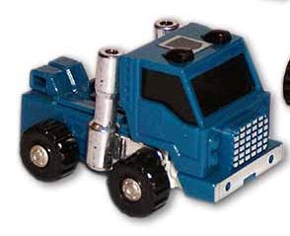

Slide 41
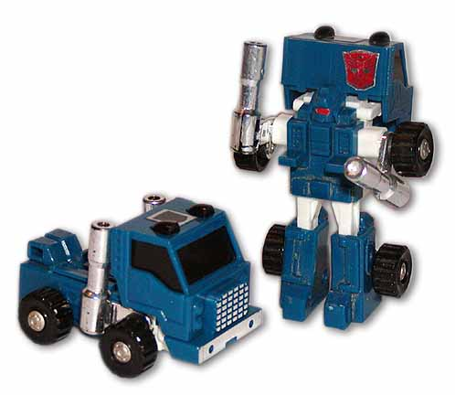

Slide 42
In the beginning was the Word,
and the Word was with God,
and the Word was God.
He was with God in the beginning.
John 1:1-2

Slide 43
You believe that God is one. You do well; the demons also believe, and shudder.
James 2:19

Slide 44
The EXAMPLE of the
SENT ONE
He laid aside His STATUS

Slide 45
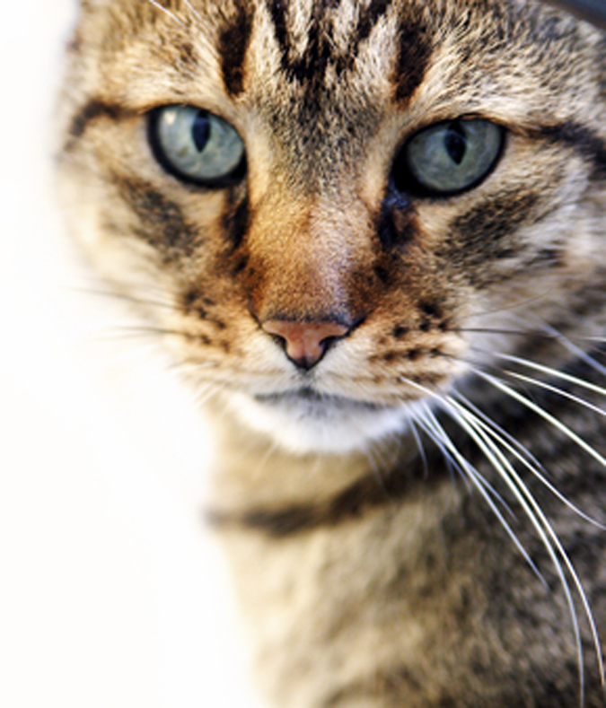
Cat Theology
You feed me,
you care for me,
you give me shelter and
provide for all my needs
- I must be wonderful!

Slide 46
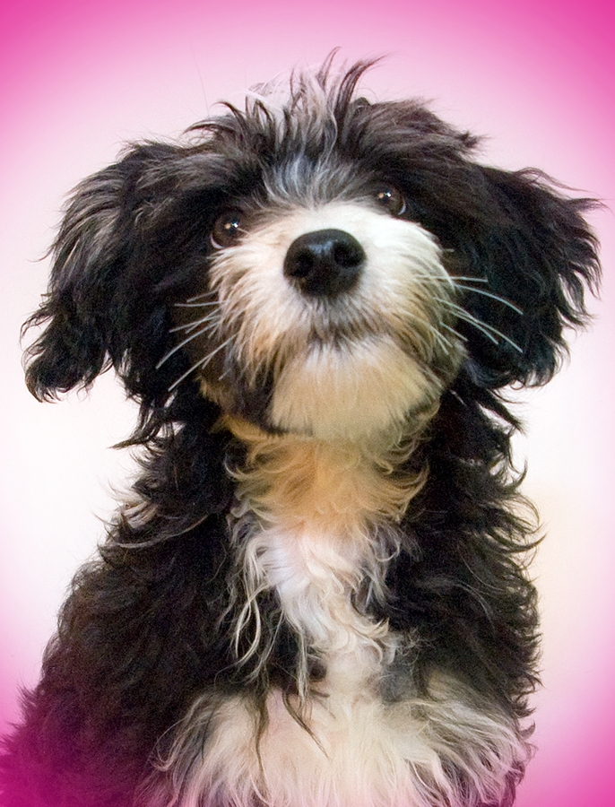
Dog Theology
You feed me,
you care for me,
you give me shelter and
provide for all my needs
- you must be wonderful!

Slide 47
The EXAMPLE of the
SENT ONE
He had the HEART of a SERVANT

Slide 48
When the time came, he set aside the privileges of deity and took on the status of a slave, became human! Having become human, he stayed human. It was an incredibly humbling process. He didn't claim special privileges.
Philippians 2:7 Message

Slide 49
The EXAMPLE of the
SENT ONE
He had the HEART of
a SERVANT

Slide 50
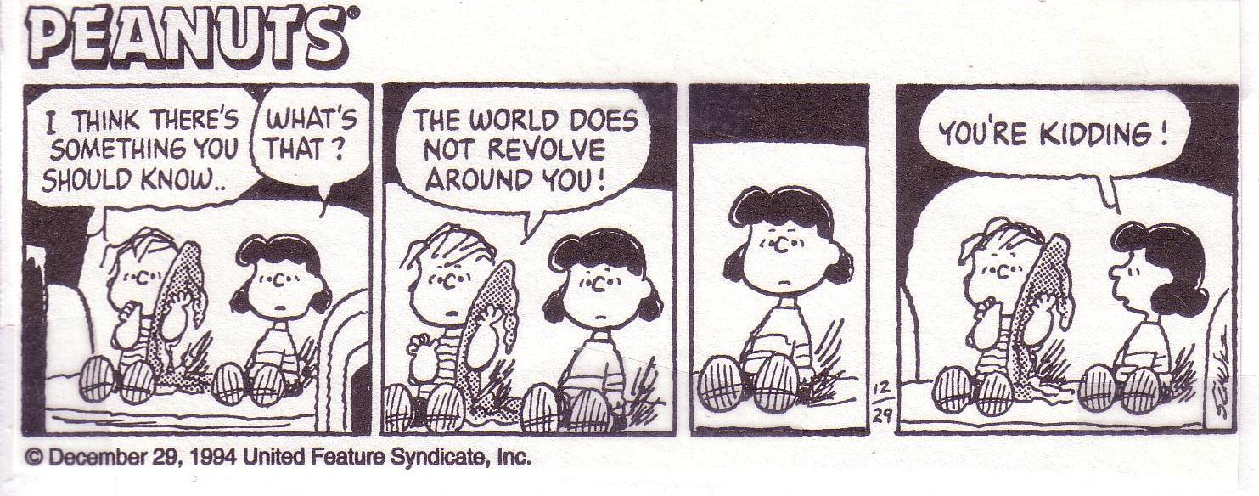

Slide 51
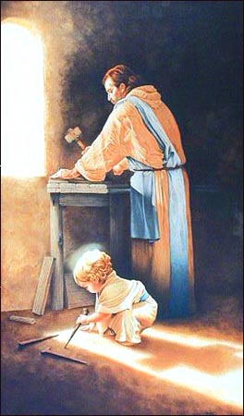
The EXAMPLE of the
SENT ONE
He gave His life in
SACRIFICIAL obedience

Slide 52
The EXALTATION
of the
SENT ONE

Slide 53
The BABE
in the MANAGER
is the HUMBLE KING
of the UNIVERSE!

