Slide 1
Welcome to Temple Bible Church

Slide 2
Kids Christmas Choir

Slide 3
Born That We May Have Life
No reputation
No stately bearing No palace bed for royalty
Notes:
No reputation
No stately bearing No palace bed for royalty

Slide 4
But a star in the heavens A sign full of wonder Announcing the coming Of the King of kings
Notes:
But a star in the heavens A sign full of wonder Announcing the coming Of the King of kings

Slide 5
Rejoice O world Your Savior has come Through the love of a virgin's womb Son of God, Son of man Born that we may have life
You were born that we may have life
Notes:
Rejoice O world Your Savior has come Through the love of a virgin's womb Son of God, Son of man Born that we may have life
You were born that we may have life

Slide 6
A throne in a manger A cross in a cradle The hidden revealing
This glorious plan
Notes:
A throne in a manger A cross in a cradle The hidden revealing
This glorious plan

Slide 7
Of the Child who would suffer The Child who would conquer The sin of every woman The sin of every man
Notes:
Of the Child who would suffer The Child who would conquer The sin of every woman The sin of every man

Slide 8
Rejoice O world Your Savior has come Through the love of a virgin's womb Son of God, Son of man Born that we may have life
You were born that we may have life
Notes:
Rejoice O world Your Savior has come Through the love of a virgin's womb Son of God, Son of man Born that we may have life

Slide 9
Rejoice O world Your Savior has come Through the love of a virgin's womb Son of God, Son of man Born that we may have life
Notes:
Rejoice O world Your Savior has come Through the love of a virgin's womb Son of God, Son of man Born that we may have life

Slide 10
You were born that we may have life
You were born that we may have life
You were born that we may have life
Ed Cash, Matt Maher, Chris Tomlin
2009 Thankyou Music, Alletrop Music, Vamos Publishing, sixsteps Music
CCLI 78316
Notes:
You were born that we may have life
You were born that we may have life
You were born that we may have life
You were born that we may have life

Slide 11
O Come All Ye Faithful
O come, all ye faithful Joyful and triumphant O come ye, O come ye to Bethlehem Come and behold Him Born the King of angels
Notes:
O come, all ye faithful Joyful and triumphant O come ye, O come ye to Bethlehem Come and behold Him Born the King of angels

Slide 12
O come let us adore Him Come let us adore Him O come let us adore Him Christ the Lord
Notes:
O come let us adore Him Come let us adore Him O come let us adore Him Christ the Lord

Slide 13
Sing choirs of angels Sing in exultation O sing, all ye citizens of heaven above Glory to God Glory in the highest
Notes:
Sing choirs of angels Sing in exultation O sing, all ye citizens of heaven above Glory to God Glory in the highest

Slide 14
O come let us adore Him Come let us adore Him O come let us adore Him Christ the Lord
Notes:
O come let us adore Him Come let us adore Him O come let us adore Him Christ the Lord

Slide 15
For He alone is worthy
For He alone is worthy
O come let us adore Him, Christ the Lord
Notes:
O come let us adore Him Come let us adore Him O come let us adore Him Christ the Lord

Slide 16
Yea, Lord, we greet Thee Born this happy morning Jesus, to Thee be all glory given Word of the Father Now in flesh appearing
Notes:
Yea, Lord, we greet Thee Born this happy morning Jesus, to Thee be all glory given Word of the Father Now in flesh appearing

Slide 17
O come let us adore Him Come let us adore Him O come let us adore Him Christ the Lord
Frederick Oakeley, John Francis Wade
1751 Public Domain, 1998 Mercy / Vineyard Publishing
CCLI 78316
Notes:
O come let us adore Him Come let us adore Him O come let us adore Him Christ the Lord

Slide 18
Angels We Have Heard on High
Angels we have heard on high Sweetly singing o'er the plains And the mountains in reply Echoing their joyous strains
Notes:
Angels we have heard on high Sweetly singing o'er the plains And the mountains in reply Echoing their glorious strains

Slide 19
Gloria In excelsis deo Gloria In excelsis deo
Notes:
Gloria In excelsis deo Gloria In excelsis deo

Slide 20
Shepherds why this jubilee Why your joyous strains prolong Say what may the tidings be Which inspire your heavenly song
Notes:
Shepherds why this jubilee Why your joyous strains prolong What the gladsome tidings be Which inspire you're heavenly song

Slide 21
Gloria In excelsis deo Gloria In excelsis deo
Notes:
Gloria In excelsis deo Gloria In excelsis deo

Slide 22
Come to Bethlehem and see Him Whose birth the angels sing Come adore on bended knee Christ the Lord the newborn king
Notes:
Come to Bethlehem and see Him Whose birth the angels sing Come adore on bended knee Christ the Lord the newborn king

Slide 23
Gloria In excelsis deo Gloria In excelsis deo
Traditional , James Chadwick, Chris Tomlin
2009 Vamos Publishing, worshiptogether.com songs, sixsteps Music
CCLI 78316
Notes:
Gloria In excelsis deo Gloria In excelsis deo

Slide 24
Christmas Eve Services
5pm and 6:30pm
No more 8:15am services.
Will resume on Jan 13th!
Church Office Closed on
Dec 25th, 26th, 31st, & Jan 1st
Holiday Schedule

Slide 28
if HE had
not been SENT

Slide 29
if HE had not been SENT
there would be no REDEMPTION
we would still be in SIN

Slide 30
Matthew 1:21
She will bear a Son;
and you shall call His name Jesus, for He will save His people from their sins.”

Slide 31
Matthew 1:21
She will bear a Son;
and you shall call His name Jesus, for He will save His people from their sins.”

Slide 32
Luke 2:11
..for today in the city of David there has been born for you a SAVIOR, who is Christ the Lord...

Slide 33
Luke 2:29-30
“Now Lord, You are releasing Your bond-servant to depart in peace, according to Your word; For my eyes have seen Your SALVATION.”

Slide 34
Luke 2:38
At that very moment she came up and began giving thanks to God, and continued to speak of Him to all those who were looking for the REDEMPTION of Jerusalem.

Slide 35
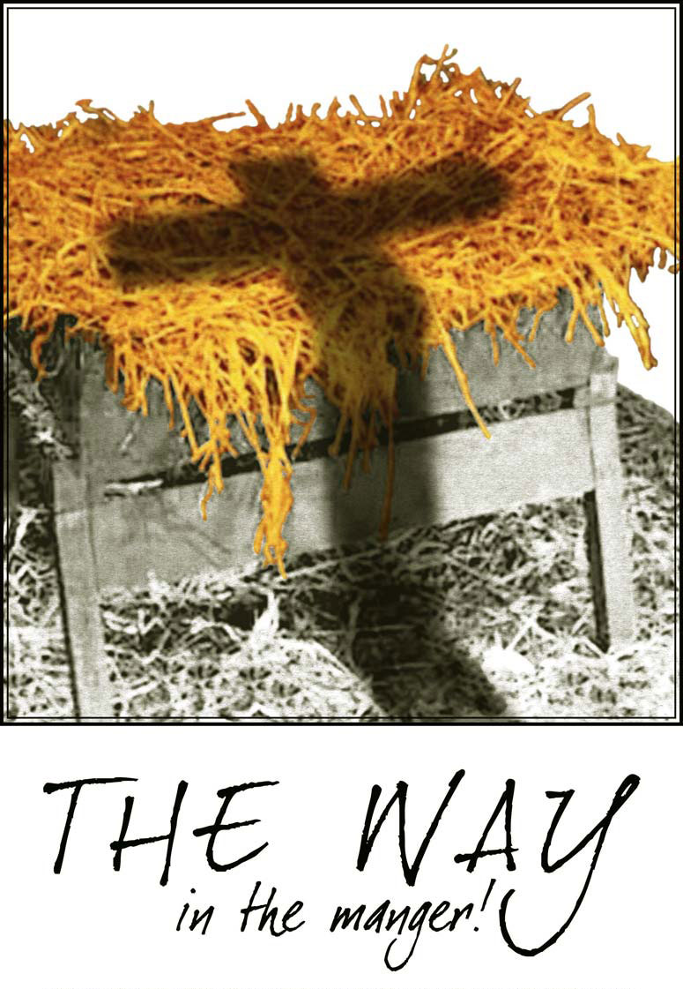

Slide 36
Unless you see the cross
overshadowing the cradle,
we will have lost the real meaning of Christ’s birth.

Slide 37
Hostages in hands of an evil captor yearn for freedom. At the appointed hour a loving Father leaves the ransom for a world held hostage by sin; a bundle wrapped in swaddling clothes lying in a manger.

Slide 38
Who are thou,
precious little babe,
nestled in the hay?
God I am, come to earth this day.
Why didst thou come,
sweet little babe, nestled in the hay?

Slide 39
To die I came,
the price of sin to pay. Who’s sin, tender little babe,
nestled in the hay? Yours it was,
that brought me down today.

Slide 41
if HE had not been SENT
there would be no LIGHT
we would still be in DARKNESS

Slide 42
Luke 2:30-32
For my eyes have seen Your salvation, Which You have prepared in the presence of all peoples, a LIGHT of revelation to the Gentiles, And the glory of Your people Israel.”

Slide 43
John 12:46
I have come as LIGHT into the world, so that everyone who believes in Me will not remain in darkness.

Slide 44
if HE had not been SENT
there would be no PEACE
we would still be in CHAOS

Slide 45
Isaiah 9:6
For a child will be born to us,
a son will be given to us; And the government will rest on His shoulders; And His name will be called Wonderful Counselor, Mighty God, Eternal Father, PRINCE of PEACE.

Slide 46
“Worship and worry cannot live in the same heart:
they are mutually exclusive.
-Ruth Bell Graham

Slide 47
if HE had not been SENT
there would be no WORSHIP
we would still be in BONDAGE

Slide 48
Matthew 2:2
“Where is He who has been born King of the Jews?
For we saw His star in the east
and have come to WORSHIP Him.”

Slide 49
Matthew 2:11
After coming into the house they saw the Child with Mary His mother; and they fell to the ground and WORSHIPED Him.
Then, opening their treasures, they presented to Him gifts of gold, frankincense, and myrrh.

Slide 50
Luke 2:13-14
And suddenly there appeared with the angel a multitude of the heavenly host PRAISING God and saying,
“Glory to God in the highest, And on earth peace among men with whom He is pleased.”

Slide 51
Luke 2:20
The shepherds went back,
GLORIFYING and PRAISING God
for all that they had heard and seen, just as had been told.

Slide 52
Luke 2:28
then he took Him into his arms,
and BLESSED God.

Slide 53
Luke 2:38
At that very moment she came up and began GIVING THANKS to God,
and continued to speak of Him to all those who were looking for the redemption of Jerusalem.

Slide 54
if HE had not been SENT
there would be no WORSHIP
we would still be in BONDAGE

Slide 55
Because HE was SENT
we can have ETERNAL
and ABUNDANT life

Slide 56
John 10:10
The thief comes only to steal and kill and destroy; I came that they may have life, and have it abundantly.

Slide 57
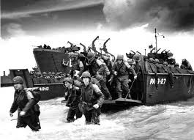

Slide 58
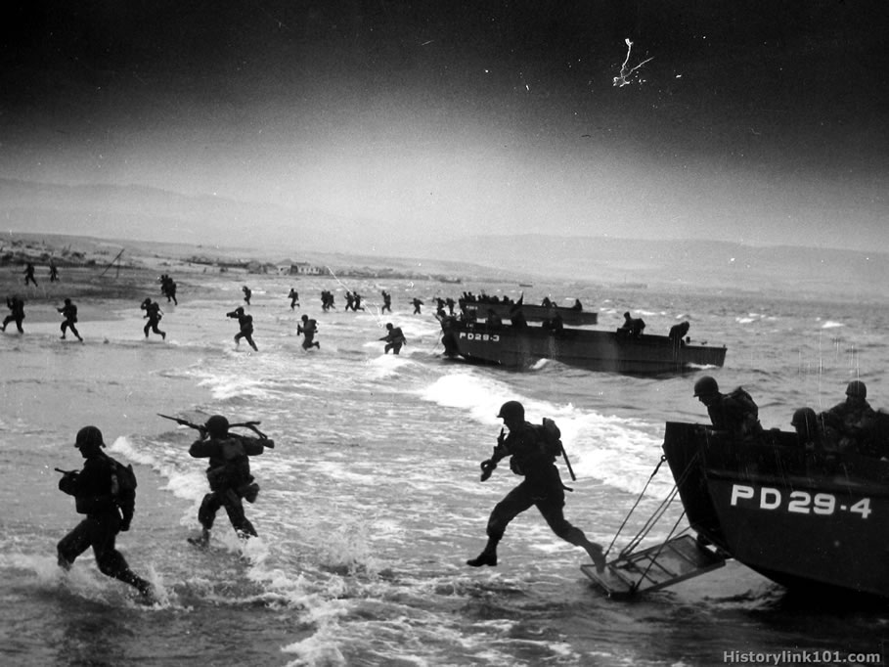

Slide 59
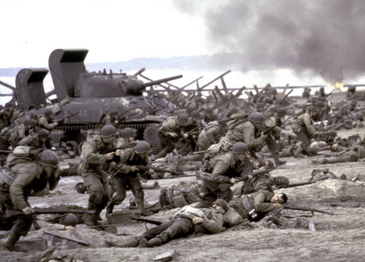

Slide 60
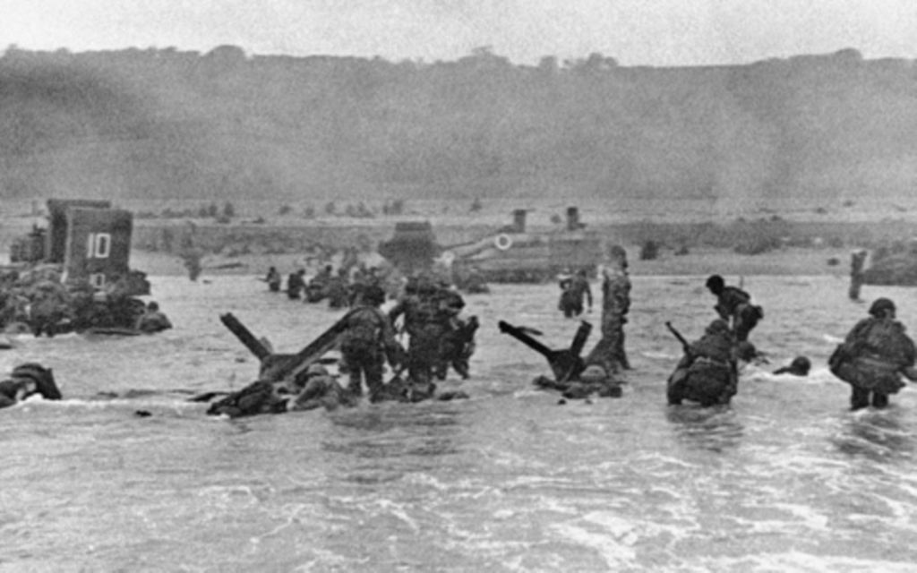

Slide 61
The revolutionary nature of God’s invasion of our world is far more significant than all the other invasions of history taken together.
This one established the possibility of the rule of God in every human heart and began the reclamation of our world as God’s own.

Slide 62
Because HE was SENT
we can have ETERNAL
and ABUNDANT life

Slide 64
Light of the Stable
Hail, hail to the newborn king
Let our voices sing Him our praises
Hail, hail to the guiding light
That brought us tonight to our Savior
Notes:
Hail, hail to the newborn king
Let our voices sing Him our praises
Hail, hail to the guiding light
That brought us tonight to our Savior

Slide 65
Alle alleluia, alle, alleluia
Alle alleluia, alle, alleluia
Notes:
Alle alleluia, alle, alleluia
Alle alleluia, alle, alleluia

Slide 66
Come now, there it shines so bright
To the knowing light of the stable
Lean close to the child so dear
Cast aside your fear and be thankful
Notes:
Come now, there it shines so bright
To the knowing light of the stable
Lean close to the child so dear
Cast aside your fear and the thankful

Slide 67
Hail, hail to the newborn king
Let our voices sing Him our praises
Hail, hail to the guiding light
That brought us tonight to our Savior
Notes:
Hail, hail to the newborn king
Let our voices sing Him our praises
Hail, hail to the guiding light
That brought us tonight to our Savior

Slide 68
Alle alleluia, alle, alleluia
Alle alleluia, alle, alleluia
Steve and Elizabeth Rhymer
Notes:
Alle alleluia, alle, alleluia
Alle alleluia, alle, alleluia

Slide 69
My Soul Magnifies The Lord
Good news of great joy For every woman every man This will be a sign to you a Baby born in Bethlehem Come and worship do not be afraid
Notes:
Good news of great joy For every woman every man This will be a sign to you a Baby born in Bethlehem Come and worship do not be afraid

Slide 70
A company of angels Glory in the highest And on the earth peace among Those on whom His favor rests Come and worship do not be afraid
Come and worship do not be afraid
Notes:
A company of angels Glory in the highest And on the earth peace among Those on whom His favor rests Come and worship do not be afraid

Slide 71
My soul my soul magnifies the Lord My soul magnifies the Lord He has done great things for me Great things for me
Notes:
My soul my soul magnifies the Lord My soul magnifies the Lord He has done great things for me Great things for me

Slide 72
Unto you a child is born Unto us a Son is given Let every heart prepare His throne
Let every nation under Heaven Come and worship do not be afraid
Come and worship do not be afraid
Notes:
Unto you a child is born Unto us a Son is given Let every heart prepare His throne
Let every nation under Heaven Come and worship do not be afraid

Slide 73
My soul my soul magnifies the Lord My soul magnifies the Lord He has done great things for me Great things for me
Notes:
My soul my soul magnifies the Lord My soul magnifies the Lord He has done great things for me Great things for me

Slide 74
Of His government there will be no end He'll establish it with His Righteousness And He shall reign on David's throne
And His name shall be from this day on
Notes:
Of His government there will be no end He'll establish it with His Righteousness And He shall reign on David's throne
And His name shall be from this day on

Slide 75
Wonderful, Counselor, Everlasting Father
Wonderful, Counselor, Everlasting Father
Notes:
Wonderful, Counselor, Everlasting Father
Wonderful, Counselor, Everlasting Father

Slide 76
My soul my soul magnifies the Lord My soul magnifies the Lord He has done great things for me Great things for me
Daniel Carson, Chris Tomlin
2009 Vamos Publishing, worshiptogether.com songs, sixsteps Music
CCLI 78316
Notes:
My soul my soul magnifies the Lord My soul magnifies the Lord He has done great things for me Great things for me

Slide 77
ALL THE POOR AND POWERLESS
All the poor and powerless And all the lost and lonely All the thieves will come confess And know that You are holy And know that You are holy
Notes:
All the poor and powerless And all the lost and lonely All the thieves will come confess And know that You are holy And know that You are holy

Slide 78
And all will sing out Hallelujah And we will cry out Hallelujah
Notes:
And all will sing out Hallelujah And we will cry out Hallelujah

Slide 79
All the hearts who are content And all who feel unworthy And all who hurt with nothing left Will know that You are holy Will know that You are holy
Notes:
All the hearts who are content And all who feel unworthy And all who hurt with nothing left Will know that You are holy Will know that You are holy

Slide 80
And all will sing out Hallelujah And we will cry out Hallelujah
Notes:
And all will sing out Hallelujah And we will cry out Hallelujah

Slide 81
Shout it Go on scream it from the mountains Go on and tell it to the masses That He is God
Notes:
Shout it Go on scream it from the mountains Go on and tell it to the masses That He is God

Slide 82
And all will sing out Hallelujah And we will cry out Hallelujah
Digital Age
CCLI 78316
Notes:
And all will sing out Hallelujah And we will cry out Hallelujah

