Slide 2
Joy To The World
Joy to the world
The Lord is come Let earth receive her King
Notes:
Joy to the world
The Lord is come Let earth receive her King

Slide 3
Let every heart prepare Him room And Heaven and nature sing And Heaven and nature sing And Heaven and Heaven and nature sing
Notes:
Let every heart prepare Him room And Heaven and nature sing And Heaven and nature sing And Heaven and Heaven and nature sing

Slide 4
Joy to the world
The Savior reigns
Let all their songs employ While fields and floods Rocks hills and plains
Notes:
Joy to the world
The Savior reigns
Let all their songs employ While fields and floods Rocks hills and plains

Slide 5
Repeat the sounding joy Repeat the sounding joy Repeat, repeat the sounding joy
Notes:
Repeat the sounding joy
Repeat the sounding joy Repeat, repeat the sounding joy

Slide 6
Joy, unspeakable joy An overflowing well No tongue can tell
Notes:
Joy, unspeakable joy An overflowing well No tongue can tell

Slide 7
Joy, unspeakable joy It rises in my soul Never lets me go
Notes:
Joy, unspeakable joy It rises in my soul Never lets me go

Slide 8
He rules the world With truth and grace And makes the nations prove The glories of His righteousness
Notes:
He rules the world With truth and grace And makes the nations prove The glories of His righteousness

Slide 9
And wonders of His love And wonders of His love And wonders, wonders of His love
Notes:
And wonders of His love And wonders of His love And wonders, wonders of His love

Slide 10
Joy, unspeakable joy An overflowing well No tongue can tell
Notes:
Joy, unspeakable joy An overflowing well No tongue can tell

Slide 11
Joy, unspeakable joy It rises in my soul Never lets me go
Ed Cash, Matt Gilder, Chris Tomlin
2009 Ryan House Music, Alletrop Music, Vamos Publishing, sixsteps Music
CCLI 78316
Notes:
Joy, unspeakable joy It rises in my soul Never lets me go

Slide 12
Angels, From the Realms of Glory
Angels from the realms of glory
Wing your flight over all the earth
Ye who sang creation’s story
Now proclaim Messiah’s birth

Slide 13
Shepherds in the fields abiding
Watching over your flocks by night
God with man is now residing
Yonder shines the Infant Light

Slide 14
Come and worship, come and worship
Come and worship Christ the newborn King
Come and worship, come and worship
Come and worship Christ the newborn King

Slide 15
Sinners wrung with true repentance
Doomed for guilt to endless pain
Justice now revokes the sentence
Mercy calls you, break your chains

Slide 16
Come and worship, come and worship
Come and worship Christ the newborn King
Come and worship, come and worship
Come and worship Christ the newborn King

Slide 17
Though an infant now we view Him
He shall fill His father’s throne
Gather all the nations to Him
Every knee shall then bow down

Slide 18
All creation join in praising
God the Father, Spirit, Son
Evermore your voices raising
To the eternal Three in One

Slide 19
Come and worship, come and worship
Come and worship Christ the newborn King
Come and worship, come and worship
Come and worship Christ the newborn King
Come and worship Christ the newborn King
Come and worship Christ the newborn King
Temple Bible Church Used by Permission CCLI#78316

Slide 20
Offering
Over the skies of Bethlehem appeared a star While angels sang to lowly shepherds Three wise men seeking truth traveled from afar
Hoping to find the Child from heaven

Slide 21
Falling on their knees
They bowed before the humble
Prince of Peace

Slide 22
I bring an offering of Worship to my King No one on earth deserves the praises
That I sing

Slide 23
Jesus, may You receive the Honor that You're due O Lord, I bring an offering to You

Slide 24
The sun cannot compare to the Glory of Your love There is no shadow in Your presence

Slide 25
No mortal man would dare
To stand before Your throne Before the Holy One of heaven

Slide 26
It’s only by Your blood
And it’s only through Your mercy
Lord, I come

Slide 27
I bring an offering of worship to my King No one on earth deserves the praises that I sing
Jesus may You receive the honor that You’re due
O Lord I bring an offering to You
Paul Baloche
2002 Integrity's Hosanna! Music
CCLI 78316

Slide 28
We bring an offering of worship to our King No one on earth deserves the praises that we sing
Jesus may You receive the honor that You’re due
O Lord we bring an offering to You
O Lord we bring an offering to You
O Lord we bring an offering to You
Paul Baloche
2002 Integrity's Hosanna! Music
CCLI 78316

Slide 29
We Fall Down
We fall down, we lay our crowns At the feet of Jesus, The greatness of mercy and love At the feet of Jesus

Slide 30
And we cry, "Holy, holy, holy," And we cry, "Holy, holy, holy," And we cry, "Holy, holy Holy is the Lamb
Chris Tomlin
1998 worshiptogether.com songs
CCLI 78316

Slide 31
Agnus Dei
Alleluia, Alleluia, For the Lord, God almighty reigns Alleluia, Alleluia, For the Lord, God almighty reigns Alleluia

Slide 32
Holy, Holy Are You Lord, God almighty Worthy is the Lamb Worthy is the Lamb

Slide 33
For You are holy, holy Are You Lord, God almighty Worthy is the Lamb Worthy is the Lamb
Amen
Michael W. Smith
1990 Sony/ATV Milene Music
CCLI 78316

Slide 35
The House God Built

Slide 37
...You are not the one to build me a house to dwell in. I have not dwelt in a house from the day I brought Israel up out of Egypt to this day...did I ever say to any of their leaders whom I commanded to shepherd my people, why have you not built me a house of cedar?
1 Chronicles 17:4-6

Slide 38
"...I took you from the pasture and from following the flock to be ruler over my people Israel. I have been with you wherever you have gone and I have cut off all your enemies from before you."
1 Chronicles 17:7-8

Slide 40
" Now I will make your name like the names of the greatest men of the earth.
...I declare to you that the Lord will build a house for you: When your days are over and you go to be with your fathers, I will raise up your offspring to succeed you, one of your own sons, and I will establish his kingdom.

Slide 41
He is the one who will build a house for me, and I will establish his throne forever. I will be his father, and he will be my son...I will set him over my house and my kingdom forever, his throne will be established forever. "
1 Chronicles 17: 8 &10-14

Slide 43
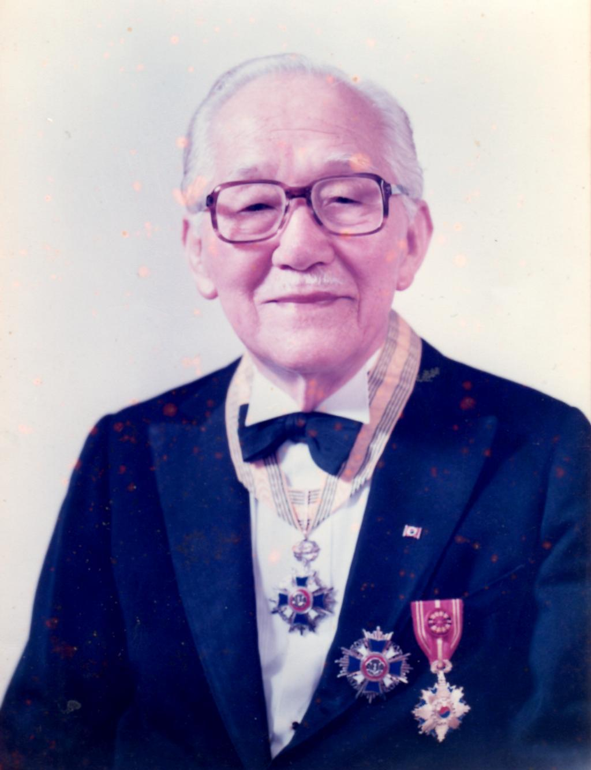
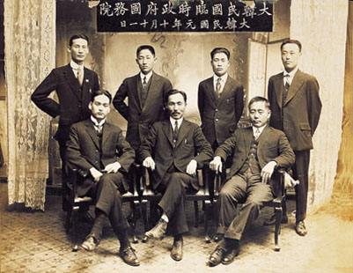

Slide 45
Jesus left the temple and was walking away when his disciples came up to him to call his attention to its buildings.
“Do you see all these things?” he asked.
“Truly I tell you, not one stone here will be left on another; everyone will be thrown down.”
Matthew 24:1-2

Slide 46
At that time Jesus went through the grain fields on the Sabbath. His disciples were hungry and began to pick some heads of grain and eat them. When the Pharisees saw this, they said to him,
“Look! Your disciples are doing what is unlawful on the Sabbath.” He answered, “Haven’t you read what David did when he and his companions were hungry?

Slide 47
He entered the house of God, and he and his companions ate the consecrated bread—which was not lawful for them to do, but only for the priests. Or haven’t you read in the Law that the priests on Sabbath duty in the temple desecrate the Sabbath and yet are innocent? I tell you that something greater than the temple is here.
Matthew 12:1-6

