Slide 2
My Soul Magnifies The Lord
Good news of great joy For every woman every man This will be a sign to you a Baby born in Bethlehem Come and worship do not be afraid

Slide 3
A company of angels Glory in the highest And on the earth peace among Those on whom His favor rests Come and worship do not be afraid

Slide 4
My soul my soul magnifies the Lord My soul magnifies the Lord He has done great things for me Great things for me

Slide 5
Unto you a child is born Unto us a Son is given Let every heart prepare His throne
Let every nation under Heaven Come and worship do not be afraid

Slide 6
My soul my soul magnifies the Lord My soul magnifies the Lord He has done great things for me Great things for me

Slide 7
Of His government there will be no end He'll establish it with His Righteousness And He shall reign on David's throne
And His name shall be from this day on

Slide 8
Wonderful, Counselor, Everlasting Father

Slide 9
My soul my soul magnifies the Lord My soul magnifies the Lord He has done great things for me Great things for me
Daniel Carson, Chris Tomlin
2009 Vamos Publishing, worshiptogether.com songs, sixsteps Music
CCLI 78316

Slide 10
What a Savior
Atoning sacrifice, Keeper of this life Hallelujah, You are Savior Beginning and the end Forgiver of my sin By Your mercy You have saved us

Slide 11
Jesus, You are stronger More than any other Hallelujah, what a Savior Jesus, You are higher My soul’s deepest desire Hallelujah, You are Savior

Slide 12
You are the Shepherd King You lead us by still waters Hallelujah, You are Savior You are my only hope Your kindness is my friend In Your presence You restore us

Slide 13
Jesus, You are stronger More than any other Hallelujah, what a Savior Jesus, You are higher My soul’s deepest desire Hallelujah, You are Savior

Slide 14
You are the way The truth and the life You are my joy and my salvation Stood in my place, taking my shame Upon Your shoulders

Slide 15
Jesus, You are stronger More than any other Hallelujah, what a Savior Jesus, You are higher My souls deepest desire Hallelujah, You are Savior
Laura Story
CCLI 78316

Slide 16
You Are God Alone
You are not a God created By human hands You are not a God dependent On any mortal man

Slide 17
You are not a God in need of Anything we can give By Your plan
That's just the way it is

Slide 18
You are not a God created By human hands You are not a God dependent On any mortal man

Slide 19
You are not a God in need of Anything we can give By Your plan
That's just the way it is

Slide 20
You are God alone
From before time began You were on Your throne You were God alone

Slide 21
And right now
In the good times and bad You are on Your throne You are God alone

Slide 22
You're the only God whose Power
None can contend You're the only God whose name And praise will never end

Slide 23
You're the only God who's
Worthy of everything we can give You are God
That's just the way it is

Slide 24
You are God alone From before Time began You were on Your throne You were God alone

Slide 25
And right now
in the good times and bad You are on Your throne You are God alone

Slide 26
Unchangeable, unshakeable Unstoppable, that's what You are
(repeat)

Slide 27
You are God alone From before time began You were on Your throne You were God alone

Slide 28
And right now
In the good times and bad You are on Your throne You are God alone

Slide 29
Unchangeable, unshakeable Unstoppable, that's what You are
Billy Foote, Cindy Foote
2004 Integrity's Hosanna! Music, Billy Foote Music (Admin. by Integrity Music)
CCLI 78316

Slide 30
How Great is Our God
How great is our God Sing with me, how great is our God And all will see how great How great is our God

Slide 31
The splendor of the King Clothed in majesty Let all the earth rejoice All the earth rejoice

Slide 32
He wraps Himself in the light And darkness tries to hide And trembles at His voice
Trembles at His voice

Slide 33
How great is our God Sing with me, how great is our God And all will see how great How great is our God

Slide 34
And age to age He stands And time is in His hands Beginning and the End Beginning and the End

Slide 35
The Godhead, three in one
Father, Spirit, Son The Lion and the Lamb The Lion and the Lamb

Slide 36
How great is our God Sing with me, how great is our God And all will see how great How great is our God

Slide 37
Name above all names Worthy of all praise My heart will sing
How great is our God

Slide 38
How great is our God Sing with me, how great is our God And all will see how great How great is our God
Ed Cash, Jesse Reeves, Chris Tomlin
2004 worshiptogether.com songs, sixsteps Music, Alletrop Music
CCLI 78316

Slide 41
2 Primary Functions
Of a Prophet
~REBUKE
~REVEAL

Slide 43
No Greater Man
Matthew 4:12-17; 11:2-11; 14:1-12

Slide 44
There came a man sent from God,
whose name was John.
He came as a witness,
to testify about the Light,
so that all might believe through him.
He was not the Light,
but he came to testify about the Light.
John 1:6-8

Slide 45
the GOSPEL of MATTHEW
presents JESUS as…
…the RIGHTFUL KING
…the REJECTED KING
…the RETURNING KING

Slide 46
No Greater Man
Matthew 4:12-17; 11:2-11; 14:1-12

Slide 47
The LAUNCHING of the
KING’S MINISTRY
...the RIGHT TIME

Slide 48
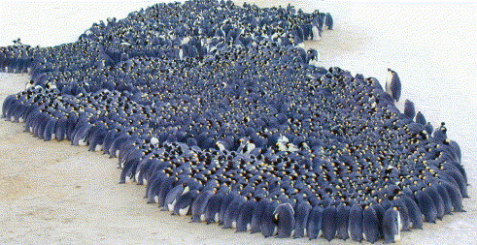

Slide 49
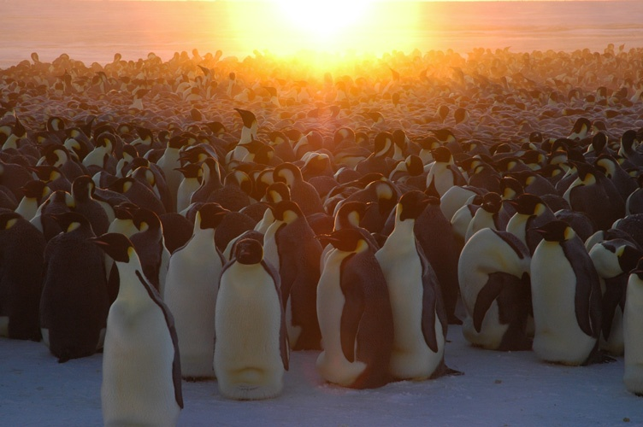

Slide 50
Even youths grow tired and weary,
and young men stumble and fall;
but those who wait upon the LORD
will renew their strength.
They will soar on wings like eagles;
they will run and not grow weary,
they will walk and not be faint.
Isaiah 40:30-31

Slide 51
The LAUNCHING of the
KING’S MINISTRY
...the RIGHT TIME
...the RIGHT PLACE

Slide 52
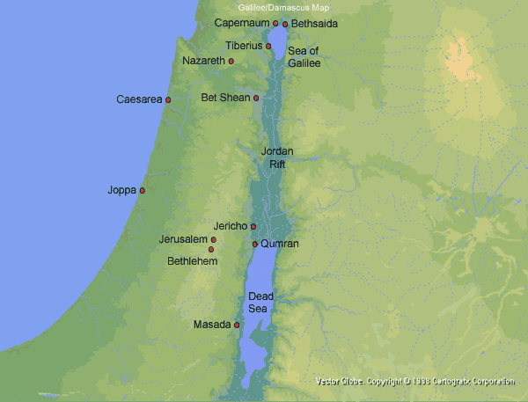
Even youths grow tired and weary, and young men stumble and fall; but those who wait upon the LORD will renew their strength. They will soar on wings like eagles; they will run and not grow weary, they will walk and not be faint.
Isaiah 40:30-31

Slide 53
Others said,
“He is the Messiah.”
Still others asked,
“How can the Messiah come from Galilee?
John 7:41

Slide 54
The LAUNCHING of the
KING’S MINISTRY
...the RIGHT TIME
...the RIGHT PLACE
...the RIGHT PROCLAMATION

Slide 55
Mark it down.
God does not save us
because of what we’ve done. Only a puny god
could be bought with tithes.
Only an egotistical god
would be impressed with our pain.

Slide 56
Only a temperamental god
could be satisfied by sacrifices.
Only a heartless god
would sell salvation to the highest bidders.
And only a great God does for
his children what they
Can’t do for themselves.

Slide 57
Those who experience salvation have declared spiritual bankruptcy
and are aware of their spiritual crisis.
Their cupboards are bare.
Their pockets are empty.
Their options are gone.

Slide 58
They have long since stopped demanding
Justice; they are pleading for mercy.
They don’t brag; they beg.
They ask God to do for them what they can’t
do for them what they can’t do without him.
They have seen how holy God is
and how sinful they are.
Max Lucado

Slide 60
a BOUT with DOUBT
...the CONFUSION of JOHN

Slide 61
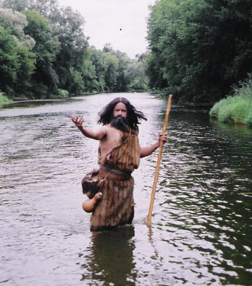

Slide 62
John had never known doubt.
Hunger, yes.
Loneliness, often.
But doubt, NEVER.
Only raw conviction,
ruthless pronouncements,
and rugged truth.
Such was John the Baptist.
Conviction as fierce as the desert sun.

Slide 63
Until now. Now the sun is blocked.
Now his courage wanes. Now the clouds come.
And now, as he faces death,
he doesn’t wave a fist of victory;
he raises only a question.
His final act is not
a proclamation of courage,
but a confession of confusion:
“Find out if Jesus is the Son of God or not.”

Slide 65
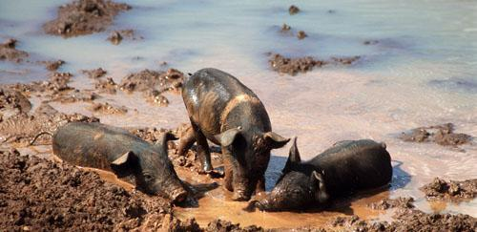

Slide 66
Christ never failed to distinguish
between doubt and unbelief.
Doubt is “can’t” believe.
Unbelief is “won’t” believe.
Doubt is honest.
Unbelief is obstinacy.
Doubt is looking for light.
Unbelief is content with darkness.
--Henry Drummond

Slide 67
a BOUT with DOUBT
...the CONFUSION of JOHN
...the CONFIRMATION of CHRIST

Slide 68
JOHN…in HIS PRESENCE

Slide 69
A PROPHET SENT to PREPARE the WAY for the KING!

