Slide 4
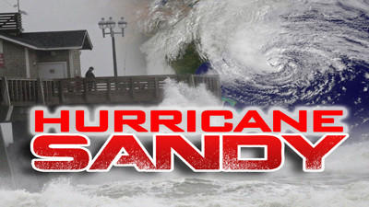
100%
of the money will go towards helping
affected families!!
See current for more information!
Salem Church in Staten Island, NY
www.salemchurchnyc.org

Slide 5
Tim Kimmel
Raising Truly Great Children by
Grace-Based Parenting
This Weekend!!
November 16-17
Register online at www.templebiblechurch.org

Slide 7
No Sweeter Name
No sweeter name
Than the name of Jesus No sweeter name
Have I ever known No sweeter name
Than the name of Jesus (repeat)

Slide 8
You are the life to my heart And my soul You are the light to the Darkness around me

Slide 9
You are the hope to
The hopeless and broken You are the only truth
And the way

Slide 10
No sweeter name
Than the name of Jesus No sweeter name
Have I ever known No sweeter name
Than the name of Jesus (repeat)

Slide 11
You are the life to my heart And my soul You are the light to the Darkness around me

Slide 12
You are the hope to
The hopeless and broken You are the only truth
And the way

Slide 13
Jesus Jesus Jesus Jesus

Slide 14
You are the life to my heart And my soul You are the light to the Darkness around me

Slide 15
You are the hope to
The hopeless and broken You are the only truth
And the way

Slide 16
You are the life to my heart And my soul You are the light to the Darkness around me

Slide 17
You are the hope to
The hopeless and broken You are the only truth
And the way
Kari Jobe
2004 Gateway Create Publishing
CCLI 78316

Slide 18
Holy Is The Lord
We stand and lift up our hands For the joy of the Lord
Is our strength We bow down and worship Him now How great, how awesome is He

Slide 19
And together we sing, Everyone sing Holy is the Lord, God Almighty The earth is filled with His glory Holy is the Lord, God Almighty The earth is filled with His glory
The earth is filled with His glory

Slide 20
We stand and lift up our hands For the joy of the Lord
Is our strength We bow down and worship Him now How great, how awesome is He

Slide 21
And together we sing, Everyone sing Holy is the Lord, God Almighty The earth is filled with His glory Holy is the Lord, God Almighty The earth is filled with His glory
The earth is filled with His glory

Slide 22
It is rising up all around It's the anthem of
The Lord's renown It is rising up all around It's the anthem of
The Lord's renown

Slide 23
And together we sing, Everyone sing Holy is the Lord, God Almighty The earth is filled with His glory Holy is the Lord, God Almighty The earth is filled with His glory
The earth is filled with His glory

Slide 24
Holy is the Lord, God Almighty The earth is filled with His glory Holy is the Lord, God Almighty The earth is filled with His glory
The earth is filled with His glory
Louie Giglio, Chris Tomlin
2003 worshiptogether.com songs, sixsteps Music
CCLI 78316

Slide 25
Where We Belong
There is no height or depth Neither life nor death Can take me from all that I find Here now in Your glory Lord

Slide 26
No other powers or love The things of now or to come There's nothing on earth in this life That could ever separate us Lord

Slide 27
Your love is never ending To Your hands we surrender Where all our sins are washed away Your grace beyond reason has Paid for our freedom We're made alive in You

Slide 28
We run to Your throne
Where we belong Every heart will sing that Jesus is Lord

Slide 29
Casting all else aside for the
Joy of our Christ Let Your glory fall Our hearts are filled
With Your fire

Slide 30
No other powers or love The things of now or to come There's nothing on earth in this life That could ever separate us Lord

Slide 31
Your love is never ending To Your hands we surrender Where all our sins are washed away Your grace beyond reason has Paid for our freedom We're made alive in You

Slide 32
We run to Your throne
Where we belong Every heart will sing that Jesus is Lord

Slide 33
Casting all else aside for the
Joy of our Christ Let Your glory fall Our hearts are filled with Your fire

Slide 34
We run to Your throne
Where we belong Every heart will sing that Jesus is Lord

Slide 35
Casting all else aside for the
Joy of our Christ Let Your glory fall Our hearts are filled with Your fire

Slide 36
We run to Your throne
Where we belong Every heart will sing that Jesus is Lord

Slide 37
Casting all else aside for the
Joy of our Christ Let Your glory fall Our hearts are filled with Your fire
Joel Davies, Reuben Morgan
2008 Hillsong Publishing
CCLI 78316

Slide 38
Made Me Glad
I will bless the Lord forever I will trust Him at all times He has delivered me from all fear He has set my feet upon a rock And I will not be moved And I'll say of the Lord

Slide 39
You are my shield My strength my portion Deliverer, my shelter strong tower My very present help in time of need

Slide 40
Whom have I in heaven but You There's none I desire besides You And You have made me glad I'll say of the Lord

Slide 41
You are my shield My strength my portion Deliverer, my shelter strong tower My very present help in time of need

Slide 42
You have made me glad And I'll say of the Lord

Slide 43
You are my shield My strength my portion Deliverer, my shelter strong tower My very present help

Slide 44
You are my shield My strength my portion Deliverer, my shelter strong tower My very present help in time of need
Miriam Webster
2001 Hillsong Publishing
CCLI 78316

Slide 45
I Surrender All
I surrender all, I surrender all All to Thee, my blessed Savior I surrender all

Slide 46
All to Jesus I surrender All to Him I freely give I will ever love and trust Him In His presence daily live

Slide 47
I surrender all, I surrender all All to Thee, my blessed Savior I surrender all

Slide 48
All to Jesus I surrender
Lord I give myself to Thee
Fill me with Thy love and power
Let Thy blessing fall on me

Slide 49
I surrender all, I surrender all All to Thee, my blessed Savior I surrender all
Judson VanDeVenter, Winfield Scott Weeden
1896 Public Domain
CCLI 78316

Slide 51
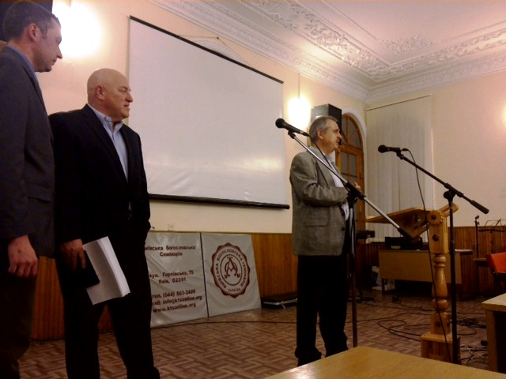

Slide 52
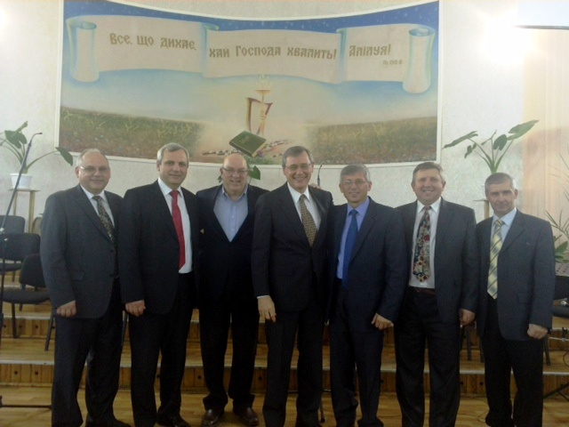

Slide 53
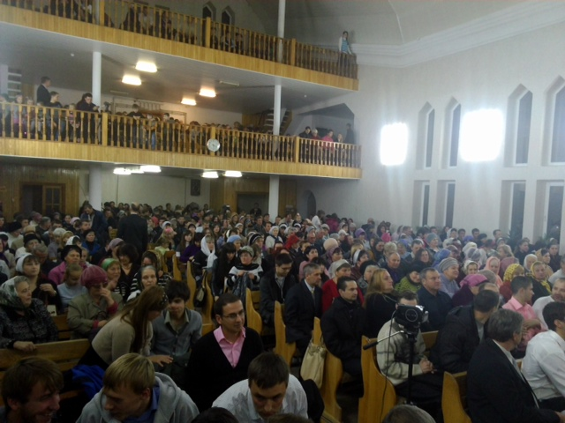

Slide 55
A Teenage Reformer

Slide 56
PURSUING GOD

Slide 58
PURSUING GOD
PURGING the LAND

Slide 59
We are UNSHAKEN because GOD is UNSHAKEN
GOVERNMENT is IMPORTANT but NOT ALL-IMPORTANT
Do not let DISAPPOINTMENT turn into BITTERNESS
SEE the BIG PICTURE
PRAY for our LEADERS

Slide 60
I Timothy 2:1-2
I urge, then, first of all, that petitions, prayers, intercession and thanksgiving be made for all people— for kings and all those in authority, that we may live peaceful and quiet lives in all godliness and holiness.

Slide 61
PURSUING GOD
PURGING the LAND

Slide 62
PURSUING GOD
PURGING the LAND
REPAIRING the TEMPLE

Slide 63
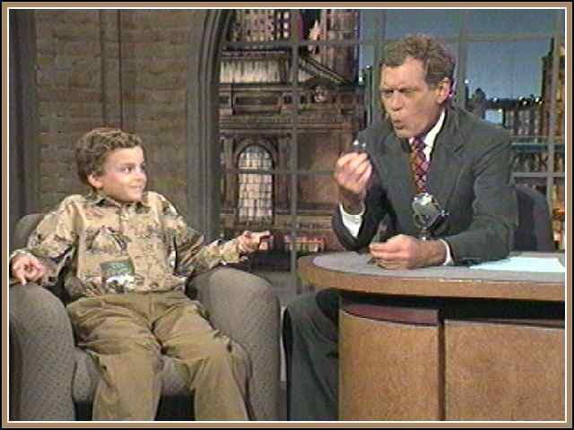

Slide 64
II Chronicles 34:14
While they were bringing out the money that had been taken into the temple of the Lord, Hilkiah the priest found the Book of the Law of the Lord that had been given through Moses.

Slide 65
PURSUING GOD
PURGING the LAND
REPAIRING the TEMPLE
RESPONDING to the WORD

Slide 66
CONVICTION

Slide 67
Hebrews 4:12-13
¹² For the word of God is alive and active. Sharper than any double-edged sword, it penetrates even to dividing soul and spirit, joints and marrow; it judges the thoughts and attitudes of the heart. ¹³ Nothing in all creation is hidden from God’s sight. Everything is uncovered and laid bare before the eyes of him to whom we must give account.

Slide 68
CONVICTION

Slide 69
CONVICTION
CONDEMNATION

Slide 70
CONVICTION
CONDEMNATION
COMMENDATION

Slide 71
CONVICTION
CONDEMNATION
COMMENDATION
CELEBRATION

Slide 72
GOD’S WORD not
only INFORMS,
but TRANSFORMS!

