Slide 2
O Praise Him
Turn your ear to heaven And hear the noise inside

Slide 3
The sound of angels awe The sound of angels songs And all this for a King We could join and sing all to Christ the King

Slide 4
How constant, how divine This song of ours will rise O how constant, how divine This love of ours will rise

Slide 5
O praise Him, O praise Him He is holy, He is holy, yeah

Slide 6
Turn your gaze to heaven And raise a joyous noise

Slide 7
The sound of salvation come The sound of rescued ones And all this for a King Angels join to sing all for Christ our King

Slide 8
How infinite and sweet this Love so rescuing O how infinitely sweet This great love that has redeemed

Slide 9
O praise Him, O praise Him He is holy, He is holy, yeah
repeat

Slide 10
Alleluia, Alleluia, He is holy He is holy, yeah

Slide 11
O praise Him, O praise Him He is holy, He is holy, yeah
Temple Bible Church

Slide 12
Heaven's Rejoice
O for a thousand tongues to sing My great redeemer's praise The glories of my God and King The triumphs of His grace

Slide 13
Let the heavens rejoice The earth be glad The sea resound, all creation dance

Slide 14
Let the fields cry out The forests will sing This is our song, this is our King

Slide 15
My gracious Master and my God Assist me to proclaim To spread through all the Earth abroad The honors of Thy Name

Slide 16
Let the heavens rejoice The earth be glad The sea resound, all creation dance

Slide 17
Let the fields cry out The forests will sing This is our song, this is our King
Author Unknown
CCLI 78316

Slide 18
How Marvelous
I stand amazed in the presence Of Jesus the Nazarene And wonder how He could love me A sinner, condemned, unclean

Slide 19
Singing' How marvelous How wonderful And my song shall ever be How marvelous How wonderful Is my Savior's love for me

Slide 20
He took my sins and my sorrows He made them His very own He bore the burden to Calvary And suffered and died alone

Slide 21
Singing' How marvelous How wonderful And my song shall ever be How marvelous How wonderful Is my Savior's love for me

Slide 22
Singing' How marvelous How wonderful And my song shall ever be How marvelous How wonderful Is my Savior's love for me
Charles H. Gabriel
2007 Public Domain
CCLI 78316

Slide 23
All the Poor and Powerless
All the poor and powerless And all the lost and lonely All the thieves will come confess And know that You are holy And know that You are holy

Slide 24
And all will sing out Hallelujah And we will cry out Hallelujah

Slide 25
All the hearts who are content And all who feel unworthy And all who hurt with nothing left Will know that You are holy Will know that You are holy

Slide 26
And all will sing out Hallelujah And we will cry out Hallelujah

Slide 27
Shout it Go on scream it from the mountains Go on and tell it to the masses That He is God

Slide 28
And all will sing out Hallelujah And we will cry out Hallelujah
Digital Age
CCLI 78316

Slide 29
Turn Your Eyes Upon Jesus
Turn your eyes upon Jesus Look full in His wonderful face And the things of earth will Grow strangely dim In the light of His glory and grace
Helen H. Lemmel
1922 Public Domain
CCLI 78316

Slide 30
Rescue
You are the source of life I can't be left behind No one else will do And I will take hold of You

Slide 31
'Cause I need You, Jesus To come to my rescue Where else can I go There's no other name by which
I am saved, capture me with grace
I will follow you

Slide 32
My heart is Yours for life I need Your hand in mine No one else will do, Lord I put my trust in You

Slide 33
'Cause I need You, Jesus To come to my rescue Where else can I go There's no other name by which
I am saved, capture me with grace
I will follow you

Slide 34
This world has nothing for me
(Guys)
I will follow you
(Ladies)
(repeat)

Slide 35
'Cause I need You, Jesus To come to my rescue Where else can I go There's no other name by which
I am saved, capture me with grace
I will follow you
Jared Anderson
2003 Vertical Worship Songs
CCLI 78316

Slide 37
A Trilogy of
Trouble

Slide 38
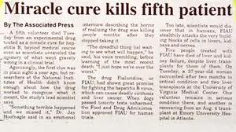

Slide 39
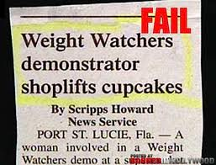

Slide 40
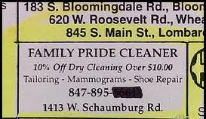

Slide 41
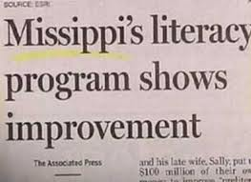

Slide 42
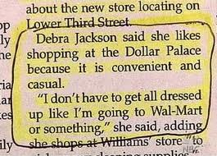

Slide 43
A Trilogy of
Trouble

Slide 45
-> one MEAN MAMA
GENERATIONAL SIN
The Failure of Ahaziah

Slide 46
"his mother was his counselor
to do wickedly” …NASB
"his mother encouraged
him to act wickedly!”…NIV
"his mother trained
him in evil ways!”…The Message
Mean Mama

Slide 47
Jehoshaphat
(King of South=Judah)
Ahab
(King of North=Israel)
Jehoram
Athaliah
Ahaziah
King of South=Judah

Slide 48
Therefore if anyone is in Christ,
he is a new creature;
the old things passed away; behold, new things have come.
2 Corinthians 5:17

Slide 49
-> one MEAN MAMA
GENERATIONAL SIN
-> LISTENING to UNGODLY COUNSEL
The Failure of Ahaziah

Slide 50
-> a chip off the old block
…GENERATIONAL SIN
The Failure of Athaliah

Slide 51
Jehoshaphat
(King of South=Judah)
Ahab
(King of North=Israel)
Jehoram
Athaliah
Ahaziah
King of South=Judah

Slide 52
Ahab the son of Omri did evil
in the sight of the Lord more than all who were before him.
1 Kings 16:30

Slide 53
-> a chip off the old block
…GENERATIONAL SIN
-> a GRANDMA MURDERS her GRANDKIDS
The Failure of Athaliah

Slide 54
-> from the ORPHANAGE to the PALACE
The Failure of Joash

Slide 55
-> the EROSION of FAITH
*Pleasing MAN not GOD
The Failure of Joash

Slide 56
“we come not as pleasing men, but God…”
I Thessalonians 2:4
“If I were still trying to please men,
I would not be a bond-servant of Christ.”
Galatians 1:10

Slide 57
”We lose the APPROVAL
of God,
when we seek the APPLAUSE
of men.”
Chuck Swindoll

Slide 58
“we make it our goal
to please Him!”
2 Corinthians 5:9

Slide 59
-> the EROSION of FAITH
*Pleasing MAN not GOD
*LISTENING to UNGODLY COUNSEL
The Failure of Joash

Slide 60
-> the EROSION of FAITH
*Pleasing MAN not GOD
*LISTENING to UNGODLY COUNSEL
*Rejecting RIGHTEOUSNESS
The Failure of Joash

Slide 62
God’s People may FAIL
But God’s PLAN
will NOT!

