Slide 1


Slide 2

Redeeming King
You are the Lord
Exalted above the most high
The Ruler of all
Worthy of all my praise

Slide 3
You are the Lord
Mighty in all of Your ways
Forever the same
So worthy of all my praise

Slide 4
And I lift my hands
In holy devotion to You
My life is my sacrifice
Daily surrendered

Slide 5
And I lift my voice
Unashamed of my love for You
For You are the Lord my
Redeeming King

Slide 6
You are the Lord
Exalted above the most high
The Ruler of all
Worthy of all my praise

Slide 7
You are the Lord
Mighty in all of Your ways
Forever the same
So worthy of all my praise

Slide 8
And I lift my hands
In holy devotion to You
My life is my sacrifice
Daily surrendered

Slide 9
And I lift my voice
Unashamed of my love for You
For You are the Lord my
Redeeming King

Slide 10
And I lift my hands
In holy devotion to You
My life is my sacrifice
Daily surrendered

Slide 11
And I lift my voice
Unashamed of my love for You
For You are the Lord my
Redeeming King

Slide 12
And I lift my hands
In holy devotion to You
My life is my sacrifice
Daily surrendered

Slide 13
And I lift my voice
Unashamed of my love for You
For You are the Lord my
Redeeming King
Jadon Lavik
2003, 2004 Thirsty Moon River Publishing, LAVIKMUSIC
CCLI 78316

Slide 14

Famous One
You are the Lord
The famous One, famous One
Great is Your name in all the earth
The heaven's declare
You're glorious, glorious
Great is Your fame beyond the earth

Slide 15
And for all You've done and yet to do
With every breath I'm praising You
Desire of nations and every heart
You alone are God, You alone are God

Slide 16
You are the Lord
The famous One, famous One
Great is Your name in all the earth
The heaven's declare
You're glorious, glorious
Great is Your fame beyond the earth

Slide 17
And the morning star is
Shining through
And every eye is watching You
Revealed by nature and miracles
You are beautiful, You are beautiful

Slide 18
You are the Lord
The famous One, famous One
Great is Your name in all the earth
The heaven's declare
You're glorious, glorious
Great is Your fame beyond the earth
Jesse Reeves, Chris Tomlin
2002 worshiptogether.com songs, sixsteps Music
CCLI 78316

Slide 19
10,000 Reasons
Bless the Lord O my soul, O my soul
Worship His holy name
Sing like never before, O my soul
I'll worship Your holy name

Slide 20
The sun comes up
It's a new day dawning
It's time to sing
Your song again

Slide 21
Whatever may pass
And whatever lies before me
Let me be singing when the
Evening comes

Slide 22
Bless the Lord O my soul, O my soul
Worship His holy name
Sing like never before, O my soul
I'll worship Your holy name

Slide 23
You're rich in love
And You're slow to anger
Your name is great
And Your heart is kind

Slide 24
For all Your goodness I will
Keep on singing
Ten thousand reasons for my
Heart to find

Slide 25
Bless the Lord O my soul, O my soul
Worship His holy name
Sing like never before, O my soul
I'll worship Your holy name

Slide 26
And on that day when my
Strength is failing
The end draws near
And my time has come

Slide 27
Still my soul will sing Your
Praise unending
Ten thousand years
And then forevermore

Slide 28
Bless the Lord O my soul, O my soul
Worship His holy name
Sing like never before, O my soul
I'll worship Your holy name

Slide 29
Bless the Lord O my soul, O my soul
Worship His holy name
Sing like never before, O my soul
I'll worship Your holy name

Slide 30
I'll worship Your holy name
Worship Your holy name
Worship Your holy name
Jonas Myrin, Matt Redman
2011 SHOUT! Music Publishing, Thankyou Music, Said and Done Music
CCLI 78316

Slide 31
Here In Your Presence
Found in Your hands, fullness of joy
Every fear suddenly wiped away
Here in Your Presence

Slide 32
All of my gains now fade away
Every crown no longer on display
Here in Your Presence

Slide 33
Heaven is trembling in awe of
Your wonders
The kings and their kingdoms
Are standing amazed

Slide 34
Here in Your Presence
We are undone
Here in Your Presence
Heaven and earth become one

Slide 35
Here in Your Presence
All things are new
Here in Your Presence
Everything bows before You

Slide 36
Found in Your hands, fullness of joy
Every fear suddenly wiped away
Here in Your Presence

Slide 37
All of my gains now fade away
Every crown no longer on display
Here in Your Presence

Slide 38
Heaven is trembling in awe of
Your wonders
The kings and their kingdoms
Are standing amazed

Slide 39
Here in Your Presence
We are undone
Here in Your Presence
Heaven and earth become one

Slide 40
Here in Your Presence
All things are new
Here in Your Presence
Everything bows before You

Slide 41
Wonderful, beautiful, glorious
Matchless in every way

Slide 42
Here in Your Presence
We are undone
Here in Your Presence
Heaven and earth become one

Slide 43
Here in Your Presence
All things are new
Here in Your Presence
Everything bows before You
Jon Egan
2006 Vertical Worship Songs
CCLI 78316

Slide 44
Holy Holy Holy
Holy, holy, holy
Lord God Almighty
Early in the morning our song
Shall rise to Thee

Slide 45
Holy, holy, holy
Merciful and mighty
God in three Persons
Blessed Trinity

Slide 46
Holy, holy, holy
Though the darkness hide Thee
Though the eye of sinful man
Thy glory may not see

Slide 47
Only Thou art holy
There is none beside Thee
Perfect in power, in love and purity

Slide 48
Holy, holy, holy
Lord God Almighty
All Thy works shall praise Thy
Name in earth and sky and sea

Slide 49
Holy, holy, holy
Merciful and mighty
God in three Persons
Blessed Trinity
John Bacchus Dykes, Reginald Heber
1826 Public Domain
CCLI 78316

Slide 50

November 16-17

Slide 51
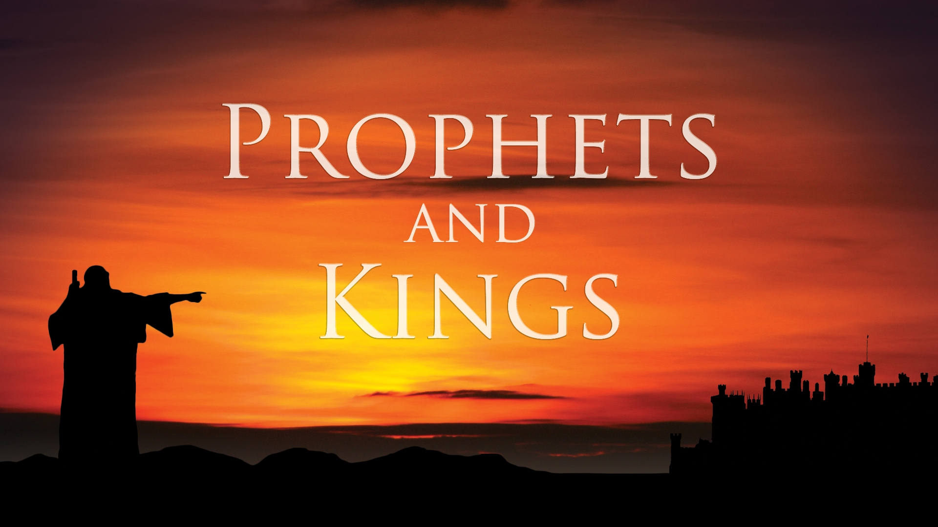

Slide 52

Compromise

Slide 53
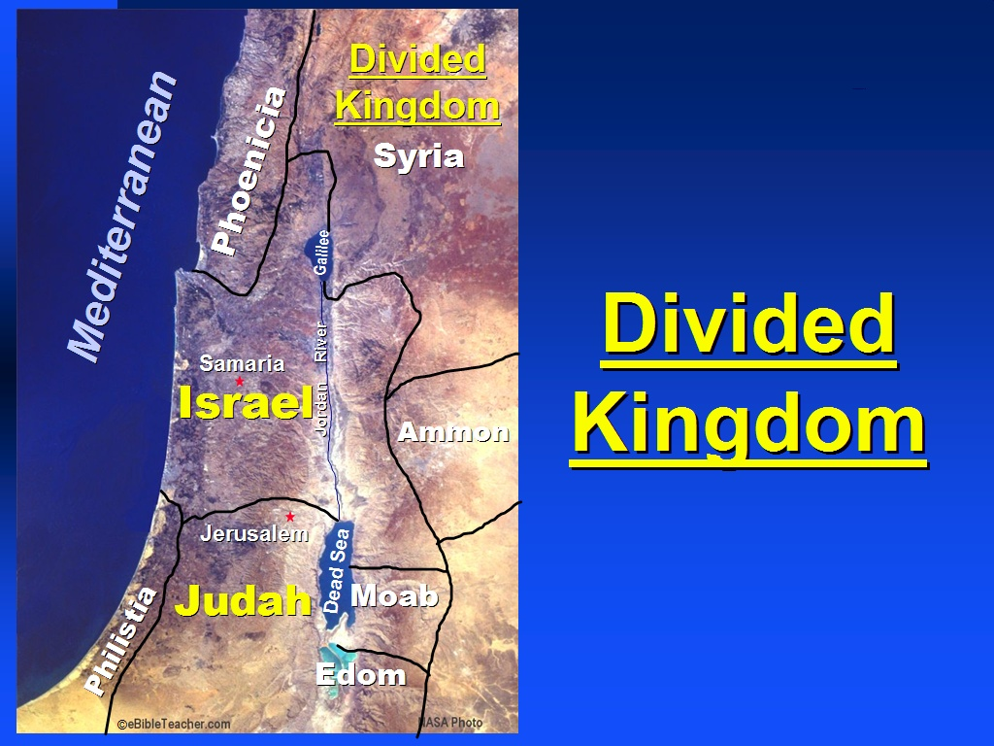

Slide 54

Ahab the son of Omri
did evil in the sight of the Lord
more than all who were before him.
1 Kings 16:30

Slide 56

A Righteous Ruler
…he FOLLOWED God

Slide 57
How blessed is the man
who does not walk in the counsel of the wicked,
Nor stand in the path of sinners,
Nor sit in the seat of scoffers!
But his delight is in the law of the Lord,
And in His law he meditates day and night.

Slide 58
He will be like a tree firmly planted
by streams of water,
Which yields its fruit in its season
And its leaf does not wither;
And in whatever he does, he prospers.
Psalm 1:1-3

Slide 59
All Scripture is inspired by God
and profitable for teaching, for reproof,
for correction, for training in righteousness;
so that the man of God may be adequate, equipped for every good work.
2 Timothy 3:16-17

Slide 60
A Righteous Ruler
…he FOLLOWED God

Slide 61
A Righteous Ruler
…he FOLLOWED God
…he corrected INJUSTICE

Slide 62
A Righteous Ruler
…he FOLLOWED God
…he corrected INJUSTICE
…he taught and modeled DEPENDENCY on God

Slide 63
Some boast in chariots
and some in horses,
But we will boast in the
name of the Lord, our God.
Psalm 20:7

Slide 64
Blessed by God
> The blessing of PEACE

Slide 65
So the kingdom of Jehoshaphat
was at peace,
for his God gave him rest on all sides.
2 Chronicles 20:30

Slide 66
Blessed by God
> The blessing of PEACE
> The blessing of PROSPERITY

Slide 67
Jehoshaphat…Sinful Compromise
~through a MARRIAGE alliance

Slide 68
He (Jehoram) walked in the way
of the kings of Israel,
just as the house of Ahab did
(for Ahab’s daughter was his wife),
and he did evil in the sight of the Lord.
2 Chronicles 21:6

Slide 69
Jehoshaphat…Sinful Compromise
~through a MARRIAGE alliance
~through a MILITARY alliance

Slide 70
Jehoshaphat…Sinful Compromise
~through a MARRIAGE alliance
~through a MILITARY alliance
~through a MARKETPLACE alliance

Slide 71
COMPROMISING
with SIN is NOT
worth the COST!

