Slide 1


Slide 2

You Are Holy
Ladies Echo
You are holy You are mighty You are worthy Worthy of praise

Slide 3

Ladies Echo
I will follow I will listen I will love You All of my days

Slide 4
I will sing to
And worship The King Who
Is worthy
I will love and
Adore Him
I will bow down
Before Him
You are Lord of lords You are King of kings You're the mighty God Lord of everything
You’re Emmanuel
You’re the Great I Am
You’re the Prince of Peace
Who is the Lamb

Slide 5
I will sing to
And worship The King Who
Is worthy
I will love and
Adore him
I will bow down
Before Him
You're the living God You're my saving grace
You'll reign forever You're the Ancient of days
You are Alpha, Omega
Beginning and End
You’re my Savior, Messiah
Redeemer and Friend

Slide 6
You're my Prince of Peace And I will live my life for You

Slide 7
Ladies Echo
You are holy You are mighty You are worthy Worthy of praise

Slide 8
Ladies Echo
I will follow I will listen I will love You All of my days

Slide 9
I will sing to
and worship The King Who
is worthy
I will love and
adore Him
I will bow down
Before Him
You are Lord of lords You are King of kings You're the mighty God Lord of everything
You’re Emmanuel
You’re the Great I Am
You’re the Prince of Peace
Who is the Lamb

Slide 10
I will sing to
And worship The King Who
Is worthy
I will love and
Adore him
I will bow down
Before Him
You're the living God You're my saving grace
You'll reign forever You're the Ancient of days
You are Alpha, Omega
Beginning and End
You’re my Savior, Messiah
Redeemer and Friend

Slide 11
You're my Prince of Peace And I will live my life for You

Slide 12
I will sing to
and worship The King Who
is worthy
I will love and
adore Him
I will bow down
Before Him
You are Lord of lords You are King of kings You're the mighty God Lord of everything
You’re Emmanuel
You’re the Great I Am
You’re the Prince of Peace
Who is the Lamb

Slide 13
I will sing to
And worship The King Who
Is worthy
I will love and
Adore him
I will bow down
Before Him
You're the living God You're my saving grace
You'll reign forever You're the Ancient of days
You are Alpha, Omega
Beginning and End
You’re my Savior, Messiah
Redeemer and Friend

Slide 14
He’s my Prince of Peace And I will live my life for Him
He’s my Prince of Peace
And I will live my life for Him
You’re my Prince of Peace
And I will live my life for You
Marc Imboden, Tammi Rhoton
1994 Martha Jo Publishing, Imboden Music
CCLI 78316

Slide 15
Nothing But The Blood
What can wash away my sin Nothing but the blood of Jesus What can make me whole again Nothing but the blood of Jesus

Slide 16
For my pardon this I see Nothing but the blood of Jesus For my cleansing this my plea Nothing but the blood of Jesus

Slide 17
Oh, precious is the flow That makes me white as snow No other fount I know Nothing but the blood of Jesus

Slide 18
Nothing but the blood Nothing but the blood Nothing but the blood Nothing but the blood

Slide 19
This is all my hope and peace Nothing but the blood of Jesus This is all my righteousness Nothing but the blood of Jesus

Slide 20
Oh, precious is the flow That makes me white as snow No other fount I know Nothing but the blood of Jesus

Slide 21
Nothing but the blood Nothing but the blood Nothing but the blood Nothing but the blood

Slide 22
Oh, precious is the flow That makes me white as snow No other fount I know Nothing but the blood of Jesus
Sean Dayton, Robert Lowry
2006 ION Publishing
CCLI 78316

Slide 23
The Wonderful Cross
When I survey the wondrous cross On which the Prince of glory died My richest gain I count but loss And pour contempt on all my pride

Slide 24
See from His head
His hands His feet Sorrow and love flow mingled down Did ever such love and sorrow meet Or thorns compose so rich a crown

Slide 25
Oh the wonderful Cross Oh the wonderful Cross Bids me come and die And find that I may truly live

Slide 26
Oh the wonderful Cross Oh the wonderful Cross All who gather here by grace Draw near and bless Your name

Slide 27
Were the whole realm of nature mine That were an offering far too small Love so amazing, so divine Demands my soul, my life, my all

Slide 28
Oh the wonderful Cross Oh the wonderful Cross Bids me come and die And find that I may truly live

Slide 29
Oh the wonderful Cross Oh the wonderful Cross All who gather here by grace Draw near and bless Your name

Slide 30
Love so amazing, so divine Demands my soul, my life, my all
Lowell Mason, Jesse Reeves, Chris Tomlin, J. D. Walt, Isaac Watts
2000 worshiptogether.com songs, sixsteps Music
CCLI 78316

Slide 31
The Stand
You stood before creation Eternity in Your hand You spoke the earth into motion My soul now to stand

Slide 32
You stood before my failure And carried the cross for my shame My sin weighed upon Your shoulders My soul now to stand

Slide 33
So what can I say and what could I do But offer this heart O God Completely to You

Slide 34
So I'll walk upon salvation Your Spirit alive in me This life to declare Your promise My soul now to stand

Slide 35
So what can I say and what could I do But offer this heart O God Completely to You

Slide 36
So I'll stand with arms high And heart abandoned In awe of the One who gave it all I'll stand my soul, Lord To You surrendered

Slide 37
So I'll stand with arms high And heart abandoned In awe of the One who gave it all I'll stand my soul, Lord To You surrendered All I am is Yours
Joel Houston
2005 Hillsong Publishing
CCLI 78316

Slide 38
Sweetly Broken
To the cross I look To the cross I cling Of it's suffering I do drink Of it's work I do sing

Slide 39
For on it my Savior Both bruised and crushed Showed that God is love And God is just

Slide 40
At the cross You beckon me You draw me gently to my knees And I am lost for words, so lost in love
I'm sweetly broken, wholly surrendered

Slide 41
What a precious gift Undeserved life, Have I been given Through Christ crucified

Slide 42
You've called me out of death, You've called me into life And I was under Your wrath Now through the cross I'm reconciled

Slide 43
At the cross You beckon me You draw me gently to my knees And I am lost for words, so lost in love
I'm sweetly broken, wholly surrendered
(repeat)
Jeremy Riddle
2005 Mercy/Vineyard Publishing
CCLI 78316

Slide 44


Slide 45
All the Poor and Powerless
All the poor and powerless And all the lost and lonely All the thieves will come confess And know that You are holy And know that You are holy

Slide 46
And all will sing out Hallelujah And we will cry out Hallelujah

Slide 47
All the hearts who are content And all who feel unworthy And all who hurt with nothing left Will know that You are holy Will know that You are holy

Slide 48
And all will sing out Hallelujah And we will cry out Hallelujah

Slide 49
Shout it Go on scream it from the mountains Go on and tell it to the masses That He is God

Slide 51
All the hearts who are content And all who feel unworthy And all who hurt with nothing left Will know that You are holy Will know that You are holy

Slide 52
And all will sing out Hallelujah And we will cry out Hallelujah

Slide 53
Shout it Go on scream it from the mountains Go on and tell it to the masses That He is God

Slide 55
Shout it Go on scream it from the mountains Go on and tell it to the masses That He is God
Digital Age
CCLI 78316

Slide 56
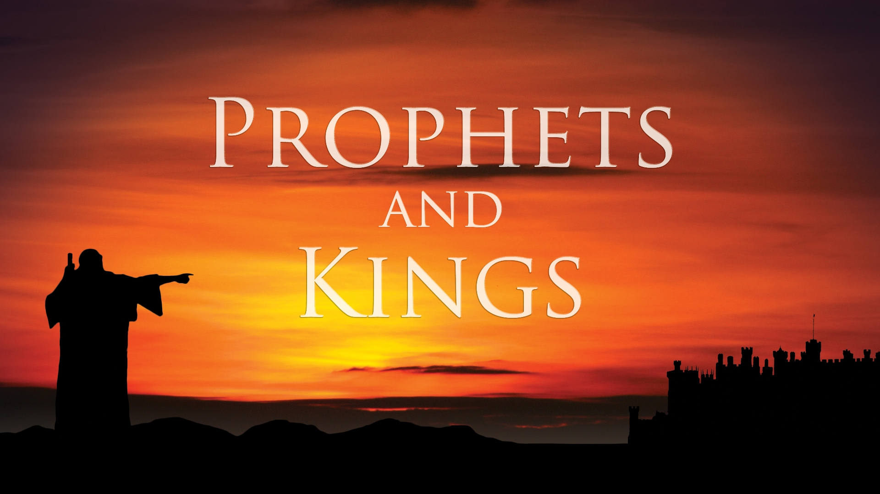


Slide 57
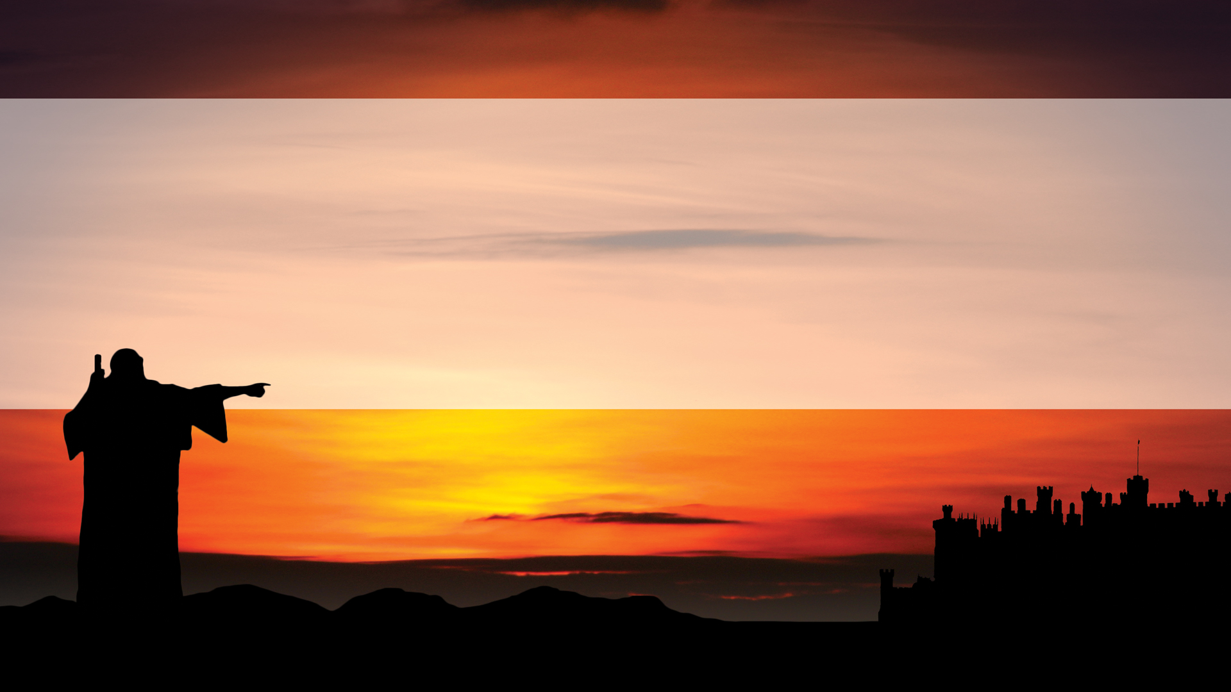
A Tale of
Two Cities

Slide 58
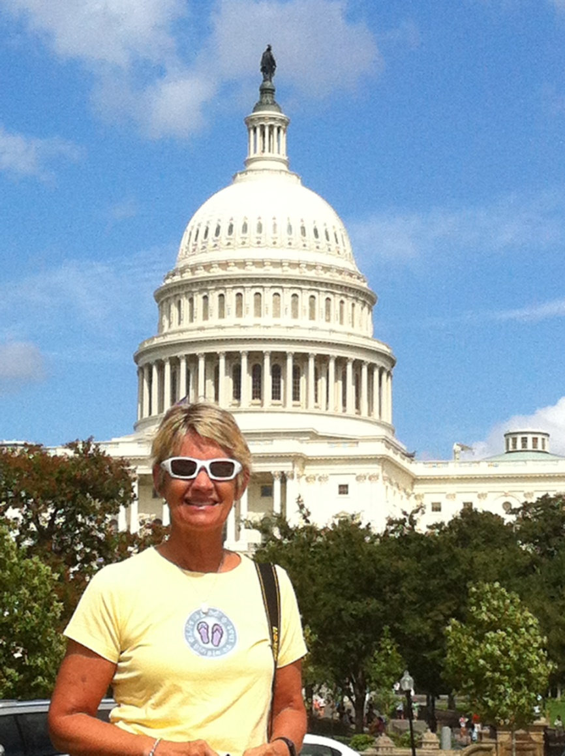

Slide 59
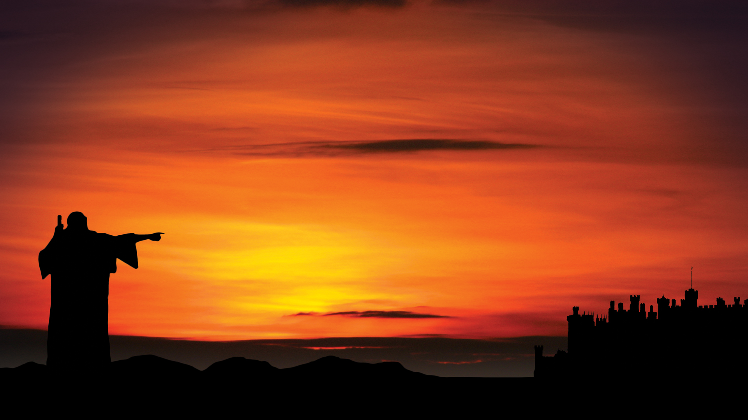

Slide 60
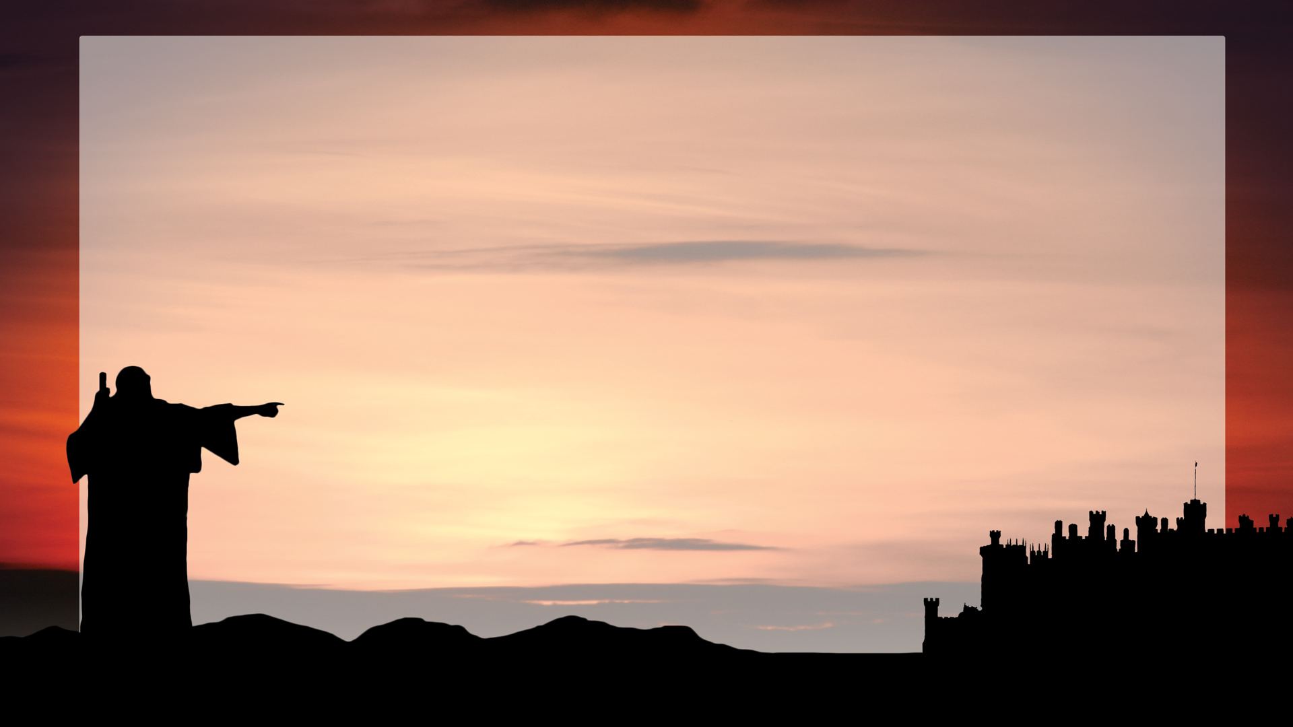
The city does not need the sun or the moon to shine on it, for the glory of God gives it light, and the Lamb is its lamp… On no day will its gates ever be shut…
Revelation 21:23, 25a

Slide 62
...went about in sheepskins and goatskins, destitute... they wandered in deserts and mountains, living in caves and in holes in the ground. (Hebrews 11:37-38)
Some faced jeers and flogging, and even chains and
imprisonment. They were put to death by
stoning; they were sawed in two; they were
killed by the sword.
(Hebrews 11:36-37)

Slide 63
Jerusalem, Jerusalem, you who stone the prophets and kill those sent to you.
Luke 13:34

Slide 65
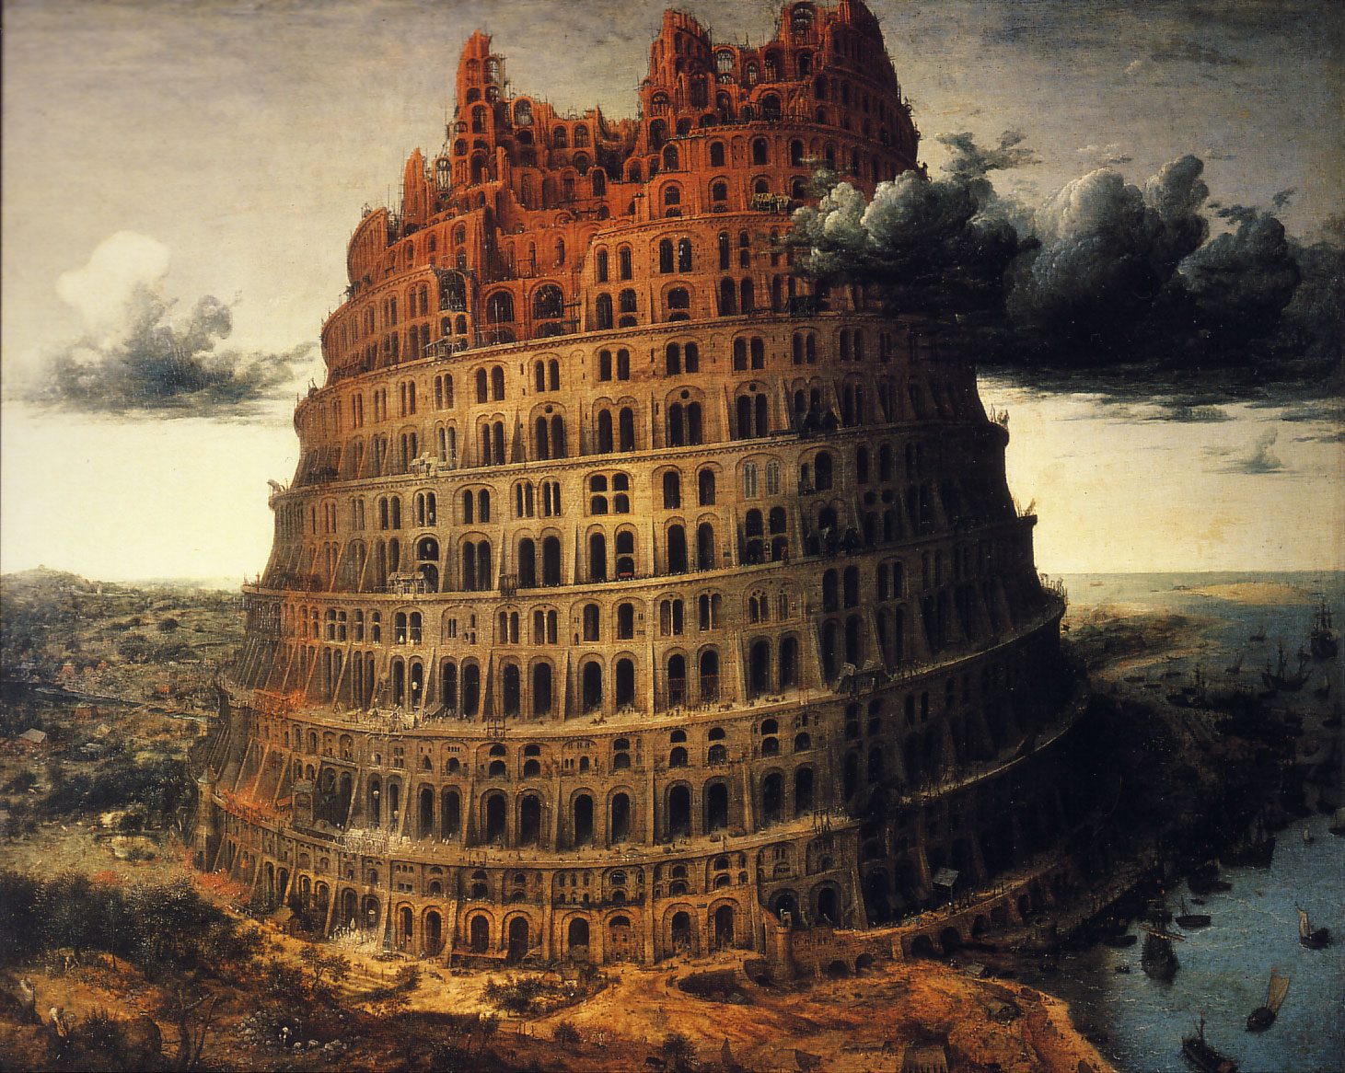

Slide 66
So the Lord scattered them from there over all the earth, and they stopped building the city. That is why it was called Babel— because there the Lord confused the language of the whole world. From there the Lord scattered them over the face of the whole earth.
Genesis 11:8-9

Slide 68
Unthinkable
Impractical
It won't make any difference

Slide 70
"Israel's prophets did not ask if this freedom is realistic, or politically practical or economically viable. To begin with such questions is to concede everything to the royal consciousness (ruler/ruling ideology) even before we begin.
We need to ask not
whether it is realistic or practical
or viable but whether it is imaginable.

Slide 71
We need to ask if our consciousness and imagination have been so assaulted co-opted by the royal consciousness (ruler/ruling ideology) that we have been robbed of the courage and power to think an alternative thought."
The Prophetic Imagination

Slide 73
Now the whole world had one language and a common speech. As people moved eastward, they found a plain in Shinar and settled there. They said to each other, “Come, let’s make bricks and bake them thoroughly.” They used brick instead of stone, and tar for mortar.

Slide 74
Then they said, “Come, let us build ourselves a city, with a tower that reaches to the heavens, so that we may make a name for ourselves; otherwise we will be scattered over the face of the whole earth.”
But the Lord came down to see the city and the tower the people were building.
Genesis 11:1-5

