Slide 1


Slide 2

Everlasting God
Strength will rise as we wait
Upon the Lord
We will wait upon the Lord
We will wait upon the Lord

Slide 3
Our God You reign forever
Our hope Our strong deliverer

Slide 4
You are the everlasting God
The everlasting God
You do not faint
You won't grow weary
You're the defender of the weak
You comfort those in need
You lift us up on wings like eagles

Slide 5
Strength will rise as we wait
Upon the Lord
We will wait upon the Lord
We will wait upon the Lord

Slide 6
Our God You reign forever
Our hope Our strong deliverer

Slide 7
You are the everlasting God
The everlasting God
You do not faint
You won't grow weary
You're the defender of the weak
You comfort those in need
You lift us up on wings like eagles

Slide 8
Our God You reign forever
Our hope Our strong deliverer

Slide 9
You are the everlasting God
The everlasting God
You do not faint
You won't grow weary
You're the defender of the weak
You comfort those in need
You lift us up on wings like eagles
Brenton Brown, Ken Riley
2005 Thankyou Music
CCLI 78316

Slide 10
Where We Belong
There is no height or depth
Neither life nor death
Can take me from all that I find
Here now in Your glory Lord

Slide 11
No other powers or love
The things of now or to come
There's nothing
On earth in this life
That could ever separate us Lord

Slide 12
Your love is never ending
To Your hands we surrender
Where all our sins
Are washed away
Your grace beyond reason has
Paid for our freedom
We're made alive in You

Slide 13
We run to Your throne
Where we belong
Every heart will sing that
Jesus is Lord
Casting all else aside for the

Slide 14
Joy of our Christ
Let Your glory fall
Our hearts are filled
With Your fire

Slide 15
No other powers or love
The things of now or to come
There's nothing
On earth in this life
That could ever separate us Lord

Slide 16
Your love is never ending
To Your hands we surrender
Where all our sins
Are washed away
Your grace beyond reason has
Paid for our freedom
We're made alive in You

Slide 17
We run to Your throne
Where we belong
Every heart will sing that
Jesus is Lord
Casting all else aside for the

Slide 18
Joy of our Christ
Let Your glory fall
Our hearts are filled
With Your fire

Slide 19
We run to Your throne
Where we belong
Every heart will sing that
Jesus is Lord
Casting all else aside for the

Slide 20
Joy of our Christ
Let Your glory fall
Our hearts are filled
With Your fire
Joel Davies, Reuben Morgan
2008 Hillsong Publishing
CCLI 78316

Slide 21
Forever Reign
You are good You are good
When there's nothing good in me
You are love You are love
On display for all to see

Slide 22
You are light You are light
When the darkness closes in
You are hope You are hope
You have covered all my sin

Slide 23
You are peace You are peace
When my fear is crippling
You are true You are true
Even in my wandering

Slide 24
You are joy You are joy
You're the reason that I sing
You are life You are life in
You death has lost its sting

Slide 25
Oh I'm running to Your arms
I'm running to Your arms
The riches of Your love will
Always be enough
Nothing compares to Your embrace
Light of the world forever reign

Slide 26
You are more You are more
Than my words will ever say
You are Lord You are Lord
All creation will proclaim

Slide 27
You are here You are here in
Your presence I'm made whole
You are God You are God
Of all else I'm letting go

Slide 28
Oh I'm running to Your arms
I'm running to Your arms
The riches of Your love will
Always be enough
Nothing compares to Your embrace
Light of the world forever reign
(repeat)

Slide 29
My heart will sing no other Name
Jesus Jesus
(repeat)

Slide 30
Oh I'm running to Your arms
I'm running to Your arms
The riches of Your love will
Always be enough
Nothing compares to Your embrace
Light of the world forever reign
(repeat)

Slide 31
My heart will sing no other Name
Jesus Jesus
Jason Ingram, Reuben Morgan
2009 SHOUT! Publishing, Windsor Hill Music, Sony/ATV Timber Publishing
CCLI 78316

Slide 32
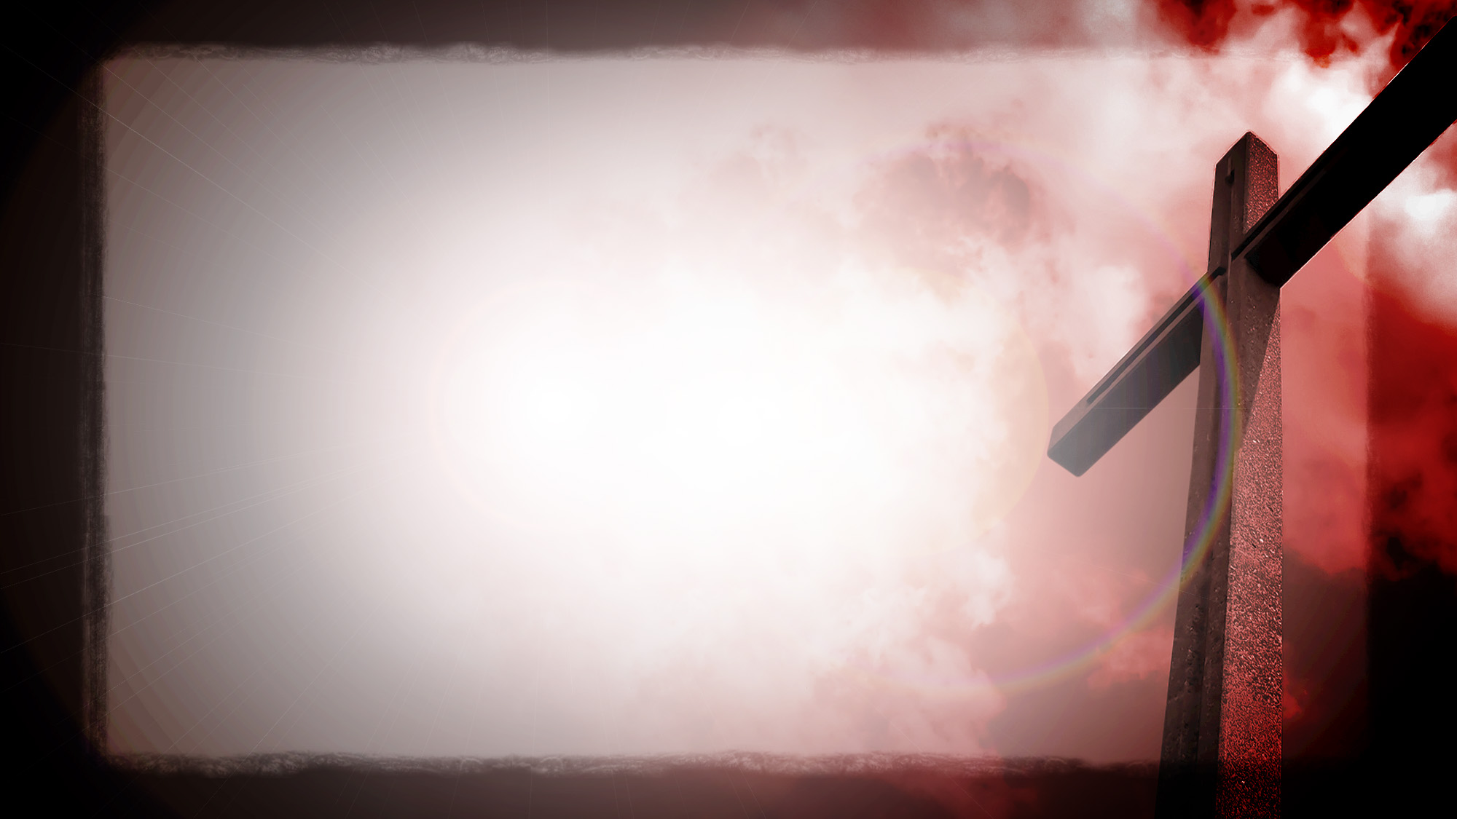
My Jesus I Love Thee
My Jesus, I love thee
I know Thou art mine
For Thee all the follies of
Sin I resign

Slide 33
My gracious Redeemer
My Savior art thou
If ever I loved Thee
My Jesus 'tis now

Slide 34
I love Thee because Thou has
First loved me
And purchased my pardon on
Calvary's tree

Slide 35
I love Thee for wearing the
Thorns on Thy brow
If ever I loved Thee, my Jesus
'tis now

Slide 36
In mansions of glory
And endless delight
I'll ever adore Thee in heaven
So bright

Slide 37
I'll sing with the glittering
Crown on my brow
If ever I loved Thee
My Jesus' tis now
Sean Dayton, William R. Featherstone, Adoniram Judson Gordon
2006 ION Publishing
CCLI 78316

Slide 38
Cannons
You are holy, great and mighty
The moon and the stars
Declare who You are
I'm so unworthy
But still You love me
Forever my heart will sing
Of how great You are

Slide 39
It's falling from the clouds
A strange and lovely sound
I hear it in the thunder and the rain
It's ringing in the skies
Like cannons in the night
The music of the universe plays

Slide 40
You are holy, great and mighty
The moon and the stars
Declare who You are
I'm so unworthy
But still You love me
Forever my heart will sing
Of how great You are

Slide 41
Beautiful and free, song of galaxies
It's reaching far beyond
The Milky Way
Let's join in with the sound,
Come on let's sing it loud
As the music of the universe plays

Slide 42
You are holy, great and mighty
The moon and the stars
Declare who You are
I'm so unworthy
But still You love me
Forever my heart will sing
Of how great You are

Slide 43
All glory, honor, power
Is Yours amen
All glory, honor, power
Is Yours amen
All glory, honor, power
Is Yours forever amen

Slide 44
You are holy, great and mighty
The moon and the stars
Declare who You are
I'm so unworthy
But still You love me
Forever my heart will sing
Of how great You are
Phil Wickham
2007 Seems Like Music, Phil Wickham Music
CCLI 78316

Slide 45
Here In Your Presence
Found in Your hands
Fullness of joy
Every fear suddenly wiped away
Here in Your Presence

Slide 46
All of my gains now fade away
Every crown no longer on display
Here in Your Presence

Slide 47
Heaven is trembling in awe of
Your wonders
The kings and their kingdoms
Are standing amazed

Slide 48
Here in Your Presence
We are undone
Here in Your Presence
Heaven and earth become one

Slide 49
Here in Your Presence
All things are new
Here in Your Presence
Everything bows before You

Slide 50
Found in Your hands
Fullness of joy
Every fear suddenly wiped away
Here in Your Presence

Slide 51
All of my gains now fade away
Every crown no longer on display
Here in Your Presence

Slide 52
Heaven is trembling in awe of
Your wonders
The kings and their kingdoms
Are standing amazed

Slide 53
Here in Your Presence
We are undone
Here in Your Presence
Heaven and earth become one

Slide 54
Here in Your Presence
All things are new
Here in Your Presence
Everything bows before You

Slide 55
Wonderful, beautiful, glorious
Matchless in every way

Slide 56
Here in Your Presence
We are undone
Here in Your Presence
Heaven and earth become one

Slide 57
Here in Your Presence
All things are new
Here in Your Presence
Everything bows before You
Jon Egan
2006 Vertical Worship Songs
CCLI 78316

Slide 58


Slide 59
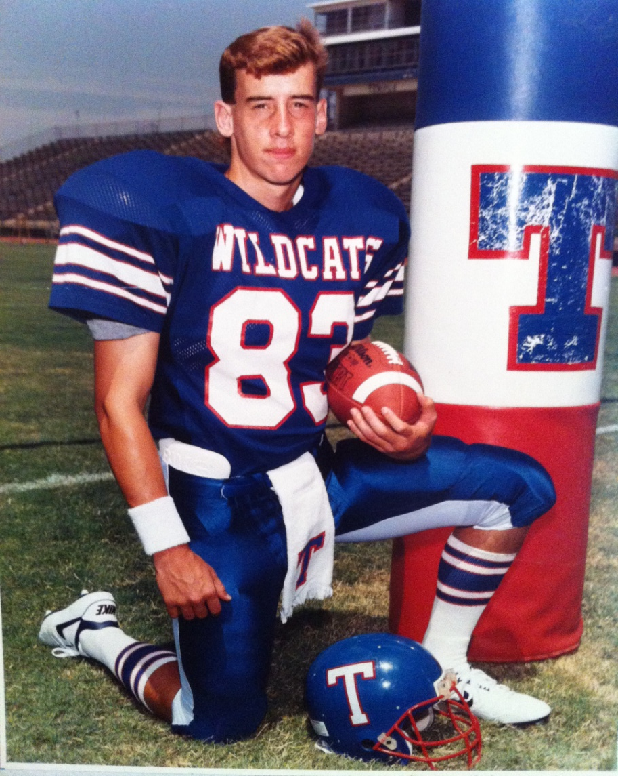

Slide 60
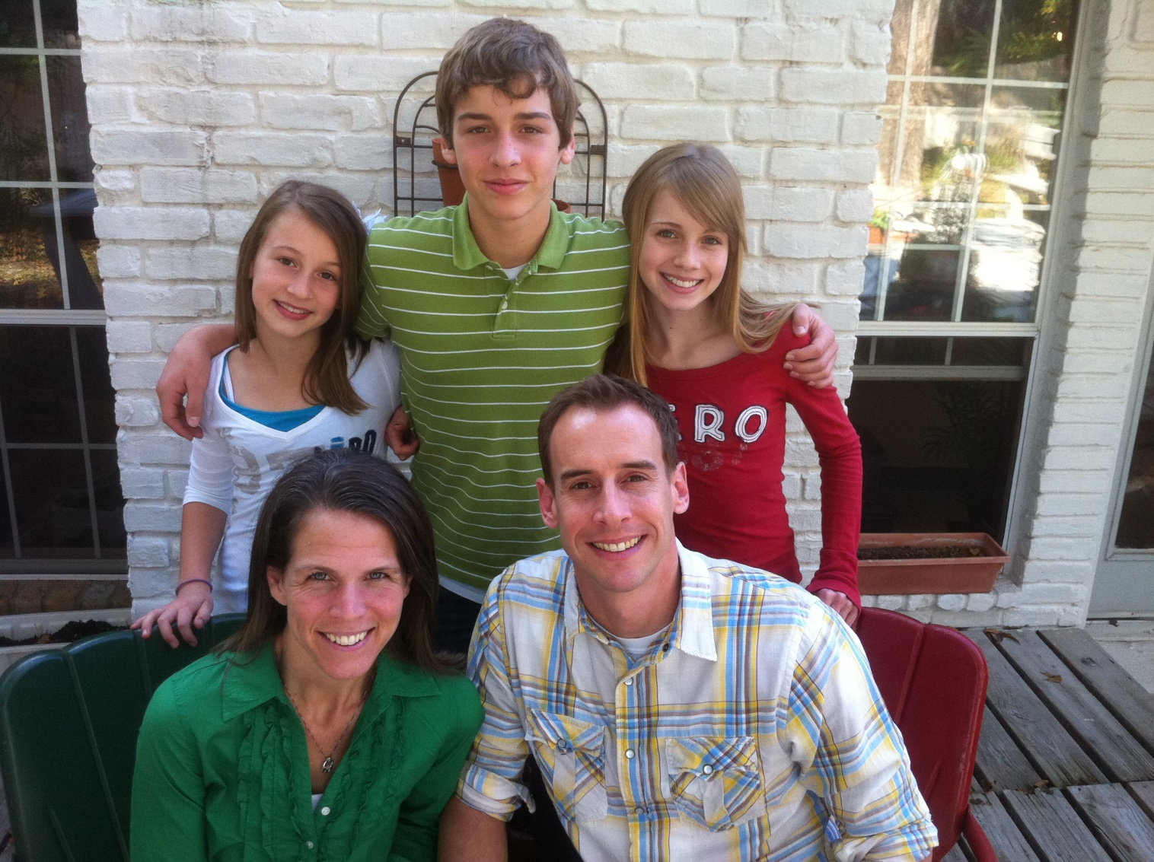

Slide 61

THE CHURCH
Matthew 16:13-20

Slide 62
Distinctive traits of TBC
our MESSAGE…WHAT we believe

Slide 63
Paul, a servant of Christ Jesus, called to be an apostle and set apart for the gospel of God …To all in Rome who are loved by God and called to be his holy people: Grace and peace to you from God our Father and from the Lord Jesus Christ.
Romans 1:1,7

Slide 64
Paul, called to be an apostle of Christ Jesus by the will of God, and our brother Sosthenes, to the church of God in Corinth…
1 Corinthians 1:1-2a

Slide 65
Paul, an apostle of Christ Jesus by the will of God, to God’s holy people in Ephesus, the faithful in Christ Jesus.
Ephesians 1:1

Slide 66
Paul and Timothy, servants of Christ Jesus, To all God’s holy people in Christ Jesus at Philippi, together with the overseers and deacons.
Philippians 1:1

Slide 67
To the elders among you, I appeal as a fellow elder and a witness of Christ’s sufferings who also will share in the glory to be revealed: Be shepherds of God’s flock that is under your care, watching over them…

Slide 68
…Not because you must, but because you are willing, as God wants you to be; not pursuing dishonest gain, but eager to serve; not lording it over those entrusted to you, but being examples to the flock.
1 Peter 5:1-3

Slide 69
So Christ himself gave the apostles, the prophets, the evangelists, the pastors and teachers, to equip his people for works of service, so that the body of Christ may be built up.
Ephesians 4:11-12

Slide 70
IMPERFECT LEADERS
HUMBLY SEEKING to
ELEVATE the SAVIOR
and EQUIP HIS PEOPLE!

Slide 71
Distinctive traits of TBC
our MESSAGE…WHAT we believe
our MISSION…WHY we do what we do

Slide 72
Distinctive traits of TBC
our MESSAGE…WHAT we believe
our MISSION…WHY we do what we do

Slide 73
Distinctive traits of TBC
our MESSAGE…WHAT we believe
our MISSION…WHY we do what we do

Slide 74
Mission Statement
Temple Bible Church exists to glorify God through fulfilling the great commission by…
Evangelizing the lost
Establishing the young
Equipping the growing
Extending the mature

Slide 75
Distinctive traits of TBC
our MESSAGE…WHAT we believe
our MISSION…WHY we do what we do
our METHODS…HOW we do it

Slide 76


Slide 77


Slide 78
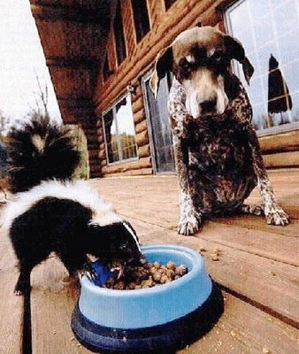

Slide 79
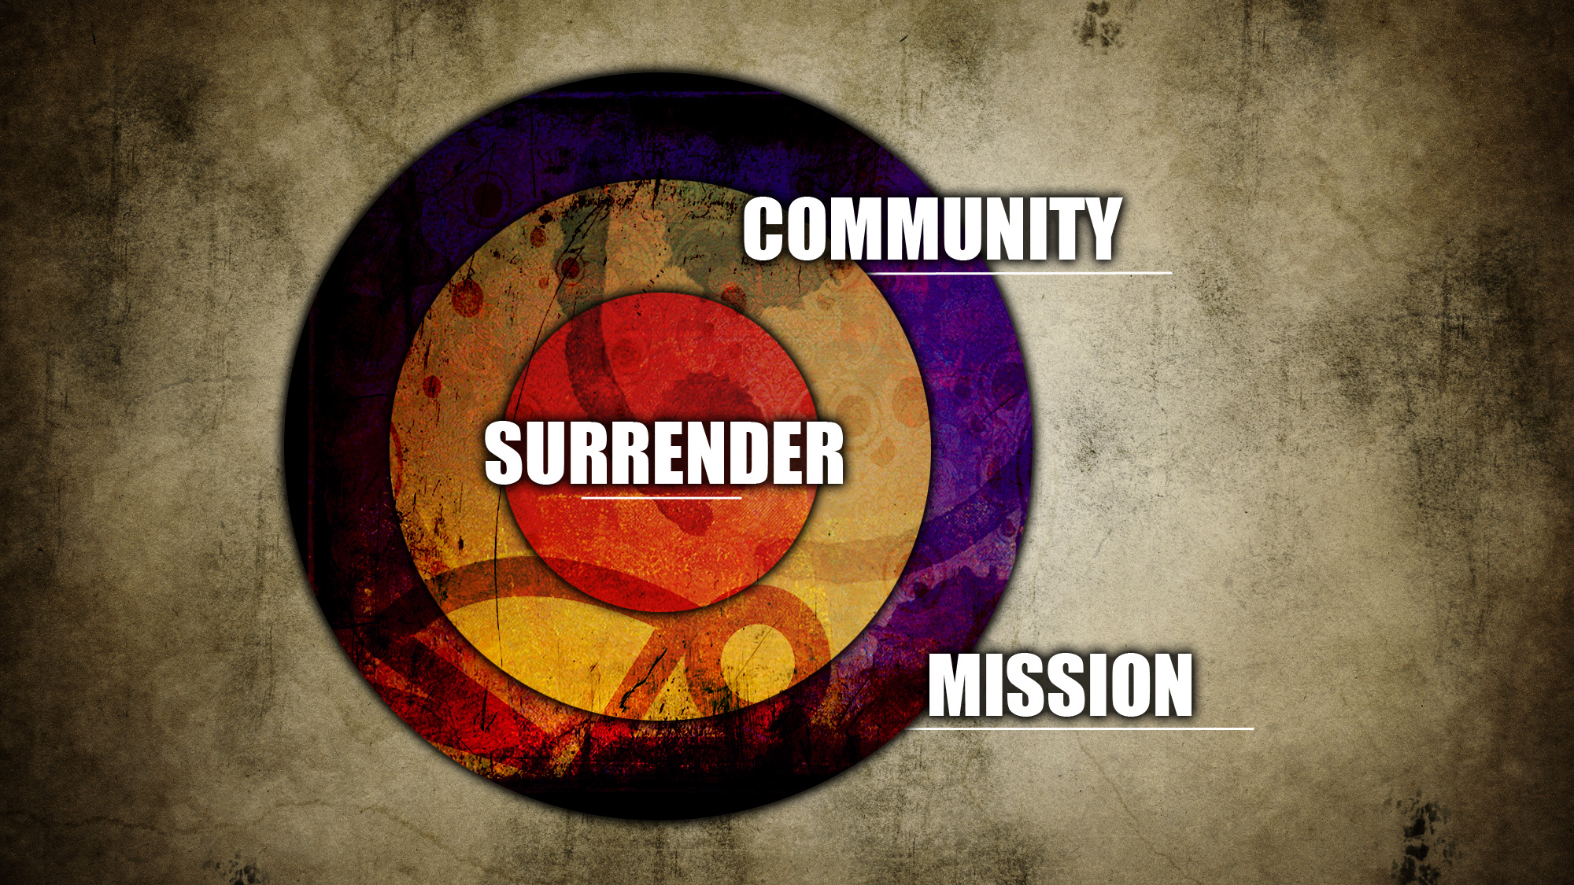

Slide 80
TBC a CHURCH
with a PURPOSE
PEOPLE with a PLAN!

