Slide 1
WELCOME
To Temple Bible Church

Slide 2
Here is Our King
From wherever spring arrives
to heal the ground
From wherever searching comes
the look itself
A trace of what we’re looking for
So be quiet now and wait

Slide 3
The ocean is growing
The tide is coming in
Here it is

Slide 4
Here is our King, Here is our Love
Here is our God who’s come
to bring us back to Him
He is the One, He is Jesus

Slide 5
He is our King, He is our Love
He is our God who’s come
to bring us back to Him
He is the One, He is Jesus

Slide 6
And what was said to the rose
To make it unfold
Was said to me here in my chest
So be quiet now and rest

Slide 7
The ocean is growing
The tide is coming in
Here it is

Slide 8
Here is our King, Here is our Love
Here is our God who’s come
to bring us back to Him
He is the One, He is Jesus

Slide 9
He is our King, He is our Love
He is our God who’s come
to bring us back to Him
He is the One, He is Jesus

Slide 10
Ma---je---sty
Fi---nal---ly
Ma---je---sty
Fi---nal---ly

Slide 11
Here is our King, Here is our Love
Here is our God who’s come
to bring us back to Him
He is the One, He is Jesus

Slide 12
He is our King, He is our Love
He is our God who’s come
to bring us back to Him
He is the One, He is Jesus
USED BY PERMISSION CCLI#78316

Slide 13
Hosanna
Praise is rising, eyes are Turning to You, we turn to You Hope is stirring, hearts are Yearning for You, we long for You

Slide 14
Cause when we see You We find strength to face the day In Your Presence all our fears Are washed away, washed away

Slide 15
Hosanna, hosanna You are the God who saves us Worthy of all our praises Hosanna, hosanna Come have Your way among us We welcome You here, Lord Jesus

Slide 16
Hear the sound of hearts Returning to You, we turn to You In Your Kingdom broken lives Are made new, You make us new

Slide 17
Cause when we see You We find strength to face the day In Your Presence all our fears Are washed away, washed away

Slide 18
Hosanna, hosanna You are the God who saves us Worthy of all our praises Hosanna, hosanna Come have Your way among us We welcome You here, Lord Jesus

Slide 19
Cause when we see You We find strength to face the day In Your Presence all our fears Are washed away, washed away

Slide 20
Hosanna, hosanna You are the God who saves us Worthy of all our praises Hosanna, hosanna Come have Your way among us We welcome You here, Lord Jesus

Slide 21
Hosanna, hosanna Hosanna
Paul Baloche, Brenton Brown
2006 Thankyou Music, Integrity's Hosanna! Music
CCLI 78316

Slide 22
What a Savior
Atoning sacrifice, Keeper of this life Hallelujah, You are Savior Beginning and the end Forgiver of my sin By Your mercy You have saved us

Slide 23
Jesus, You are stronger More than any other Hallelujah, what a Savior Jesus, You are higher My soul’s deepest desire Hallelujah, You are Savior

Slide 24
You are the Shepherd King You lead us by still waters Hallelujah, You are Savior You are my only hope Your kindness is my friend In Your presence You restore us

Slide 25
Jesus, You are stronger More than any other Hallelujah, what a Savior Jesus, You are higher My soul’s deepest desire Hallelujah, You are Savior

Slide 26
You are the way The truth and the life You are my joy and my salvation Stood in my place, taking my shame Upon Your shoulders

Slide 27
Jesus, You are stronger More than any other Hallelujah, what a Savior Jesus, You are higher My soul’s deepest desire Hallelujah, You are Savior
Laura Story
CCLI 78316

Slide 28
Revelation Song
Worthy is the Lamb who was slain Holy Holy is He Sing a new song, to Him who Sits on heaven's mercy seat
Notes:
Intro D
Verse 1 D Am7 C G D Am7 C G

Slide 29
Holy Holy Holy Is the Lord God Almighty Who was and is and is to come
Notes:
D Am7 C G

Slide 30
With all creation I sing
Praise to the King of kings You are my everything And I will adore You
Notes:
D Am7 C G D

Slide 31
Clothed in rainbows of living color Flashes of lightning rolls of thunder Blessing and honor strength And glory and power be To You the only wise King
Notes:
D Am7 C G D Am7 C G

Slide 32
Holy Holy Holy Is the Lord God Almighty Who was and is and is to come
Notes:
D Am7 C G

Slide 33
With all creation I sing
Praise to the King of kings You are my everything And I will adore You
Notes:
D Am7 C G D

Slide 34
Filled with wonder, awe struck wonder At the mention of Your name Jesus Your name is power Breath and living water Such a marvelous mystery
Notes:
D Am7 C G D Am7 C G

Slide 35
Holy Holy Holy Is the Lord God Almighty Who was and is and is to come
Notes:
D Am7 C G

Slide 36
With all creation I sing
Praise to the King of kings You are my everything And I will adore You
Notes:
D Am7 C G D

Slide 37
Holy Holy Holy Is the Lord God Almighty Who was and is and is to come
Notes:
D Am7 C G

Slide 38
With all creation I sing
Praise to the King of kings You are my everything And I will adore You
Jennie Lee Riddle
2004 Gateway Create Publishing
CCLI 78316
Notes:
D Am7 C G D

Slide 41
The Dating Game
Revelation 22:20

Slide 42
book

Slide 44
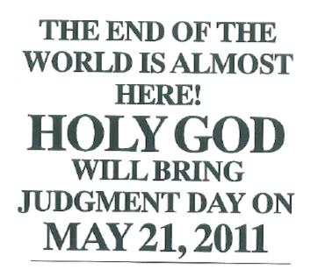
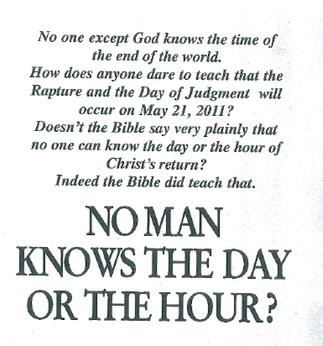
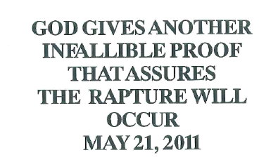

Slide 45
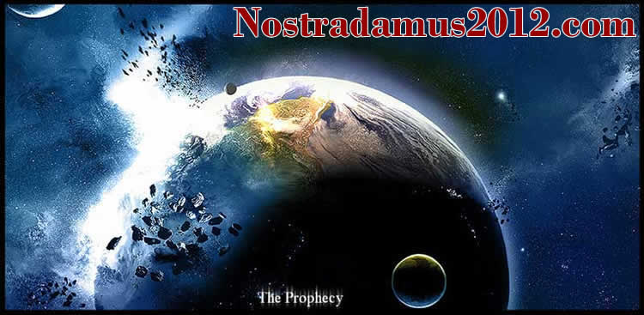
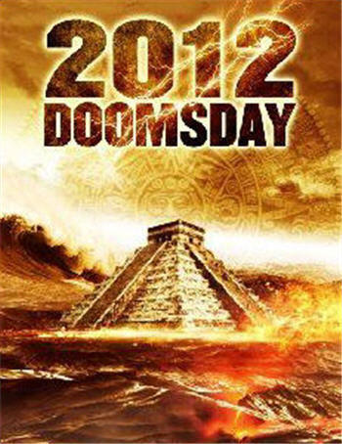
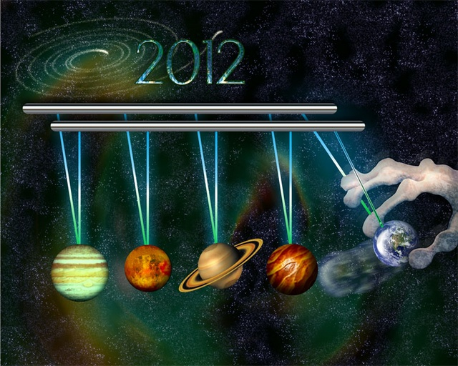

Slide 46
But of that day and hour
no one knows,
not even the angels of heaven,
nor the Son,
but the Father alone.
--Matthew 24:36

Slide 47
It is not for you to know
the times or epochs
which the Father has fixed
by His own authority…
--Acts 1:7

Slide 49
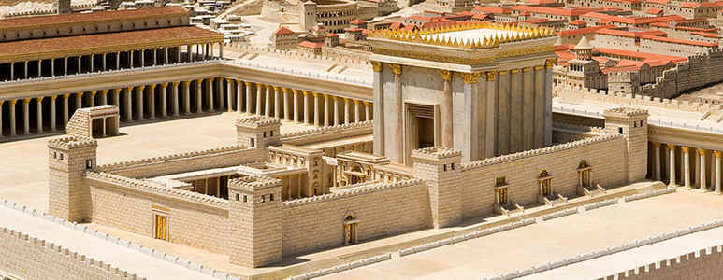

Slide 50
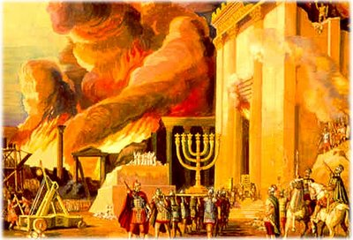

Slide 51
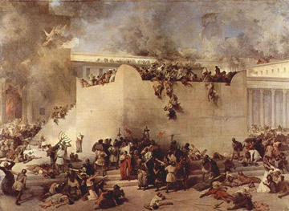

Slide 52
Q&A with Christ
Trouble’s comin’…be PREPARED

Slide 54
We are to be ready
for the last moment
by being ready
at every moment.
--Bonar

Slide 55
Q&A with Christ
Trouble’s comin’…be PREPARED
Trouble’s comin’…be READY

Slide 56
Don't let anyone deceive you in any
way, for (that day will not come) until
the rebellion occurs and the man of
lawlessness is revealed, the man
doomed to destruction.

Slide 57
He will oppose and will exalt himself
over everything that is called God or
is worshiped, so that he sets himself
up in God's temple, proclaiming
himself to be God.
-- 2 Thessalonians 2:3-4

Slide 58
Q&A with Christ
Trouble’s comin’…be PREPARED
Trouble’s comin’…be READY
Trouble’s comin’…but so is the KING
Trouble’s comin’…be ALERT

Slide 59
What to Do ‘till the End?
Be WORKING

Slide 60
What to Do ‘till the End?
Be WORKING
Be WATCHING

Slide 61
In the future there is laid up for me
the crown of righteousness, which
the Lord, the righteous Judge, will
award to me on that day; and not
only to me, but also to all who have
loved His appearing.
-- 2 Timothy 4:8

Slide 62
What to Do ‘till the End?
Be WORKING
Be WATCHING
Be RIGHTEOUS

Slide 63
For the grace of God has appeared,
bringing salvation to all men, instructing us
to deny ungodliness and worldly desires
and to live sensibly, righteously and godly in
the present age, looking for the blessed
hope and the appearing of the glory of our
great God and Savior, Christ Jesus.
-- Titus 2:11-13

Slide 64
What to Do ‘till the End?
Be WORKING
Be WATCHING
Be RIGHTEOUS
Be READY

Slide 65
Little children, abide in Him so that
when He appears we may have
confidence and not shrink away
from Him in shame at His coming!
-- I John 2:28

Slide 66
Focus on the KING,
Not the calendar!

