Slide 1


Slide 2
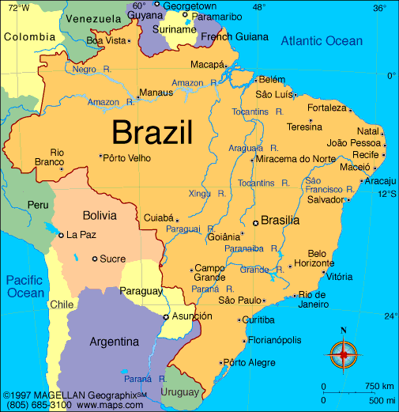
Charles & Vivian Stoner
Pray for…
Prep of course materials
Safety, stamina, and grace
Guidance, joy, and boldness

Slide 3
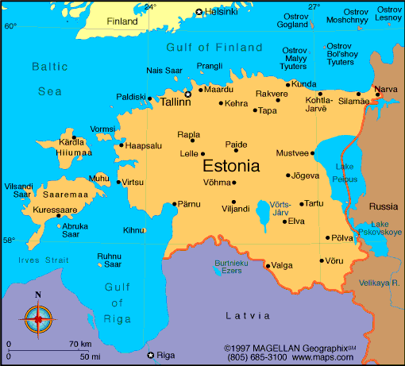
Estonia Team
Pray for…
Hearts to be prepared
A productive time building
Financial support

Slide 4
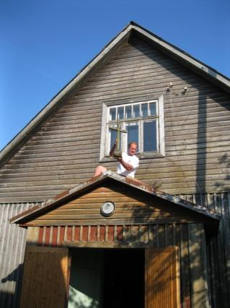
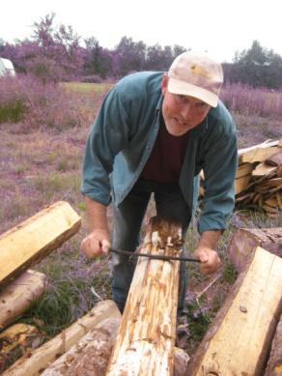
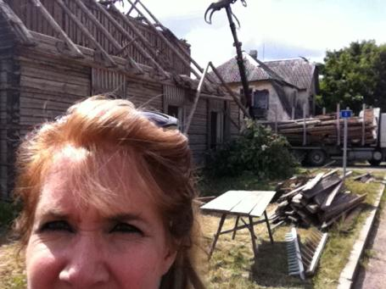
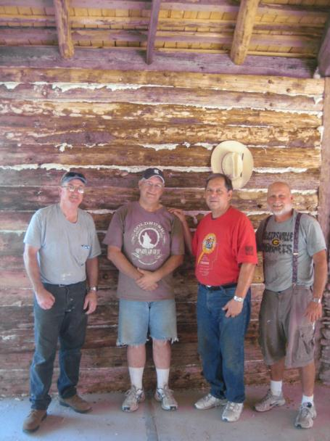
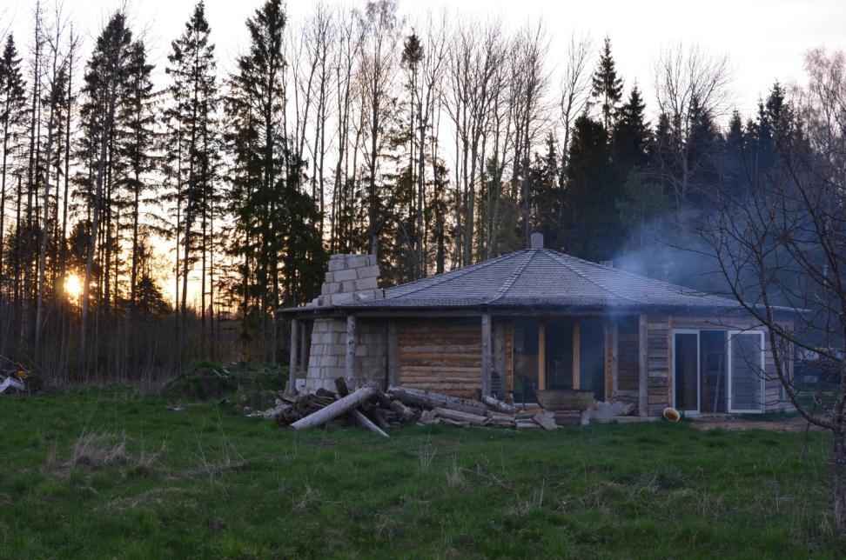
2011 Project

Slide 5
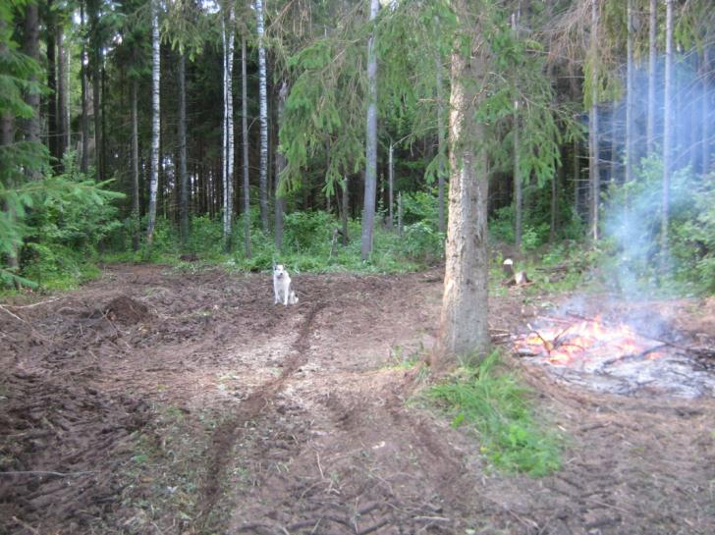
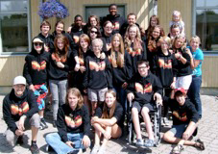
2012 Projects
1) Build a Texas Cabin
2) Work at English Camp
Prayer Requests:
Complete a large amount of the building
Much fruit at English Camp
Raise $18,000

Slide 6
I’ll Fly Away
I’ll fly away, O Glory
I’ll fly away
When I die, Hallelujah, bye and bye
I’ll fly away

Slide 7
Some glad morning when this life is over
I’ll fly away
To a home on God’s celestial shore
I’ll fly away

Slide 8
I’ll fly away, O Glory
I’ll fly away
When I die, Hallelujah, bye and bye
I’ll fly away

Slide 9
When the shadows of this life have gone,
I’ll fly away
Like a bird from prison bars has flown,
I’ll fly away

Slide 10
I’ll fly away, O Glory
I’ll fly away
When I die, Hallelujah, bye and bye
I’ll fly away

Slide 11
Just a few more weary days and then
I’ll fly away
To a land where joy shall never end
I’ll fly away

Slide 12
I’ll fly away, O Glory
I’ll fly away
When I die, Hallelujah, bye and bye
I’ll fly away
CCLI 78316

Slide 13
Your Name
As morning dawns and evening fades
You inspire songs of praise
That rise from earth to touch
Your heart and glorify Your name

Slide 14
As morning dawns and evening
Fades You inspire songs of praise
That rise from earth to touch
Your heart and glorify Your name

Slide 15
Your name is a strong and mighty tower
Your name is a shelter like no other
Your name, let the nations
Sing it louder
'Cause nothing has the power to save
But Your Name

Slide 16
Jesus, in Your name we pray
Come and fill our hearts today
Lord, give us strength to live
For You and glorify Your name

Slide 17
Your name is a strong and mighty tower
Your name is a shelter like no other
Your name, let the nations
Sing it louder
'Cause nothing has the power to save
But Your Name

Slide 18
Your name is a strong and mighty tower
Your name is a shelter like no other
Your name, let the nations
Sing it louder
'Cause nothing has the power to save
But Your Name
CCLI 78316

Slide 19
My Jesus I Love Thee
My Jesus, I love thee
I know Thou art mine
For Thee all the follies of
Sin I resign

Slide 20
My gracious Redeemer
My Savior art thou
If ever I loved Thee
My Jesus 'tis now

Slide 21
I love Thee because Thou has
First loved me
And purchased my pardon on
Calvary's tree

Slide 22
I love Thee for wearing the
Thorns on Thy brow
If ever I loved Thee, my Jesus
'tis now

Slide 23
In mansions of glory
And endless delight
I'll ever adore Thee in heaven
So bright

Slide 24
I'll sing with the glittering
Crown on my brow
If ever I loved Thee
My Jesus' tis now
CCLI 78316

Slide 25

I can only Imagine
I can only imagine what it will be like
When I walk by your side
I can only imagine what my eyes will see
When your face, is before me
I can only imagine
I can only imagine

Slide 26
Surrounded by Your glory
What will my heart feel
Will I dance for You Jesus
or in awe of You be still

Slide 27
Will I stand in Your presence
or to my knees will I fall
Will I sing hallelujah
Will I be able to speak at all

Slide 28
I can only imagine
I can only imagine

Slide 29
I can only imagine when that day comes
And I find myself standing in the Son
I can only imagine when all I will do
Is forever, forever worship You
I can only imagine
I can only imagine

Slide 30
Surrounded by Your glory
What will my heart feel
Will I dance for You Jesus
or in awe of You be still

Slide 31
Will I stand in Your presence
or to my knees will I fall
Will I sing hallelujah
Will I be able to speak at all
I can only imagine

Slide 32
Surrounded by Your glory
What will my heart feel
Will I dance for You Jesus
or in awe of You be still

Slide 33
Will I stand in Your presence
or to my knees will I fall
Will I sing hallelujah
Will I be able to speak at all
I can only imagine

Slide 34
I can only imagine
When all I will do
Is forever, forever worship You
I can only imagine
TEMPLE BIBLE CHURCH Used by Permission CCLI #78316

Slide 35
Cannons
It's falling from the clouds
A strange and lovely sound
I hear it in the thunder and the rain
It's ringing in the skies
Like cannons in the night
The music of the universe plays

Slide 36
You are holy, great and mighty
The moon and the stars
Declare who You are
I'm so unworthy, but still You love me
Forever my heart will sing
Of how great You are

Slide 37
Beautiful and free, song of galaxies
It's reaching far beyond the Milky Way
Let's join in with the sound,
Come on let's sing it loud
As the music of the universe plays

Slide 38
You are holy, great and mighty
The moon and the stars
Declare who You are
I'm so unworthy, but still You love me
Forever my heart will sing
Of how great You are

Slide 39
All glory, honor, power is Yours amen
All glory, honor, power is Yours amen
All glory, honor, power is
Yours forever amen

Slide 40
You are holy, great and mighty
The moon and the stars
Declare who You are
I'm so unworthy, but still You love me
Forever my heart will sing
Of how great You are
CCLI 78316

Slide 41


Slide 42


Slide 43
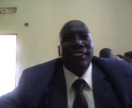

Slide 44
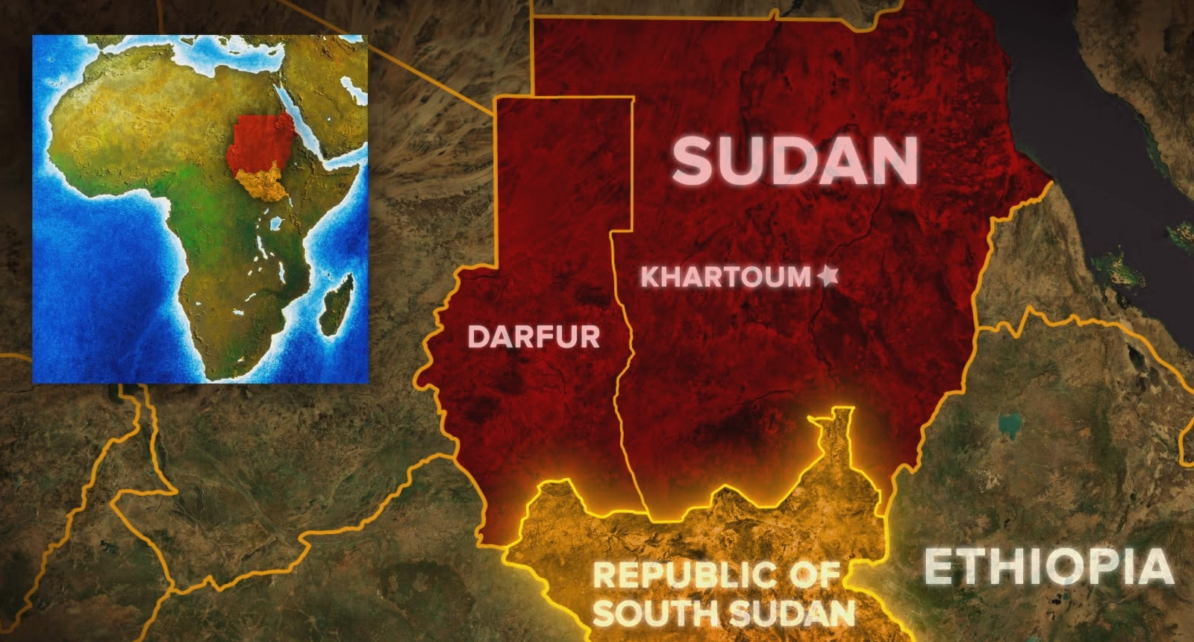

Slide 45

After this I looked, and there before me was a great multitude that no one could count, from every nation, tribe, people and language, standing before the throne and before the Lamb.
Revelation 7:9

Slide 46

The kingdom of God is in your midst.
Luke 17:21

Slide 47

And God saw all that he had made
and it was very good.
Genesis 1:31

Slide 48
Rev 21:1 Then I saw “a new heaven and a new earth,” for the first heaven and the first earth had passed away, and there was no longer any sea.

Slide 49
2) I saw the Holy City, the new Jerusalem, coming down out of heaven from God, prepared as a bride beautifully dressed for her husband..”

Slide 50
3) And I heard a loud voice from the throne saying, “Look! God’s dwelling place is now among the people, and he will dwell with them. They will be his people, and God himself will be with them and be their God.

Slide 51
4) ‘He will wipe every tear from their eyes. There will be no more death’ or mourning or crying or pain, for the old order of things has passed away.”

Slide 52
