Slide 2
Holding On to You
All I want is You, all I need is You And I do believe what You say is true But I don't understand Why it's taken me so long to know

Slide 3
Well I tried to be everything I need But a broken heart was all That I achieved Still I don't understand Why it's taken me so long to know

Slide 4
You never change Your love remains Oh God, I'm holding onto You When I'm afraid Still Your love remains Oh God, I'm holding onto You

Slide 5
I just want to be, with You every day Never let You down, never walk away But I know if I do You will be waiting for me

Slide 6
You never change Your love remains Oh God, I'm holding onto You When I'm afraid Still Your love remains Oh God, I'm holding onto You

Slide 7
You never change Your love remains Oh God, I'm holding onto You When I'm afraid Still Your love remains Oh God, I'm holding onto You
Paul Colman
CCLI 78316

Slide 8
Only One For Me
By Your blood, You have saved me
With Your love,
You have brought me close to You By Your hands, You have made me With one word, You amaze me

Slide 9
Forever I will sing Your praise And worship You alone
Until the day I die I live my life for You

Slide 10
With every breath I take I bless Your name and want You more And now I'm running to You, O Lord

Slide 11
You are the reason my heart Can go on and on You are the life inside of me You are the answer to my cries You're all that I could ever need You are the only One for me

Slide 12
With one breath, You sustain me By Your grace You have given me a hope To dream of Your intentions to Be more like You

Slide 13
Forever I will sing Your praise And worship You alone
Until the day I die I live my life for You

Slide 14
With every breath I take I bless Your name and want You more And now I'm running to You, O Lord

Slide 15
You are the reason my heart Can go on and on You are the life inside of me

Slide 16
You are the answer to my cries
You're all that I could ever need You are the only One for me
David Moore
2005 Gateway Create Publishing
CCLI 78316

Slide 17
Forever I will sing Your praise And worship You alone until The day I die I live my life for You

Slide 18
With every breath I take I bless Your name and want You more And now I'm running to You, O Lord

Slide 19
You are the reason my heart Can go on and on You are the life inside of me

Slide 20
You are the answer to my cries
You're all that I could ever need You are the only One for me
CCLI 78316

Slide 21
You are the reason my heart Can go on and on You are the life inside of me

Slide 22
You are the answer to my cries
You're all that I could ever need You are the only One for me
David Moore
2005 Gateway Create Publishing
CCLI 78316

Slide 23
Come Thou Fount, Come Thou King
Come Thou Fount of every blessing Tune my heart to sing thy grace Streams of mercy never ceasing
Call for songs of loudest praise

Slide 24
Teach me some melodious sonnet Sung by flaming tongues above
Praise His Name, I'm fixed upon it Name of God’s redeeming love

Slide 25
Come thou Fount come thou King Come thou precious Prince of Peace Hear Your bride to You we sing Come thou Fount of our blessing

Slide 26
I was lost in utter darkness 'til You came and rescued me I was bound by all my sin when Your love came and set me free

Slide 27
Now my soul can sing a new Song now my heart has found a home Now Your grace is always with me And I'll never be alone

Slide 28
Come Thou Fount, come Thou King Come Thou precious Prince of Peace Hear Your bride, to You we sing Come Thou Fount of our blessing

Slide 29
O to grace how great a debtor Daily I'm constrained to be Let Thy goodness like a fetter Bind my wandering heart to Thee

Slide 30
Prone to wander, Lord I feel it Prone to leave the God I love Here's my heart Lord, take and seal it Seal it for Thy courts above

Slide 31
Come Thou Fount, come Thou King Come Thou precious Prince of Peace Hear Your bride, to You we sing Come Thou Fount of our blessing
Thomas Miller, Robert Robinson
2005 Gateway Create Publishing
CCLI 78316

Slide 32
Here In Your Presence
Found in Your hands, fullness of joy Every fear suddenly wiped away Here in Your Presence

Slide 33
All of my gains now fade away Every crown no longer on display Here in Your Presence

Slide 34
Heaven is trembling in awe of Your wonders The kings and their kingdoms Are standing amazed

Slide 35
Here in Your Presence
We are undone Here in Your Presence
Heaven and earth become one

Slide 36
Here in Your Presence
All things are new
Here in Your Presence
Everything bows before You

Slide 37
Found in Your hands, fullness of joy Every fear suddenly wiped away Here in Your Presence

Slide 38
All of my gains now fade away Every crown no longer on display Here in Your Presence

Slide 39
Heaven is trembling in awe of Your wonders The kings and their kingdoms Are standing amazed

Slide 40
Here in Your Presence
We are undone Here in Your Presence
Heaven and earth become one

Slide 41
Here in Your Presence
All things are new
Here in Your Presence
Everything bows before You

Slide 42
Wonderful, beautiful, glorious Matchless in every way

Slide 43
Here in Your Presence
We are undone Here in Your Presence
Heaven and earth become one

Slide 44
Here in Your Presence
All things are new
Here in Your Presence
Everything bows before You
Jon Egan
2006 Vertical Worship Songs
CCLI 78316

Slide 45
Waiting Here For You
If faith can move the mountains
Let the mountains move
We come with expectation
Waiting here for You
Waiting here for You

Slide 46
You’re the Lord of all creation
And still You know my heart
The Author of Salvation
You loved us from the start

Slide 47
Waiting here for You
With our hands lifted high in praise
And it’s You we adore
Singing alleluia

Slide 48
You are everything You’ve promised
Your faithfulness is true
We’re desperate for Your presence
All we need is You

Slide 49
Waiting here for You
With our hands lifted high in praise
And it’s You we adore
Singing alleluia

Slide 50
We’re singing alleluia
We’re singing alleluia
We’re singing alleluia
We’re singing alleluia

Slide 51
Waiting here for You
With our hands lifted high in praise
And it’s You we adore
Singing alleluia
Traditional , James Chadwick, Chris Tomlin
2009 Vamos Publishing, worshiptogether.com songs, sixsteps Music
CCLI 78316

Slide 54
The Monster
of the Deep

Slide 55
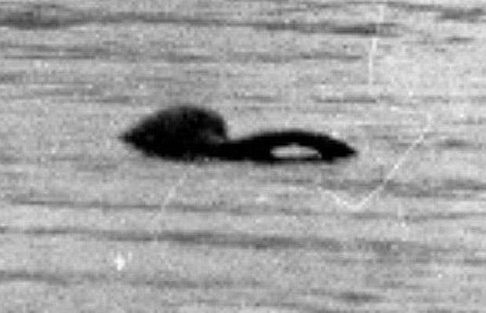

Slide 56
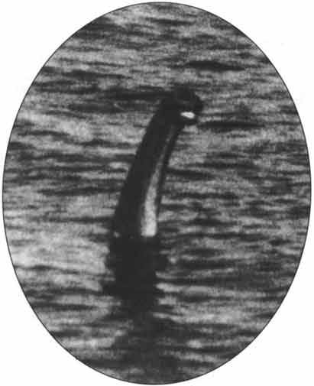

Slide 57
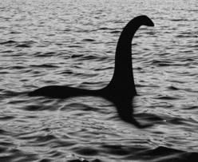

Slide 58
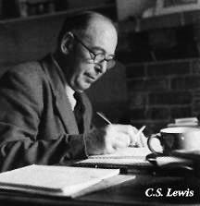
There are two equal and opposite errors
into which our race can fall about demons.
One is to disbelieve in their existence.
The other is to believe, and to feel an
excessive and unhealthy interest in them.
They are equally
pleased by both errors.
C.S. Lewis

Slide 59
“It is never wise to leave a live dragon out of your calculations, especially if one lives nearby.”
Bilbo Baggins

Slide 60
The Monster
of the Deep

Slide 61
LUCIFER the LIAR!
who the DEVIL he is?

Slide 62
“How you have fallen from heaven,
O star of the morning, son of the dawn!
You have been cut down to the earth,
You who have weakened the nations!
“But you said in your heart,
‘I will ascend to heaven;
I will raise my throne above the stars of God,
And I will sit on the mount of assembly
In the recesses of the north.

Slide 63
‘I will ascend above the heights of the clouds;
I will make myself like the Most High.’
“Nevertheless you will be thrust down to Sheol,
To the recesses of the pit.
Isaiah 14:12-15

Slide 64
LUCIFER the LIAR!
who the DEVIL he is?
what the DEVIL is he doing?

Slide 65
THE OBJECTIVES OF SATAN
~KEEP UNBELIEVERS in the DARK

Slide 66
And even if our gospel is veiled, it is veiled to those who are perishing, in whose case the god of this world has blinded the minds of the unbelieving so that they might not see the light of the gospel of the glory of Christ, who is the image of God.
2 Corinthians 4:3-4

Slide 67
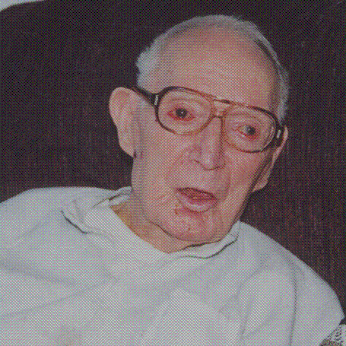

Slide 68
THE OBJECTIVES OF SATAN
~KEEP UNBELIEVERS in the DARK
~DEFAME the CHARACTER &
CREDIBILITY of GOD
~TEMPT us to walk in DISOBEDIENCE & SIN

Slide 69
Sin seldom strides into our lives announcing its hostile intentions.
It prefers stealth, camouflage, or even better, to appear friendly.

Slide 70
THE OBJECTIVES OF SATAN
~KEEP UNBELIEVERS in the DARK
~DEFAME the CHARACTER &
CREDIBILITY of GOD
~TEMPT us to walk in DISOBEDIENCE & SIN
~CREATE doctrinal CONFUSION

Slide 71
Be on guard for yourselves and
for all the flock, among which the
Holy Spirit has made you overseers,
to shepherd the church of God which He purchased with His own blood.

Slide 72
I know that after my departure
savage wolves will come in among you,
not sparing the flock;
and from among your own selves
men will arise, speaking perverse things,
to draw away the disciples after them.
Acts 20:28-30

Slide 73
THE OBJECTIVES OF SATAN
~KEEP UNBELIEVERS in the DARK
~DEFAME the CHARACTER &
CREDIBILITY of GOD
~TEMPT us to walk in DISOBEDIENCE & SIN
~CREATE doctrinal CONFUSION
~HINDER our SPIRITUAL SERVICE

Slide 74
For we wanted to come to you—
I, Paul, more than once—and yet Satan hindered us.
1 Thessalonians 2:18

Slide 75
THE OBJECTIVES OF SATAN
~KEEP UNBELIEVERS in the DARK
~DEFAME the CHARACTER &
CREDIBILITY of GOD
~TEMPT us to walk in DISOBEDIENCE & SIN
~CREATE doctrinal CONFUSION
~HINDER our SPIRITUAL SERVICE
~Lead churches into dead orthodoxy

Slide 76
I know your deeds and your toil and perseverance, and that you cannot tolerate evil men, and you put to the test those who call themselves apostles, and they are not, and you found them to be false; and you have perseverance and have endured for My name’s sake, and have not grown weary.
But I have this against you, that you have left your first love.
Revelation 2:2-4

Slide 77
the TACTICS of SATAN
~DECEPTION

Slide 78
And the great dragon was thrown down, the serpent of old who is called the devil and Satan, who deceives the whole world; he was thrown down to the earth, and his angels were thrown down with him.
Revelation 12:9

Slide 79
the TACTICS of SATAN
~DECEPTION
~ACCUSATION

Slide 80
…for the accuser of our brethren has been thrown down, he who accuses them before our God day and night.
Revelation 12:10

Slide 81
the TACTICS of SATAN
~DECEPTION
~ACCUSATION
~STRONGHOLDS

Slide 82
For though we walk in the flesh,
we do not war according to the flesh,
for the weapons of our warfare
are not of the flesh, but divinely powerful for the destruction of fortresses.

Slide 83
We are destroying speculations
and every lofty thing raised up
against the knowledge of God,
and we are taking every thought captive to the obedience of Christ, and we are ready to punish all disobedience, whenever your obedience is complete.
2 Corinthians 10:3-6

Slide 84
the TACTICS of SATAN
~DECEPTION
~ACCUSATION
~STRONGHOLDS
~OPPRESSION

Slide 85
For our struggle is not against
flesh and blood,
but against the rulers,
against the powers,
against the world forces of this darkness, against the spiritual forces of wickedness in the heavenly places.
Ephesians 6:12

Slide 86
STANDING against the ENEMY

Slide 87
Be of sober spirit, be on the alert. Your adversary, the devil, prowls around like a roaring lion, seeking someone to devour. But resist him, firm in your
faith, knowing that the same experiences of suffering are being accomplished by your brethren who are in the world.
1 Peter 5:8-9

Slide 88
STANDING against the ENEMY
RESPECT SATAN…he is DANGEROUS

Slide 90
STANDING against the ENEMY
RESPECT SATAN…he is DANGEROUS
RECOGNIZE SATAN…he is DEVIOUS

Slide 91
Most often though,
the skirmishes are more subtle.
Satan prefers stealth strategies:
The guerilla ambushes of temptation,
the sporadic sniper fire of false or ungodly thoughts, a siege of distractions that cause us to neglect spiritual nourishment. His objective remains the same: to take prisoner as many people as possible and to disarm the rest.

Slide 92
STANDING against the ENEMY
RESPECT SATAN…he is DANGEROUS
RECOGNIZE SATAN…he is DEVIOUS
RESIST SATAN…he is on the PROWL

Slide 93
REMEMBER…
The BATTLE continues,
BUT the WAR is WON!

Slide 94
Your Grace Still Amazes Me
My faithful Father, enduring friend Your tender mercy's like a river,
With no end It overwhelms me, covers my sin Each time I come into Your presence I stand in wonder once again

Slide 95
Your grace still amazes me Your love is still a mystery Each day I fall on my knees 'Cause Your grace still amazes me Your grace still amazes me

Slide 96
O patient Savior, You make me whole You are the Author and
The Healer of my soul What can I give You

Slide 97
Lord, What can I say? I know there's no way to repay You Only to offer You my praise

Slide 98
Your grace still amazes me Your love is still a mystery Each day I fall on my knees 'Cause Your grace still amazes me Your grace still amazes me

Slide 99
It's deeper, it's wider It's stronger, it's higher
(repeat)
Than anything my eyes can see

Slide 100
Your grace still amazes me Your love is still a mystery Each day I fall on my knees 'Cause Your grace still amazes me Your grace still amazes me
Shawn Craig, Connie Harrington
2001 Little Cricket Music, Ariose Music, PraiseSong Press Music Inc.
CCLI 78316

Slide 101
You, You Are God
Here I am I've come to find You Here I am to see Your grace To bring to You an offering I have to ask myself one thing How can I do anything but praise I praise

Slide 102
You, You are God, You are Lord You are all I'm living for You are King of everything I want my life to praise You

Slide 103
Here I am I've come to thank You Here I am a life You've changed Because You gave Your life for me You crucified Your Son for me How can I do anything but praise I praise

Slide 104
You, You are God, You are Lord You are all I'm living for You are King of everything I want my life to praise You

Slide 105
You are God, You are Lord You are all I'm living for You are King of everything I want my life to praise You

Slide 106
You are God, You are Lord You are all I'm living for You are King of everything I want my life to praise You
I want my life to praise You
Walker Beach
2003 Gateway Create Publishing
CCLI 78316

