Slide 2
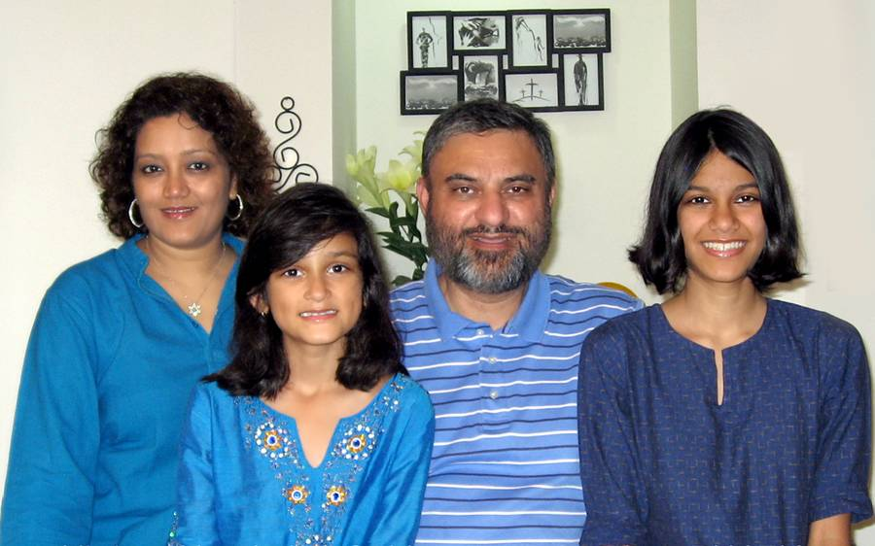
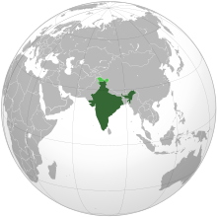
Welcome Bhatia Family
India

Slide 3
Our God Saves
In the Name of the Father In the Name of the Son In the Name of the Spirit, Lord We come

Slide 4
We're gathered together to Lift up Your Name To call on our Savior To fall on Your grace

Slide 5
In the Name of the Father In the Name of the Son In the Name of the Spirit, Lord We come

Slide 6
We're gathered together to Lift up Your Name To call on our Savior To fall on Your grace

Slide 7
Hear the joyful sound of our offering As Your saints bow down As Your people sing

Slide 8
We will rise with You
Lifted on Your Wings And the world will see that

Slide 9
Our God saves, our God saves, There is hope in Your Name Mourning turns to songs of praise Our God saves, our God saves

Slide 10
In the Name of the Father In the Name of the Son In the Name of the Spirit, Lord We come

Slide 11
We're gathered together to Lift up Your Name To call on our Savior To fall on Your grace

Slide 12
Hear the joyful sound of our offering As Your saints bow down As Your people sing

Slide 13
We will rise with You
Lifted on Your Wings And the world will see that

Slide 14
Our God saves, our God saves There is hope in Your Name Mourning turns to songs of praise Our God saves, our God saves

Slide 15
Hear the joyful sound of our offering As Your saints bow down As Your people sing

Slide 16
We will rise with You
Lifted on Your Wings And the world will see that

Slide 17
Our God saves, our God saves, There is hope in Your Name Mourning turns to songs of praise Our God saves, our God saves

Slide 18
Our God saves, our God saves
Paul Baloche, Brenton Brown
2007 Thankyou Music, Leadworship Songs, Integrity's Hosanna! Music
CCLI 78316

Slide 19
Majestic
O Lord our Lord how majestic Is Your name in all the earth O Lord our Lord how majestic Is Your name in all the earth

Slide 20
The heavens declare Your greatness The oceans cry out to You The mountains they bow down before You So I'll join with the earth
And I'll give my praise to You

Slide 21
O Lord our Lord how majestic Is Your name in all the earth O Lord our Lord how majestic Is Your name in all the earth

Slide 22
The heavens declare Your greatness The oceans cry out to You The mountains they bow down before You So I'll join with the earth
And I'll give my praise to You

Slide 23
I will worship You I will worship You I will worship You I will worship You We will worship You
We will worship You

Slide 24
The heavens declare Your greatness The oceans cry out to You The mountains they bow down before You So I'll join with the earth
And I'll sing

Slide 25
The heavens declare Your greatness The oceans cry out to You The mountains they bow down before You So I'll join with the earth
And I'll give my praise to You
Lincoln Brewster
2005 Integrity's Praise! Music
CCLI 78316

Slide 26
Overcome
Seated above
Enthroned in the Father's love Destined to die Poured out for all mankind

Slide 27
God's only Son Perfect and spotless One He never sinned But suffered as if He did

Slide 28
All authority
Every victory is Yours

Slide 29
Savior, worthy of honor and glory Worthy of all our praise You overcame

Slide 30
Jesus, awesome in power forever Awesome and great is Your Name You overcame

Slide 31
Power in hand Speaking the Father's plan Sending us out Light in this broken land

Slide 32
All authority
Every victory is Yours

Slide 33
Savior, worthy of honor and glory Worthy of all our praise You overcame

Slide 34
Jesus, awesome in power forever Awesome and great is Your Name You overcame

Slide 35
We will overcome
By the blood of the Lamb And the word of our testimony Everyone overcome
(repeat)
Notes:
Four Times

Slide 36
Savior, worthy of honor and glory Worthy of all our praise You overcame

Slide 37
Jesus, awesome in power forever Awesome and great is Your Name You overcame
Jon Egan
2007 Vertical Worship Songs
CCLI 78316

Slide 38
Mighty To Save
Everyone needs compassion Love that's never failing Let mercy fall on me

Slide 39
Everyone needs forgiveness The kindness of a Savior The hope of nations

Slide 40
Savior, He can move the mountains My God is mighty to save He is mighty to save

Slide 41
Forever, Author of salvation
He rose and conquered the grave, Jesus conquered the grave

Slide 42
So take me as You find me All my fears and failures Fill my life again

Slide 43
I give my life to follow Everything I believe in Now I surrender

Slide 44
Savior, He can move the mountains My God is mighty to save He is mighty to save

Slide 45
Forever, Author of salvation
He rose and conquered the grave, Jesus conquered the grave

Slide 46
Savior, He can move the mountains My God is mighty to save He is mighty to save

Slide 47
Forever, Author of salvation
He rose and conquered the grave, Jesus conquered the grave

Slide 48
Savior, He can move the mountains My God is mighty to save He is mighty to save

Slide 49
Forever, Author of salvation
He rose and conquered the grave, Jesus conquered the grave
Ben Fielding, Reuben Morgan
2006 Hillsong Music Publishing
CCLI 78316

Slide 51
ANGELS
DEMONS

Slide 52
ANGELS-
Spirit beings that God created to serve His purposes and minister to His people.

Slide 53
Angels: Their Mission
*They are worshippers and messengers.
*They battle against demonic forces.
*They are agents of God’s judgment.

Slide 54
Angels: Their Mission
*They intervene in human affairs.
*They are sent to serve those who will inherit salvation.
*Sometimes they give protection to God’s people.

Slide 55
Two Areas of Instruction
When it Comes to Angels
~Do not be afraid!
~Treat strangers well.

Slide 56
DEMONS
The group of angels who followed Satan
and his rebellion who seek to rob God of glory and keep his people from being fully devoted followers of Christ.

Slide 57
Demons: Their Mission
*To work indirectly and directly against God’s people, so as to hinder them from being all God has created them to be in Christ.

Slide 58
Demons work indirectly…
…through temptation.
…through the world
…through our own flesh

Slide 59
Demons work directly…
…through attack
~God loves you and offers a
wonderful plan for your life.
~Demons hate you, and offer a
wonderful plan for your life.

Slide 60
Demons work directly…
…through attack
…through possession and oppression
…through deception. Satan is the father of lies.

Slide 61
Be Alert, Believe the Word

Slide 62
ANGELS
DEMONS

