Slide 2
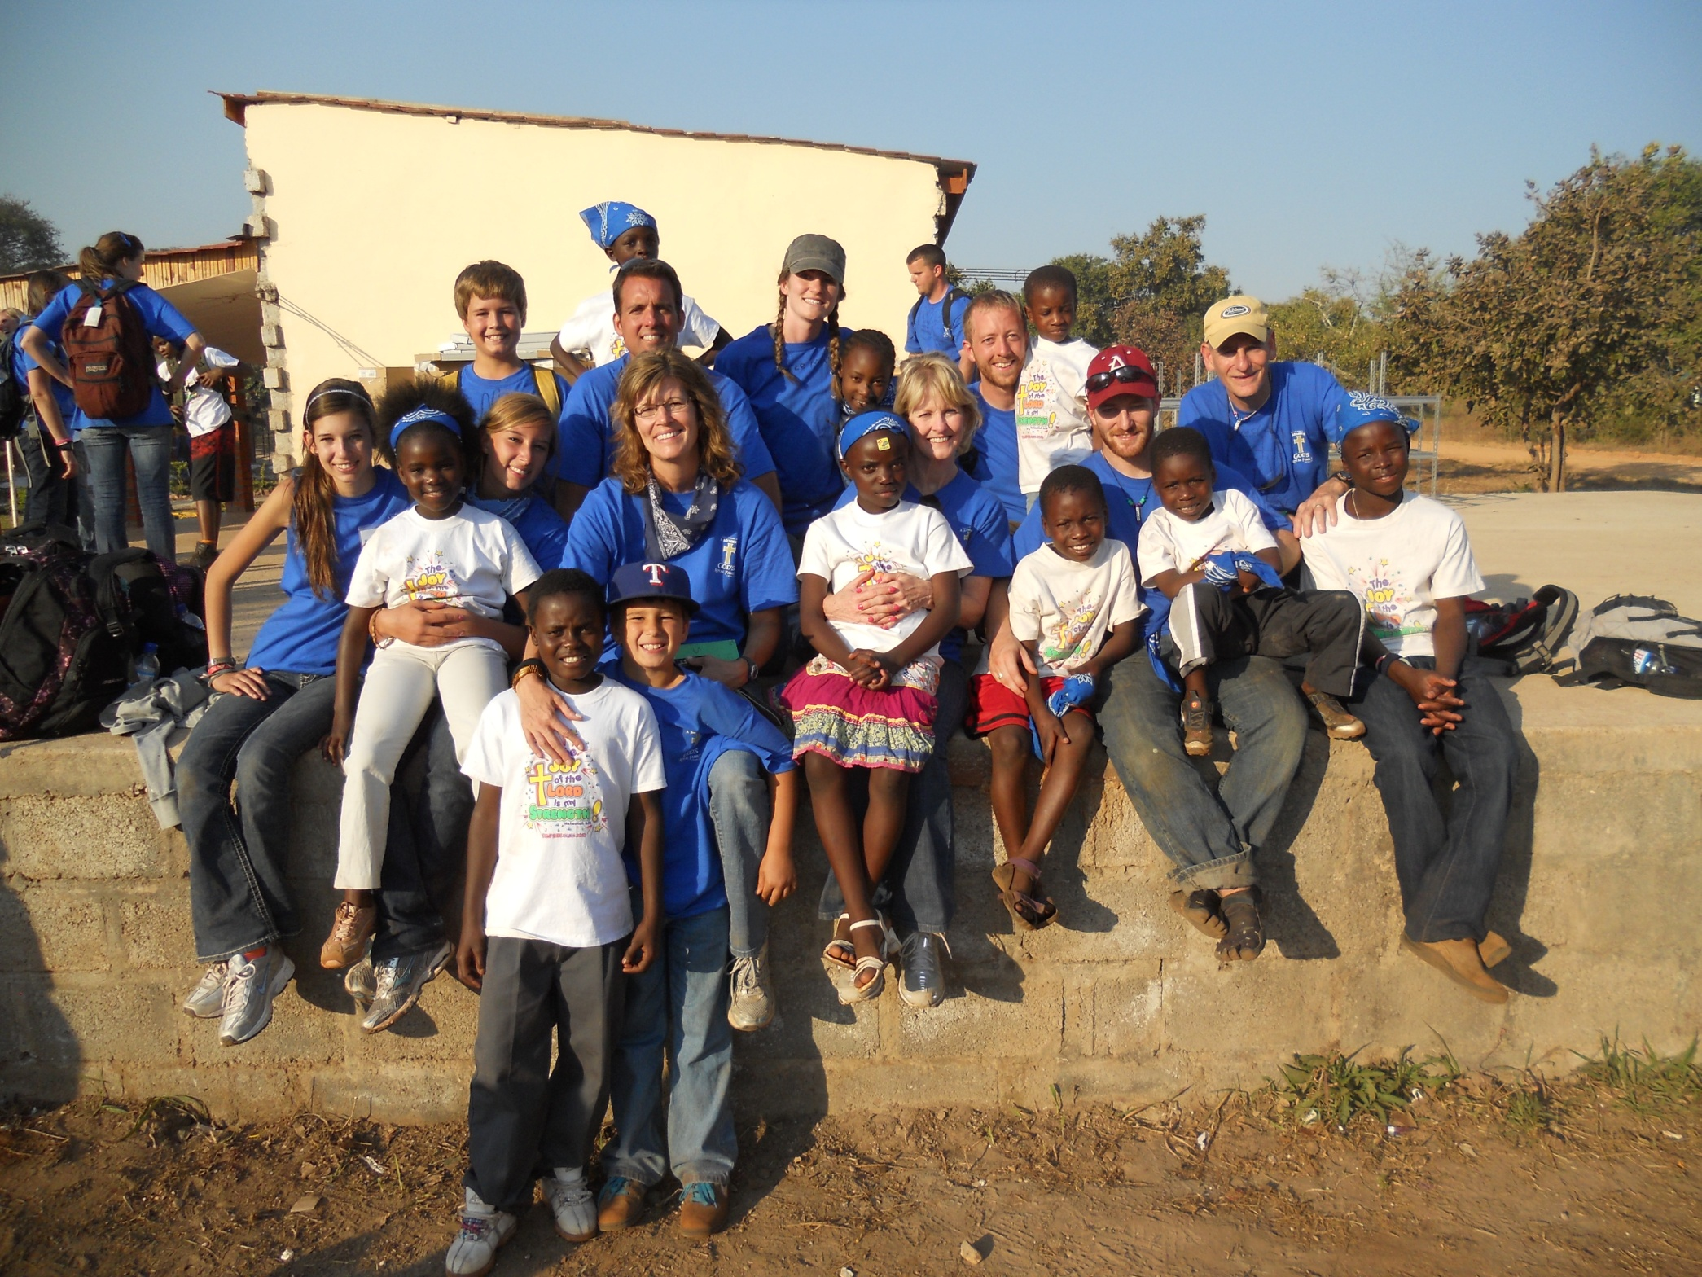
Zambia Team

Slide 3
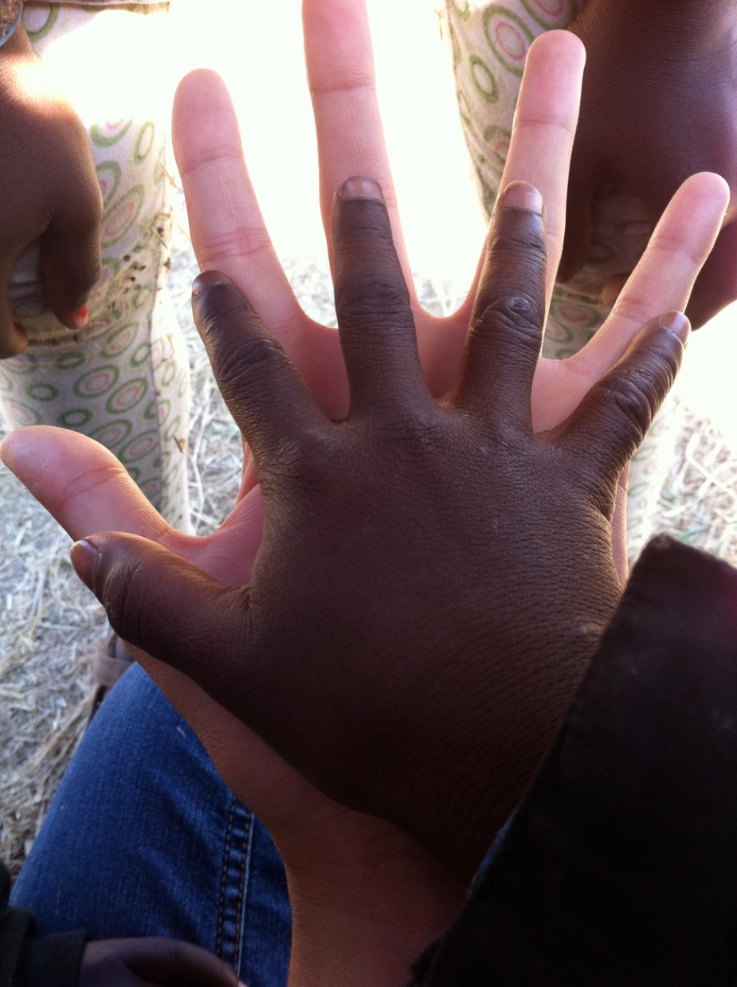
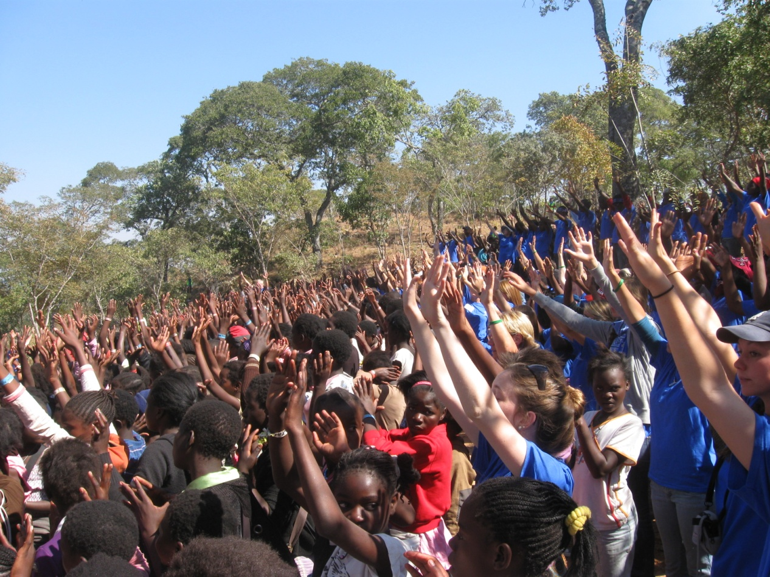

Slide 4
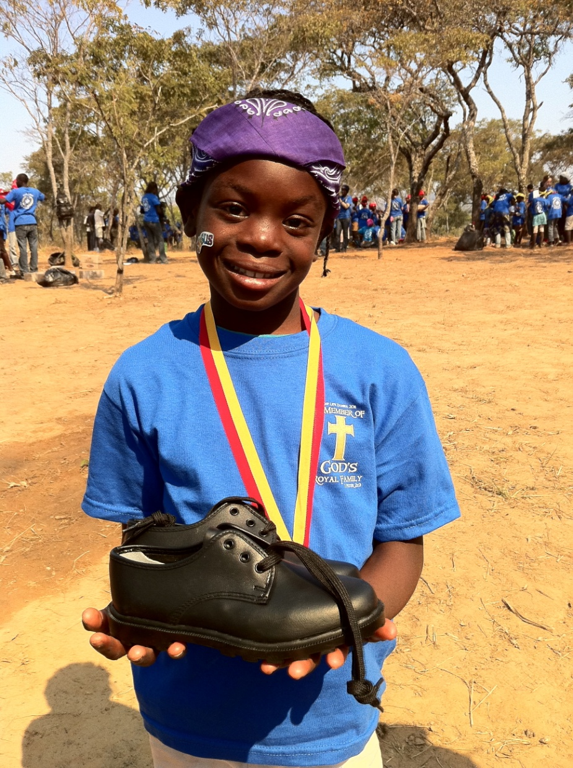
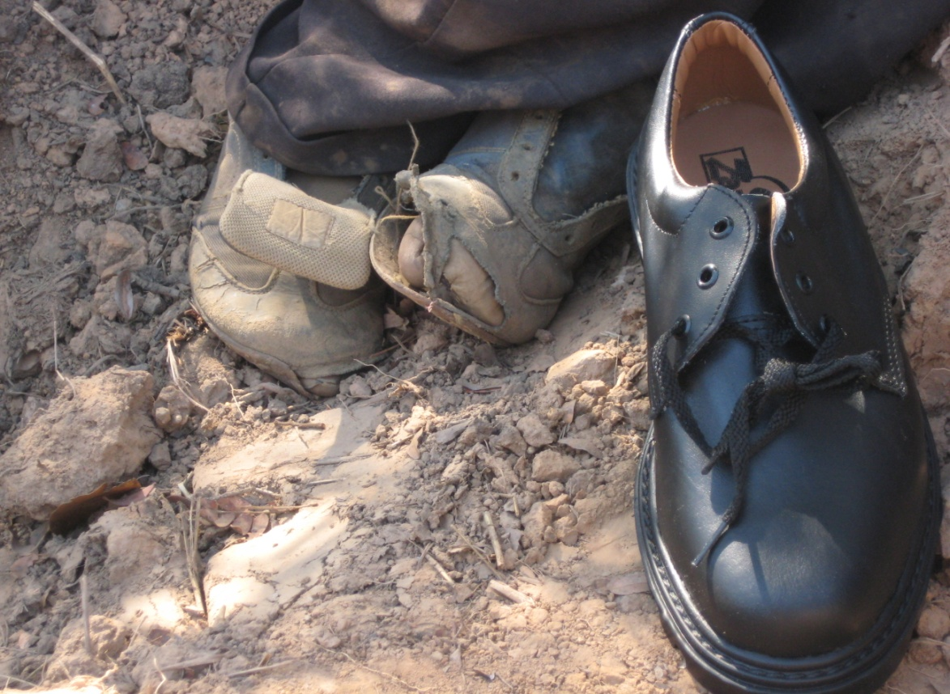

Slide 5
No Sweeter Name
No sweeter name than the name of Jesus No sweeter name have I ever known No sweeter name than the name of Jesus (repeat)

Slide 6
You are the life to my heart and my soul You are the light to the Darkness around me

Slide 7
You are the hope to the hopeless And broken You are the only truth and the way

Slide 8
No sweeter name than the name of Jesus No sweeter name have I ever known No sweeter name than the name of Jesus (repeat)

Slide 9
You are the life to my heart and my soul You are the light to the Darkness around me

Slide 10
You are the hope to the hopeless And broken You are the only truth and the way

Slide 11
Jesus Jesus Jesus Jesus

Slide 12
You are the life to my heart and my soul You are the light to the Darkness around me

Slide 13
You are the hope to the hopeless And broken You are the only truth and the way

Slide 14
You are the life to my heart and my soul You are the light to the Darkness around me

Slide 15
You are the hope to the hopeless And broken You are the only truth and the way
Kari Jobe
2004 Gateway Create Publishing
CCLI 78316

Slide 16
Grace Greater Than Our Sin
Grace, Grace, God's grace
Grace that will pardon and cleanse within
Grace, Grace, God's grace
Grace that is greater than all our sin

Slide 17
Marvelous grace of our loving Lord
Grace that exceeds our sin and our guilt
Yonder on Calvary's mount outpoured
There where the blood of the
Lamb was spilt

Slide 18
Grace, Grace, God's grace
Grace that will pardon and cleanse within
Grace, Grace, God's grace
Grace that is greater than all our sin

Slide 19
Dark is the stain that we cannot hide
What can avail to wash it away?
Look, there is flowing a crimson tide
Whiter than snow you may be today

Slide 20
Grace, grace, God's grace
Grace that will pardon and cleanse within
Grace, grace, God's grace
Grace that is greater than all our sin

Slide 21
Marvelous, infinite, matchless grace
Freely bestowed on all who believe
You that are longing to see His face
Will you this moment His grace receive

Slide 22
Grace, grace, God's grace
grace that will pardon and cleanse within
Grace, grace, God's grace
Grace that is greater than all our sin
Words: Julia Johnston Music: Daniel Towner
TEMPLE BIBLE CHURCH USED BY PERMISSION CCLI #78316

Slide 23
Here I Am To Worship
Light of the world You stepped down into darkness Opened my eyes let me see Beauty that made this heart adore You Hope of a life spent with You

Slide 24
Here I am to worship Here I am to bow down Here I am to say that You're my God You're altogether lovely Altogether worthy Altogether wonderful to me

Slide 25
King of all days oh so highly exalted Glorious in Heaven above Humbly You came To the earth You created All for love's sake became poor

Slide 26
Here I am to worship Here I am to bow down Here I am to say that You're my God You're altogether lovely Altogether worthy
Altogether wonderful to me

Slide 27
I’ll never know
How much it cost
To see my sin
Upon that cross
(repeat)

Slide 28
Here I am to worship Here I am to bow down Here I am to say that You're my God You're altogether lovely Altogether worthy Altogether wonderful to me
Tim Hughes
2000 Thankyou Music
CCLI 78316

Slide 29
You Are My King
I'm forgiven because You were forsaken I'm accepted, You were condemned I'm alive and well
Your Spirit is within me Because You died and rose again

Slide 30
Amazing love, how can it be That You, my King, would die for me Amazing love, I know it's true It's joy to honor You In all I do I honor You

Slide 31
I'm forgiven because You were forsaken I'm accepted, You were condemned I'm alive and well Your Spirit is within me Because You died and rose again

Slide 32
Amazing love, how can it be That You, my King, would die for me Amazing love, I know it's true It's joy to honor You In all I do I honor You

Slide 33
You are my King You are my King Jesus, You are my King Jesus, You are my King

Slide 34
Amazing love, how can it be That You, my King, would die for me Amazing love, I know it's true It's joy to honor You In all I do I honor You
Billy Foote
1996 worshiptogether.com songs
CCLI 78316

Slide 37
Where are the clubs going to be?
Pick up a club location sheet on the Impact table
or in the children’s wing.
1 Morning Host Needed
2 Park Host Needed
TONS of Food Donations

Slide 38
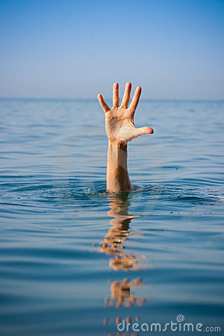
SUNK

Slide 39
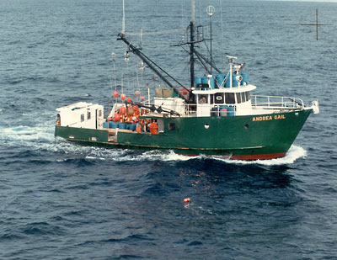
Andrea Gail

Slide 40
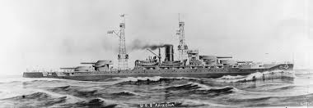
USS Arizona

Slide 41
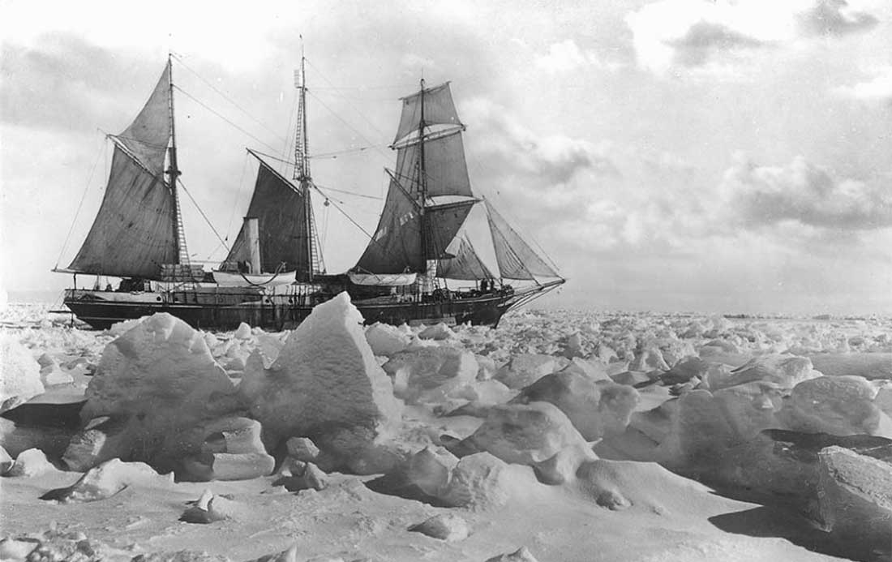
The Endurance

Slide 42
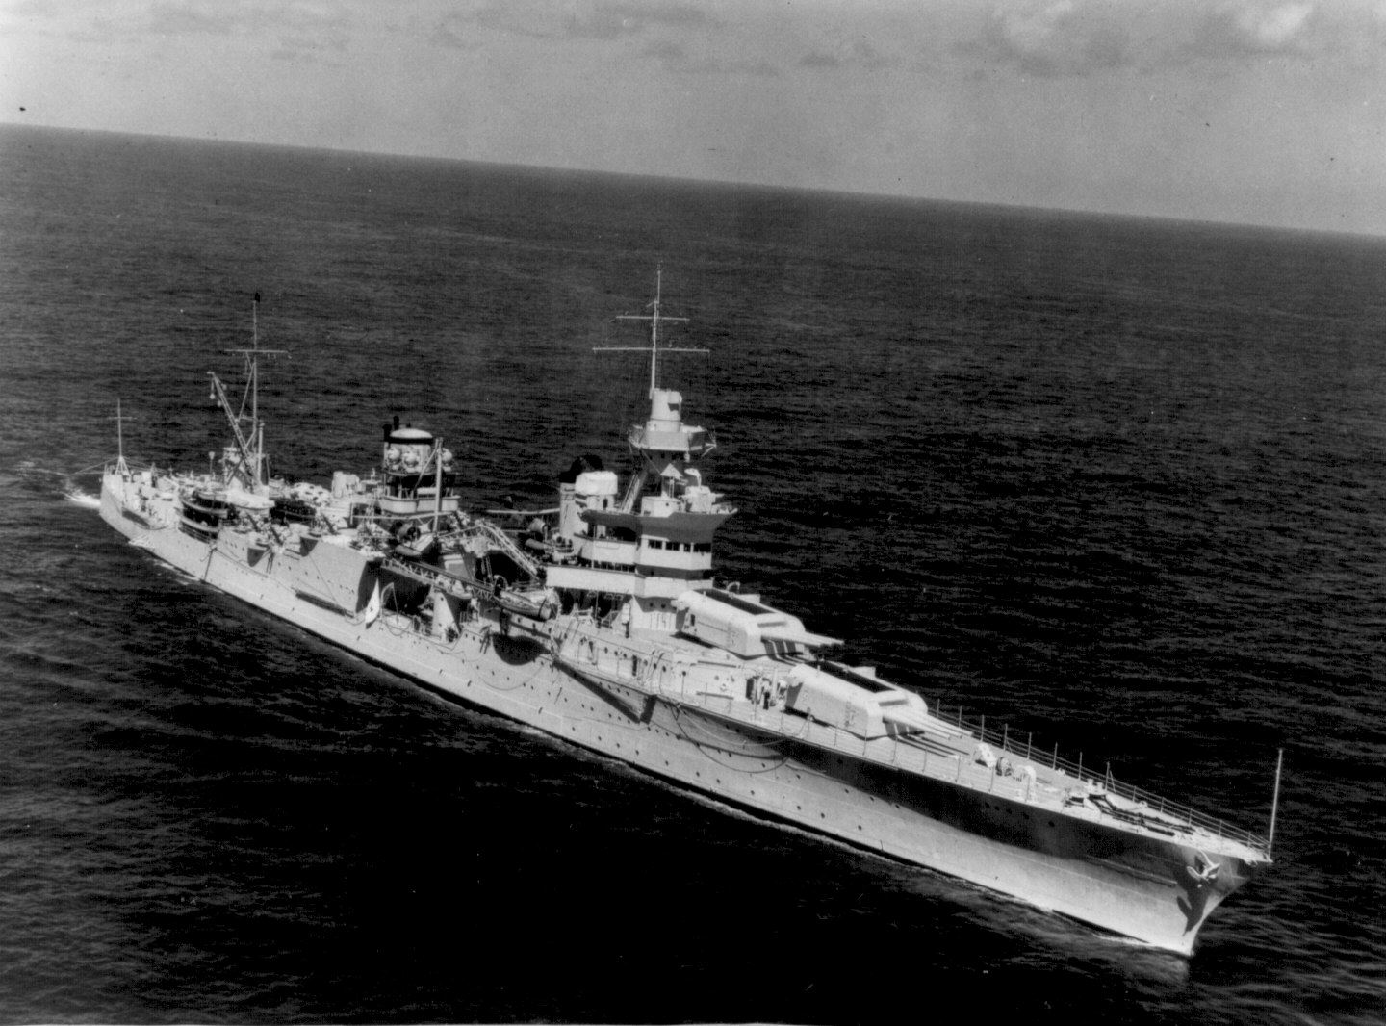
USS Indianapolis

Slide 43
THE BIRTH
OF
DEATH

Slide 44
Therefore, just as through one man sin entered into the world, and death through sin, and so death spread to all men, because all sinned…
Romans 5:12

Slide 45
…for all have sinned and fall short of the glory of God.
Romans 3:23

Slide 46
“ There is none righteous,
not even one;
There is none who understands,
There is none who seeks for God;
All have turned aside, together they have become useless;
There is none who does good, There is not even one.”
Romans 3:10-12

Slide 47
“When I’m alone,
I’m in bad company.”
-Country Western Lyrics

Slide 48
“Man was created a little lower than the angels, and he has been a getting a little lower ever since.”
Mark Twain

Slide 49
What terrifies us is not the explosive force of the atomic bomb, but the power of the wickedness of the human heart.
Albert Einstein

Slide 50
“Our consciences, callings, art, ethics, responsibility, family and marriage, health, history, imagination, kingdom, culture and society, work ecology, angelic realms, academics, leisure and rest, worship, sexuality and language are stained by the sin of the original couple.”
Michael Metzger

Slide 51
The heart is more deceitful
than all else and is desperately sick;
Who can understand it?
Jeremiah 17:9

Slide 52
A TEMPORARY
SOLUTION
FOR SIN

Slide 53
A PERMANENT
SOLUTION
FOR SIN

Slide 54
For it was fitting for us to have such a high priest, holy, innocent, undefiled, separated from sinners and exalted above the heavens; who does not need daily, like those high priests, to offer up sacrifices, first for His own sins and then for the sins of the people, because this He did once for all when He offered up Himself.
Hebrews 7:26-27

Slide 55
We are more WICKED than we could ever believe,
but more LOVED and ACCEPTED in Christ than we could ever hope!
Tim Keller

