Slide 1


Slide 2

All Hail The Power Of Jesus Name
All hail the power of Jesus' name
Let angels prostrate fall
Bring forth the royal diadem
And crown Him Lord of all
Bring forth the royal diadem
And crown Him Lord of all

Slide 3
Ye chosen seed of Israel’s race
Ye ransomed from the fall
Hail Him who saves you by His grace
And crown Him Lord of all
Hail Him who saves you by His grace
And crowns Him Lord of all

Slide 4
Lord of All
You are Lord of All
Lord of All
You are Lord of all
Temple Bible Church CCL

Slide 5
Let every kindred, every tribe
On this terrestrial ball
To Him all majesty ascribe
And crown Him Lord of all
To Him all majesty ascribe
And crown Him Lord of all

Slide 6
Lord of All
You are Lord of All
Lord of All
You are Lord of all
Temple Bible Church CCL

Slide 7
And crown Him Lord of All
And crown Him Lord of All
And crown Him Lord of All
Temple Bible Church CCL

Slide 8
Everlasting God
Strength will rise as we wait
Upon the Lord
We will wait upon the Lord
We will wait upon the Lord

Slide 9
Our God You reign forever
Our hope Our strong deliverer

Slide 10
You are the everlasting God
The everlasting God
You do not faint
You won't grow weary
You're the defender of the weak
You comfort those in need
You lift us up on wings like eagles
CCLI 78316

Slide 11
Strength will rise as we wait
Upon the Lord
We will wait upon the Lord
We will wait upon the Lord

Slide 12
Our God You reign forever
Our hope Our strong deliverer

Slide 13
You are the everlasting God
The everlasting God
You do not faint
You won't grow weary
You're the defender of the weak
You comfort those in need
You lift us up on wings like eagles
CCLI 78316

Slide 14
Our God You reign forever
Our hope Our strong deliverer

Slide 15
You are the everlasting God
The everlasting God
You do not faint
You won't grow weary
You're the defender of the weak
You comfort those in need
You lift us up on wings like eagles
Brenton Brown, Ken Riley
2005 Thankyou Music
CCLI 78316

Slide 16
10,000 Reasons
Bless the Lord O my soul, O my soul
Worship His holy name
Sing like never before, O my soul
Worship Your holy name

Slide 17
The sun comes up
It's a new day dawning
It's time to sing
Your song again

Slide 18
Whatever may pass
And whatever lies before me
Let me be singing when the
Evening comes

Slide 19
Bless the Lord O my soul, O my soul
Worship His holy name
Sing like never before, O my soul
Worship Your holy name

Slide 20
You're rich in love
And You're slow to anger
Your name is great
And Your heart is kind

Slide 21
For all Your goodness I will
Keep on singing
Ten thousand reasons for my
Heart to find

Slide 22
Bless the Lord O my soul, O my soul
Worship His holy name
Sing like never before, O my soul
Worship Your holy name

Slide 23
And on that day when my
Strength is failing
The end draws near
And my time has come

Slide 24
Still my soul will sing Your
Praise unending
Ten thousand years
And then forevermore

Slide 25
Bless the Lord O my soul, O my soul
Worship His holy name
Sing like never before, O my soul
I'll worship Your holy name

Slide 26
Bless the Lord O my soul, O my soul
Worship His holy name
Sing like never before, O my soul
I'll worship Your holy name

Slide 27
Worship Your holy name
Worship Your holy name
Jonas Myrin, Matt Redman
2011 SHOUT! Music Publishing, Thankyou Music, Said and Done Music
CCLI 78316

Slide 28
We Fall Down
We fall down
We lay our crowns
At the feet of Jesus,
The greatness of Your mercy and love
At the feet of Jesus

Slide 29
And we cry, "Holy, Holy, Holy,"
And we cry, "Holy, Holy, Holy,"
And we cry, "Holy, Holy
Holy is the Lamb
CCLI 78316

Slide 30
We fall down
We lay our crowns
At the feet of Jesus,
The greatness of Your mercy and love
At the feet of Jesus

Slide 31
And we cry, "Holy, Holy, Holy,"
And we cry, "Holy, Holy, Holy,"
And we cry, "Holy, Holy
Holy is the Lamb
Chris Tomlin
1998 worshiptogether.com songs
CCLI 78316

Slide 32
Made Me Glad
I will bless the Lord forever
I will trust Him at all times
He has delivered me from all fear
He has set my feet upon a rock
And I will not be moved
And I'll say of the Lord

Slide 33
You are my shield
My strength my portion
Deliverer
My shelter strong tower
My very present help
In time of need

Slide 34
Whom have I in heaven
But You
There's none I desire
Besides You
And You have made me glad
I'll say of the Lord

Slide 35
You are my shield
My strength my portion
Deliverer
My shelter strong tower
My very present help

Slide 36
You are my shield
My strength my portion
Deliverer
My shelter strong tower
My very present help
In time of need

Slide 37
And I will not be moved
And I'll say of the Lord

Slide 38
You are my shield
My strength my portion
Deliverer
My shelter strong tower
My very present help

Slide 39
You are my shield
My strength my portion
Deliverer
My shelter strong tower
My very present help
In time of need
Miriam Webster
2001 Hillsong Publishing
CCLI 78316

Slide 40
CCLI 78316

Slide 41
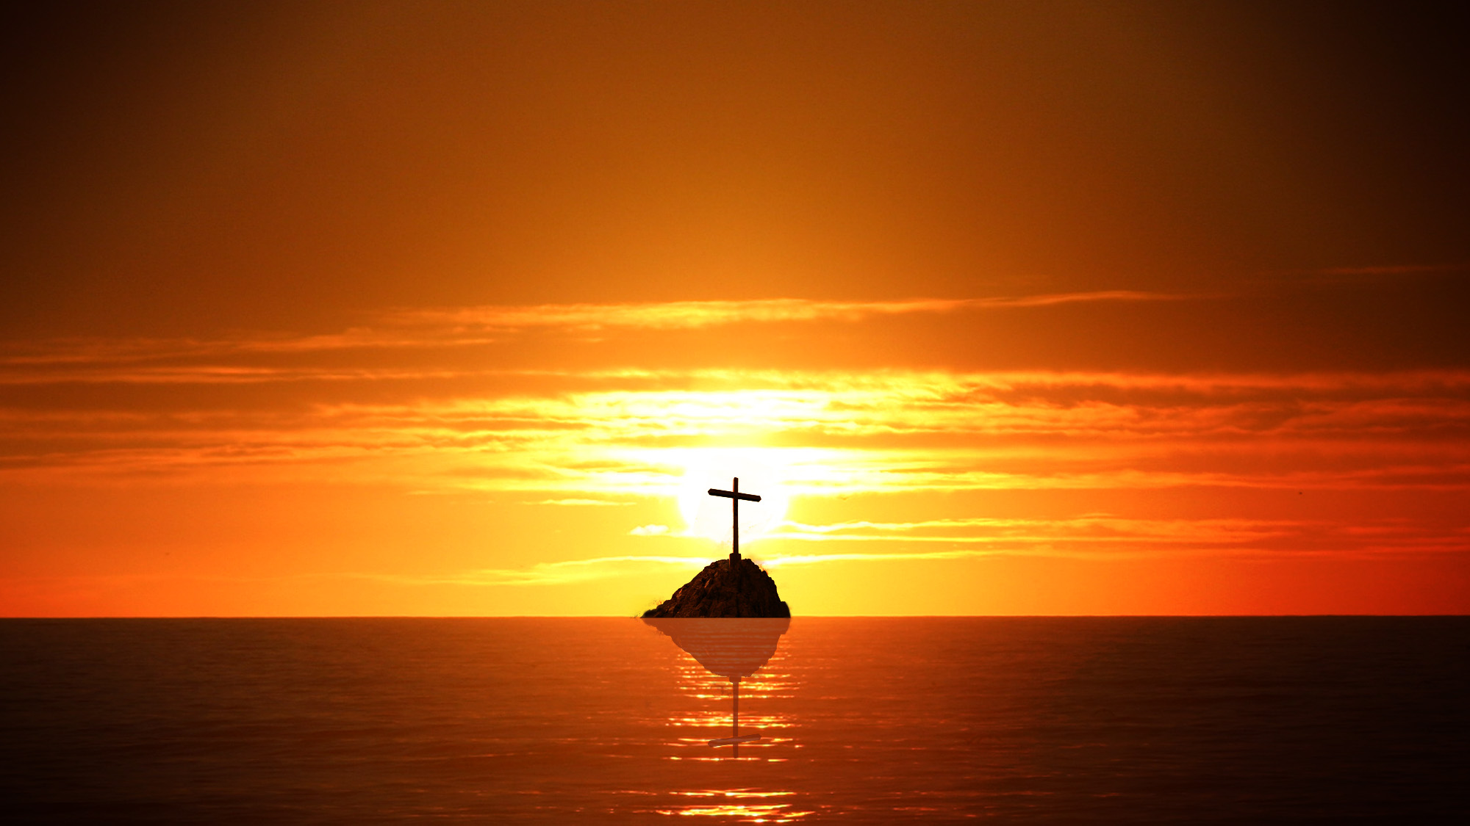
10 ESSENTIAL TRUTHS ABOUT OUR LORD JESUS CHRIST & WHY THEY ARE IMPORTANT

Slide 42
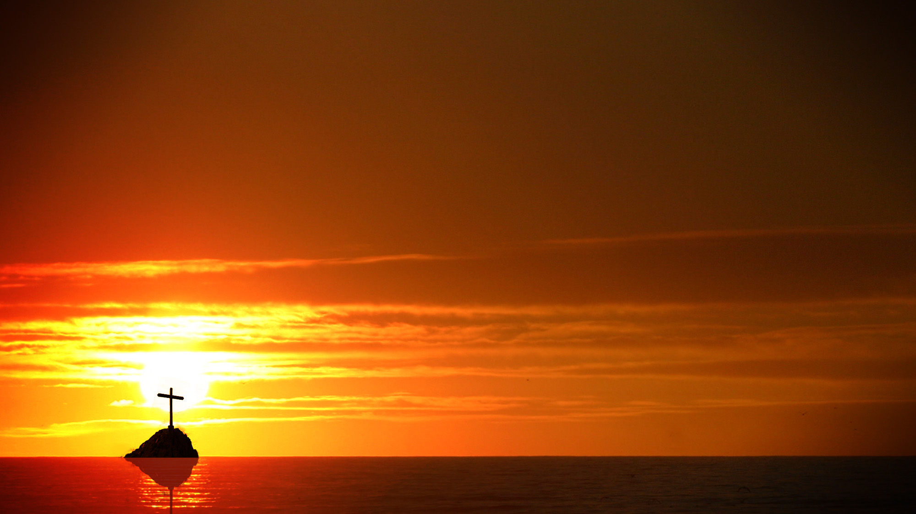
Truth #1
JESUS IS THE ETERNAL 2ND PERSON OF THE TRINITY

Slide 43
“Hear, O Israel:
The LORD our God, the LORD is one.
Deuteronomy 6:4

Slide 44
In the beginning was the Word,
and the Word was with God,
and the Word was God.
John 1:1

Slide 45
Truth #2
JESUS IS THE CREATOR &
SUSTAINER OF ALL THINGS

Slide 46
For by him all things were created, in heaven and on earth, visible and invisible, whether thrones or dominions or rulers or authorities, all things were created through him and for him. And he is before all things, and in him all things hold together.
Colossians 1:16-17

Slide 47
Truth #3
JESUS: ETERNAL GOD
BECAME A HUMAN

Slide 48
But when the fullness of time had come,
God sent forth his Son,
born of woman, born under the law…
Galatians 4:4

Slide 49
And the Word became flesh
and dwelt among us,
and we have seen his glory,
glory as of the only Son from the Father,
full of grace and truth.
John 1:14

Slide 50
Truth #4
JESUS LIVED A PERFECT SINLESS LIFE

Slide 51
For we do not have a high priest who is unable to sympathize with our weaknesses, but one who in every respect has been tempted as we are, yet without sin.
Hebrews 4:15

Slide 52
He committed no sin,
neither was deceit
found in his mouth.
1 Peter 2:22

Slide 53
Truth #5
JESUS TOOK THE PUNISHMENT FOR ALL THE SINS OF ALL BELIEVERS

Slide 54
For our sake
he made him to be sin
who knew no sin,
so that in him we might become
the righteousness of God.
2 Corinthians 5:21

Slide 55
…but God shows his love for us
in that while we were still sinners,
Christ died for us.
Romans 5:8

Slide 56
He himself bore our sins
in his body on the tree,
that we might die to sin
and live to righteousness.
By his wounds you have been healed.
1 Peter 2:24

Slide 57
For even the Son of Man
came not to be served but to serve,
and to give his life as a ransom for many.
Mark 10:45

Slide 58
Truth #6
JESUS DIED & WAS BURIED

Slide 59
And when evening had come, since it was the day of Preparation, that is, the day before the Sabbath, Joseph of Arimathea, a respected member of the Council, who was also himself looking for the kingdom of God, took courage and went to Pilate and asked for the body of Jesus.

Slide 60
Pilate was surprised to hear that he should have already died. And summoning the centurion, he asked him whether he was already dead. And when he learned from the centurion that he was dead, he granted the corpse to Joseph.

Slide 61
And Joseph bought a linen shroud, and taking him down, wrapped him in the linen shroud and laid him in a tomb that had been cut out of the rock. And he rolled a stone against the entrance of the tomb. Mary Magdalene and Mary the mother of Jesus saw where he was laid.
Mark 15:42-47

Slide 62
Truth #7
JESUS WAS RESURRECTED FROM
THE DEAD ON THE THIRD DAY

Slide 63
But on the first day of the week, at early dawn, they went to the tomb, taking the spices they had prepared. And they found the stone rolled away from the tomb, but when they went in they did not find the body of the Lord Jesus. While they were perplexed about this, behold, two men stood by them in dazzling apparel.

Slide 64
And as they were frightened and bowed their faces to the ground, the men said to them, “Why do you seek the living among the dead? He is not here, but has risen. Remember how he told you, while he was still in Galilee,

Slide 65
that the Son of Man must be delivered into the hands of sinful men and be crucified and on the third day rise.” And they remembered his words, and returning from the tomb they told all these things to the eleven and to all the rest.
Luke 24:1-9

Slide 66
For I delivered to you as of first importance what I also received: that Christ died for our sins in accordance with the Scriptures, that he was buried, that he was raised on the third day in accordance with the Scriptures,
1 Corinthians 15:3-4

Slide 67
Truth #8
JESUS ASCENDED INTO HEAVEN

Slide 68
Jesus said to her, “Do not cling to me,
for I have not yet ascended to the Father;
but go to my brothers and say to them,
‘I am ascending to my Father and your Father, to my God and your God.’ ”
John 20:17

Slide 69
And when he had said these things,
as they were looking on, he was lifted up, and a cloud took him out of their sight.
Acts 1:9

Slide 70
Truth #9
JESUS IS ON HIS THRONE & IS THE FINAL JUDGE OF EVERY PERSON

Slide 71
And just as it is appointed
for man to die once,
and after that comes judgment…
Hebrews 9:27

Slide 72
For we must all appear before the judgment seat of Christ, so that each one may receive what is due for what he has done in the body, whether good or evil.
2 Corinthians 5:10

Slide 73
Then I saw a great white throne and him who was seated on it. From his presence earth and sky fled away, and no place was found for them. And I saw the dead, great and small, standing before the throne, and books were opened.

Slide 74
Then another book was opened, which is the book of life. And the dead were judged by what was written in the books, according to what they had done.
Revelation 20:11-12

Slide 75
Truth #10
JESUS IS COMING BACK

Slide 76
…so Christ, having been offered
once to bear the sins of many,
will appear a second time,
not to deal with sin but to save
those who are eagerly waiting for him. Hebrews 9:28

Slide 77
Behold, he is coming with the clouds,
and every eye will see him, even those who pierced him, and all tribes of the earth will wail on account of him. Even so. Amen. Revelation 1:7

Slide 78
WHY ARE THESE TRUTHS IMPORTANT?
You have two problems
and the Lord Jesus Christ
is the only answer to both.

Slide 79
Problem #1
YOU HAVE CAUSED MUCH HARM:
SIN, GUILT, SEPARATION

Slide 80
For the wages of sin is death,
but the free gift of God is eternal life
in Christ Jesus our Lord.
Romans 6:23

Slide 81
There is therefore now no condemnation for those who are in Christ Jesus. Who shall bring any charge against God’s elect? It is God who justifies. Who is to condemn? Christ Jesus is the one who died—more than that, who was raised— who is at the right hand of God, who indeed is interceding for us.
Romans 8:1,33-34

Slide 82
Jesus said to him,
“I am the way, and the truth, and the life.
No one comes to the Father except through me.
John 14:6

Slide 83
Problem#2
YOU HAVE RECEIVED MUCH HARM:
SADNESS, SORROW, ANXIETY, PAIN

Slide 84
Come to me,
all who labor and are heavy laden,
and I will give you rest.
Matthew 11:28
…casting all your anxieties
on him, because he cares for you.
1 Peter 5:7

Slide 85
He will wipe away every tear from their eyes, and death shall be no more,
neither shall there be mourning,
nor crying, nor pain anymore,
for the former things have passed away.” Revelation 21:4

