Slide 1


Slide 2
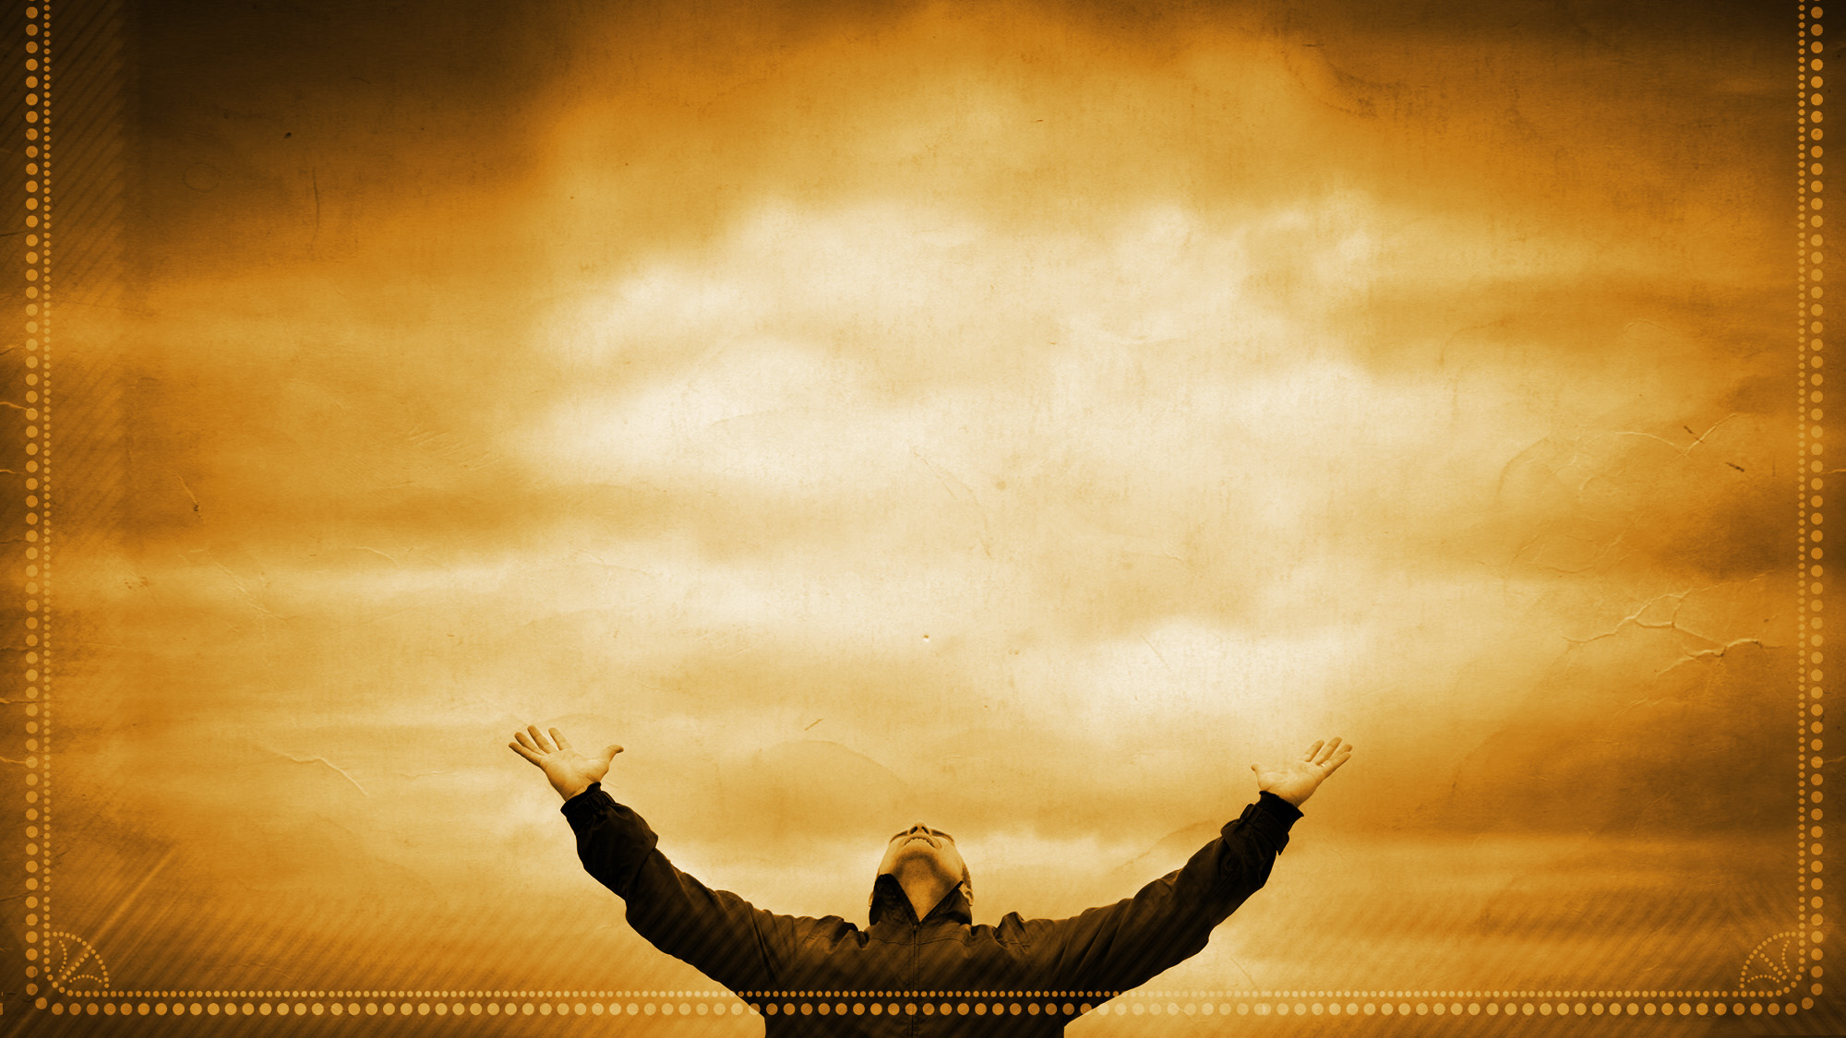
Your Grace Is Enough
Great is Your faithfulness, oh God
You wrestle with the sinner's heart
You lead us by still waters into mercy
And nothing can keep us apart

Slide 3
So remember Your people
Remember Your children
Remember Your promise, Oh God

Slide 4
Your grace is enough
Your grace is enough
Your grace is enough for me

Slide 5
Great is Your love and justice, God
You use the weak to lead the strong
You lead us in the song of
Your salvation
And all Your people sing along

Slide 6
So remember Your people
Remember Your children
Remember Your promise, Oh God

Slide 7
Your grace is enough
Your grace is enough
Your grace is enough for me

Slide 8
So remember Your people
Remember Your children
Remember Your promise, Oh God

Slide 9
Your grace is enough
Your grace is enough
Your grace is enough for me
Matt Maher
2003 Thankyou Music, Spiritandsong.com Pub
CCLI 78316

Slide 10
Your grace is enough
Heaven reaching down to us
Your grace is enough for me
Matt Maher
2003 Thankyou Music, Spiritandsong.com Pub
CCLI 78316

Slide 11
God I see
Your grace is enough
I’m covered in Your Love
Your grace is enough for me
Matt Maher
2003 Thankyou Music, Spiritandsong.com Pub
CCLI 78316

Slide 12

God of Wonders
Lord of all creation
Of water, earth, and sky
The heavens are Your tabernacle
Glory to the Lord on high

Slide 13
God of wonders, beyond our galaxy
You are holy, holy
The universe declares Your majesty
You are holy, holy

Slide 14
Lord of Heaven and earth
Lord of Heaven and Earth
Lord of Heaven and Earth

Slide 15
Early in the morning
I will celebrate the light
And when I stumble in the darkness
I will call Your name by night

Slide 16
God of wonders, beyond our galaxy
You are holy, holy
The universe declares Your majesty
You are holy, holy

Slide 17
Lord of Heaven and earth
Lord of Heaven and Earth
Lord of Heaven and Earth

Slide 18
Hallelujah,
To the Lord of Heaven and earth
Hallelujah,
To the Lord of Heaven and earth

Slide 19
God of wonders, beyond our galaxy
You are holy, holy
The universe declares Your majesty
You are holy, holy

Slide 20
God of wonders, beyond our galaxy
You are holy, holy
The universe declares Your majesty
You are holy, holy

Slide 21
Lord of Heaven and earth
Lord of Heaven and earth
Marc Byrd, Steve Hindalong
2000 New Spring, Storm Boy Music, Meaux Mercy
CCLI 78316

Slide 22

How Great Thou Art
Then sings my soul
My Savior, God to Thee
How great Thou art
How great Thou art
(repeat)
Stuart K. Hine
1949, 1953 Stuart Hine Trust
CCLI 78316

Slide 23
What a Savior
Atoning sacrifice, Keeper of this life
Hallelujah, You are Savior
Beginning and the end
Forgiver of my sin
By Your mercy You have saved us

Slide 24
Jesus, You are stronger
More than any other
Hallelujah, what a Savior
Jesus, You are higher
My souls deepest desire
Hallelujah, You are Savior

Slide 25
You are the Shepherd King
You lead us by still waters
Hallelujah, You are Savior
You are my only hope
Your kindness is my friend
In Your presence You restore us

Slide 26
Jesus, You are stronger
More than any other
Hallelujah, what a Savior
Jesus, You are higher
My souls deepest desire
Hallelujah, You are Savior

Slide 27
You are the way
The truth and the life
You are my joy and salvation
Stood in my place, taking my shame
Upon Your shoulders

Slide 28
Jesus, You are stronger
More than any other
Hallelujah, what a Savior
Jesus, You are higher
My souls deepest desire
Hallelujah, You are Savior
Laura Story
CCLI 78316

Slide 29
Stronger
There is love that came for us
Humbled to a sinner's cross
You broke my shame and sinfulness
You rose again, victorious

Slide 30
Faithfulness none can deny
Through the storm and through the fire
There is truth that sets me free
Jesus Christ Who lives in me

Slide 31
You are stronger, You are stronger
Sin is broken You have saved me
It is written Christ is risen
Jesus You are Lord of all

Slide 32
No beginning and no end
You're my hope and my defense
You came to seek and save the lost
You paid it all upon the cross

Slide 33
You are stronger, You are stronger
Sin is broken You have saved me
It is written Christ is risen
Jesus You are Lord of all

Slide 34
So let Your name be lifted higher
Be lifted higher, be lifted higher
(repeat)

Slide 35
You are stronger, You are stronger
Sin is broken You have saved me
It is written Christ is risen
Jesus You are Lord of all

Slide 36
You are stronger, You are stronger
Sin is broken You have saved me
It is written Christ is risen
Jesus You are Lord of all
Ben Fielding, Reuben Morgan
2007 Hillsong Publishing
CCLI 78316

Slide 37
Revelation Song
Worthy is the
Lamb who was slain
Holy, Holy is He
Sing a new song, to Him who
Sits on heaven's mercy seat

Slide 38
Holy, Holy, Holy
Is the Lord God Almighty
Who was and is and is to come

Slide 39
With all creation I sing
Praise to the King of Kings
You are my everything
And I will adore You

Slide 40
Clothed in rainbows
Of living color
Flashes of lightning
Rolls of thunder
Blessing and honor, strength
And glory and power be
To You the only wise King

Slide 41
Holy Holy Holy
Is the Lord God Almighty
Who was and is and is to come

Slide 42
With all creation I sing
Praise to the King of kings
You are my everything
And I will adore You

Slide 43
Filled with wonder
Awe struck wonder
At the mention of Your name
Jesus Your name is power
Breath and living water
Such a marvelous mystery

Slide 44
Holy Holy Holy
Is the Lord God Almighty
Who was and is and is to come
With all creation I sing

Slide 45
Praise to the King of kings
You are my everything
And I will adore You

Slide 46
Holy Holy Holy
Is the Lord God Almighty
Who was and is and is to come
With all creation I sing

Slide 47
Praise to the King of kings
You are my everything
And I will adore You
Jennie Lee Riddle
2004 Gateway Create Publishing
CCLI 78316

Slide 48


Slide 49

Putting It All Back
Together
Ephesians 1:9-10

Slide 50
Mystery: Heaven and Earth
_{(1:9-10)}
…With all wisdom and understanding,
he made known to us the mystery of his
will according to his good pleasure,
which he purposed in Christ, to be put into effect when the times reach their fulfillment —to bring unity to all things in heaven
and on earth under Christ.

Slide 51
Mystery: A New Humanity
Jews and Gentiles
This mystery is that through the gospel the Gentiles are heirs together with Israel, members together of one body,
and sharers together in the promise
in Christ Jesus.

Slide 52
For he himself is our peace,
who has made the two groups one
and has destroyed the barrier,
the dividing wall of hostility
...His purpose was to create in himself one new humanity out of the two...
Ephesians 3:6 Ephesians 2:14-15

Slide 53
Mystery: A New Humanity:
Male and Female
Husbands, love your wives, just as Christ loved the church and gave himself up for her… In this same way, husbands ought to love their wives as their own bodies.
He who loves his wife loves himself.

Slide 54
After all, no one ever hated their own body, but they feed and care for their body, just as Christ does the church for we are members of his body. “For this reason a man will leave his father and mother and be united to his wife, and the two will become one flesh.”

Slide 55
This is a profound mystery—but I am talking about Christ and the church. However, each one of you also must love his wife as he loves himself, and the wife must respect her husband.
Ephesians 5:25-33

Slide 56
Built on the foundation of the apostles and prophets, with Christ Jesus himself as the chief cornerstone. In him the whole building is joined together and rises to become a holy temple in the Lord. And in him you too are being built together to become a dwelling in which God lives by his Spirit.
Ephesians 2:20-22

