Slide 2
Hosanna
Praise is rising, eyes are Turning to You, we turn to You Hope is stirring, hearts are Yearning for You, we long for You

Slide 3
Cause when we see You We find strength to face the day In Your Presence all our fears Are washed away, washed away

Slide 4
Hosanna, hosanna You are the God who saves us Worthy of all our praises Hosanna, hosanna Come have Your way among us We welcome You here, Lord Jesus

Slide 5
Hear the sound of hearts Returning to You, we turn to You In Your Kingdom broken lives Are made new, You make us new

Slide 6
Cause when we see You We find strength to face the day In Your Presence all our fears Are washed away, washed away

Slide 7
Hosanna, hosanna You are the God who saves us Worthy of all our praises Hosanna, hosanna Come have Your way among us We welcome You here, Lord Jesus

Slide 8
Cause when we see You We find strength to face the day In Your Presence all our fears Are washed away, washed away

Slide 9
Hosanna, hosanna You are the God who saves us Worthy of all our praises Hosanna, hosanna Come have Your way among us We welcome You here, Lord Jesus

Slide 10
Hosanna, hosanna Hosanna, hosanna
Paul Baloche, Brenton Brown
2006 Thankyou Music, Integrity's Hosanna! Music
CCLI 78316

Slide 11
Reign In Us
You thought of us before the World began to breathe You knew our names before we Came to be

Slide 12
You saw the very day we'd fall Away from you How desperately We need to be redeemed

Slide 13
Lord Jesus come lead us We're desperate for Your touch

Slide 14
Oh great and mighty One with One desire we come That You would reign that You Would reign in us

Slide 15
We're offering up our lives a Living sacrifice That You would reign that You Would reign in us

Slide 16
Spirit of the living God fall Fresh again Come search our hearts And purify our lives

Slide 17
We need Your perfect love we Need Your discipline We're lost unless You guide us With Your light

Slide 18
Lord Jesus come lead us We're desperate for Your touch

Slide 19
Oh great and mighty One with One desire we come That You would reign that You Would reign in us

Slide 20
We're offering up our lives a Living sacrifice That You would reign that You Would reign in us

Slide 21
We cry out for Your life to refine us Cry out for Your love to define us Cry out for Your mercy to keep us Blameless until you return

Slide 22
So reign please reign in us Come purify our hearts we need Your touch Come cleanse us like a flood

Slide 23
And send us out So the world may know You Reign You reign in us
Ben Glover, Jon Neufeld, Tim Neufeld
2008 Birdwing Music, Screaming Norman Music, WB Music Corp., Fieldstar Music
CCLI 78316

Slide 24
Come Thou Fount, Come Thou King
Come Thou Fount of every blessing Tune my heart to sing Thy grace Streams of mercy, never

Slide 25
Ceasing call for songs of Loudest praise Teach me some melodious sonnet Sung by flaming tongues above

Slide 26
Praise the mount I'm fixed upon it Mount of Thy redeeming love

Slide 27
Come Thou Fount, come Thou King Come Thou precious Prince of Peace Hear Your bride, to You we sing Come Thou Fount of our blessing

Slide 28
I was lost in utter darkness Til You came and rescued me I was bound by all my sin when Your love came and set me free

Slide 29
Now my soul can sing a new Song now my heart has found a home Now Your grace is always with me And I'll never be alone

Slide 30
Come Thou Fount, come Thou King Come Thou precious Prince of Peace Hear Your bride, to You we sing Come Thou Fount of our blessing

Slide 31
O to grace how great a debtor Daily I'm constrained to be Let Thy goodness like a fetter Bind my wandering heart to Thee

Slide 32
Prone to wander, Lord I feel it Prone to leave the God I love Here's my heart Lord, take and seal it Seal it for Thy courts above

Slide 33
Come Thou Fount, come Thou King Come Thou precious Prince of Peace Hear Your bride, to You we sing Come Thou Fount of our blessing
Thomas Miller, Robert Robinson
2005 Gateway Create Publishing
CCLI 78316

Slide 34
Forever Reign
You are good You are good
When there's nothing good in me You are love You are love
On display for all to see

Slide 35
You are light You are light When the darkness closes in You are hope You are hope
You have covered all my sin

Slide 36
You are peace You are peace When my fear is crippling You are true You are true
Even in my wandering

Slide 37
You are joy You are joy
You're the reason that I sing You are life You are life in You death has lost its sting

Slide 38
Oh I'm running to Your arms
I'm running to Your arms The riches of Your love will Always be enough Nothing compares to Your embrace Light of the world forever reign

Slide 39
You are more You are more
Than my words will ever say You are Lord You are Lord
All creation will proclaim

Slide 40
You are here You are here in Your presence I'm made whole You are God You are God
Of all else I'm letting go

Slide 41
Oh I'm running to Your arms
I'm running to Your arms The riches of Your love will Always be enough Nothing compares to Your embrace Light of the world forever reign

Slide 42
Oh I'm running to Your arms
I'm running to Your arms The riches of Your love will Always be enough Nothing compares to Your embrace Light of the world forever reign

Slide 43
My heart will sing No other Name Jesus Jesus

Slide 44
Oh I'm running to Your arms
I'm running to Your arms The riches of Your love will Always be enough Nothing compares to Your embrace Light of the world forever reign

Slide 45
Oh I'm running to Your arms
I'm running to Your arms The riches of Your love will Always be enough Nothing compares to Your embrace Light of the world forever reign

Slide 46
My heart will sing No other Name Jesus Jesus
Jason Ingram, Reuben Morgan
2009 SHOUT! Publishing, Windsor Hill Music, Sony/ATV Timber Publishing
CCLI 78316

Slide 47
Waiting Here For You
If faith can move the mountains
Let the mountains move
We come with expectation
Waiting here for You
Waiting here for You

Slide 48
You’re the Lord of all creation
And still You know my heart
The Author of Salvation
You’ve love us from the start

Slide 49
Waiting here for You
With our hands lifted high in praise
And it’s You we adore
Singing alleluia

Slide 50
You are everything You’ve promised
Your faithfulness is true
We’re desperate for Your presence
All we need is You

Slide 51
Waiting here for You
With our hands lifted high in praise
And it’s You we adore
Singing alleluia

Slide 52
We’re singing alleluia
We’re singing alleluia
We’re singing alleluia
We’re singing alleluia

Slide 53
Waiting here for You
With our hands lifted high in praise
And it’s You we adore
Singing alleluia
Traditional , James Chadwick, Chris Tomlin
Traditional , James Chadwick, Chris Tomlin
2009 Vamos Publishing, worshiptogether.com songs, sixsteps Music
2009 Vamos Publishing, worshiptogether.com songs, sixsteps Music
CCLI 78316

Slide 54
You Have Saved Us
Who am I that You would know me Who are we to You Lord You have shown Your love and mercy We are strangers no more We are daughters we are sons All because of what You've done

Slide 55
You have saved us You have raised us up with You You have saved us Called us out and made us new

Slide 56
Turn our hearts from earthly idols Turn our eyes to You Lord Only You can heal what's broken Only You can restore We are daughters we are sons All because of what You've done

Slide 57
You have saved us You have raised us up with You You have saved us Called us out and made us new

Slide 58
We are daughters we are sons All because of what You've done

Slide 59
You have saved us You have raised us up with You You have saved us Called us out and made us new

Slide 60
You have saved us You have raised us up with You You have saved us Called us out and made us new

Slide 61
You have saved us You have saved us
You have saved us You have saved us
Paul Baloche, Ben Gowell
2009 Leadworship Songs, Integrity Worship Music
CCLI 78316

Slide 62
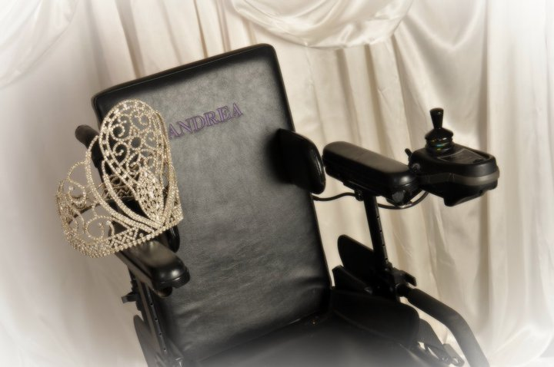
WELCOME TEXAS ANGELS!!

Slide 64
HUSBANDS
Ephesians 5:25-33

Slide 65
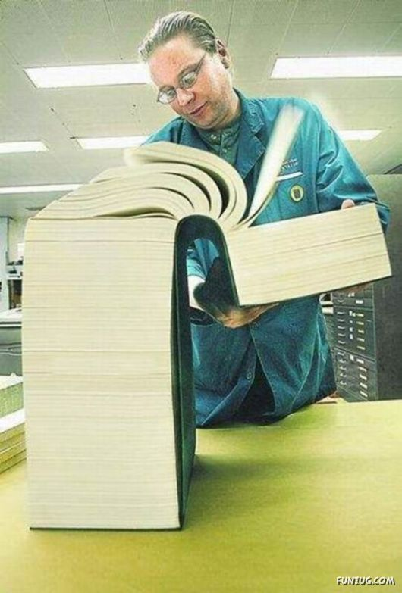

Slide 66
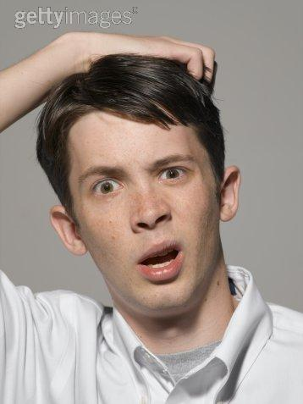
Top 10 Things
Men Understand About Women

Slide 67
Top 10 Things
Men Understand About Women
1.
2.
3.
4.
5.
6.
7.
8.
9.
10.

Slide 68
What I Want in a Man… Original List @ 22
Handsome, Charming, Witty
Financially successful
A caring listener
In good shape
Dresses with style
Appreciates finer things
Full of thoughtful surprises

Slide 69
What I Want in a Man… Revised List @ 32
Nice looking
Open car doors, hold chairs
Has enough money for a nice dinner
Listens more than talks
Laughs at my jokes
Carries bags of groceries of ease
Remembers birthdays and anniversaries

Slide 70
What I Want in a Man… Revised List @ 42
Not too ugly
Doesn’t drive off until I’m in the car
Works steady-splurges on dinner out occasionally
Usually remembers punch lines of jokes
Wears a shirt that covers his stomach
Remembers to put the toilet seat down
Knows not to buy champagne w/ screw-top lids

Slide 71
What I Want in a Man… Revised List @ 52
Keeps hair in nose and ears trimmed
Doesn’t belch or scratch in public
Doesn’t nod off when I’m venting
Doesn’t re-tell the same joke too many times
Is in good enough shape to get off the couch on weekends
Usually wears matching socks and fresh underwear

Slide 72
What I Want in a Man… Revised List @ 62
Doesn’t scare small children
Remembers where the bathroom is
Doesn’t require much money for upkeep
Remembers why he’s laughing
Is in good enough shape to stand up by himself

Slide 73
What I Want in a Man… Revised List @ 72
Breathing…
Doesn’t miss the toilet…

Slide 74
INSTRUCTIONS TO HUSBANDS
*The Command... Love your wives unconditionally

Slide 75
INSTRUCTIONS TO HUSBANDS
*The Character of Unconditional Love
Sacrificial Love

Slide 77
INSTRUCTIONS TO HUSBANDS
*The Character of Unconditional Love
Sacrificial Love
Purifying Love

Slide 78
Indulgence does not satisfy aroused desire, it inflames it

Slide 79
Satan will do everything he can to bring two people together sexually before marriage. He also does everything he can to keep them away from each other after marriage.

Slide 80
INSTRUCTIONS TO HUSBANDS
*The Character of Unconditional Love
Sacrificial Love
Purifying Love
Caring Love

Slide 81
INSTRUCTIONS TO HUSBANDS
*The Character of Unconditional Love
Sacrificial Love
Purifying Love
Caring Love

Slide 82
INSTRUCTIONS TO HUSBANDS
*The Character of Unconditional Love
Sacrificial Love
Purifying Love
Caring Love
Unbreakable Love

Slide 83
HUSBANDS…
WHAT’S it LIKE to be MARRIED to YOU?

