Slide 2
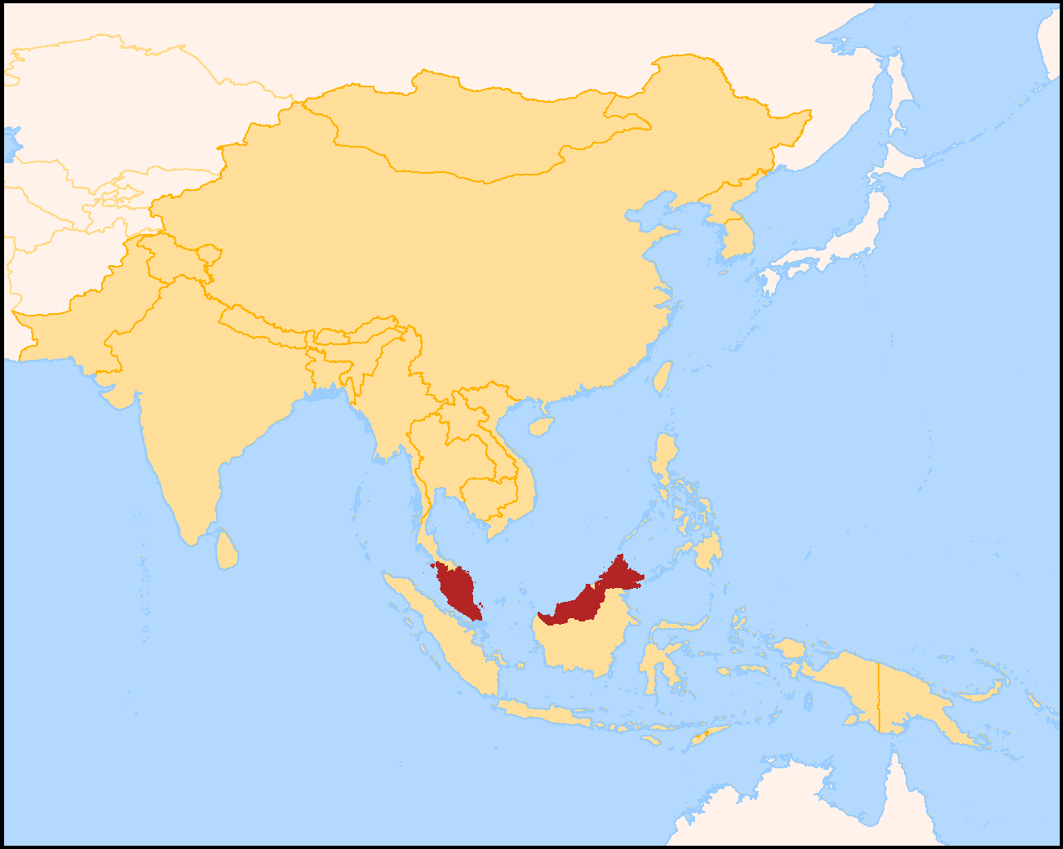
The Brandon’s in
Penang, Malaysia
CHINA
INDIA
MALAYSIA
INDONISA
AUSTRAILA

Slide 3
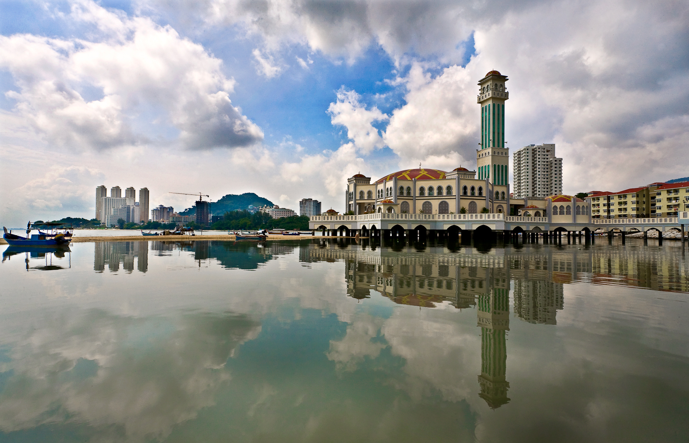
The Brandon’s in
Penang, Malaysia

Slide 4
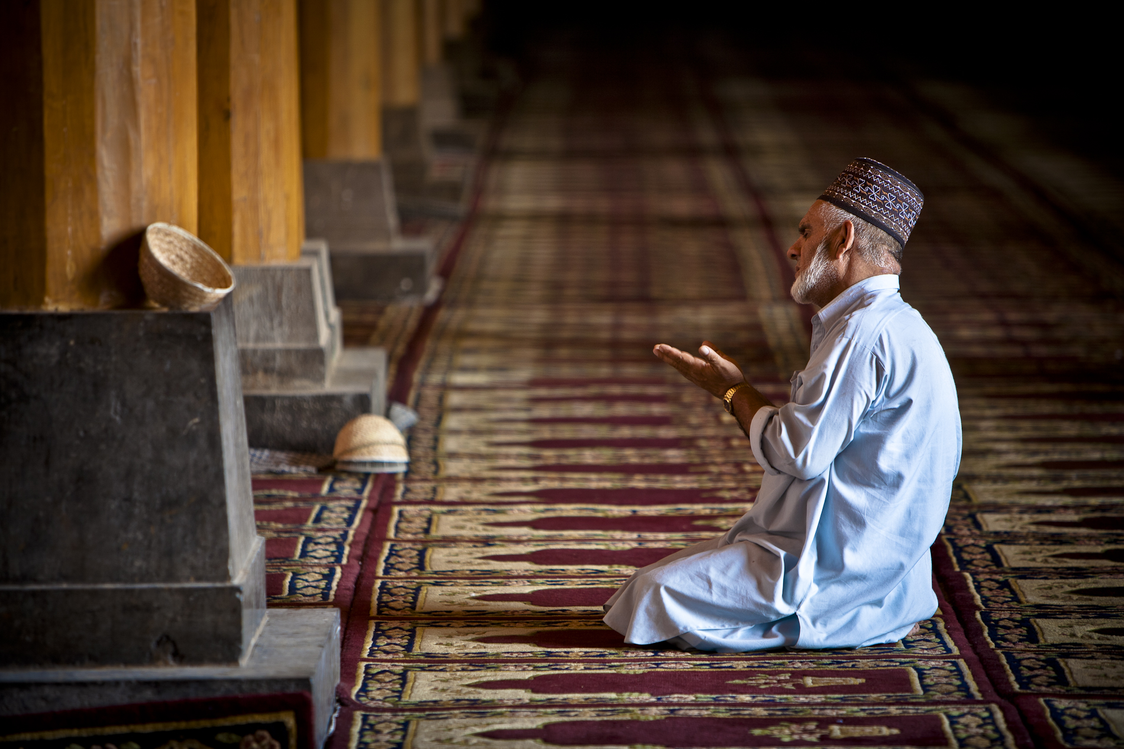
18 years serving and
being a light in Asia

Slide 5
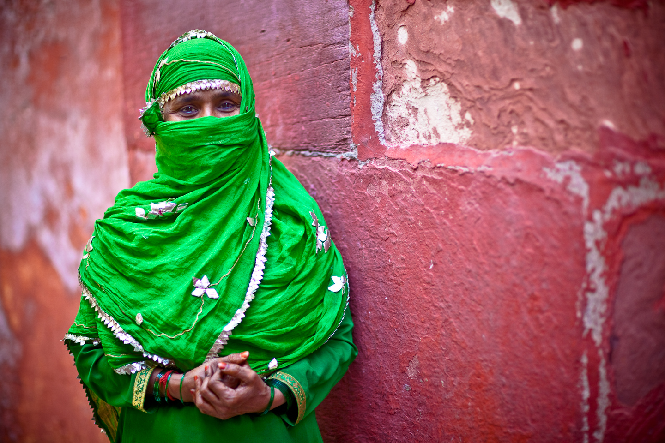
Pray for
Alou’s business as it provides
income that keeps women out of the sex trade
and…

Slide 6
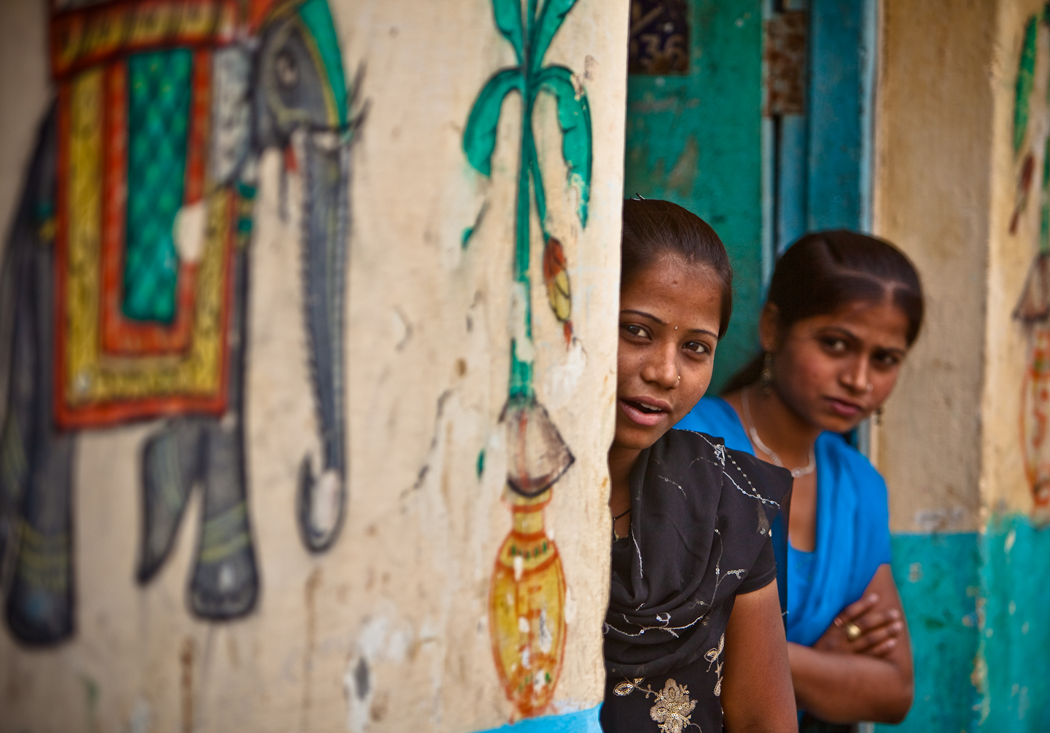
…the profits go to support Filipino
Christian
workers
in Indonesia.

Slide 7
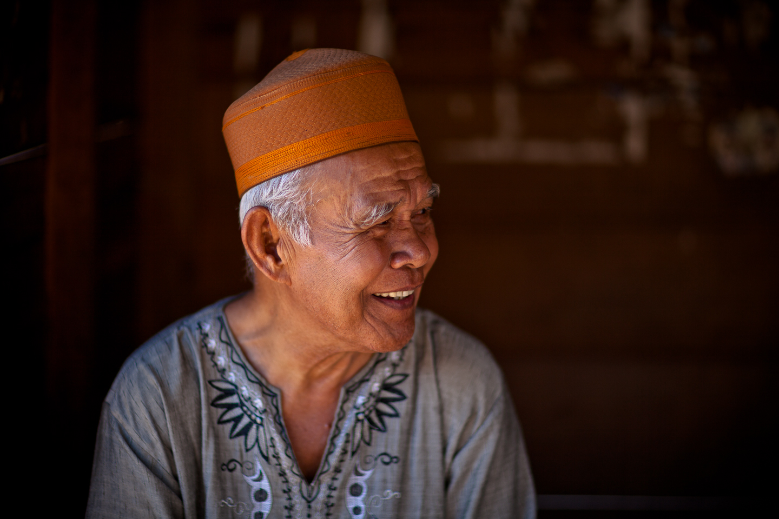
Pray for Matt’s photography as he uses it as an entry into the lives of Muslims across the world.

Slide 8
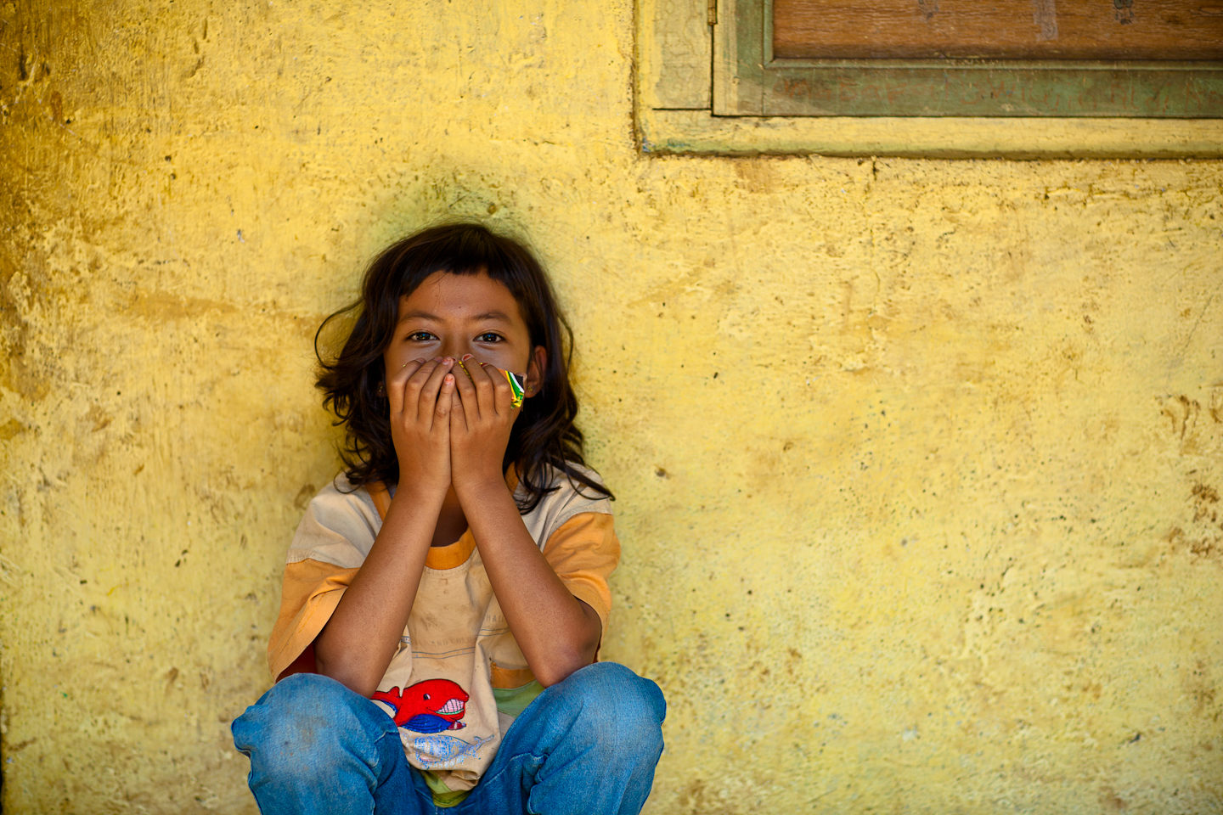
Pray for Matt’s photography as he uses it as an entry into the lives of Muslims across the world.

Slide 9
Pray for the Brandon’s as
they equip and train apostolic teams
in India and Malaysia

Slide 10
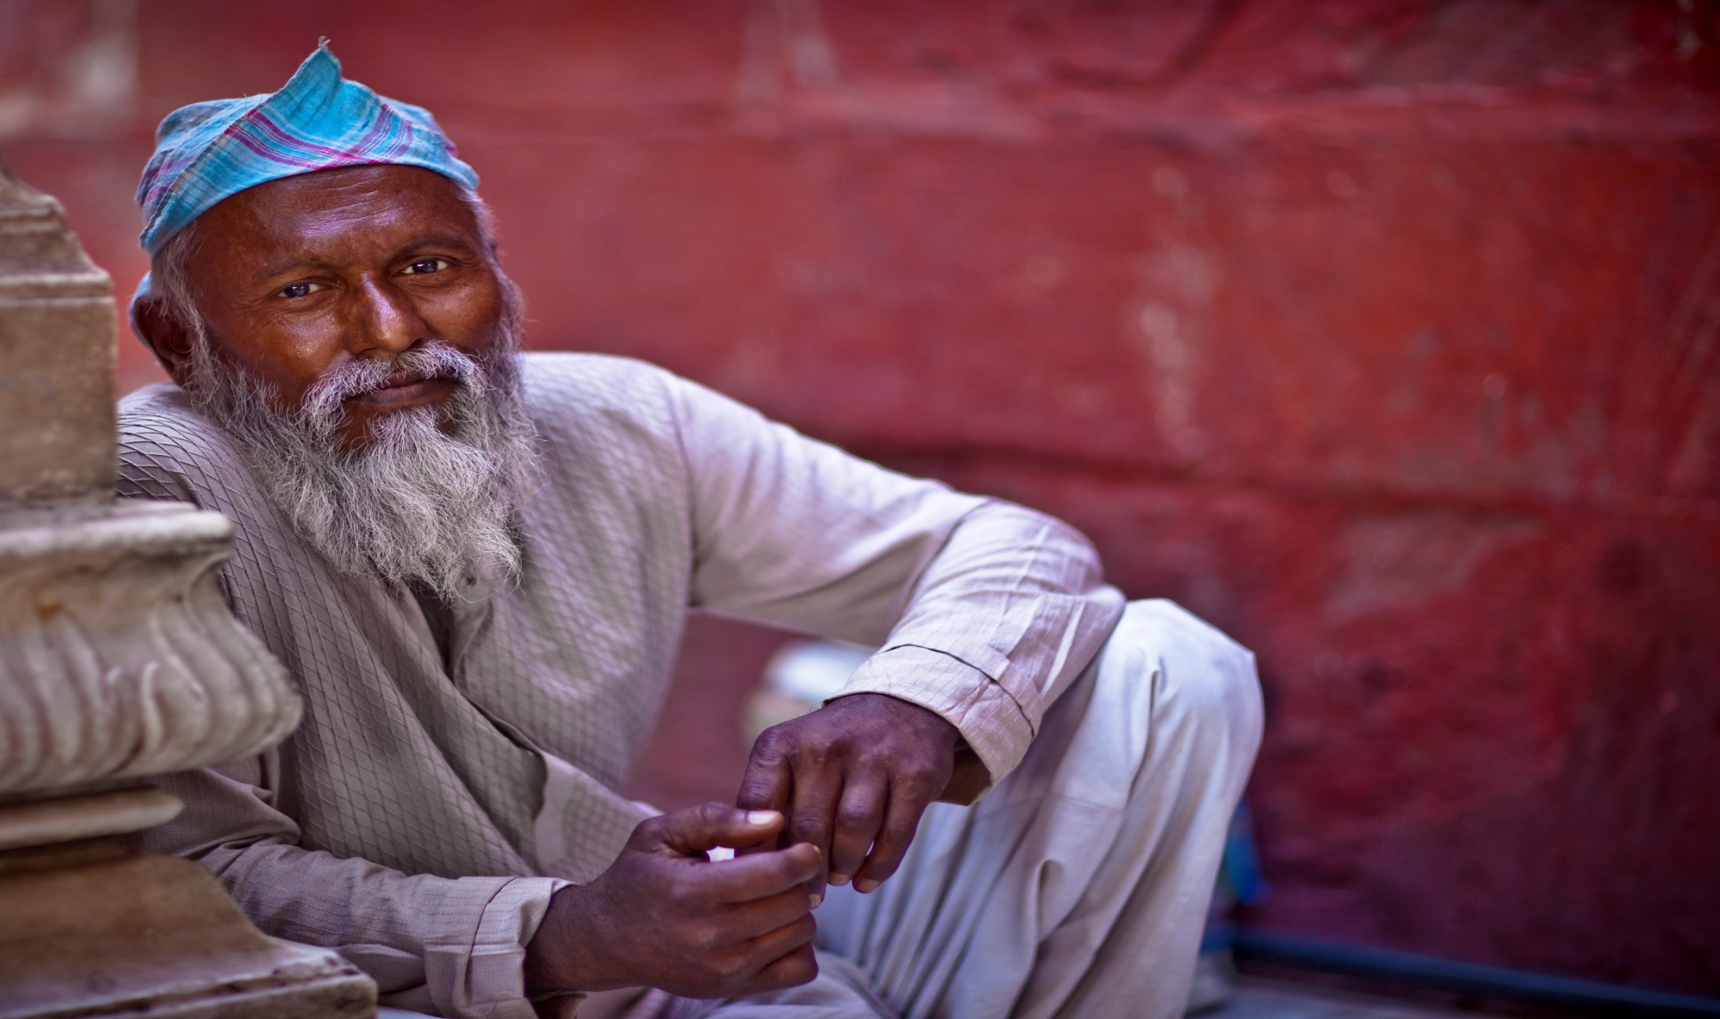
Pray for ongoing partnership in financial support

Slide 11
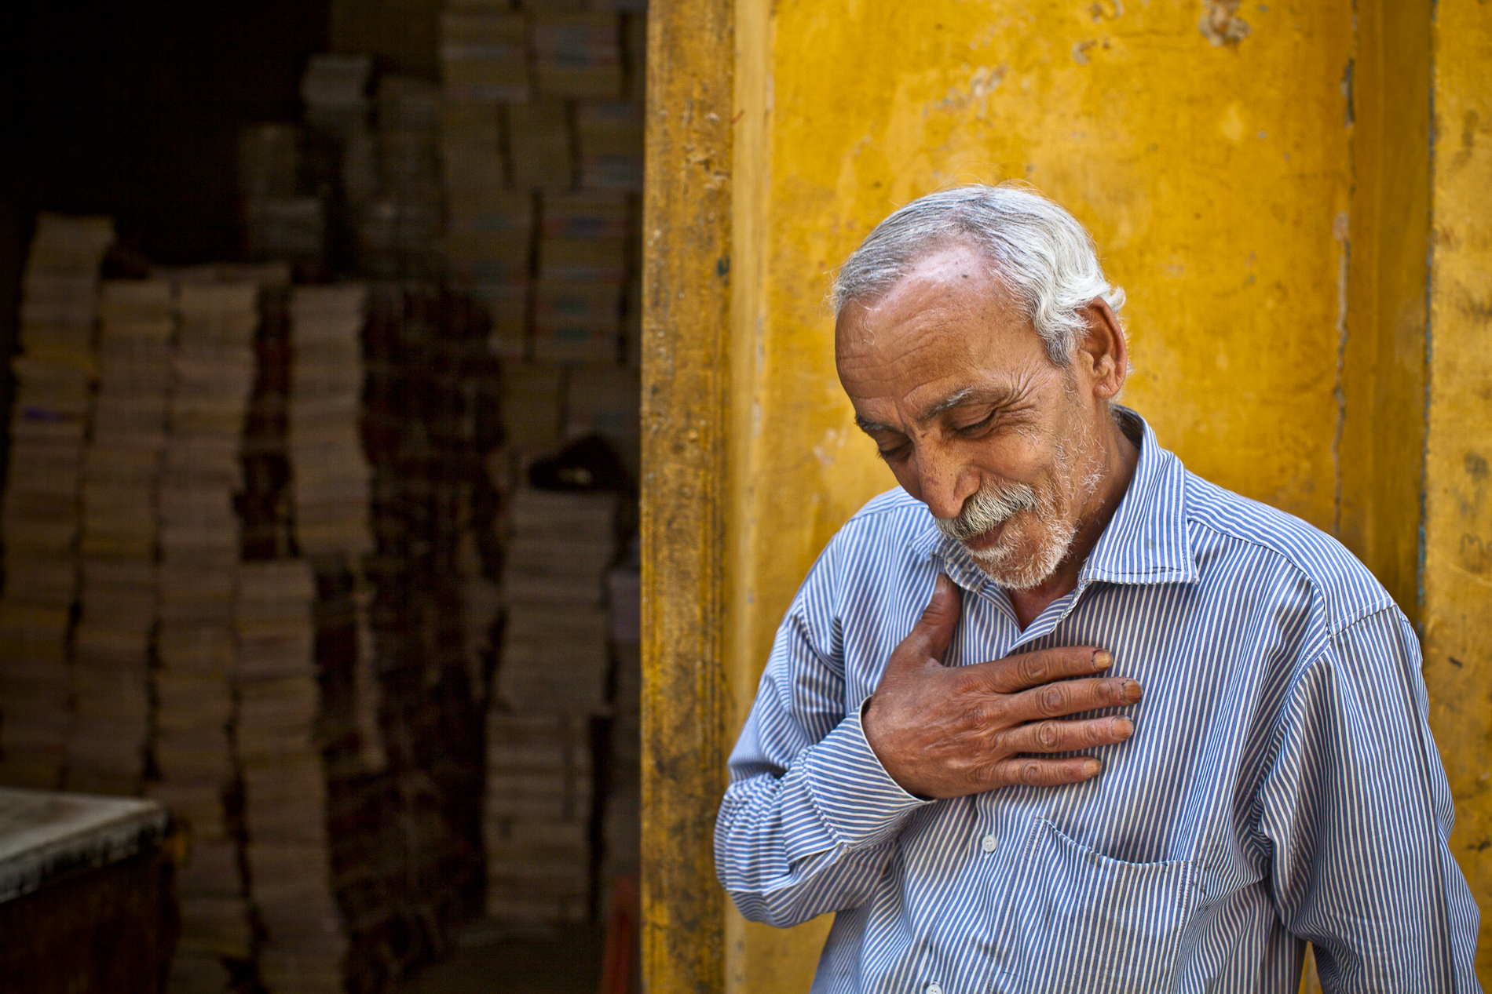
Thank You!

Slide 12
Our God Saves
In the Name of the Father In the Name of the Son In the Name of the Spirit
Lord we come

Slide 13
We're gathered together
To lift up Your Name To call on our Savior To fall on Your grace

Slide 14
In the Name of the Father In the Name of the Son In the Name of the Spirit
Lord we come

Slide 15
We're gathered together
To lift up Your Name To call on our Savior To fall on Your grace

Slide 16
Hear the joyful sound of our offering As Your saints bow down As Your people sing We will rise with You

Slide 17
Lifted on Your Wings And the world will see that

Slide 18
Our God saves, our God saves There is hope in Your Name Mourning turns to songs of praise Our God saves, our God saves

Slide 19
In the Name of the Father In the Name of the Son In the Name of the Spirit
Lord we come

Slide 20
We're gathered together
To lift up Your Name To call on our Savior To fall on Your grace

Slide 21
Hear the joyful sound of our offering As Your saints bow down As Your people sing We will rise with You

Slide 22
Lifted on Your Wings And the world will see that

Slide 23
Our God saves, our God saves, There is hope in Your Name Mourning turns to songs of praise Our God saves, our God saves

Slide 24
Hear the joyful sound of our offering As Your saints bow down As Your people sing We will rise with You

Slide 25
Lifted on Your Wings And the world will see that

Slide 26
Our God saves, our God saves, There is hope in Your Name Mourning turns to songs of praise Our God saves, our God saves
Paul Baloche, Brenton Brown
2007 Thankyou Music, Leadworship Songs, Integrity's Hosanna! Music
CCLI 78316

Slide 27
Only One For Me
By Your blood, You have saved me
With Your love,
You have brought me close to You By Your hands, You have made me With one word, You amaze me

Slide 28
Forever I will sing Your praise And worship You alone
Until the day I die I live my life for You

Slide 29
With every breath I take I bless Your name and want You more And now I'm running to You, O Lord

Slide 30
You are the reason my heart Can go on and on You are the life inside of me You are the answer to my cries You're all that I could ever need You are the only One for me

Slide 31
With one breath, You sustain me By Your grace You have given me a hope To dream of Your intentions
To be more like You

Slide 32
Forever I will sing Your praise And worship You alone
Until the day I die I live my life for You

Slide 33
With every breath I take I bless Your name and want You more And now I'm running to You, O Lord

Slide 34
You are the reason my heart Can go on and on You are the life inside of me

Slide 35
You are the answer to my cries
You're all that I could ever need You are the only One for me

Slide 36
Forever I will sing Your praise And worship You alone
Until the day I die I live my life for You

Slide 37
With every breath I take I bless Your name and want You more And now I'm running to You, O Lord

Slide 38
You are the reason my heart Can go on and on You are the life inside of me

Slide 39
You are the answer to my cries
You're all that I could ever need You are the only One for me
David Moore
2005 Gateway Create Publishing
CCLI 78316

Slide 40
In Christ Alone
In Christ alone my hope is found He is my Light, my strength, my song This Cornerstone, this solid ground Firm through the fiercest
drought and storm

Slide 41
What heights of love,
What depths of peace When fears are stilled,
When strivings cease
My Comforter, my all in all Here in the love of Christ I stand

Slide 42
In Christ alone Who took on flesh Fullness of God in helpless Babe
This gift of love and righteousness Scorned by the ones He came to save

Slide 43
'Til on that cross as Jesus died The wrath of God was satisfied For every sin on Him was laid Here in the death of Christ I live

Slide 44
There in the ground His body lay Light of the world by darkness slain Then bursting forth in glorious day Up from the grave He rose again

Slide 45
And as He stands in victory Sin's curse has lost its grip on me For I am His and He is mine Bought with the precious blood of Christ

Slide 46
No guilt in life, no fear in death This is the power of Christ in me From life's first cry to final breath
Jesus commands my destiny

Slide 47
No power of hell, no scheme of man
can ever pluck me from His hand 'Til He returns, or calls me home Here in the power of Christ I'll stand
Keith Getty, Stuart Townend
2001 Thankyou Music
CCLI 78316

Slide 48
Stronger
There is love that came for us Humbled to a sinner's cross You broke my shame and sinfulness You rose again, victorious

Slide 49
Faithfulness none can deny Through the storm and through the fire There is truth that sets me free Jesus Christ Who lives in me

Slide 50
You are stronger, You are stronger Sin is broken You have saved me It is written Christ is risen Jesus You are Lord of all

Slide 51
No beginning and no end You're my hope and my defense You came to seek and save the lost You paid it all upon the cross

Slide 52
You are stronger, You are stronger Sin is broken You have saved me It is written Christ is risen Jesus You are Lord of all

Slide 53
So let Your name be lifted higher Be lifted higher, be lifted higher
(repeat)

Slide 54
You are stronger, You are stronger Sin is broken You have saved me It is written Christ is risen Jesus You are Lord of all

Slide 55
You are stronger, You are stronger Sin is broken You have saved me It is written Christ is risen Jesus You are Lord of all
Ben Fielding, Reuben Morgan
2007 Hillsong Publishing
CCLI 78316

Slide 59
Extreme Makeover
Ephesians 4:17-24

Slide 60
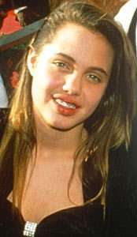
Angelina Jolie

Slide 61
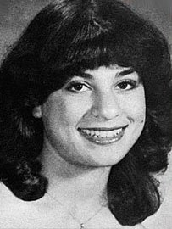
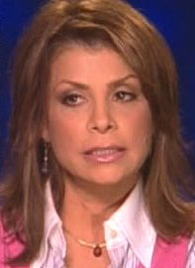
Paula Abdul

Slide 62
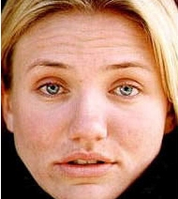
Cameron Diaz

Slide 63
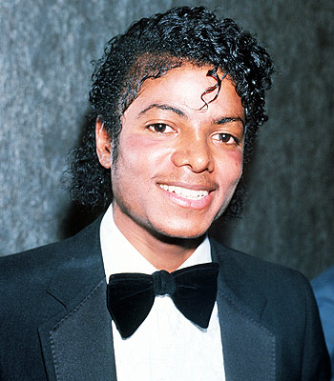
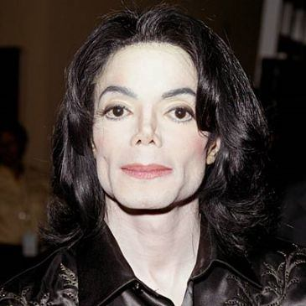
Michael Jackson

Slide 64
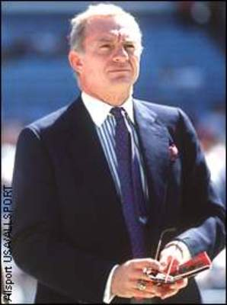
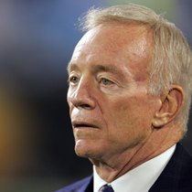
Jerry Jones

Slide 65
Extreme Makeover
Ephesians 4:17-24

Slide 66
Therefore if anyone is in Christ,
he is a new creature;
the old things passed away;
behold, new things have come.
2 Corinthians 5:17

Slide 67
3 Characteristics of the OLD MAN…
a FUTILE MIND

Slide 68
The person without the Spirit does not accept the things that come from the Spirit of God but considers them foolishness, and cannot understand them because they are discerned only through the Spirit.
1 Corinthians 2:14

Slide 69
3 Characteristics of the OLD MAN…
a FUTILE MIND
SPIRITUALLY & MORALLY CALLOUSED
IGNORANT of GOD’S TRUTH

Slide 70
3 Characteristics of the NEW MAN…
a NEW WAY
a NEW DESIRE
a NEW MIND

Slide 71
REFORMATION IS PUTTING A NEW COAT ON THE OLD MAN…
TRANSFORMATION IS CREATING A NEW MAN!

