Slide 2
Reaching For You
You created me inside Your great imagination You're the One who gave me My first breath

Slide 3
You have overseen my life
And brought me to redemption And I know that
You're not finished with me yet

Slide 4
I'm reaching for You, I'm singing to You I'm lifting my hands to praise You
I'm lifting my voice to thank You

Slide 5
I'm reaching for You, Jesus I need You I'm giving my heart to know You,
I'm living my life to serve You I'm reaching for You

Slide 6
You're the one who spoke
the Word of life to light my darkness You opened up my eyes 'til I could see

Slide 7
Jesus You have promised to
complete the work You started Faithful to fulfill Your grace in me

Slide 8
I'm reaching for You, I'm singing to You I'm lifting my hands to praise You
I'm lifting my voice to thank You

Slide 9
I'm reaching for You, Jesus I need You I'm giving my heart to know You,
I'm living my life to serve You I'm reaching for You

Slide 10
Pour out Your love from heaven
Fill me until I overflow Lord I want more Reach down Your hands from heaven
Pull me closer than ever before
Lord I want more
(repeat)

Slide 11
I'm reaching for You, I'm singing to You I'm lifting my hands to praise You
I'm lifting my voice to thank You

Slide 12
I'm reaching for You, Jesus I need You I'm giving my heart to know You,
I'm living my life to serve You I'm reaching for You
TEMPLE BIBLE CHURCH Used by Permission CCLI #78316

Slide 13
No Sweeter Name
No sweeter name than the name of Jesus No sweeter name have I ever known No sweeter name than the name of Jesus (repeat)

Slide 14
You are the life to my heart And my soul You are the light to the Darkness around me

Slide 15
You are the hope to the hopeless And broken You are the only truth and the way

Slide 16
No sweeter name than the name of Jesus No sweeter name have I ever known No sweeter name than the name of Jesus (repeat)

Slide 17
You are the life to my heart And my soul You are the light to the Darkness around me

Slide 18
You are the hope to the hopeless And broken You are the only truth and the way

Slide 19
Jesus Jesus Jesus Jesus

Slide 20
You are the life to my heart And my soul You are the light to the Darkness around me

Slide 21
You are the hope to the hopeless And broken You are the only truth and the way

Slide 22
You are the life to my heart And my soul You are the light to the Darkness around me

Slide 23
You are the hope to the hopeless And broken You are the only truth and the way
Kari Jobe
2004 Gateway Create Publishing
CCLI 78316

Slide 24
Come Thou Fount, Come Thou King
Come Thou Fount of every blessing Tune my heart to sing thy grace Streams of mercy never ceasing
Call for songs of loudest praise

Slide 25
Teach me some melodious sonnet Sung by flaming tongues above
Praise thy name, I'm fixed upon it Mount of Thy redeeming love

Slide 26
Come thou Fount come thou King Come thou precious Prince of Peace Hear Your bride to You we sing Come thou Fount of our blessing

Slide 27
I was lost in utter darkness 'til You came and rescued me I was bound by all my sin when Your love came and set me free

Slide 28
Now my soul can sing a new Song now my heart has found a home Now Your grace is always with me And I'll never be alone

Slide 29
Come Thou Fount, come Thou King Come Thou precious Prince of Peace Hear Your bride, to You we sing Come Thou Fount of our blessing

Slide 30
O to grace how great a debtor Daily I'm constrained to be Let Thy goodness like a fetter Bind my wandering heart to Thee

Slide 31
Prone to wander, Lord I feel it Prone to leave the God I love Here's my heart Lord, take and seal it Seal it for Thy courts above

Slide 32
Come Thou Fount, come Thou King Come Thou precious Prince of Peace Hear Your bride, to You we sing Come Thou Fount of our blessing
Thomas Miller, Robert Robinson
2005 Gateway Create Publishing
CCLI 78316

Slide 33
Forever Reign
You are good You are good
When there's nothing good in me You are love You are love
On display for all to see

Slide 34
You are light You are light When the darkness closes in You are hope You are hope
You have covered all my sin

Slide 35
You are peace You are peace When my fear is crippling You are true You are true
Even in my wandering

Slide 36
You are joy You are joy
You're the reason that I sing You are life You are life in You death has lost its sting

Slide 37
Oh I'm running to Your arms
I'm running to Your arms The riches of Your love will Always be enough Nothing compares to Your embrace Light of the world forever reign

Slide 38
You are more You are more
Than my words will ever say You are Lord You are Lord
All creation will proclaim

Slide 39
You are here You are here in Your presence I'm made whole You are God You are God
Of all else I'm letting go

Slide 40
Oh I'm running to Your arms
I'm running to Your arms The riches of Your love will Always be enough Nothing compares to Your embrace Light of the world forever reign
(repeat)

Slide 41
My heart will sing no other Name Jesus Jesus
(repeat)

Slide 42
Oh I'm running to Your arms
I'm running to Your arms The riches of Your love will Always be enough Nothing compares to Your embrace Light of the world forever reign
(repeat)

Slide 43
My heart will sing no other Name Jesus Jesus
Jason Ingram, Reuben Morgan
2009 SHOUT! Publishing, Windsor Hill Music, Sony/ATV Timber Publishing
CCLI 78316

Slide 44
Here In Your Presence
Found in Your hands, fullness of joy Every fear suddenly wiped away Here in Your Presence

Slide 45
All of my gains now fade away Every crown no longer on display Here in Your Presence

Slide 46
Heaven is trembling in awe of Your wonders The kings and their kingdoms Are standing amazed

Slide 47
Here in Your Presence
We are undone Here in Your Presence
Heaven and earth become one

Slide 48
Here in Your Presence
All things are new
Here in Your Presence
Everything bows before You

Slide 49
Found in Your hands, fullness of joy Every fear suddenly wiped away Here in Your Presence

Slide 50
All of my gains now fade away Every crown no longer on display Here in Your Presence

Slide 51
Heaven is trembling in awe of Your wonders The kings and their kingdoms Are standing amazed

Slide 52
Here in Your Presence
We are undone Here in Your Presence
Heaven and earth become one

Slide 53
Here in Your Presence
All things are new
Here in Your Presence
Everything bows before You

Slide 54
Wonderful, beautiful, glorious Matchless in every way

Slide 55
Here in Your Presence
We are undone Here in Your Presence
Heaven and earth become one

Slide 56
Here in Your Presence
All things are new
Here in Your Presence
Everything bows before You
Jon Egan
2006 Vertical Worship Songs
CCLI 78316

Slide 58
^{The} Quiet
Before
^{the} STORM

Slide 59
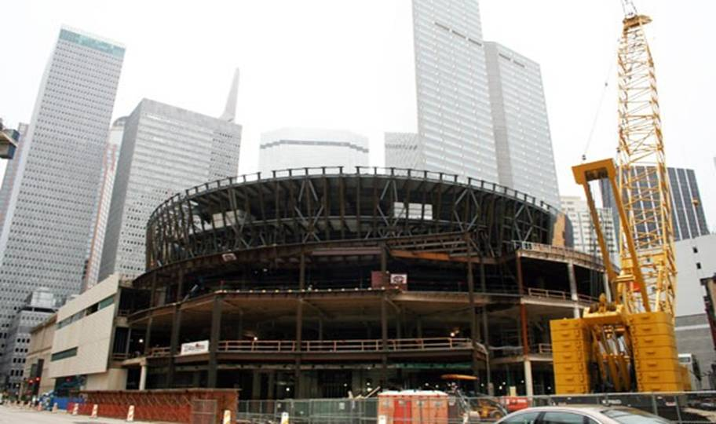
First Baptist of Dallas

Slide 61
*Only 15% of churches in the US are growing and just less than 5% of those are growing by conversion growth.
*10,000 churches in America disappeared in a five year period.

Slide 62
*The number of people who do not attend church has doubled in the past 15 years.
*There are over 100mllion un-churched Americans.
*70% of students between the ages 18 and 23 fall away from the faith.

Slide 64
Watch your life and doctrine closely. Persevere in them, because if you do, you will save both yourself and your hearers.
1 Timothy 4:16

Slide 65
We also know that the law is made not for the righteous but for lawbreakers and rebels, the ungodly and sinful, the unholy and irreligious, for those who kill their fathers or mothers, for murderers, for the sexually immoral, for those practicing homosexuality, for slave traders and liars and perjurers—and for whatever else is contrary to sound doctrine.
1 Timothy 1:9-10

Slide 67
…holding on to faith and a good conscience, which some have rejected and so have suffered shipwreck with regard to the faith.
1 Timothy 1:19

Slide 69
…holding on to faith and a good conscience, which some have rejected and so have suffered shipwreck with regard to the faith.
1 Timothy 1:19

Slide 70
Then we will no longer be infants, tossed back and forth by the waves, and blown here and there by every wind of teaching and by the cunning and craftiness of men in their deceitful scheming.
Ephesians 4:14

