Slide 2
Our God Saves
In the Name of the Father In the Name of the Son In the Name of the Spirit
Lord we come
Notes:
D2 G2

Slide 3
We're gathered together to Lift up Your Name To call on our Savior To fall on Your grace
Notes:
Bm G2 (G2)

Slide 4
In the Name of the Father In the Name of the Son In the Name of the Spirit
Lord we come
Notes:
D2 G2

Slide 5
We're gathered together to Lift up Your Name To call on our Savior To fall on Your grace
Notes:
Bm G2 (G2)

Slide 6
Hear the joyful sound of our offering As Your saints bow down As Your people sing We will rise with You
Notes:
D
Asus
Bm

Slide 7
Lifted on Your Wings And the world will see that
Notes:
Bm G2 (G2)

Slide 8
Our God saves, our God saves There is hope in Your Name Mourning turns to songs of praise Our God saves, our God saves
Notes:
D Asus Bm G D Asus Bm G

Slide 9
In the Name of the Father In the Name of the Son In the Name of the Spirit
Lord we come
Notes:
D2 G2

Slide 10
We're gathered together to Lift up Your Name To call on our Savior To fall on Your grace
Notes:
Bm G2 (G2)

Slide 11
Hear the joyful sound of our offering As Your saints bow down As Your people sing We will rise with You
Notes:
D
Asus
Bm

Slide 12
Lifted on Your Wings And the world will see that
Notes:
Bm G2 (G2)

Slide 13
Our God saves, our God saves, There is hope in Your Name Mourning turns to songs of praise Our God saves, our God saves
Notes:
D Asus Bm G D Asus B m G

Slide 14
Hear the joyful sound of our offering As Your saints bow down As Your people sing We will rise with You
Notes:
D
Asus
Bm

Slide 15
Lifted on Your Wings And the world will see that
Notes:
Bm G2 (G2)

Slide 16
Our God saves, our God saves, There is hope in Your Name Mourning turns to songs of praise Our God saves, our God saves
Paul Baloche, Brenton Brown
2007 Thankyou Music, Leadworship Songs, Integrity's Hosanna! Music
CCLI 78316
Notes:
D Asus Bm G D Asus B m G

Slide 17
Our God
Water You turned into wine Opened the eyes of the blind There's no one like You
None like You
Notes:
Intro Em/G C/G G Dsus/G [2x] Verse 1 Em/G C/G G Em/G C/G G Am7 Dsus D

Slide 18
Into the darkness, You shine Out of the ashes, we rise There's no one like You
None like You
Notes:
Em/G C G Em C G Am7 Dsus D

Slide 19
Our God is greater Our God is stronger God, You are higher than any other Our God is healer
Awesome in power Our God, our God
Notes:
Em C(C2) G Dsus (D/F# ) Em C(C2) G Dsus

Slide 20
Into the darkness, You shine Out of the ashes, we rise There's no one like You
None like You
Notes:
Em/G C G Em C G Am7 Dsus D

Slide 21
Our God is greater Our God is stronger God, You are higher than any other Our God is healer
Awesome in power Our God, our God
Notes:
Em C(C2) G Dsus (D/F# ) Em C(C2) G Dsus

Slide 22
And if our God is for us then Who could ever stop us And if our God is with us Then what could stand against
(repeat)
Notes:
Em C(C2) G Dsus (D/F# ) Em

Slide 23
Our God is greater Our God is stronger God, You are higher than any other Our God is healer
Awesome in power Our God, our God
Notes:
Em C(C2) G Dsus (D/F# ) Em C(C2) G Dsus

Slide 24
And if our God is for us then Who could ever stop us And if our God is with us then What could stand against
(Then) What could stand against
Notes:
Em C(C2) G Dsus (D/F# ) Em

Slide 25
Our God is greater Our God is stronger God, You are higher than any other Our God is healer
Awesome in power Our God, our God
Jonas Myrin, Matt Redman, Jesse Reeves, Chris Tomlin
2010 SHOUT! Publishing, sixsteps Music, Vamos Publishing, Said and Done Music, Thankyou Music
CCLI 78316
Notes:
Em C(C2) G Dsus (D/F# ) Em C(C2) G Dsus

Slide 26
From The Inside Out
A thousand times I’ve failed
Still Your mercy remains
And should I stumble again
I’m caught in Your grace
Notes:
D A E D A E D A E

Slide 27
Everlasting
Your light will shine when all else fades
Never ending
Your glory goes beyond all fame
Notes:
F#m D A E
F#m D A E

Slide 28
In my heart and my soul
I give you control
Consume from the inside out
Let justice and praise
become my embrace
To love You from the inside out
Notes:
D A F#m E D F#m E Bm

Slide 29
Your will above all else
My purpose remains
the art of losing myself
In bringing You praise
Notes:
D A E D A E D A E

Slide 30
Everlasting
Your light will shine when all else fades
Never ending
Your glory goes beyond all fame
And the cry of my heart
Is to bring You praise
From the inside out, Lord my soul cries out
Notes:
F#m D A E
F#m D A E

Slide 31
In my heart and my soul
Lord I give You control
Consume me from the inside out Lord let justice and praise
Become my embrace
To love You from the inside out
Notes:
D A F#m E D F#m E Bm

Slide 32
Everlasting
Your light will shine when all else fades
Never ending
Your glory goes beyond all fame
And the cry of my heart
Is to bring You praise
From the inside out, Lord my soul cries out
Notes:
F#m D A E
F#m D A E
A D E F#m D E D E

Slide 33
In my heart and my soul
Lord I give You control
Consume me from the inside out Lord
let justice and praise
Become my embrace
To love You from the inside out
Notes:
D A F#m E D F#m E Bm

Slide 34
Everlasting
Your light will shine when all else fades
Never ending
Your glory goes beyond all fame
And the cry of my heart
Is to bring You praise
From the inside out, Lord my soul cries out
(repeat)
Notes:
F#m D A E
F#m D A E
A D E F#m D E D E

Slide 35
from the inside out, Lord my soul cries out
from the inside out, Lord my soul cries out
TEMPLE BIBLE CHURCH Used by Permission CCLI #78316
Notes:
D E D E

Slide 36
Revelation Song
Worthy is the Lamb who was slain Holy Holy is He Sing a new song, to Him who Sits on heaven's mercy seat
(Repeat)
Notes:
Intro D
Verse 1 D Am7 C G D Am7 C G

Slide 37
Holy Holy Holy Is the Lord God Almighty Who was and is and is to come With all creation I sing
Notes:
D Am7 C G

Slide 38
Praise to the King of kings You are my everything And I will adore You
Notes:
D Am7 C G D

Slide 39
Clothed in rainbows of living color Flashes of lightning rolls of thunder Blessing and honor strength And glory and power be To You the only wise King
Notes:
D Am7 C G D Am7 C G

Slide 40
Holy Holy Holy Is the Lord God Almighty Who was and is and is to come With all creation I sing
Notes:
D Am7 C G

Slide 41
Praise to the King of kings You are my everything And I will adore You
Notes:
D Am7 C G D

Slide 42
Filled with wonder, awe struck wonder At the mention of Your name Jesus Your name is power Breath and living water Such a marvelous mystery
Notes:
D Am7 C G D Am7 C G

Slide 43
Holy Holy Holy Is the Lord God Almighty Who was and is and is to come With all creation I sing
Notes:
D Am7 C G

Slide 44
Praise to the King of kings You are my everything And I will adore You
Notes:
D Am7 C G D

Slide 45
Holy Holy Holy Is the Lord God Almighty Who was and is and is to come With all creation I sing
Notes:
D Am7 C G

Slide 46
Praise to the King of kings You are my everything And I will adore You
Jennie Lee Riddle
2004 Gateway Create Publishing
CCLI 78316
Notes:
D Am7 C G D

Slide 48
IMPACT 2012
NEEDS FOR JUNE 11-14
Prayer
36 Host Homes
25+ Drivers
Food Donations
Carnival Volunteers
To help, see table in the foyer!

Slide 49
TBC MISSIONS
APRIL 28

Slide 51
ANCHOR
Isaiah 40:8, Matthew 5:18

Slide 52
The BIBLE is the most PURCHASED and LEAST READ BOOK ever PUBLISHED!

Slide 53
Mahatma Gandhi
“You Christians have in your keeping a document with enough dynamite in it to blow the whole of civilization to bits; to turn society upside down; to bring peace to this war-torn world. But you read it as if it were just good literature and nothing else.”

Slide 54
Ours is a day when people believe everything is true, but nothing is absolutely true!

Slide 55
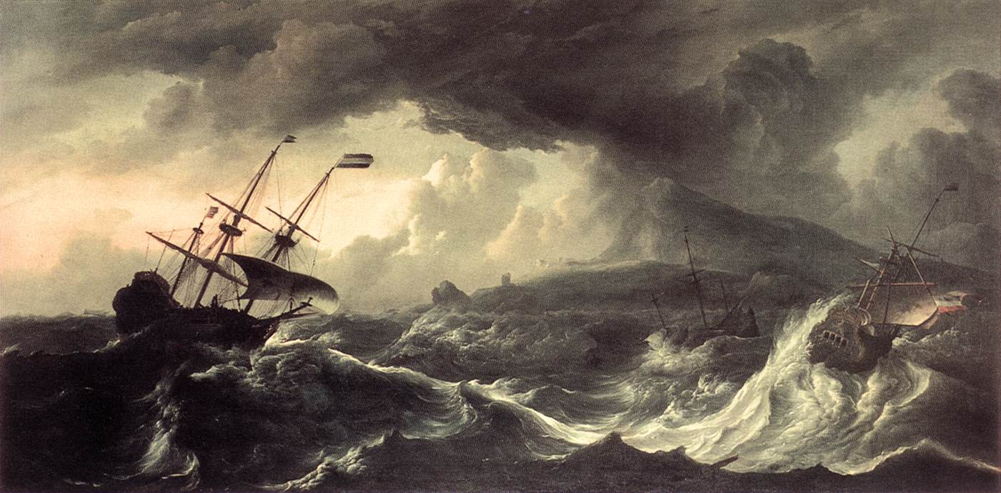
DRIFTING AIMLESSLY
OR
ANCHORED TO TRUTH

Slide 56
DRIFTING AIMLESSLY without an ANCHOR by PURSUING…
HEDONISM

Slide 57
Ecclesiastes 2:10
And all that my eyes desired I did not refuse them. I did not withhold my heart from any pleasure…

Slide 58
“First I tried health food, then transcendental meditation, then jogging;
and now I am more serenely, tranquilly, robustly, miserable than I’ve ever been before.”

Slide 59
DRIFTING AIMLESSLY without an ANCHOR by PURSUING…
ESCAPISM

Slide 60
DRIFTING AIMLESSLY without an ANCHOR by PURSUING…
SUPERNATURALISM

Slide 61
DRIFTING AIMLESSLY without an ANCHOR by PURSUING…
MATERIALISM

Slide 62
Fred Smith
There is some persistent quirk in our thinking that convinces us that temporal things will give us permanent joy.

Slide 63
DRIFTING AIMLESSLY without an ANCHOR by PURSUING…
INTELLECTUALISM

Slide 64
ANCHORED by the WORD of GOD
The UNIQUENESS of the WORD

Slide 65
THE UNIQUENESS OF THE WORD
Unique in its…. CONTINUITY
Unique in its…. CIRCULATION
Unique in its…. TRANSLATION
Unique in its…. SURVIVAL
Unique in its…. INFLUENCE

Slide 66
ANCHORED by the WORD of GOD
The INSPIRATION of the WORD

Slide 67
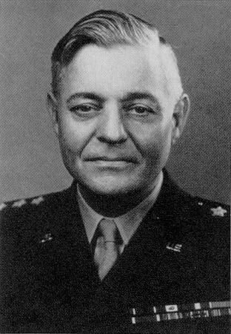

Slide 68
ANCHORED by the WORD of GOD
The VALUE of the WORD

Slide 69
THE VALUE OF THE WORD… Ps 119
It REVEALS GOD
It KEEPS us from SIN
It GIVES us UNDERSTANDING
It GIVES us GUIDANCE

Slide 70
“The Bible was written not to satisfy your curiosity but to help you conform to Christ’s image. Not to make you a smarter sinner but to make you like the Savior…

Slide 71
…not to fill your head with a collection of biblical facts but to transform your life.”
- Howard G. Hendricks

Slide 72
To keep from DRIFTING through LIFE AIMLESSLY… HOLD to the ANCHOR… GOD’S WORD

