Slide 2
Everlasting God
Strength will rise as
We wait upon the Lord We will wait upon the Lord We will wait upon the Lord

Slide 3
Strength will rise as
We wait upon the Lord We will wait upon the Lord We will wait upon the Lord

Slide 4
Our God You reign forever Our hope Our strong deliverer

Slide 5
You are the everlasting God The everlasting God You do not faint You won't grow weary You're the defender of the weak You comfort those in need You lift us up on wings like eagles

Slide 6
Strength will rise as
We wait upon the Lord We will wait upon the Lord We will wait upon the Lord

Slide 7
Strength will rise as
We wait upon the Lord We will wait upon the Lord We will wait upon the Lord

Slide 8
Our God You reign forever Our hope Our strong deliverer

Slide 9
You are the everlasting God The everlasting God You do not faint You won't grow weary You're the defender of the weak You comfort those in need You lift us up on wings like eagles
Brenton Brown, Ken Riley
2005 Thankyou Music
CCLI 78316

Slide 10
Holding On to You
All I want is You
all I need is You And I do believe What You say is true But I don't understand Why it's taken me So long to know

Slide 11
Well I tried to be everything I need But a broken heart was all That I achieved Still I don't understand Why it's taken me so long to know

Slide 12
You never change Your love remains Oh God, I'm holding onto You When I'm afraid Still Your love remains Oh God, I'm holding onto You

Slide 13
I just want to be
With You every day Never let You down
Never walk away But I know if I do You will be waiting for me

Slide 14
You never change Your love remains Oh God, I'm holding onto You When I'm afraid Still Your love remains Oh God, I'm holding onto You

Slide 15
You never change Your love remains Oh God, I'm holding onto You When I'm afraid Still Your love remains Oh God, I'm holding onto You
Paul Colman
CCLI 78316

Slide 16
Your Name
As morning dawns and evening Fades You inspire songs of praise That rise from earth to touch Your heart and glorify Your name

Slide 17
As morning dawns and evening Fades You inspire songs of praise That rise from earth to touch Your heart and glorify Your name

Slide 18
Your name is a strong
And mighty tower Your name is a shelter
Like no other Your name, let the nations Sing it louder 'Cause nothing has the power To save but Your Name

Slide 19
Jesus, in Your name we pray come And fill our hearts today Lord, give us strength to live For You and glorify Your name

Slide 20
Your name is a strong
And mighty tower Your name is a shelter
Like no other Your name, let the nations Sing it louder 'Cause nothing has the power To save but Your Name

Slide 21
Your name is a strong
And mighty tower Your name is a shelter
Like no other Your name, let the nations Sing it louder 'Cause nothing has the power To save but Your Name
Paul Baloche, Glenn Packiam
2006 Vertical Worship Songs, Integrity's Hosanna! Music
CCLI 78316

Slide 22
Where We Belong
There is no height or depth Neither life nor death Can take me from all that I find Here now in Your glory Lord

Slide 23
No other powers or love The things of Now or to come There's nothing On earth in this life That could ever separate us Lord

Slide 24
Your love is never ending To Your hands we surrender Where all our sins Are washed away Your grace beyond reason has Paid for our freedom We're made alive in You

Slide 25
We run to Your throne Where we belong Every heart will sing that Jesus is Lord

Slide 26
Casting all else aside
For the joy of our Christ Let Your glory fall Our hearts are filled With Your fire

Slide 27
No other powers or love The things of Now or to come There's nothing
On earth in this life That could ever separate us Lord

Slide 28
Your love is never ending To Your hands we surrender Where all our sins Are washed away Your grace beyond reason has Paid for our freedom We're made alive in You

Slide 29
We run to Your throne Where we belong Every heart will sing that Jesus is Lord

Slide 30
Casting all else aside
For the joy of our Christ Let Your glory fall Our hearts are filled With Your fire

Slide 31
We run to Your throne Where we belong Every heart will sing that Jesus is Lord

Slide 32
Casting all else aside
For the joy of our Christ Let Your glory fall Our hearts are filled With Your fire
Joel Davies, Reuben Morgan
2008 Hillsong Publishing
CCLI 78316

Slide 33
Made Me Glad
I will bless the Lord forever I will trust Him at all times He has delivered me from all fear He has set my feet upon a rock And I will not be moved And I'll say of the Lord

Slide 34
You are my shield My strength my portion Deliverer, my shelter Strong tower My very present help In time of need

Slide 35
Whom have I in heaven but You There's none I desire besides You And You have made me glad I'll say of the Lord

Slide 36
You are my shield My strength my portion Deliverer, my shelter Strong tower My very present help In time of need

Slide 37
You have made me glad And I'll say of the Lord

Slide 38
You are my shield My strength my portion Deliverer, my shelter Strong tower My very present help

Slide 39
You are my shield My strength my portion Deliverer, my shelter Strong tower My very present help In time of need
Miriam Webster
2001 Hillsong Publishing
CCLI 78316

Slide 40
I Surrender All
I surrender all, I surrender all All to Thee, my blessed Savior I surrender all, I surrender all I surrender all, I surrender all

Slide 41
All to Jesus I surrender All to Him I freely give I will ever love and trust Him In His presence daily live

Slide 42
I surrender all, I surrender all All to Thee, my blessed Savior I surrender all, I surrender all I surrender all, I surrender all
Judson VanDeVenter, Winfield Scott Weeden
1896 Public Domain
CCLI 78316

Slide 44
CHOSEN 1:4
ADOPTED
1:5
REDEEMED
1:7
out of our DEADNESS
2:1
RESULT = UNITY
2:11-3:21

Slide 45
A TRANSFORMED HEART
WILL RESULT IN CHANGED BEHAVIOR!

Slide 46
Therefore I, the prisoner of the Lord, implore you to walk in a manner worthy of the calling with which you have been called,
Ephesians 4:1

Slide 47
So this I say, and affirm together with the Lord, that you walk no longer just as the Gentiles also walk, in the futility of their mind,
Ephesians 4:17

Slide 48
…walk in love, just as Christ also loved you and gave Himself up for us, an offering and a sacrifice to God as a fragrant aroma.
Ephesians 5:2

Slide 49
…for you were formerly darkness, but now you are Light in the Lord; walk as children of Light.
Ephesians 5:8

Slide 50
Therefore be careful how you walk, not as unwise men but as wise
Ephesians 5:15

Slide 51
Walking in LOVE LIGHT WISDOM

Slide 52
IMITATE YOUR FATHER BY…5:1
> WALKING IN LOVE

Slide 53
By this all men will know that you are My disciples, if you have love for one another.
John 13:35

Slide 54
¹ If I speak with the tongues of men and of angels, but do not have love, I have become a noisy gong or a clanging cymbal.

Slide 55
² If I have the gift of prophecy, and know all mysteries and all knowledge; and if I have all faith, so as to remove mountains, but do not have love, I am nothing.

Slide 56
³ And if I give all my possessions to feed the poor, and if I surrender my body to be burned, but do not have love, it profits me nothing.
1 Corinthians 13:1-3

Slide 57
If someone says, “I love God,” and hates his brother, he is a liar; for the one who does not love his brother whom he has seen, cannot love God whom he has not seen.
1 John 4:20

Slide 58
WALKING IN LOVE…5:2-7
~ THE PATTERN - JESUS…5:2

Slide 59
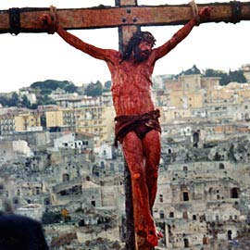

Slide 60
WALKING IN LOVE…5:2-7
~ THE PATTERN - JESUS…5:2
~ THE PERVERSION… NOT LIVING LIKE A SON…5:3-7

Slide 61
WALKING IN LIGHT…5:8-14
~ PLEASING THE FATHER…5:8-10
~ EXPOSING DARKNESS…5:11-14

Slide 62
How to Overcome Sin
Express to the Lord
Expose to the Light
Expel from your Life

Slide 63
WALKING IN LOVE…5:2-7
WALKING IN LIGHT…5:8-14
WALKING IN WISDOM…5:15-17

Slide 64
DO YOU LOOK LIKE YOUR FATHER?

Slide 66
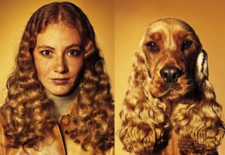

Slide 67
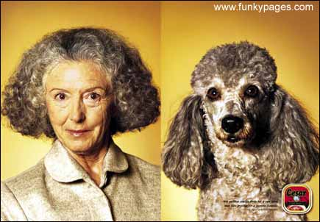

Slide 68
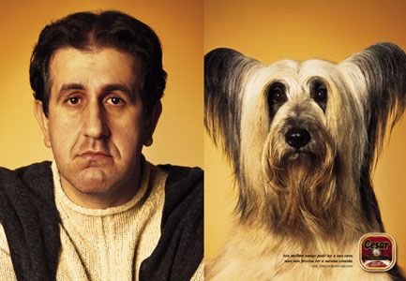

Slide 69
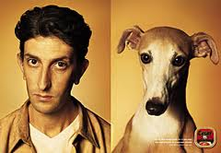

Slide 70
