Slide 3
I Love Christmas
I love freedom, I love peace
I love joy in the world
I love knowing tomorrow holds

Slide 4
Hope for every boy and girl
And it’s very clear to me
It’s all because He came to set us free!

Slide 5
That’s why I love Christmas
and all the hope it brings
Celebrating, Jesus King of Kings
Bringing love, bringing peace,
bring joy to us
I love Christmas!

Slide 6
I love songs that fill the night
and time with my family
Churches praying for peace on earth
and love’s generosity
And it’s very clear to me
It’s all because He came to set us free!

Slide 7
That’s why I love Christmas
and all the hope it brings
Celebrating, Jesus King of Kings
Bringing love, bringing peace,
bring joy to us
I love Christmas!

Slide 8
It’s more than just the carols
And presents by the Christmas tree
It’s all about the promise
His coming brought to you and me!

Slide 9
That’s why I love Christmas
and all the hope it brings
Celebrating, Jesus King of Kings
Bringing love, bringing peace,
bring joy to us
I love Christmas!

Slide 10
Happy Birthday Jesus
Happy birthday Jesus
I’m so glad it’s Christmas
All the tinsel and lights
And the presents are nice
But the real gift is You

Slide 11
Happy birthday Jesus
I’m so glad it’s Christmas
All the carols and bells
Make the holiday swell
And it’s all about You

Slide 12
Happy birthday Jesus
Jesus I love you!

Slide 13
Angels, From the Realms of Glory
(men only)
Angels from the realms of glory
Wing your flight over all the earth
Ye who sing creation’s story
Now proclaim Messiah’s birth

Slide 14
(women only)
Shepherds in the fields abiding
Watching over your flocks by night
God with man is now residing
Yonder shines the Infant Light

Slide 15
Come and worship, come and worship
Come and worship Christ the newborn King
Come and worship, come and worship
Come and worship Christ the newborn King

Slide 16
Sinners wrung with true repentance
Doomed for guilt and endless pain
Justice now revokes the sentence
Mercy calls you, break your chains

Slide 17
Come and worship, come and worship
Come and worship Christ the newborn King
Come and worship, come and worship
Come and worship Christ the newborn King

Slide 18
Though an infant now we view Him
He shall fill His father’s throne
Gather all the nations to Him
Every knee shall then bow down

Slide 19
All creation join in praising
God the Father, Spirit, Son
Evermore your voices raising
To the eternal Three in One

Slide 20
Come and worship, come and worship
Come and worship Christ the newborn King
Come and worship, come and worship
Come and worship Christ the newborn King
Come and worship Christ the newborn King
Temple Bible Church Used by Permission CCLI#78316

Slide 21
Light of the Stable
Hail, hail to the newborn king
Let our voices sing Him our praises
Hail, hail to the guiding light
That brought us tonight to our Savior

Slide 22
Alle alleluia, alle, alleluia
Alle alleluia, alle, alleluia

Slide 23
Come now, there it shines so bright
To the knowing light of the stable
Lean close to the child so dear
Cast aside your fear and be thankful

Slide 24
Hail, hail to the newborn king
Let our voices sing Him our praises
Hail, hail to the guiding light
That brought us tonight to our Savior

Slide 25
Alle alleluia, alle, alleluia
Alle alleluia, alle, alleluia
Steve and Elizabeth Rhymer

Slide 26
My Soul Magnifies The Lord
Good news of great joy
For every woman every man This will be a sign to you a Baby born in Bethlehem Come and worship do not be afraid

Slide 27
A company of angels Glory in the highest And on the earth peace among Those on whom His favor rests Come and worship do not be afraid
Come and worship do not be afraid

Slide 28
My soul my soul magnifies the Lord My soul magnifies the Lord He has done great things for me Great things for me

Slide 29
Unto you a child is born Unto us a Son is given Let every heart prepare His throne
Let every nation under Heaven Come and worship do not be afraid
Come and worship do not be afraid

Slide 30
My soul my soul magnifies the Lord My soul magnifies the Lord He has done great things for me Great things for me

Slide 31
Of His government there will be no end He'll establish it with His Righteousness And He shall reign on David's throne
And His name shall be from this day on

Slide 32
Wonderful, Counselor, Everlasting Father
Wonderful, Counselor, Everlasting Father

Slide 33
My soul my soul magnifies the Lord My soul magnifies the Lord He has done great things for me Great things for me
Daniel Carson, Chris Tomlin
2009 Vamos Publishing, worshiptogether.com songs, sixsteps Music
CCLI 78316

Slide 34
Here I Am To Worship
Light of the world You stepped down into darkness Opened my eyes let me see Beauty that made this heart adore You Hope of a life spent with You

Slide 35
Here I am to worship Here I am to bow down Here I am to say that You're my God You're altogether lovely, Altogether worthy Altogether wonderful to me

Slide 36
King of all days oh so highly exalted Glorious in Heaven above Humbly You came to the earth You created All for love's sake became poor

Slide 37
Here I am to worship Here I am to bow down Here I am to say that You're my God You're altogether lovely, altogether worthy
Altogether wonderful to me

Slide 38
Prince of Peace
You were born in a manger
Humbled, a poor baby King
“Glory to God in the highest of heaven”
The shepherds and angels did sing

Slide 39
Here I am to worship Here I am to bow down Here I am to say that You're my God You're altogether lovely, altogether worthy Altogether wonderful to me
Tim Hughes
2000 Thankyou Music
CCLI 78316

Slide 40
We Fall Down
We fall down, we lay our crowns At the feet of Jesus, The greatness of mercy and love At the feet of Jesus

Slide 41
And we cry, "Holy, holy, holy," And we cry, "Holy, holy, holy," And we cry, "Holy, holy Holy is the Lamb

Slide 42
We fall down, we lay our crowns At the feet of Jesus, The greatness of mercy and love At the feet of Jesus

Slide 43
And we cry, "Holy, holy, holy," And we cry, "Holy, holy, holy," And we cry, "Holy, holy Holy is the Lamb
Chris Tomlin
1998 worshiptogether.com songs
CCLI 78316

Slide 45
Christmas Lights

Slide 46
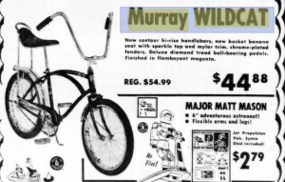

Slide 47
Christmas Lights

Slide 48
‘
JOHN the BAPTIST…
a WITNESS of the LIGHT

Slide 49
Doubt is can’t believe.
Unbelief is won’t believe.
Doubt is honest.
Unbelief is obstinacy.
Doubt is looking for light.
Unbelief is content with darkness.
Henry Drummond

Slide 50
The SHEPHERDS…
the LIGHT REVEALED
in the DARKNESS

Slide 51
So faith comes
from hearing,
and hearing by
the word of Christ.
Romans 10:17

Slide 52
The MAGI…
FOLLOWING a LIGHT
to the LIGHT

Slide 53
SIMEON…
PROPHETIC words
regarding the LIGHT

Slide 54
The LIGHT EXTINGUISHED

Slide 55
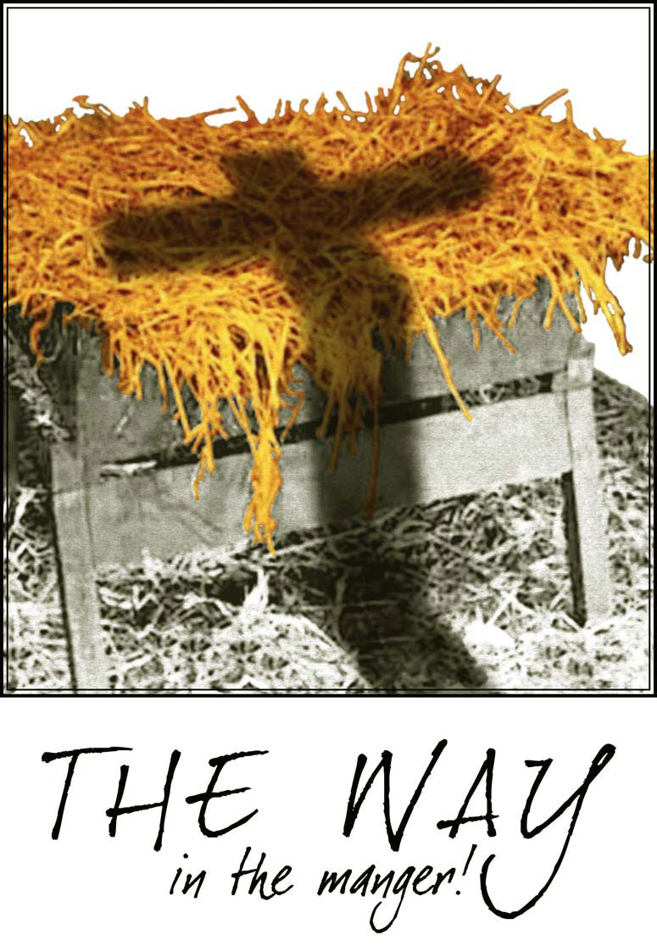

Slide 56
The LIGHT of the WORLD,
DON’T REJECT the ONE who
ILLUMINES the WAY
FOREVER AND TODAY!

Slide 57
Offering
Over the skies of Bethlehem appeared a star While angels sang to lowly shepherds Three wise men seeking
truth traveled from afar
Hoping to find the Child from heaven

Slide 58
Falling on their knees
They bowed before the humble
Prince of Peace

Slide 59
We bring an offering of Worship to our King No one on earth deserves the praises
That we sing

Slide 60
Jesus, may You receive the Honor that You're due O Lord, we bring an offering to You

Slide 61
The sun cannot compare to the Glory of Your love There is no shadow in Your presence

Slide 62
No mortal man would dare
To stand before Your throne Before the Holy One of heaven

Slide 63
It’s only by Your blood
And it’s only through Your mercy
Lord, I come

Slide 64
I bring an offering of worship to my King No one on earth deserves the praises that I sing
Jesus may You receive the
honor that You’re due
O Lord I bring an offering to You
(repeat)
Paul Baloche
2002 Integrity's Hosanna! Music
CCLI 78316

