Slide 2
You, You Are God
Here I am I've come to find You Here I am to see Your grace To bring to You an offering I have to ask myself one thing How can I do anything but praise I praise

Slide 3
You, You are God, You are Lord You are all I'm living for You are King of everything I want my life to praise You

Slide 4
Here I am I've come to thank You Here I am a life You've changed Because You gave Your life for me You crucified Your Son for me How can I do anything but praise I praise

Slide 5
You, You are God, You are Lord You are all I'm living for You are King of everything I want my life to praise You

Slide 6
You are God, You are Lord You are all I'm living for You are King of everything I want my life to praise You
I want my life to praise You
Walker Beach
2003 Gateway Create Publishing
CCLI 78316

Slide 7
Our God Saves
In the Name of the Father In the Name of the Son In the Name of the Spirit
Lord we come

Slide 8
We're gathered together
To Lift up Your Name To call on our Savior To fall on Your grace

Slide 9
In the Name of the Father In the Name of the Son In the Name of the Spirit
Lord we come

Slide 10
We're gathered together
To Lift up Your Name To call on our Savior To fall on Your grace

Slide 11
Hear the joyful sound of our offering As Your saints bow down As Your people sing We will rise with You
Lifted on Your Wings And the world will see that

Slide 12
Our God saves, our God saves There is hope in Your Name Mourning turns to songs of praise Our God saves, our God saves

Slide 13
In the Name of the Father In the Name of the Son In the Name of the Spirit
Lord we come

Slide 14
We're gathered together
To Lift up Your Name To call on our Savior To fall on Your grace

Slide 15
Hear the joyful sound of our offering As Your saints bow down As Your people sing We will rise with You
Lifted on Your Wings And the world will see that

Slide 16
Our God saves, our God saves, There is hope in Your Name Mourning turns to songs of praise Our God saves, our God saves

Slide 17
Hear the joyful sound of our offering As Your saints bow down As Your people sing We will rise with You
Lifted on Your Wings And the world will see that

Slide 18
Our God saves, our God saves, There is hope in Your Name Mourning turns to songs of praise Our God saves, our God saves
Our God saves, our God saves
Our God saves
Paul Baloche, Brenton Brown
2007 Thankyou Music, Leadworship Songs, Integrity's Hosanna! Music
CCLI 78316

Slide 19
Forever Reign
You are good You are good
When there's nothing good in me You are love You are love
On display for all to see

Slide 20
You are light You are light When the darkness closes in You are hope You are hope
You have covered all my sin

Slide 21
You are peace You are peace When my fear is crippling You are true You are true
Even in my wandering

Slide 22
You are joy You are joy
You're the reason that I sing You are life You are life
In You death has lost its sting

Slide 23
Oh I'm running to Your arms
I'm running to Your arms The riches of Your love
Will always be enough Nothing compares to Your embrace Light of the world forever reign

Slide 24
You are more You are more
Than my words will ever say You are Lord You are Lord
All creation will proclaim

Slide 25
You are here You are here
In Your presence I'm made whole You are God You are God
Of all else I'm letting go

Slide 26
Oh I'm running to Your arms
I'm running to Your arms The riches of Your love
Will always be enough Nothing compares to Your embrace Light of the world forever reign

Slide 27
Oh I'm running to Your arms
I'm running to Your arms The riches of Your love
Will always be enough Nothing compares to Your embrace Light of the world forever reign

Slide 28
My heart will sing no other Name Jesus Jesus

Slide 29
Oh I'm running to Your arms
I'm running to Your arms The riches of Your love
Will always be enough Nothing compares to Your embrace Light of the world forever

Slide 30
Oh I'm running to Your arms
I'm running to Your arms The riches of Your love
Will always be enough
Nothing compares to Your embrace Light of the world forever reign

Slide 31
My heart will sing no other Name Jesus Jesus
Jason Ingram, Reuben Morgan
2009 SHOUT! Publishing, Windsor Hill Music, Sony/ATV Timber Publishing
CCLI 78316

Slide 32
COMMUNION
Do this in remembrance of me.

Slide 33
Offering
The sun cannot compare to the Glory of Your love There is no shadow in Your presence No mortal man would dare to
Stand before Your throne Before the Holy One of Heaven

Slide 34
It's only by Your blood, And it's only through Your mercy
Lord, I come

Slide 35
I bring an offering of worship To my King No one on earth deserves the Praises that I sing Jesus, may You receive the Honor that You're due
O Lord, I bring an offering to You

Slide 36
The sun cannot compare to the Glory of Your love There is no shadow in Your presence No mortal man would dare to
Stand before Your throne Before the Holy One of Heaven

Slide 37
It's only by Your blood, And it's only through Your mercy
Lord, I come

Slide 38
I bring an offering of worship To my King No one on earth deserves the Praises that I sing Jesus, may You receive the Honor that You're due

Slide 39
O Lord, I bring an offering to You O Lord, I bring an offering to You O Lord I bring an offering to You
Paul Baloche
2003 Integrity's Hosanna! Music
CCLI 78316

Slide 40
In Christ Alone
In Christ alone my hope is found He is my Light, my strength, my song This Cornerstone, this solid ground Firm through the fiercest drought and storm

Slide 41
What heights of love, What depths of peace When fears are stilled, When strivings cease
My Comforter, my all in all Here in the love of Christ I stand

Slide 42
In Christ alone Who took on flesh Fullness of God in helpless Babe
This gift of love and righteousness Scorned by the ones He came to save

Slide 43
'Till on that cross as Jesus died The wrath of God was satisfied For every sin on Him was laid Here in the death of Christ I live

Slide 44
There in the ground His body lay Light of the world by darkness slain Then bursting forth in glorious day Up from the grave He rose again

Slide 45
And as He stands in victory Sin's curse has lost its grip on me For I am His and He is mine Bought with the precious blood of Christ
Keith Getty, Stuart Townend
2001 Thankyou Music
CCLI 78316

Slide 46
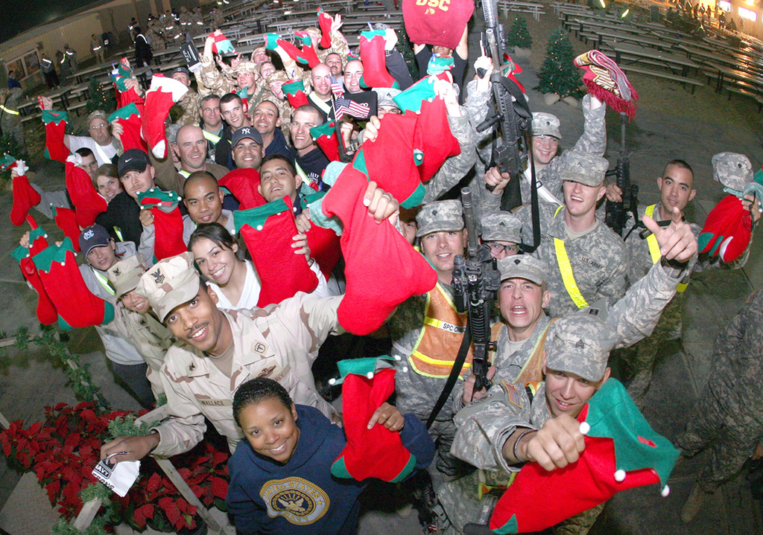
Merry Christmas
to our Deployed
Soldier's
See table in
lobby for more information!

Slide 48
INTERCESSION
Ephesians 3:14-21

Slide 49
I freely admit that my prayer life has been deficient
and my growth in this area less than stellar.
I believe in prayer but don’t always do it.
I understand that I’m told to pray,
but I don’t always obey.
I am an activist by nature;
I am not contemplative by temperament.

Slide 50
I am not happy with this state of affairs
and have given much thought to
what prayer is,
what it does,
and what I need to be doing about it.
Stuart Briscoe

Slide 51
INTERCESSION
Ephesians 3:14-21

Slide 52
Praying for Others
~ the REQUEST

Slide 53
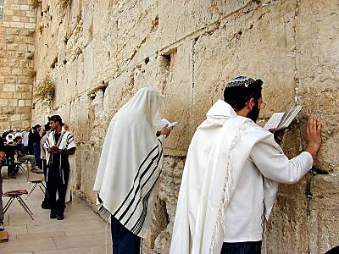

Slide 54
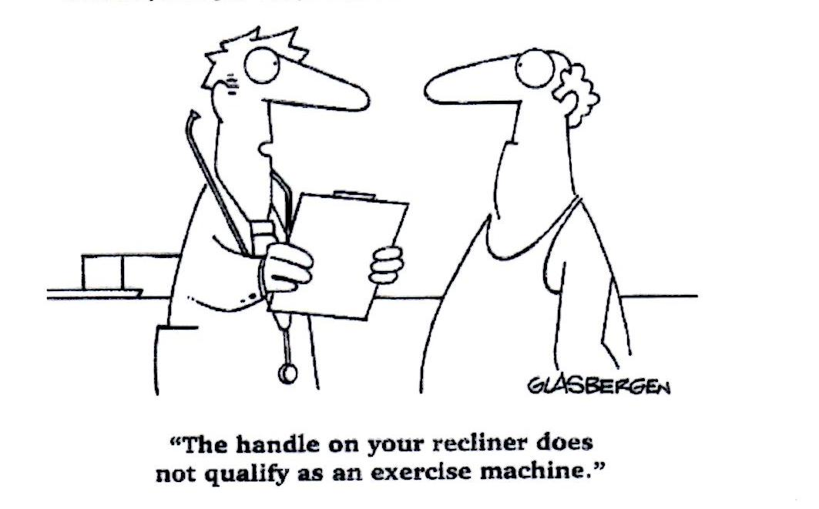

Slide 55
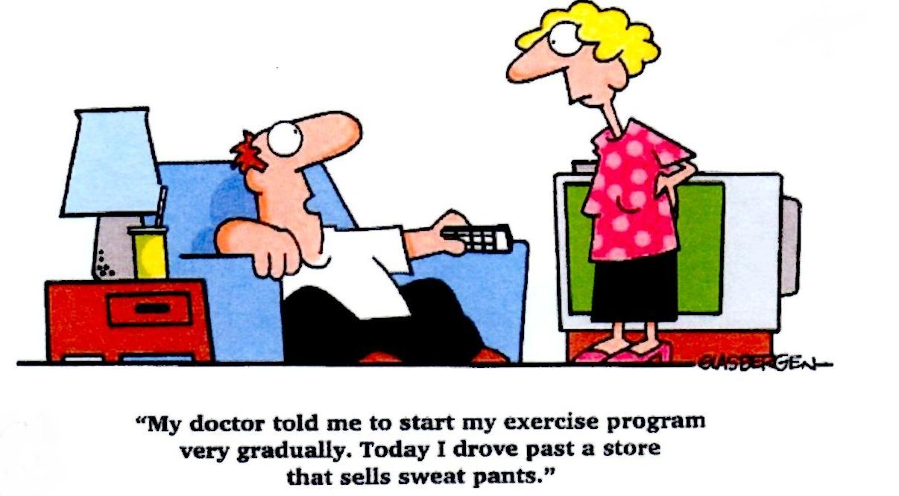

Slide 56
Praying for Others
~ the REQUEST

Slide 57
Praying for Others
~ the RESULTS
CHRIST INDWELLING
LOVE’S ABUNDANCE

Slide 58
It took me too long to learn that
knowing the Bible is not
the same thing as knowing God,
loving the Bible is not
the same thing as loving God,
and reading the Bible is not
the same as hearing God.

Slide 59
The Pharisees knew the Bible,
loved the Bible,
and read the Bible,
but they did not know, love, or hear God.
Jack Deere

Slide 60
We do not become spiritually mature simply because we acquire doctrinal and biblical knowledge. Truth is a necessary catalyst for spiritual growth, but genuine growth occurs only when biblical truth is applied.
John Piper

Slide 61
There are those who seek knowledge
for the sake of knowledge---that is curiosity
There are those who seek knowledge
to be known by others---that is vanity
There are those who seek knowledge
in order to serve---that is LOVE.
Bernard of Clairvaux

Slide 62
¹ If I speak in the tongues of men or of angels, but do not have love, I am only a resounding gong or a clanging cymbal. ² If I have the gift of prophecy and can fathom all mysteries and all knowledge, and if I have a faith that can move mountains, but do not have love, I am nothing. ³ If I give all I possess to the poor and give over my body to hardship that I may boast, but do not have love,
I gain nothing.
1 Corinthians 13:1-3

Slide 63
Praying for Others
~ the RESULTS
CHRIST INDWELLING
LOVE’S ABUNDANCE
GOD’S FULLNESS
~ the RESPONSE

Slide 64
The TRAGEDY of our DAY
is not UNANSWERED PRAYER, but UNOFFERED PRAYER!
Ruth Bell Graham

