Slide 2
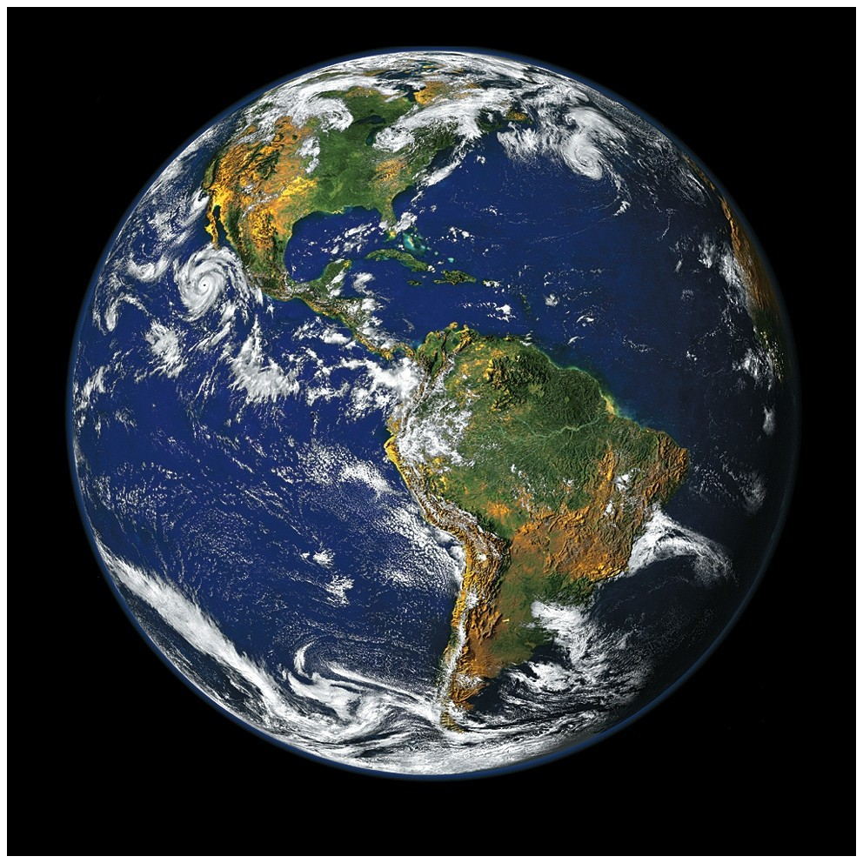

Slide 3
All The Earth Will Sing Your Praises
You lived, You died You said in three days
You would rise You did, You're alive

Slide 4
You rule, You reign
You said
You're coming back again I know You will And all the earth will sing Your praises

Slide 5
You took,
You take our sins away O God You give, You gave Your life Away for us

Slide 6
You came down, You saved us Through the cross Our hearts are changed because Of Your great love

Slide 7
You lived, You died You said in three days
You would rise You did, You're alive

Slide 8
You rule, You reign
You said
You're coming back again I know You will And all the earth will sing Your praises

Slide 9
You took,
You take our sins away O God You give, You gave Your life Away for us

Slide 10
You came down, You saved us Through the cross Our hearts are changed because Of Your great love

Slide 11
You lived, You died You said in three days
You would rise You did, You're alive

Slide 12
You rule, You reign
You said
You're coming back again I know You will And all the earth will sing Your praises
CCLI 78316

Slide 13
Your Name
As morning dawns
and evening fades
You inspire songs of praise That rise from earth to touch Your heart
And glorify Your Name

Slide 14
As morning dawns
and evening fades
You inspire songs of praise That rise from earth to touch Your heart
And glorify Your Name

Slide 15
Your Name
is a strong and mighty tower Your Name
is a shelter like no other
Paul Baloche, Glenn Packiam
CCLI 78316

Slide 16
Your Name,
Let the nations sing it louder 'Cause nothing has
the power to save
But Your Name
CCLI 78316

Slide 17
Jesus, in Your Name we pray
Come and fill our hearts today Lord, give us strength to live For You and glorify Your name

Slide 18
Your Name
is a strong and mighty tower Your Name
is a shelter like no other
Paul Baloche, Glenn Packiam
CCLI 78316

Slide 19
Your Name,
Let the nations sing it louder 'Cause nothing has
the power to save
But Your Name
Paul Baloche, Glenn Packiam
CCLI 78316

Slide 20
Your Name
is a strong and mighty tower Your Name
is a shelter like no other
CCLI 78316

Slide 21
Your Name,
Let the nations sing it louder 'Cause nothing has
the power to save
But Your Name
2006 Vertical Worship Songs, Integrity's Hosanna! Music
Paul Baloche, Glenn Packiam
CCLI 78316

Slide 22
Lead Me To The Cross
Savior I come, quiet my soul Remember
Redemptions hill Where Your blood was spilled For my ransom

Slide 23
Everything I once held dear I count it all as loss

Slide 24
Lead me to the cross where Your love poured out Bring me to my knees Lord I lay me down

Slide 25
Rid me of myself,
I belong to You O lead me Lead me to the cross

Slide 26
You were as I,
Tempted and tried, Human The Word became flesh Bore my sin in death Now You're risen

Slide 27
Everything I once held dear I count it all as loss

Slide 28
Lead me to the cross
Where Your love poured out Bring me to my knees Lord I lay me down

Slide 29
Rid me of myself,
I belong to You O lead me Lead me to the cross

Slide 30
Lead me to the cross
Where Your love poured out Bring me to my knees Lord I lay me down

Slide 31
Rid me of myself,
I belong to You O lead me Lead me to the cross
Brooke Fraser
2006 Hillsong Publishing
CCLI 78316

Slide 32
Revelation Song
Worthy is the
Lamb who was slain Holy Holy is He Sing a new song, to Him who Sits on heaven's mercy seat

Slide 33
Holy Holy Holy Is the Lord God Almighty Who was and is and is to come

Slide 34
With all creation I sing
Praise to the King of kings You are my everything And I will adore You

Slide 35
Clothed in rainbows
of living color Flashes of lightning
rolls of thunder Blessing and honor strength And glory and power be To You the only wise King

Slide 36
Holy Holy Holy Is the Lord God Almighty Who was and is and is to come

Slide 37
With all creation I sing
Praise to the King of kings You are my everything And I will adore You

Slide 38
Filled with wonder,
awestruck wonder At the mention of Your name Jesus Your name is power Breath and living water Such a marvelous mystery

Slide 39
Holy Holy Holy Is the Lord God Almighty Who was and is and is to come

Slide 40
With all creation I sing
Praise to the King of kings You are my everything And I will adore You

Slide 41
Holy Holy Holy Is the Lord God Almighty Who was and is and is to come With all creation I sing

Slide 42
Praise to the King of kings You are my everything And I will adore You
CCLI 78316
Jennie Lee Riddle

Slide 43
Communion

Slide 45
For we are God’s handiwork, created in Christ Jesus to do good works, which God prepared in advance for us to do. Eph. 2:10

Slide 46
Good Works
Ephesians 2:10

Slide 48
“It’s not about you.
The purpose of your life is far greater than your own personal fulfillment,
your peace of mind
or even your happiness.”

Slide 49
Amazing Depths…2:1-3
Amazing Heights…2:4-7
Amazing Grace…2:8-9
Amazing Work…Created Again…2:10

Slide 50
Therefore, if anyone is in Christ,
the new creation has come:
The old has gone, the new is here!
2 Corinthians 5:17

Slide 51
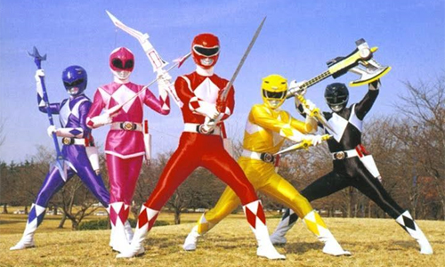

Slide 52
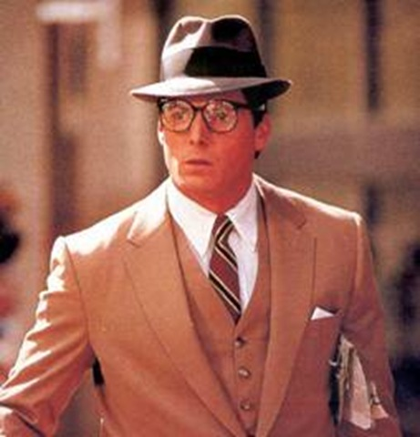

Slide 53
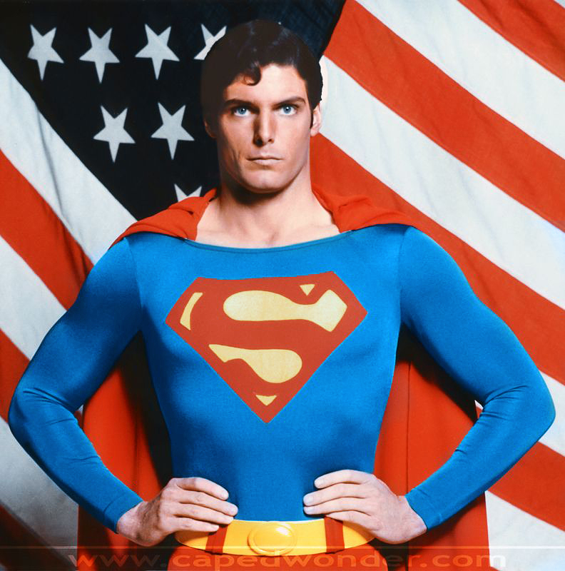

Slide 54
God doesn’t send us to obedience school to learn new habits; He sends us to the hospital to be given a new heart. Forget training…He gives transplants.
John Piper

Slide 55
Amazing works…Created Again
~ as His Masterpiece

Slide 56
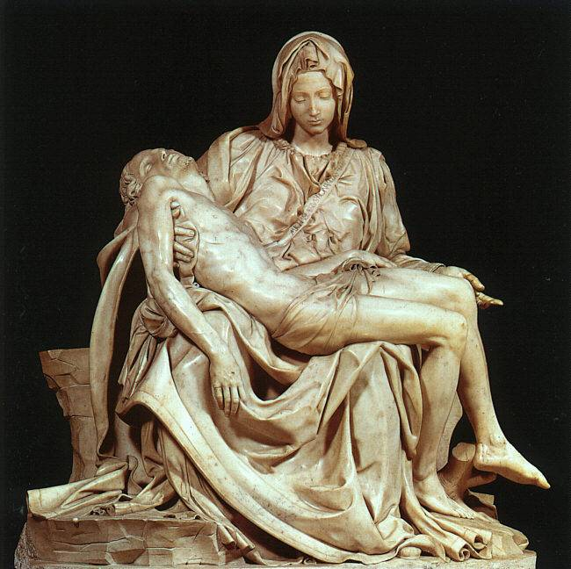

Slide 57
Amazing works…Created Again
~ as His Masterpiece
~ for Good Works

Slide 59
a WARNING from JESUS

Slide 60
You are on DISPLAY as the CREATOR’S MASTERPIECE….
How are you being VIEWED?

