Slide 2
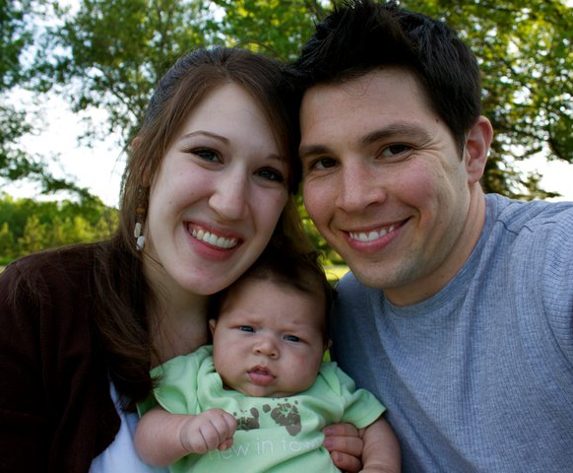
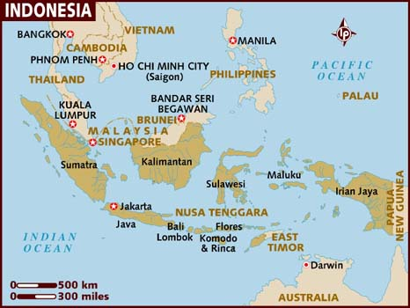
Praying for the Nass Family
in Southeast Asia

Slide 3
Redeeming King
You are the Lord
Exalted above the most high, The Ruler of all Worthy of all my praise
Jadon Lavik
2003, 2004 Thirsty Moon River Publishing, LAVIKMUSIC
CCLI 78316

Slide 4
You are the Lord
Mighty in all of Your ways, Forever the same,
So worthy of all my praise
Jadon Lavik
2003, 2004 Thirsty Moon River Publishing, LAVIKMUSIC
CCLI 78316

Slide 5
And I lift my hands
In holy devotion to You My life is my sacrifice Daily surrendered
Jadon Lavik
2003, 2004 Thirsty Moon River Publishing, LAVIKMUSIC
CCLI 78316

Slide 6
And I lift my voice
Unashamed of my love for You For You are the Lord my Redeeming King
Jadon Lavik
2003, 2004 Thirsty Moon River Publishing, LAVIKMUSIC
CCLI 78316

Slide 7
You are the Lord
Exalted above the most high, The Ruler of all Worthy of all my praise
Jadon Lavik
2003, 2004 Thirsty Moon River Publishing, LAVIKMUSIC
CCLI 78316

Slide 8
You are the Lord
Mighty in all of Your ways, Forever the same,
So worthy of all my praise
Jadon Lavik
2003, 2004 Thirsty Moon River Publishing, LAVIKMUSIC
CCLI 78316

Slide 9
And I lift my hands
In holy devotion to You My life is my sacrifice Daily surrendered
Jadon Lavik
2003, 2004 Thirsty Moon River Publishing, LAVIKMUSIC
CCLI 78316

Slide 10
And I lift my voice
Unashamed of my love for You For You are the Lord my Redeeming King
Jadon Lavik
2003, 2004 Thirsty Moon River Publishing, LAVIKMUSIC
CCLI 78316

Slide 11
And I lift my hands
In holy devotion to You My life is my sacrifice Daily surrendered
Jadon Lavik
2003, 2004 Thirsty Moon River Publishing, LAVIKMUSIC
CCLI 78316

Slide 12
And I lift my voice
Unashamed of my love for You For You are the Lord my Redeeming King
Jadon Lavik
2003, 2004 Thirsty Moon River Publishing, LAVIKMUSIC
CCLI 78316

Slide 13
And I lift my hands
In holy devotion to You My life is my sacrifice Daily surrendered
Jadon Lavik
2003, 2004 Thirsty Moon River Publishing, LAVIKMUSIC
CCLI 78316

Slide 14
And I lift my voice
Unashamed of my love for You For You are the Lord my Redeeming King
Jadon Lavik
END
CCLI 78316

Slide 15
No Sweeter Name
No sweeter name than the name of Jesus No sweeter name have I ever known No sweeter name than the name of Jesus (repeat)

Slide 16
You are the life to my heart And my soul You are the light to the Darkness around me
Kari Jobe
2004 Gateway Create Publishing
CCLI 78316

Slide 17
You are the hope to the hopeless And broken You are the only truth and the way
Kari Jobe
2004 Gateway Create Publishing
CCLI 78316

Slide 18
No sweeter name than the name of Jesus No sweeter name have I ever known No sweeter name than the name of Jesus (repeat)

Slide 19
You are the life to my heart And my soul You are the light to the Darkness around me

Slide 20
You are the hope to the hopeless And broken You are the only truth and the way

Slide 21
Jesus, Jesus Jesus, Jesus

Slide 22
You are the life to my heart And my soul You are the light to the Darkness around me

Slide 23
You are the life to my heart And my soul You are the light to the Darkness around me

Slide 24
You are the hope to the hopeless And broken You are the only truth and the way
Kari Jobe
END
CCLI 78316

Slide 25
At Your Name
At Your name
The mountains shake and crumble At Your name The oceans roar and tumble

Slide 26
At Your name
Angels will bow
The earth will rejoice Your people cry out

Slide 27
Lord of all the earth We'll shout Your name, shout Your name Filling up the skies with
Endless praise, endless praise

Slide 28
Yahweh, Yahweh
We love to shout Your name,
O Lord
CCLI 78316

Slide 29
At Your name
The morning breaks in glory At Your name Creation sings Your story

Slide 30
At Your name
Angels will bow The earth will rejoice Your people cry out
Tim Hughes, Phil Wickham
2011 Thankyou Music, Seems Like Music, Phil Wickham Music
CCLI 78316

Slide 31
Lord of all the earth We'll shout Your name, shout Your name Filling up the skies with
Endless praise, endless praise
Tim Hughes, Phil Wickham
2011 Thankyou Music, Seems Like Music, Phil Wickham Music
CCLI 78316

Slide 32
Yahweh, Yahweh
We love to shout Your name
O Lord
Tim Hughes, Phil Wickham
2011 Thankyou Music, Seems Like Music, Phil Wickham Music
CCLI 78316

Slide 33
There is no one like our God We will praise You, praise You There's no one like our God We will sing, we will sing
Tim Hughes, Phil Wickham
2011 Thankyou Music, Seems Like Music, Phil Wickham Music
CCLI 78316

Slide 34
There is no one like our God We will praise You, praise You Jesus is our God, we will sing
We will sing
Tim Hughes, Phil Wickham
2011 Thankyou Music, Seems Like Music, Phil Wickham Music
CCLI 78316

Slide 35
There is no one like our God We will praise You, praise You There's no one like our God We will sing, we will sing
Tim Hughes, Phil Wickham
2011 Thankyou Music, Seems Like Music, Phil Wickham Music
CCLI 78316

Slide 36
There is no one like our God We will praise You, praise You Jesus is our God, we will sing
We will sing
Tim Hughes, Phil Wickham
2011 Thankyou Music, Seems Like Music, Phil Wickham Music
CCLI 78316

Slide 37
Lord of all the earth We'll shout Your name, shout Your name Filling up the skies with
Endless praise, endless praise
Tim Hughes, Phil Wickham
2011 Thankyou Music, Seems Like Music, Phil Wickham Music
CCLI 78316

Slide 38
Yahweh, Yahweh
We love to shout Your name
O Lord
Tim Hughes, Phil Wickham
2011 Thankyou Music, Seems Like Music, Phil Wickham Music
CCLI 78316

Slide 39
Lord of all the earth We'll shout Your name, shout Your name Filling up the skies with
Endless praise, endless praise
Tim Hughes, Phil Wickham
2011 Thankyou Music, Seems Like Music, Phil Wickham Music
CCLI 78316

Slide 40
Yahweh, Yahweh
We love to shout Your name
O Lord
(repeat)

Slide 42
Jesus Paid It All
And I hear the Savior say, Thy strength indeed is small Child of weakness, watch and pray, Find in Me thine all in all
Elvina M. Hall, Alex Nifong
2006 Pay Me Please Publishing, worshiptogether.com songs, sixsteps Music
CCLI 78316

Slide 43
Jesus paid it all All to Him I owe Sin had left a crimson stain He washed it white as snow
Elvina M. Hall, Alex Nifong
2006 Pay Me Please Publishing, worshiptogether.com songs, sixsteps Music
CCLI 78316

Slide 44
Lord, now indeed I find Thy power and thine alone Can change the leper's spots And melt the heart of stone
Elvina M. Hall, Alex Nifong
2006 Pay Me Please Publishing, worshiptogether.com songs, sixsteps Music
CCLI 78316

Slide 45
Jesus paid it all All to Him I owe Sin had left a crimson stain He washed it white as snow
Elvina M. Hall, Alex Nifong
2006 Pay Me Please Publishing, worshiptogether.com songs, sixsteps Music
CCLI 78316

Slide 46
Lord when before the throne I stand in Him complete, Jesus died my soul to save My lips shall still repeat
Elvina M. Hall, Alex Nifong
2006 Pay Me Please Publishing, worshiptogether.com songs, sixsteps Music
CCLI 78316

Slide 47
Jesus paid it all All to Him I owe Sin had left a crimson stain He washed it white as snow
He washed it white as snow
He washed it white as snow
Elvina M. Hall, Alex Nifong
2006 Pay Me Please Publishing, worshiptogether.com songs, sixsteps Music
CCLI 78316

Slide 48
Oh, praise the One who paid my debt, And raised this life up from the dead
(repeat)

Slide 49
Oh, praise the One who paid my debt, And raised this life up from the dead
Jesus
Jesus

Slide 50
Mighty To Save
Everyone needs compassion Love that's never failing Let mercy fall on me Everyone needs forgiveness The kindness of a Savior The hope of nations
Ben Fielding, Reuben Morgan
2006 Hillsong Publishing
CCLI 78316

Slide 51
Savior, He can move the mountains My God is mighty to save He is mighty to save Forever, Author of salvation
He rose and conquered the grave, Jesus conquered the grave
Ben Fielding, Reuben Morgan
2006 Hillsong Publishing
CCLI 78316

Slide 52
So take me as You find me All my fears and failures Fill my life again I give my life to follow Everything I believe in Now I surrender
Ben Fielding, Reuben Morgan
2006 Hillsong Publishing
CCLI 78316

Slide 53
Savior, He can move the mountains My God is mighty to save He is mighty to save Forever, Author of salvation
He rose and conquered the grave, Jesus conquered the grave
Ben Fielding, Reuben Morgan
2006 Hillsong Publishing
CCLI 78316

Slide 54
Savior, He can move the mountains My God is mighty to save He is mighty to save Forever, Author of salvation
He rose and conquered the grave, Jesus conquered the grave
(repeat)
Ben Fielding, Reuben Morgan
2006 Hillsong Publishing
CCLI 78316

Slide 55
EXPANDED WORSHIP TEAM...
gifted in singing and want to use your talent?
Join an expanded worship team!
Rehearse at TBC on
Thursday Oct 13th at 7pm
Sing as a group all 3 services on Oct 16
Email Mark Rojas at markr@tbcweb.org
for more information and to be included

Slide 58
Celebrating
God’s Provision
Ephesians 1:3-14

Slide 59
OFFERING PRAISE for…
the SELECTION of the FATHER
the SACRIFICE of the SON
~the PRICE of REDEMPTION

Slide 60
¹⁸ For you know that it was not with perishable things such as silver or gold that you were redeemed …¹⁹ but with the precious blood of Christ, a lamb without blemish or defect.
1 Peter 1:18-19

Slide 61
And they sang a new song, saying:
“You are worthy to take the scroll and to open its seals, because you were slain, and with your blood you purchased for God persons from every tribe and language and people and nation.
Revelation 5:9

Slide 62
In creation we see God’s hand;
In redemption we see His heart.

Slide 63
OFFERING PRAISE for…
the SACRIFICE of the SON
~the PRICE of REDEMPTION
~the RESULTS of REDEMPTION
*FORGIVENESS

Slide 64
as far as the east is from the west, so far has he removed our transgressions from us.
Psalm 103:12

Slide 65
I have swept away your offenses like a cloud, your sins like the morning mist. Return to me, for I have redeemed you.
Isaiah 44:22

Slide 66
OFFERING PRAISE for…
the SACRIFICE of the SON
~the PRICE of REDEMPTION
~the RESULTS of REDEMPTION
*FORGIVENESS
*WISDOM and INSIGHT

Slide 67
the SACRIFICE of the SON…
~the REASON for REDEMPTION
*all CREATION given to CHRIST

Slide 68
the SACRIFICE of the SON…
~the REASON for REDEMPTION
*all CREATION given to CHRIST
*an INHERITANCE given to US

Slide 69
~the SEALING of the HOLY SPIRIT…
the GUARANTEE of our INHERITANCE

Slide 70
²⁸ I give them eternal life, and they shall never perish; no one will snatch them out of my hand. ²⁹ My Father, who has given them to me, is greater than all; no one can snatch them out of my Father’s hand.
John 10:28-29

Slide 71
³⁸ For I am convinced that neither death nor life, neither angels nor demons, neither the present nor the future, nor any powers, ³⁹neither height nor depth, nor anything else in all creation, will be able to separate us from the love of God that is in Christ Jesus our Lord.
Romans 8:38-39

Slide 72
the PRICE of REDEMPTION
has been PAID…
ACCEPT it and be FREE!!

