Slide 5
Discovering the Christian Life
Understanding our Position in Christ
The Significance of Baptism
The Discipline of Prayer
The World & The Flesh
Lifestyles Choices in the Real World
And many more…
Sunday Mornings in
Room 301 at 9:30am
First Class Begins September 11th

Slide 7
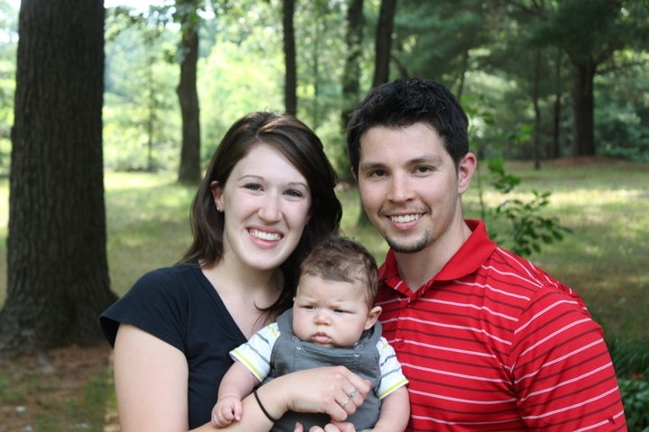
The Nass Family
Southeast Asia

Slide 9
PRINCE OF PEACE
(Ladies echo)
You are holy
You are mighty
You are worthy
Worthy of praise

Slide 10
I will follow
I will listen
I will love You
All of my days

Slide 11
MEN: WOMEN:
I will sing to, You’re the Lord of Lords
And worship You’re King of Kings
The King who You’re the Mighty God
Is worthy Lord of Everything
I will love and You’re Emmanuel
Adore Him You’re the Great I AM
I will bow down You’re my Prince of Peace
Before Him Who is the Lamb

Slide 12
MEN: WOMEN:
I will sing to You’re the Living God
And worship You’re the Saving Grace
The King who You will reign forever
Is worthy You’re the Ancient of Days
I will love and You’re the Alpha Omega
Adore Him Beginning and End
I will bow down You’re my Savior, Messiah
Before Him Redeemer and Friend

Slide 13
He’s my Prince of Peace
And I will live my life for Him
On Christ the Solid Rock I stand
All other ground is sinking sand
All other ground is sinking sand

Slide 14
(Ladies echo)
You are holy
You are mighty
You are worthy
Worthy of praise

Slide 15
I will follow
I will listen
I will love You
All of my days

Slide 16
MEN WOMEN
I will sing to, You’re the Lord of Lords
And worship You’re King of Kings
The King who You’re the Mighty God
Is worthy Lord of Everything
I will love and You’re Emmanuel
Adore Him You’re the Great I AM
I will bow down You’re my Prince of Peace
Before Him Who is the Lamb

Slide 17
MEN: WOMEN:
I will sing to You’re the Living God
And worship You’re the Saving Grace
The King who You will reign forever
Is worthy You’re the Ancient of Days
I will love and You’re the Alpha Omega
Adore Him Beginning and End
I will bow down You’re my Savior, Messiah
Before Him Redeemer and Friend

Slide 18
He’s my Prince of Peace
And I will live my life for Him
On Christ the Solid Rock I stand
All other ground is sinking sand
All other ground is sinking sand

Slide 19
MEN WOMEN
I will sing to, You’re the Lord of Lords
And worship You’re King of Kings
The King who You’re the Mighty God
Is worthy Lord of Everything
I will love and You’re Emmanuel
Adore Him You’re the Great I AM
I will bow down You’re my Prince of Peace
Before Him Who is the Lamb

Slide 20
MEN: WOMEN:
I will sing to You’re the Living God
And worship You’re the Saving Grace
The King who You will reign forever
Is worthy You’re the Ancient of Days
I will love and You’re the Alpha Omega
Adore Him Beginning and End
I will bow down You’re my Savior, Messiah
Before Him Redeemer and Friend

Slide 21
You’re my Prince of Peace
And I will live my life for You
TEMPLE BIBLE CHURCH Used by Permission CCLI #78316

Slide 22
SWEETLY BROKEN
To the cross I look,
to the cross I cling
Of it’s suffering I do drink,
of it’s work I do sing

Slide 23
For on it my Savior,
Both bruised and crushed
Showed that God is love
And God is just

Slide 24
At the cross You beckon me
You draw me gently to my knees,
and I am
Lost for words, so lost in love,
I’m sweetly broken,
wholly surrendered

Slide 25
What a precious gift,
undeserved life
Have I been given
through Christ crucified

Slide 26
You’ve called me out of death,
You’ve called me into life
And I was under Your wrath,
now through the cross
I’m reconciled

Slide 27
At the cross You beckon me
You draw me gently to my knees,
and I am
Lost for words, so lost in love,
I’m sweetly broken,
wholly surrendered
(repeat)
TEMPLE BIBLE CHURCH USED BY PERMISSION CCLI#78316

Slide 28
YOUR NAME
As morning dawns and evening fades
You inspire songs of praise
That rise from earth to touch Your heart
And glorify Your Name
(repeat)

Slide 29
Your Name, is a strong and mighty tower
Your Name, is a shelter like no other
Your Name, let the nations sing louder
‘Cause nothing has the power to save
But Your Name

Slide 30
Jesus, in Your Name we pray
Come and fill our hearts today
Lord, give us strength to live for You
And glorify Your Name

Slide 31
Your Name, is a strong and mighty tower
Your Name, is a shelter like no other
Your Name, let the nations Sing louder
‘Cause nothing has the power to save
But Your Name
(repeat)
TEMPLE BIBLE CHURCH Used by Permission CCLI #78316

Slide 35
Thursday Morning
Men’s Study At 6:30am
Rise and Fall of a Roam'in Empire

Slide 37
¹Out of the depths I cry to you, LORD; ²Lord, hear my voice. Let your ears be attentive to my cry for mercy.

Slide 38
³If you, LORD, kept a record of sins, Lord, who could stand?
⁴But with you there is forgiveness, so that we can, with reverence, serve you.

Slide 39
⁵I wait for the LORD, my whole being waits, and in his word I put my hope.
⁶I wait for the Lord more than watchmen wait for the morning, more than watchmen wait for the morning.

Slide 40
⁷Israel, put your hope in the LORD, for with the LORD is unfailing love and with him is full redemption.
⁸He himself will redeem Israel from all their sins

Slide 41
Psalm 130

Slide 42
Desperate is a strong word.
That’s why I like it. People who are desperate are rude, frantic, reckless, explosive, focused, and uncompromising in their desire to get what they want. Someone who is desperate will crash through the veil of niceness.

Slide 43
The New Testament is filled with desperate people,
people who barged into private dinners,
screamed at Jesus until they had his attention,
or destroyed the roof of someone’s house
to get to Him.
People who are desperate for spirituality very seldom worry about the mess they make on their way
to be with Jesus.
Mike Yaconelli

Slide 44
DESPERATE for DELIVERANCE
from the DEPTHS
a CRY for DELIVERANCE

Slide 45
¹ Save me, O God,
for the waters have come up to my neck. ² I sink in the miry depths,
where there is no foothold.
I have come into the deep waters;
the floods engulf me.
Psalm 69

Slide 46
DESPERATE for DELIVERANCE
from the DEPTHS
a CRY for DELIVERANCE
a CONFESSION that results in WORSHIP
LOOKING with CONFIDENT EXPECTATION

Slide 47
¹ I waited patiently for the LORD;
he turned to me and heard my cry. ² He lifted me out of the slimy pit, out of the mud and mire; he set my feet on a rock and gave me a firm place to stand. ³ He put a new song in my mouth, a hymn of praise to our God. Many will see and fear the LORD
and put their trust in him.
Psalm 40

Slide 48
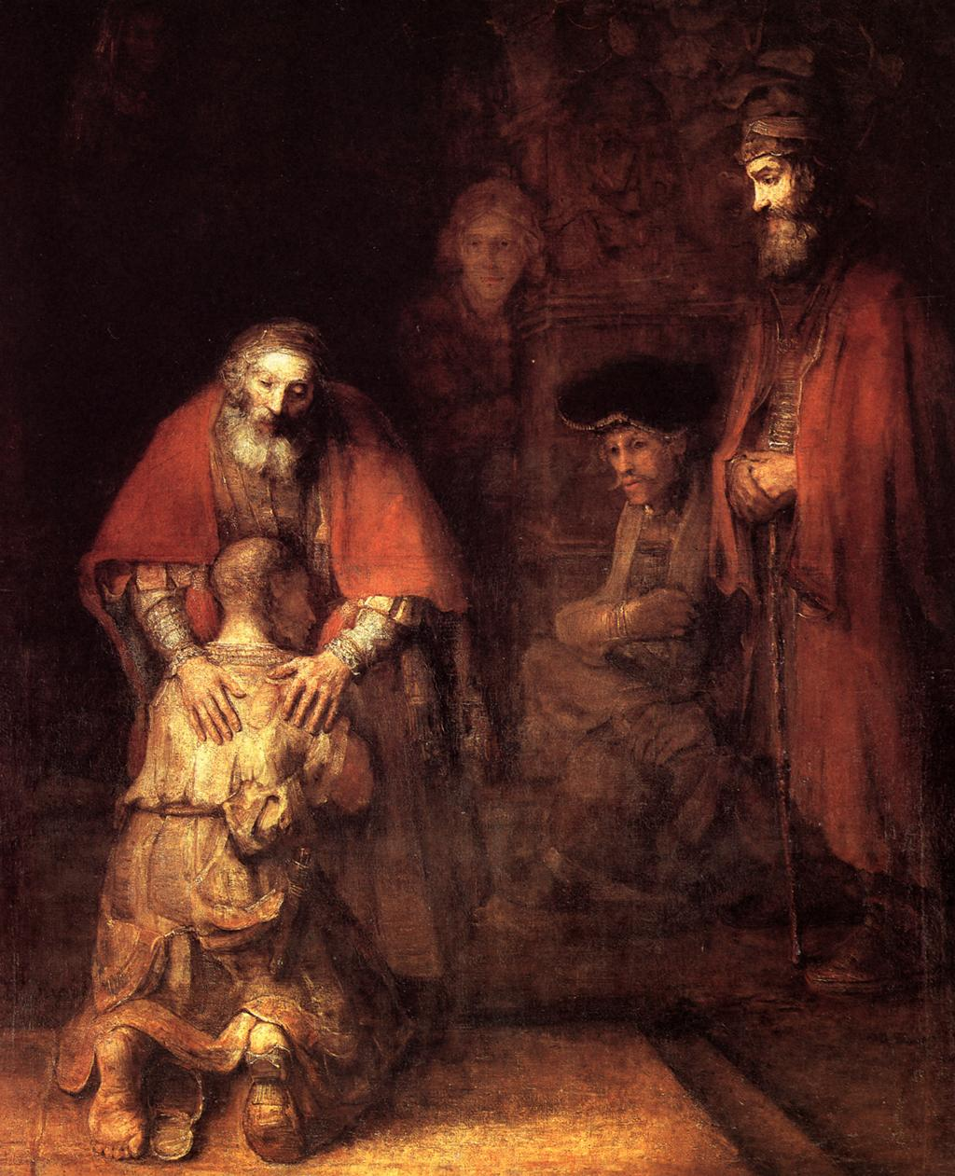

Slide 49
DESPERATE for DELIVERANCE
from the DEPTHS
a CRY for DELIVERANCE
a CONFESSION that results in WORSHIP
LOOKING with CONFIDENT EXPECTATION
LONGING for NATIONAL REPENTANCE

Slide 50
When YOU are in the DEPTHS…
CRY to the ONLY ONE who can DELIVER YOU!!

Slide 52
Amazing Grace (my chains are gone)
Amazing grace how sweet the sound
That saved a wretch like me
I once was lost, but now am found
Was blind, but now I see

Slide 53
T’was grace that taught
my heart to fear
And grace my fears relieved;
How precious did that grace appear
The hour I first believed

Slide 54
My chains are gone,
I've been set free
My God my Savior has ransomed me
And like a flood His mercy rains
Unending love Amazing Grace

Slide 55
The Lord has promised good to me
His word my hope secures
He will my shield and portion be
As long as life endures

Slide 56
My chains are gone,
I've been set free
My God my Savior has ransomed me
And like a flood His mercy rains
Unending love Amazing Grace

Slide 57
The earth shall soon
dissolve like snow
The sun forbear to shine;
But God, who called me here below
Will be forever mine
Will be forever mine
You are forever mine
TEMPLE BIBLE CHURCH Used by Permission CCLI #78316

Slide 58
YOU ARE MY KING
I’m forgiven,
because You were forsaken
I’m accepted, You were condemned
I’m alive and well,
Your Spirit is within me
Because You died and rose again

Slide 59
I’m forgiven,
because You were forsaken
I’m accepted, You were condemned
I’m alive and well,
Your Spirit is within me
Because You died and rose again

Slide 60
Amazing love how can it be
That You my King would die for me
Amazing love I know it’s true
And it’s my joy to honor You
In all I do, I honor You

Slide 61
I’m forgiven,
because You were forsaken
I’m accepted, You were condemned
I’m alive and well,
Your Spirit is within me
Because You died and rose again

Slide 62
Amazing love how can it be
That You my King would die for me
Amazing love I know it’s true
And it’s my joy to honor You
In all I do, I honor You

Slide 63
You are my King
You are my King
You are my King
You are my King

Slide 64
Amazing love how can it be
That You my King would die for me
Amazing love I know it’s true
And it’s my joy to honor You
In all I do, I honor You
(repeat)
TEMPLE BIBLE CHURCH Used by Permission CCLI #78316
Words & Music by Billy James Foot ©1997 worshiptogether.com

Slide 65
HERE I AM TO WORSHIP
Light of the world
You stepped down into darkness
Open my eyes let me see
Beauty that makes this heart
Adore You
Hope of a life spent with You

Slide 66
Here I am to Worship
Here I am to bow down
Here I am to say
That You’re my God
You’re altogether lovely
Altogether worthy
Altogether wonderful to me

Slide 67
King of all days
Oh so highly exalted
Glorious in heaven above
Humbly You came to the
Earth You created
All for love’s sake became poor

Slide 68
Here I am to worship
Here I am to bow down
Here I am to say
That You’re my God
You’re altogether lovely
Altogether worthy
Altogether wonderful to me
(repeat)

Slide 69
I’ll never know how much it cost
To see my sin upon that cross
(repeat 4x)

Slide 70
Here I am to Worship
Here I am to bow down
Here I am to say
That You’re my God
You’re altogether lovely
Altogether worthy
Altogether wonderful to me
(repeat)
TEMPLE BIBLE CHURCH Used by Permission CCLI #78316

Slide 71
Revelation Song
Worthy is the Lamb that was slain
Holy, Holy is He
Sing a new song to Him
Who sits on Heaven’s mercy seat

Slide 72
Worthy is the Lamb that was slain
Holy, Holy is He
Sing a new song to Him
Who sits on Heaven’s mercy seat

Slide 73
Holy, Holy, Holy
Is the Lord, God Almighty
Who was, and is, and is to come
With all creation I sing
Praise to the King of Kings
You are my everything
and I will adore You

Slide 74
Clothed in rainbows of living color
Flashes of lightning rolls of thunder
Blessing and honor
Strength and glory and power be
To You, the only wise King

Slide 75
Holy, Holy, Holy
Is the Lord, God Almighty
Who was, and is, and is to come
With all creation I sing
Praise to the King of Kings
You are my everything
and I will adore You

Slide 76
I’m filled with wonder,
awestruck wonder
At the mention of your name
Jesus, Your name is power
Breath and Living water
Such a marvelous mystery

Slide 77
Holy, Holy, Holy
Is the Lord, God Almighty
Who was, and is, and is to come
With all creation I sing
Praise to the King of Kings
You are my everything
and I will adore You
(Repeat)
TEMPLE BIBLE CHURCH Used By Permission CCLI #78316

