Slide 1
W
e
l
e
c
o
m
we’re glad you’re here

Slide 2
You Are Good
Lord You are good
And Your mercy endureth forever
(repeat)

Slide 3
People from every nation and tongue
From generation to generation

Slide 4
We worship You hallelujah hallelujah
We worship You for who You are
We worship You hallelujah hallelujah
We worship You for who You are
You are good

Slide 5
Lord You are good
And Your mercy endureth forever
(repeat)

Slide 6
People from every nation and tongue
From generation to generation

Slide 7
We worship You hallelujah hallelujah
We worship You for who You are
We worship You hallelujah hallelujah
We worship You for who You are
You are good

Slide 8
You are good
All the time
All the time
You are good

Slide 9
Lord You are good
And Your mercy endureth forever (repeat)

Slide 10
People from every nation and tongue
From generation to generation

Slide 11
We worship You hallelujah hallelujah
We worship You for who You are
We worship You hallelujah hallelujah
We worship You for who You are
You are good
TEMPLE BIBLE CHURCH Used by Permission CCLI #78316

Slide 12
PRAISE ADONAI
Who is like Him
The Lion and the Lamb
Seated on the throne
Mountains bow down
Every ocean roars
To the Lord of hosts

Slide 13
Praise Adonai
From the rising of the sun
‘Til the end of every day
Praise Adonai
All the nations of the earth
All the angels and the saints
Sing praise

Slide 14
Who is like Him
The Lion and the Lamb
Seated on the throne
Mountains bow down
Every ocean roars
To the Lord of hosts

Slide 15
Praise Adonai
From the rising of the sun
‘Til the end of every day
Praise Adonai
All the nations of the earth
All the angels and the saints
Sing praise
(repeat)
TEMPLE BIBLE CHURCH Used by Permission CCLI#78316

Slide 16
ukraine

Slide 17
Meeting
THIS THURSDAY 7pm

Slide 19
Focused on Praise

Slide 21
Focused on Praise

Slide 22
To just read the Bible, attend church, and avoid “big” sins- is this passionate, whole hearted love for God? -Francis Fenelon

Slide 23
our FAITHFUL God is to be PRAISED
CALL to praise

Slide 24
I will give thanks to the LORD because of his righteousness; I will sing the praises of the name of the LORD Most High. -Psalm 7:17

Slide 25
I will sing the LORD’s praise, for he has been good to me. -Psalm 13:6

Slide 26
I called to the LORD, who is worthy of praise, and I have been saved from my enemies. -Psalm 18:3

Slide 27
Therefore I will praise you, LORD, among the nations; I will sing the praises of your name. -Psalm 18:49

Slide 28
Sing joyfully to the LORD, you righteous; it is fitting for the upright to praise him. -Psalm 33:1

Slide 29
Enter his gates with thanksgiving and his courts with praise; give thanks to him and praise his name. -Psalm 100:4

Slide 30
From the rising of the sun to the place where it sets, the name of the LORD is to be praised. -Psalm 113:3

Slide 31
Lift up your hands in the sanctuary and praise the LORD. -Psalm 134:2

Slide 32
Praise the LORD. How good it is to sing praises to our God, how pleasant and fitting to praise him! -Psalm 147:1

Slide 33
our FAITHFUL God is to be PRAISED
CALL to praise

Slide 34
It is not enough to have a song on your lips. You must have a song in your heart. -Fanny Crosby

Slide 35
At the heart of worship is worship from the heart.

Slide 37
our FAITHFUL God is to be PRAISED
CALL to praise
CAUSE to praise

Slide 38
the SENSELESS man is to be PITTIED
the FOLLY of man

Slide 39
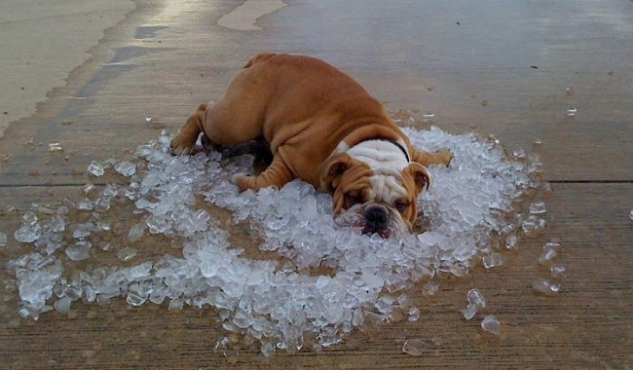

Slide 40
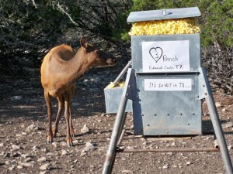

Slide 41
the SENSELESS man is to be PITTIED
the FOLLY of man
the FAITHFULNESS of God
the FUTURE of the LOST man

Slide 42
the RIGHTEOUS man will be BLESSED

Slide 43
UNRIGHTEOUS | RIGHTEOUS
is destroyed…92:7 | will flourish…92:12

Slide 44
UNRIGHTEOUS | RIGHTEOUS
is destroyed…92:7 | will flourish…92:12
like grass…92:7 | like a palm tree…92:12

Slide 45
UNRIGHTEOUS | RIGHTEOUS
is destroyed…92:7 | will flourish…92:12
like grass…92:7 | like a palm tree…92:12
unrighteous will perish…92:9 | cedar of Lebanon…92:12

Slide 46
UNRIGHTEOUS | RIGHTEOUS
is destroyed…92:7 | will flourish…92:12
like grass…92:7 | like a palm tree…92:12
unrighteous will perish…92:9 | cedar of Lebanon…92:12
flourishing in the world…92:7 | flourishing in the spiritual arena…92:13

Slide 47
UNRIGHTEOUS | RIGHTEOUS
is destroyed…92:7 | will flourish…92:12
like grass…92:7 | like a palm tree…92:12
unrighteous will perish…92:9 | cedar of Lebanon…92:12
flourishing in the world…92:7 | flourishing in the spiritual arena…92:13
short-lived, destroyed/will perish …92:7,9 | fruitful even into old age…92:14

Slide 49
Praise
make
a CONTINUAL part of your life!

Slide 50
Our God
Water You turned into wine
Opened the eyes of the blind
There’s no one like You, none like You

Slide 51
Into the darkness You shine
Out of the ashes we rise
There’s no one like You, none like You

Slide 52
Our God is greater
Our God is stronger
God You are higher than any other
Our God is healer, awesome in power
Our God, our God

Slide 53
Into the darkness You shine
Out of the ashes we rise
There’s no one like You, none like You

Slide 54
Our God is greater
Our God is stronger
God You are higher than any other
Our God is healer, awesome in power
Our God, our God

Slide 55
And if our God is for us
then who could ever stop us
and if our God is with us
then what could stand against
(repeat)

Slide 56
Our God is greater
Our God is stronger
God You are higher than any other
Our God is healer, awesome in power
Our God, our God

Slide 57
And if our God is for us
then who could ever stop us
and if our God is with us
then what could stand against
(repeat)

Slide 58
Our God is greater
Our God is stronger
God You are higher than any other
Our God is healer, awesome in power
Our God, our God
TEMPLE BIBLE CHURCH Used by Permission CCLI #78316

Slide 59
The Stand
You stood before creation
eternity in Your hand You spoke the earth into motion, my soul now to stand

Slide 60
You stood before my failure and carried the cross for my shame My sin weighed upon Your shoulders, my soul now to stand

Slide 61
So what can I say
and what could I do But offer this heart O God completely to You

Slide 62
So I'll walk upon salvation,
Your Spirit alive in me This life to declare Your promise, my soul now to stand

Slide 63
So what can I say
and what could I do But offer this heart O God completely to You

Slide 64
I'll stand with arms high and heart abandoned In awe of the One who gave it all I'll stand my soul, Lord,
to You surrendered
All I am is Yours

Slide 65
I'll stand with arms high and heart abandoned In awe of the One who gave it all I'll stand my soul, Lord,
to You surrendered All I am is Yours
USED BY PERMISSION CCLI#78316

Slide 66
HOW GREAT IS OUR GOD
How great is our God
Sing with me
How great is our God
All will see
How great, How great is our God

Slide 67
The splendor of the King
Clothed in majesty
Let all the earth rejoice
All the earth rejoice

Slide 68
He wraps Himself in light
And darkness tries to hide
And trembles at His voice
Trembles at His voice

Slide 69
How great is our God
Sing with me
How great is our God
All will see
How great, How great is our God

Slide 70
Age to age He stands
And time is in His hands
Beginning and the end
beginning and the end

Slide 71
The Godhead, three in One
Father, Spirit, Son
The Lion and the Lamb
The Lion and the Lamb

Slide 72
How great is our God
Sing with me
How great is our God
All will see
How great
How great is our God

Slide 73
Name above all names
Worthy of all praise
My heart will sing
How great is our God

Slide 74
How great is our God
Sing with me
How great is our God
All will see
How great
How great is our God
TEMPLE BIBLE CHURCH Used by Permission CCLI #78316

