Slide 2

YOUR GRACE IS ENOUGH
Great is Your faithfulness oh God
You wrestle with the sinner’s heart
You lead us by still waters into mercy
And nothing can keep us apart

Slide 3
So remember Your people
Remember Your children
Remember Your promise oh God

Slide 4
Your grace is enough
Your grace is enough
Your grace is enough for me

Slide 5
Great is Your love and justice, God
You use the weak to lead the strong
You lead us in the
Song of Your salvation
And all Your people sing along

Slide 6
So remember Your people
Remember Your children
Remember Your promise oh God

Slide 7
Your grace is enough
Your grace is enough
Your grace is enough for me
(repeat)

Slide 8
So remember Your people
Remember Your children
Remember Your promise oh God

Slide 9
Your grace is enough
Your grace is enough
Your grace is enough for me

Slide 10
Your grace is enough
Heaven reaching down to us
Your grace is enough for me

Slide 11
God I see Your grace is enough
I’m covered in Your love
Your grace is enough for me
TEMPLE BIBLE CHURCH Used by Permission CCLI#78316
Words and music: Matt Maher and Chris Tomlin 2003

Slide 12
NOTHING BUT THE BLOOD
What can wash away my sin?
Nothing but the blood of Jesus
What can make me whole again?
Nothing but the blood of Jesus

Slide 13
For my pardon this I see
Nothing but the blood of Jesus
For my cleansing, this my plea
Nothing but the blood of Jesus

Slide 14
Oh! precious is the flow
That makes me white as snow
No other fount I know
Nothing but the blood of Jesus

Slide 15
This is all my hope and peace
Nothing but the blood of Jesus
This is all my righteousness
Nothing but the blood of Jesus

Slide 16
Oh! precious is the flow
That makes me white as snow
No other fount I know
Nothing but the blood of Jesus
TEMPLE BIBLE CHURCH Used by Permission CCLI #78316

Slide 17
Majesty
Here I am humbled by Your majesty
Covered by Your grace so free
Here I am knowing I'm a sinful man
Covered by the blood of the Lamb

Slide 18
Now I've found
The greatest love of all is mine
Since You laid down Your life
The greatest sacrifice

Slide 19
Singin' Majesty, Majesty
Your grace has found me just as I am
Empty handed
But alive in Your hands

Slide 20
Here I am,
Humbled by the love that You give,
Forgiven so that I can forgive
Here I stand,
knowing that I'm Your desire,
Sanctified by glory and fire

Slide 21
Now I've found,
the greatest love of all is mine
Since You laid down Your life,
The greatest sacrifice

Slide 22
Singin' Majesty, Majesty
Your grace has found me just as I am
Empty handed,
But alive in Your hands

Slide 23
Singin Majesty, Majesty,
Forever I am changed by Your love,
In the presence of Your majesty.

Slide 24
Singin' Majesty, Majesty
Your grace has found me just as I am
Empty handed,
But alive in Your hands

Slide 25
Singin’ Majesty, Majesty,
Forever I am changed by Your love,
In the presence of Your majesty.
TEMPLE BIBLE CHURCH Used By Permission CCLI #78316

Slide 26
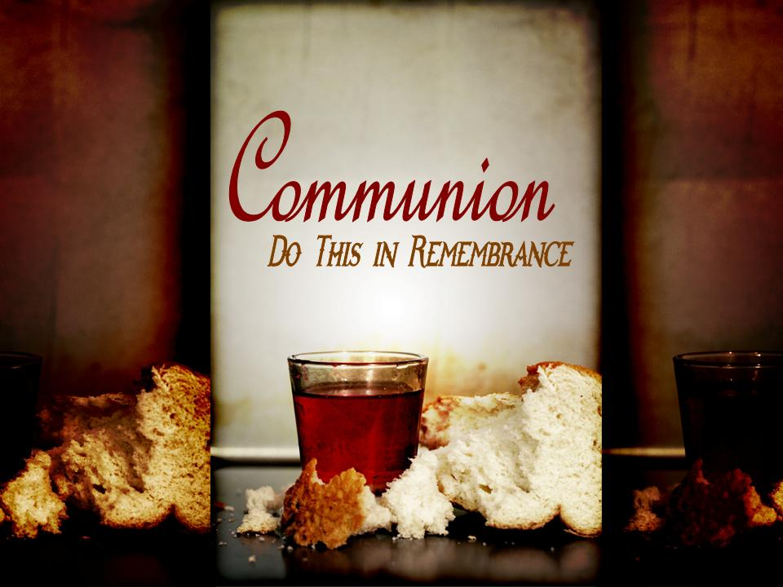

Slide 27
Jesus Paid It All
And I hear the Savior say
Thy strength indeed is small
Child of weakness watch and pray
Find in Me thine all in all

Slide 28
Jesus paid it all, all to Him I owe
Sin had left a crimson stain
He washed it white as snow

Slide 29
Lord, now indeed I find
Thy pow'r and Thine alone
Can change the leper's spots
And melt the heart of stone

Slide 30
Jesus paid it all, all to Him I owe
Sin had left a crimson stain
He washed it white as snow

Slide 31
Lord when before the throne
I stand in Him complete
Jesus died my soul to save
My lips shall still repeat

Slide 32
Jesus paid it all, all to Him I owe
Sin had left a crimson stain
He washed it white as snow
He washed it white as snow
He washed it white as snow

Slide 33
Oh, praise the One
Who paid my debt
And raised this life
Up from the dead
(repeat)
TEMPLE BIBLE CHURCH Used By Permission CCLI #78316

Slide 34
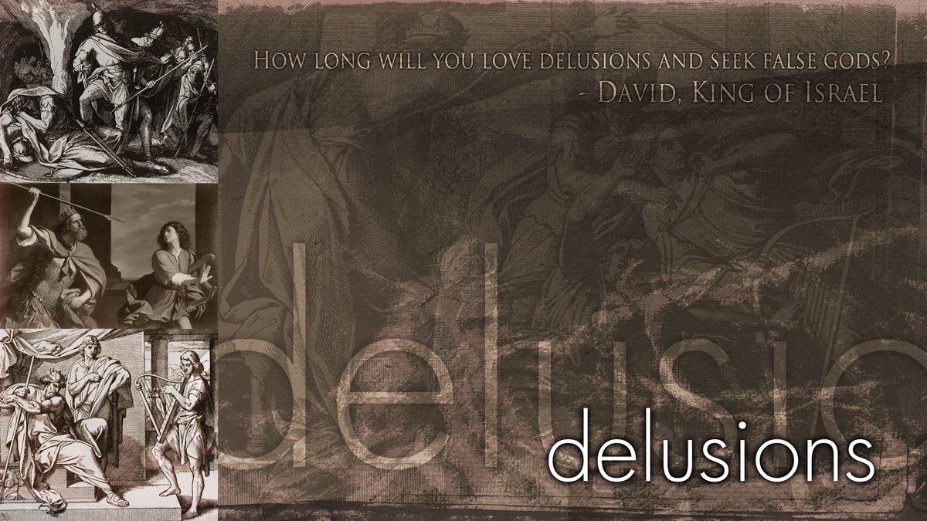

Slide 35
II Samuel 6:1—7:17
THE
PRESENCE
&
PROMISE
OF GOD
II Samuel 6:1 - 7:17

Slide 36
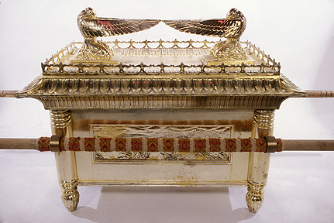

Slide 37
Let us bring the ark of our God back to us, for we did not inquire of it during the reign of Saul.”
1 Chronicles 13:3

Slide 39
the PRESENCE of GOD...
the RETURN of the ARK
the
PRESENCE & PROMISE
of God

Slide 40
There, above the cover between the two cherubim that are over the ark of the covenant law, I will meet with you and give you all my commands for the Israelites.
Exodus 25:22

Slide 41
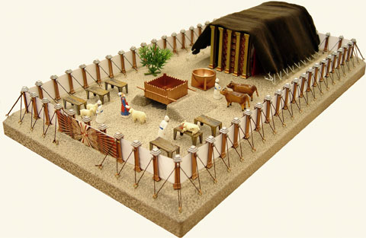
Tabernacle

Slide 42
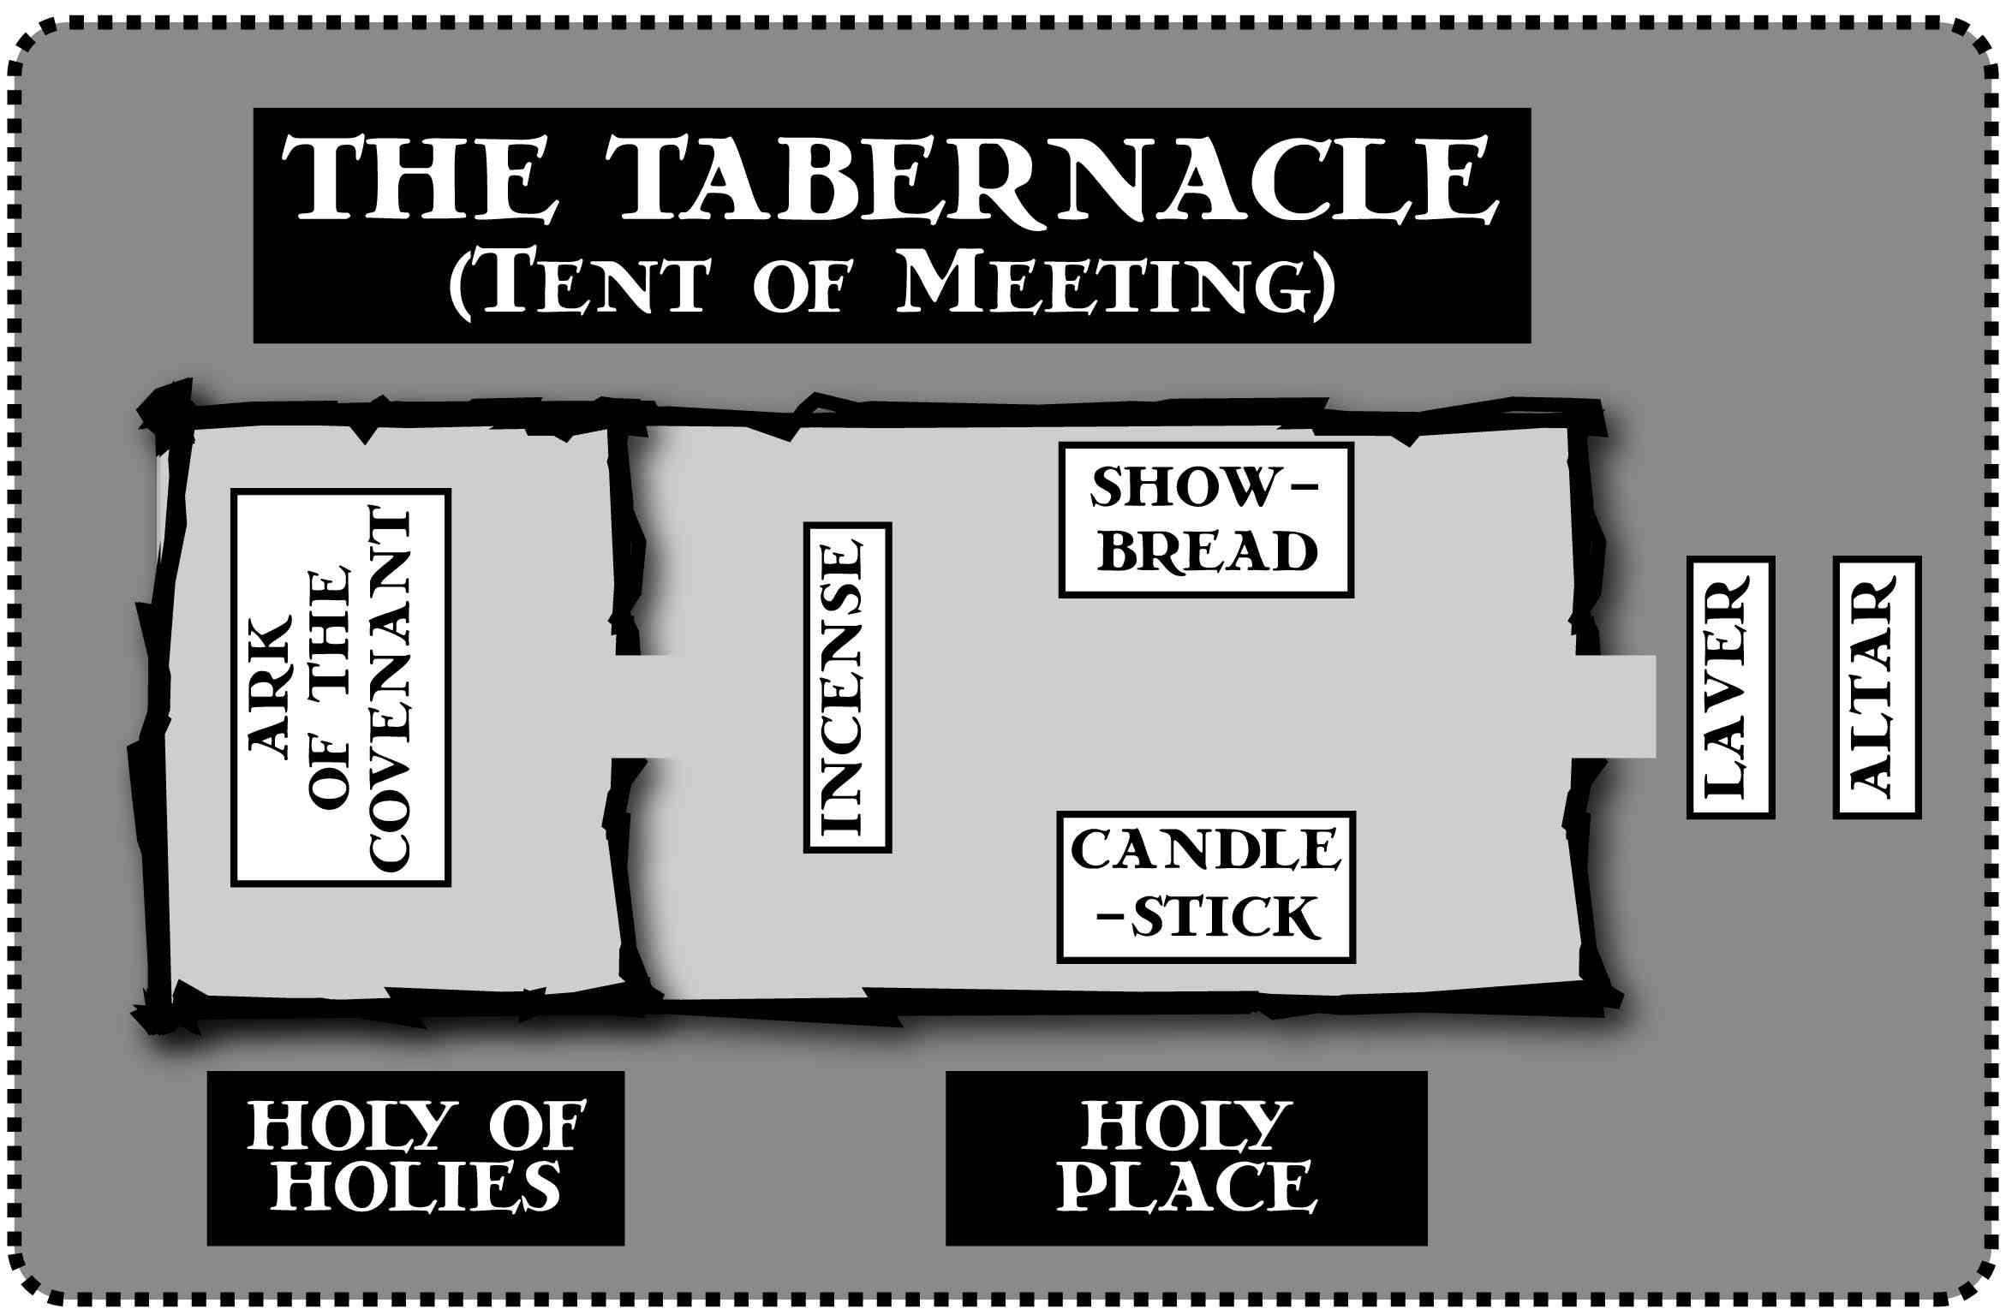

Slide 43
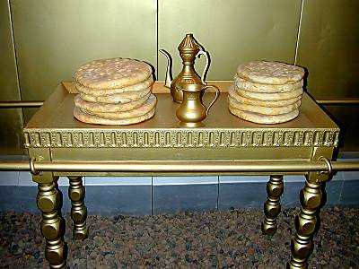
Show Bread

Slide 44
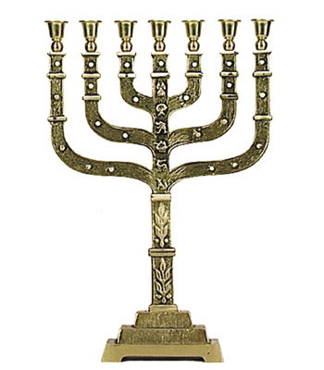
Menorah

Slide 45
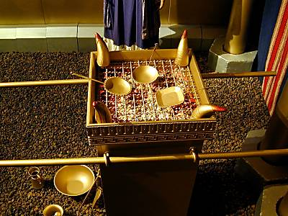
Table of Incense

Slide 46
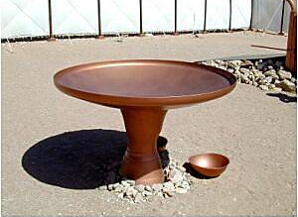
Laver

Slide 47
Ark of the Covenant

Slide 48
Let us bring the ark of our God back to us, for we did not inquire of it during the reign of Saul.”
1 Chronicles 13:3

Slide 49
When he mentioned the ark of God, Eli fell backward off his chair by the side of the gate. His neck was broken and he died, for he was an old man, and he was heavy. He had led Israel forty years.
1 Samuel 4:18

Slide 50
She named the boy Ichabod, saying,
"The Glory has departed from Israel" because of the capture of the ark of God and the deaths of her father-in-law and her husband. She said, "The Glory has departed from Israel, for the ark of God has been captured.”
1 Samuel 4:21-22

Slide 51
Ark of the Covenant

Slide 52


Slide 53
a celebration turned...
TRAGIC
SOUR
the
PRESENCE & PROMISE
of God

Slide 54
the PROMISE of GOD...
the BUILDING of a KINGDOM not a TEMPLE
the
PRESENCE & PROMISE
of God

Slide 55
a PROPOSAL during a PEACEFUL INTERLUDE
the
PRESENCE & PROMISE
of God

Slide 56
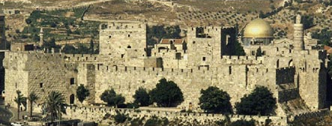

Slide 57
GODS DISPOSAL
of David’s PROPOSAL...
when GOD says "NO!"
the
PRESENCE & PROMISE
of God

Slide 58
Though the fig tree does not bud
and there are no grapes on the vines,
though the olive crop fails
and the fields produce no food,
though there are no sheep in the pen
and no cattle in the stalls,
yet I will rejoice in the LORD,
I will be joyful in God my Savior.
Habakkuk 3:17-18

Slide 59
when GOD says "NO"...
He has a BETTER WAY
the
PRESENCE & PROMISE
of God

Slide 60
And behold, you will conceive in your womb and bear a son, and you shall name Him Jesus.
"He will be great and will be called the Son of the Most High;
Luke 1:31-33

Slide 61
and the Lord God will give Him the throne of His father David;
and He will reign over the house of Jacob forever, and His kingdom will have no end."
Luke 1:31-33

Slide 62
when GOD says "NO"...
He has a BETTER WAY
the
PRESENCE & PROMISE
of God

Slide 63
Or do you not know that your body is a temple of the Holy Spirit who is in you, whom you have from God,
and that you are not your own?
1 Corinthians 6:19

Slide 64
II Samuel 6:1—7:17
TODAY’S“NO”
CAN BECOME
TOMORROW’S
“TRIUMPH”

Slide 65
