Slide 2
Reaching For You
You created me inside Your great imagination You're the One who gave me my first breath You have overseen my life
and brought me to redemption And I know that
You're not finished with me yet

Slide 3
I'm reaching for You, I'm singing to You I'm lifting my hands to praise You
I'm lifting my voice to thank You I'm reaching for You, Jesus I need You I'm giving my heart to know You,
I'm living my life to serve You I'm reaching for You

Slide 4
You're the one who spoke
the Word of life to light my darkness You opened up my eyes 'til I could see Jesus You have promised to
complete the work You started Faithful to fulfill Your grace in me

Slide 5
I'm reaching for You, I'm singing to You I'm lifting my hands to praise You
I'm lifting my voice to thank You I'm reaching for You, Jesus I need You I'm giving my heart to know You,
I'm living my life to serve You I'm reaching for You

Slide 6
Pour out Your love from heaven
Fill me until I overflow Lord I want more Reach down Your hands from heaven
Pull me closer than ever before
Lord I want more (repeat)

Slide 7
I'm reaching for You, I'm singing to You I'm lifting my hands to praise You
I'm lifting my voice to thank You I'm reaching for You, Jesus I need You I'm giving my heart to know You,
I'm living my life to serve You I'm reaching for You
TEMPLE BIBLE CHURCH Used by Permission CCLI #78316

Slide 8
Hosanna
Praise is rising, eyes are turning to You,
we turn to You Hope is stirring,
hearts are yearning for You,
we long for You 'Cause when we see You,
we find strength to face the day
In Your Presence all our fears
are washed away, washed away

Slide 9
Hosanna, Hosanna
You are the God Who saves us,
worthy of all our praises
Hosanna, hosanna
Come have Your way among us
We welcome You here, Lord Jesus

Slide 10
Hear the sound of
hearts returning to You, we turn to You
In Your Kingdom
broken lives are made new,
You make us new
'Cause when we see You,
we find strength to face the day
In Your Presence all our fears
are washed away, washed away

Slide 11
Hosanna, Hosanna
You are the God Who saves us,
worthy of all our praises
Hosanna, Hosanna
Come have Your way among us
We welcome You here, Lord Jesus

Slide 12
'Cause when we see You,
we find strength to face the day
In Your Presence
all our fears are washed away,
(repeat)

Slide 13
Hosanna, Hosanna
You are the God Who saves us,
worthy of all our praises
Hosanna, Hosanna
Come have Your way among us
We welcome You here, Lord Jesus
TEMPLE BIBLE CHURCH Used by Permission CCLI #78316

Slide 14
Reign in Us
You thought of us
before the world began to breathe
You knew our names
Before we came to be

Slide 15
You saw the very day
We’d fall away from You
How desperately
we need to be redeemed

Slide 16
Lord Jesus
Come lead us
We’re desperate
For Your touch

Slide 17
Oh great and mighty One
With one desire we come
That You would reign
That You would reign in us

Slide 18
We’re offering up our lives
A living sacrifice
That You would reign
That You would reign in us

Slide 19
Spirit of the living God
Fall fresh again
Come search our hearts and
Purify our lives

Slide 20
We need Your perfect love
We need Your discipline
We’re lost unless You guide us
With Your light

Slide 21
Lord Jesus
Come lead us
We’re desperate
For Your touch

Slide 22
Oh great and mighty One
With one desire we come
That You would reign
That You would reign in us

Slide 23
We’re offering up our lives
A living sacrifice
That You would reign
That You would reign in us

Slide 24
We cry out for Your life to refine us
Cry out for Your love to define us
Cry out for Your mercy to keep us
Blameless until You return

Slide 25
Oh great and mighty One
With one desire we come
That You would reign
That You would reign in us

Slide 26
We’re offering up our lives
A living sacrifice
That You would reign
That You would reign in us
TEMPLE BIBLE CHURCH Used by Permission CCLI#78316

Slide 27
HOLY IS THE LORD, GOD ALMIGHTY!
We stand and lift up our hands
For the joy of the Lord is our strength
We bow down and worship Him now
How great, how awesome is He
And together we sing, everyone sing

Slide 28
Holy is the Lord, God Almighty!
The earth is filled with His glory
Holy is the Lord, God Almighty!
The earth is filled with His glory
The earth is filled with His glory

Slide 29
We stand and lift up our hands
For the joy of the Lord is our strength
We bow down and worship Him now
How great, how awesome is He
And together we sing, everyone sing

Slide 30
Holy is the Lord, God Almighty!
The earth is filled with His glory
Holy is the Lord, God Almighty!
The earth is filled with His glory
The earth is filled with His glory

Slide 31
It’s rising up all around
It’s the anthem of the Lord’s renown
(repeat)
And together we sing, everyone sing
(repeat)

Slide 32
Holy is the Lord, God Almighty!
The earth is filled with His glory
Holy is the Lord, God Almighty!
The earth is filled with His glory
The earth is filled with His glory
TEMPLE BIBLE CHURCH USED BY PERMISSION CCLI #78316

Slide 33
Here in Your Presence
Found in Your hands, fullness of joy
Every fear suddenly wiped away
Here in Your presence
All of my gains now fade away
Every crown no longer on display
Here in Your presence

Slide 34
Heaven is trembling
In awe of Your wonder
Kings and their kingdoms
Are standing amazed

Slide 35
Here in Your presence
We are undone
Here in Your presence
Heaven and earth become one
Here in Your presence
All things are new
Here in Your presence
Everything bows before You

Slide 36
Found in Your hands, fullness of joy
Every fear suddenly wiped away
Here in Your presence
All of my gains now fade away
Every crown no longer on display
Here in Your presence

Slide 37
Heaven is trembling
In awe of Your wonder
Kings and their kingdoms
Are standing amazed

Slide 38
Here in Your presence
We are undone
Here in Your presence
Heaven and earth become one
Here in Your presence
All things are new
Here in Your presence
Everything bows before You

Slide 39
Wonderful, Beautiful, Glorious
Matchless in every way
Wonderful, Beautiful, Glorious
Matchless in every way
(repeat)

Slide 40
Here in Your presence
We are undone
Here in Your presence
Heaven and earth become one
Here in Your presence
All things are new
Here in Your presence
Everything bows before You
TEMPLE BIBLE CHURCH Used by Permission CCLI #78316

Slide 43
REGISTER NOW IN THE FOYER

Slide 45
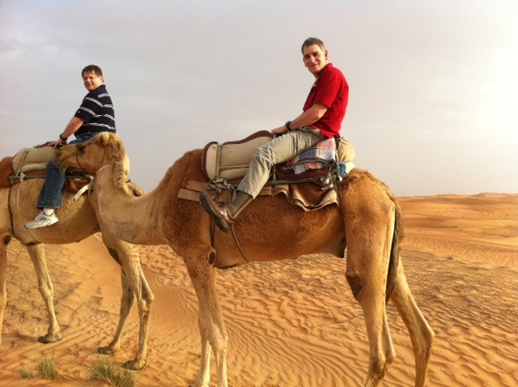
Scripture Reference

Slide 46
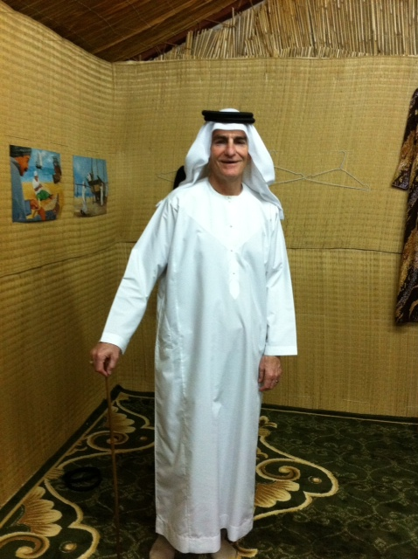

Slide 48
a tragic end…
a new beginning

Slide 53
a tragic end…
a new beginning

Slide 54
The tragic demise of a gifted man

Slide 55
a gifted leader

Slide 56
1 Samuel 9:2
He had a son named Saul, an impressive young man without equal among the Israelites a head taller than any of the others.

Slide 57
1 Samuel 10:10
When they arrived at Gibeah,
a procession of prophets met him; the Spirit of God came upon him in power, and he joined in their prophesying.

Slide 58
1 Samuel 16:14
Now the Spirit of the LORD had departed from Saul, and an evil spirit from the LORD tormented him.

Slide 59
Ephesians 4:30
And do not grieve the Holy Spirit of God, with whom you were sealed for the day of redemption.

Slide 60
a flawed leader

Slide 61
1 Samuel 13:13-14a
You acted foolishly,” Samuel said. “You have not kept the command the LORD your God gave you; if you had, he would have established your kingdom over Israel for all time. But now your kingdom will not endure…

Slide 62
1 Samuel 15:26, 35
But Samuel said to him, “I will not go back with you. You have rejected the word of the LORD, and the LORD has rejected you as king over Israel!”…
Until the day Samuel died, he did not go to see Saul again, though Samuel mourned for him. And the LORD was grieved that he had made Saul king over Israel.

Slide 63
a tragic ending
an unrighteous ending

Slide 64
Romans 8:1, 38-39
Therefore, there is now no condemnation for those who are in Christ Jesus…
For I am convinced that neither death nor life, neither angels nor demons, neither the present nor the future, nor any powers, neither height nor depth, nor anything else in all creation, will be able to separate us from the love of God that is in Christ Jesus our Lord.

Slide 65
a tragic ending
an unrighteous ending
a squandered life exploited

Slide 66
Saul’s Death …
Christ’s Death
Appeared to be the end of all national hope;
Appeared to be the end of all spiritual hope
Seemed as though the adversary had one final victory;
Seemed as though the Satan had one final victory
Opened the throne room to David;
Opened the throne room to sinners
Ended an era of dissatisfaction and failure;
Ended an era of law and guilt
Displayed the foolishness of man;
Displayed the foolishness of God

Slide 67
A New Beginning

Slide 68
the action of the king

Slide 69
the attitude of the king

Slide 70
How Will Your Epitaph Read

Slide 71
“With his sword unsheathed and his armor still in place,
he went directly to see the King with the stain of battle still on his garments.”

