Slide 2
OFFERINGS OF PRAISE
Lord, we come into this place
Believing that Your grace
Grants entrance to Your throne

Slide 3
Not, by works do we draw near
No longer shall we fear
That we will stand alone

Slide 4
Your Gift of love has set us free
Our humbled hearts,
Lord, won’t You see

Slide 5
We’ve come to worship You our King
Our lives we bring
Our offerings of praise
Our offerings of praise

Slide 6
No longer broken and ashamed
But righteous by the power of Your name
The power of Your name

Slide 7
Lord, we come into this place
Believing that Your grace
Grants entrance to Your throne

Slide 8
Not, by works do we draw near
No longer shall we fear
That we will stand alone

Slide 9
Your Gift of love has set us free
Our humbled hearts,
Lord, won’t You see

Slide 10
We’ve come to worship You our King
Our lives we bring
Our offerings of praise
Our offerings of praise

Slide 11
No longer broken and ashamed
But righteous by the power of Your name
The power of Your name

Slide 12
We’ve come to worship You our King
Our lives we bring
Our offerings of praise
Our offerings of praise

Slide 13
TEMPLE BIBLE CHURCH Used by Permission CCLI #78316
No longer broken and ashamed
But righteous by the power of Your name
The power of Your name

Slide 14
SING TO THE KING
Sing to the King
Who is coming to reign
Glory to Jesus
the Lamb that was slain

Slide 15
Life and salvation
His empire shall bring
Joy to the nations
when Jesus is King

Slide 16
Come let us sing a song
A song declaring we belong
To Jesus, He is all we need
Lift up a heart of praise
Sing now with voices raised
To Jesus, sing to the King

Slide 17
For He’s returning
We watch and we pray
We will be ready
The dawn of that day

Slide 18
We’ll join in singing
With all the redeemed
Satan is vanquished
And Jesus is King

Slide 19
So come let us sing a song
A song declaring we belong
To Jesus, He is all we need
Lift up a heart of praise
Sing now with voices raised
To Jesus, sing to the King

Slide 20
For He’s returning
We watch and we pray
We will be ready
The dawn of that day

Slide 21
We’ll join in singing
With all the redeemed
Satan is vanquished
And Jesus is King

Slide 22
So come let us sing a song
A song declaring we belong
To Jesus, He is all we need
Lift up a heart of praise
Sing now with voices raised
To Jesus, sing to the King
(repeat)
TEMPLE BIBLE CHURCH Used by Permission CCLI #78316

Slide 23
Stronger
There is love that came for us
Humbled to a sinner’s cross
You broke my shame and sinfulness
You rose again victorious

Slide 24
Faithfulness none can deny
Through the storm
and through the fire
There is truth that sets me free
Jesus Christ who lives in me

Slide 25
You are stronger, You are stronger
Sin is broken, You have saved me
It is written, Christ is risen
Jesus You are Lord of all

Slide 26
No beginning and no end
You’re my hope and my defense
You came to seek and save the lost
You paid it all upon the cross

Slide 27
You are stronger, You are stronger
Sin is broken, You have saved me
It is written, Christ is risen
Jesus You are Lord of all

Slide 28
So let Your name be lifted higher
Be lifted higher, Be lifted higher
So let Your name be lifted higher
Be lifted higher, Be lifted higher
(repeat)

Slide 29
You are stronger, You are stronger
Sin is broken, You have saved me
It is written, Christ is risen
Jesus You are Lord of all
TEMPLE BIBLE CHURCH Used by Permission CCLI #78316

Slide 30
HOLY, HOLY, HOLY
Holy, Holy, Holy
Lord God Almighty
Early in the morning
Our song shall rise to Thee

Slide 31
Holy, Holy, Holy
Merciful and Mighty
God in three persons
Blessed Trinity

Slide 32
Holy, Holy, Holy
Though the darkness hide Thee
Though the eye of sinful man
Thy glory may not see

Slide 33
Only Thou art holy
There is none beside Thee
Perfect in power, in
Love and purity

Slide 34
Holy, Holy, Holy
Lord God Almighty
All Thy works shall praise Thy name
In earth and sky and sea

Slide 35
Holy, Holy, Holy
Merciful and mighty
God in three Persons
Blessed Trinity
TEMPLE BIBLE CHURCH Used by Permission CCLI #78316

Slide 37
Mighty to Save
Everyone needs compassion
A love that’s never failing
Let mercy fall on me

Slide 38
Everyone needs forgiveness
The kindness of a Savior
The hope of nations

Slide 39
Savior
He can move the mountains
My God is mighty to save
He is mighty to save

Slide 40
Forever
Author of salvation
He rose and conquered the grave
Jesus conquered the grave

Slide 41
So take me as You find me
All my fears and failures
Fill my life again

Slide 42
I give my life to follow
Everything I believe in
Now I surrender

Slide 43
Savior
He can move the mountains
My God is mighty to save
He is mighty to save

Slide 44
Forever
Author of salvation
He rose and conquered the grave
Jesus conquered the grave

Slide 45
Savior
He can move the mountains
My God is mighty to save
He is mighty to save

Slide 46
Forever
Author of salvation
He rose and conquered the grave
Jesus conquered the grave

Slide 47
Savior
He can move the mountains
My God is mighty to save
He is mighty to save

Slide 48
Forever
Author of salvation
He rose and conquered the grave
Jesus conquered the grave
Temple Bible Church Used by permission #78316

Slide 49
The
Chosen One

Slide 50
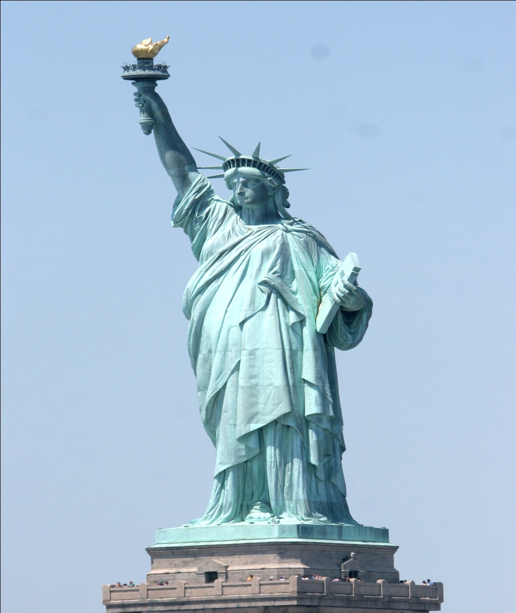

Slide 51
The bows of the warriors are broken,
but those who stumbled are armed with strength. Those who were full hire themselves out for food, but those who were hungry hunger no more. She who was barren has borne seven children, but she who has had many sons pines away. -1 Samuel 2:4-5

Slide 52
the
Chosen
One

Slide 53
The LORD said to Samuel, “How long will you mourn for Saul, since I have rejected him as king over Israel? Fill your horn with oil and be on your way; I am sending you to Jesse of Bethlehem. I have chosen one of his sons to be king.”
-1 Samuel 16:1

Slide 54
the
Chosen
One

Slide 55
The sacrifices of God are
a broken spirit;
a broken and contrite heart, O God, you will not despise.
-Psalm 51:17

Slide 56
the
Chosen
One

Slide 57
Humble yourselves before the Lord,
and he will lift you up.
-James 4:10
Humble yourselves, therefore, under God's mighty hand,
That he may lift you up
in due time. -1 Peter 5:6

Slide 58
But God chose the foolish things of the world to shame the wise; God chose the weak things of the world to shame the strong.
1 Corinthians 1:27
the
Chosen
One

Slide 59
the
Chosen
One

Slide 60
Jesus called them together and said, "You know that the rulers of the Gentiles lord it over them, and their high officials exercise
authority over them. Not so with you. Instead,
whoever wants to become great among
you must be your servant, and who- ever wants to be first must be your slave; just as the Son of Man did not come to be served, but to serve, and to give his life as a ransom for many." -Matthew 20:25-28

Slide 61
the
Chosen
One

