Slide 1


Slide 2

O Come All Ye Faithful
O come, all ye faithful
Joyful and triumphant
O come ye, O come ye to Bethlehem
Come and behold Him
Born the King of angels

Slide 3
O come let us adore Him
O come let us adore Him
O come let us adore Him
Christ the Lord

Slide 4
Sing choirs of angels
Sing in exultation
O sing, all ye citizens of heaven above
Glory to God
All glory in the highest

Slide 5
O come let us adore Him
O come let us adore Him
O come let us adore Him
Christ the Lord

Slide 6
For He alone is worthy
For He alone is worthy
O come let us adore Him
Christ the Lord

Slide 7
Yea Lord, we greet Thee
Born this happy morning
Jesus, to Thee be all glory given
Word of the Father
Now in flesh appearing

Slide 8
O come let us adore Him
O come let us adore Him
O come let us adore Him
Christ the Lord
Frederick Oakeley, John Francis Wade
1751 Public Domain
CCLI 78316

Slide 9
No Sweeter Name
No sweeter name than the name of Jesus
No sweeter name have I ever known
No sweeter name than the name of Jesus
(repeat)

Slide 10
You are the life to my heart
And my soul
You are the light to the
Darkness around me

Slide 11
You are the hope to the hopeless
And broken
You are the only truth and the way

Slide 12
No sweeter name than the name of Jesus
No sweeter name have I ever known
No sweeter name than the name of Jesus
(repeat)

Slide 13
You are the life to my heart
And my soul
You are the light to the
Darkness around me

Slide 14
You are the hope to the hopeless
And broken
You are the only truth and the way

Slide 15
Jesus Jesus
Jesus Jesus

Slide 16
You are the life to my heart
And my soul
You are the light to the
Darkness around me

Slide 17
You are the hope to the hopeless
And broken
You are the only truth and the way

Slide 18
You are the life to my heart
And my soul
You are the light to the
Darkness around me

Slide 19
You are the hope to the hopeless
And broken
You are the only truth and the way
Kari Jobe
2004 Gateway Create Publishing
CCLI 78316

Slide 20
Angels We Have Heard on High
Angels we have heard on high
Sweetly singing o'er the plains
And the mountains in reply
Echoing their glorious strains

Slide 21
Gloria In excelsis deo
Gloria In excelsis deo

Slide 22
Shepherds why this jubilee
Why your joyous strains prolong
Say what may the tidings be
Which inspire your heavenly song

Slide 23
Gloria In excelsis deo
Gloria In excelsis deo

Slide 24
Come to Bethlehem and see
Him whose birth the angels sing
Come adore on bended knee
Christ the Lord the newborn King

Slide 25
Gloria In excelsis deo
Gloria In excelsis deo
Traditional , James Chadwick, Chris Tomlin
2009 Vamos Publishing, worshiptogether.com songs, sixsteps Music
CCLI 78316

Slide 26
What Child Is This
What child is this, who laid to rest
on Mary's lap is sleeping
Whom angels greet with anthems sweet
While shepherds watch are keeping

Slide 27
This, this is Christ the King
Whom shepherds guard and angels sing
Haste, haste to bring Him laud
The Babe, the Son of Mary

Slide 28
Why lies He in such mean estate
Where ox and lamb are feeding
Good Christian, fear for sinners here
The silent Word is pleading

Slide 29
This, this is Christ the King
Whom shepherds guard and angels sing
Haste, haste to bring Him laud
The Babe, the Son of Mary

Slide 30
So bring Him incense, gold and myrrh
Come, peasant, king, to own Him
The King of kings salvation brings
Let loving hearts enthrone Him

Slide 31
This, this is Christ the King
Whom shepherds guard and angels sing
Haste, haste to bring Him laud
The Babe, the Son of Mary
William C. Dix
1865 Public Domain
CCLI 78316

Slide 32
How Great Is Our God
The splendor of the King
Clothed in majesty
Let all the earth rejoice
All the earth rejoice

Slide 33
He wraps Himself in the light
And darkness tries to hide
And trembles at His voice
Trembles at His voice

Slide 34
How great is our God
Sing with me, how great is our God
And all will see how great
How great is our God

Slide 35
And age to age He stands
And time is in His hands
Beginning and the End
Beginning and the End

Slide 36
The Godhead, three in one
Father, Spirit, Son
The Lion and the Lamb
The Lion and the Lamb

Slide 37
How great is our God
Sing with me, how great is our God
And all will see how great
How great is our God

Slide 38
Name above all names
Worthy of all praise
My heart will sing
How great is our God

Slide 39
How great is our God
Sing with me, how great is our God
And all will see how great
How great is our God
Ed Cash, Jesse Reeves, Chris Tomlin
2004 worshiptogether.com songs, sixsteps Music, Alletrop Music
CCLI 78316

Slide 40
Agnus Dei
Hallelujah, Hallelujah
For the Lord God Almighty reigns
Hallelujah, Hallelujah
For the Lord God Almighty reigns
Hallelujah

Slide 41
Holy, Holy
Are You Lord God Almighty
Worthy is the Lamb
Worthy is the Lamb

Slide 42
You are holy, holy
Are You Lord God Almighty
Worthy is the Lamb
Worthy is the Lamb
Amen

Slide 43
Hallelujah, Hallelujah
For the Lord God Almighty reigns
Hallelujah, Hallelujah
For the Lord God Almighty reigns
Hallelujah

Slide 44
Holy, Holy
Are You Lord God almighty
Worthy is the Lamb
Worthy is the Lamb

Slide 45
You are holy, holy
Are You Lord God Almighty
Worthy is the Lamb
Worthy is the Lamb
Amen
Michael W. Smith
1990 Sony/ATV Milene Music
CCLI 78316

Slide 46
How great is our God
Sing with me, how great is our God
And all will see how great
How great is our God
Ed Cash, Jesse Reeves, Chris Tomlin
2004 worshiptogether.com songs, sixsteps Music, Alletrop Music
CCLI 78316

Slide 47
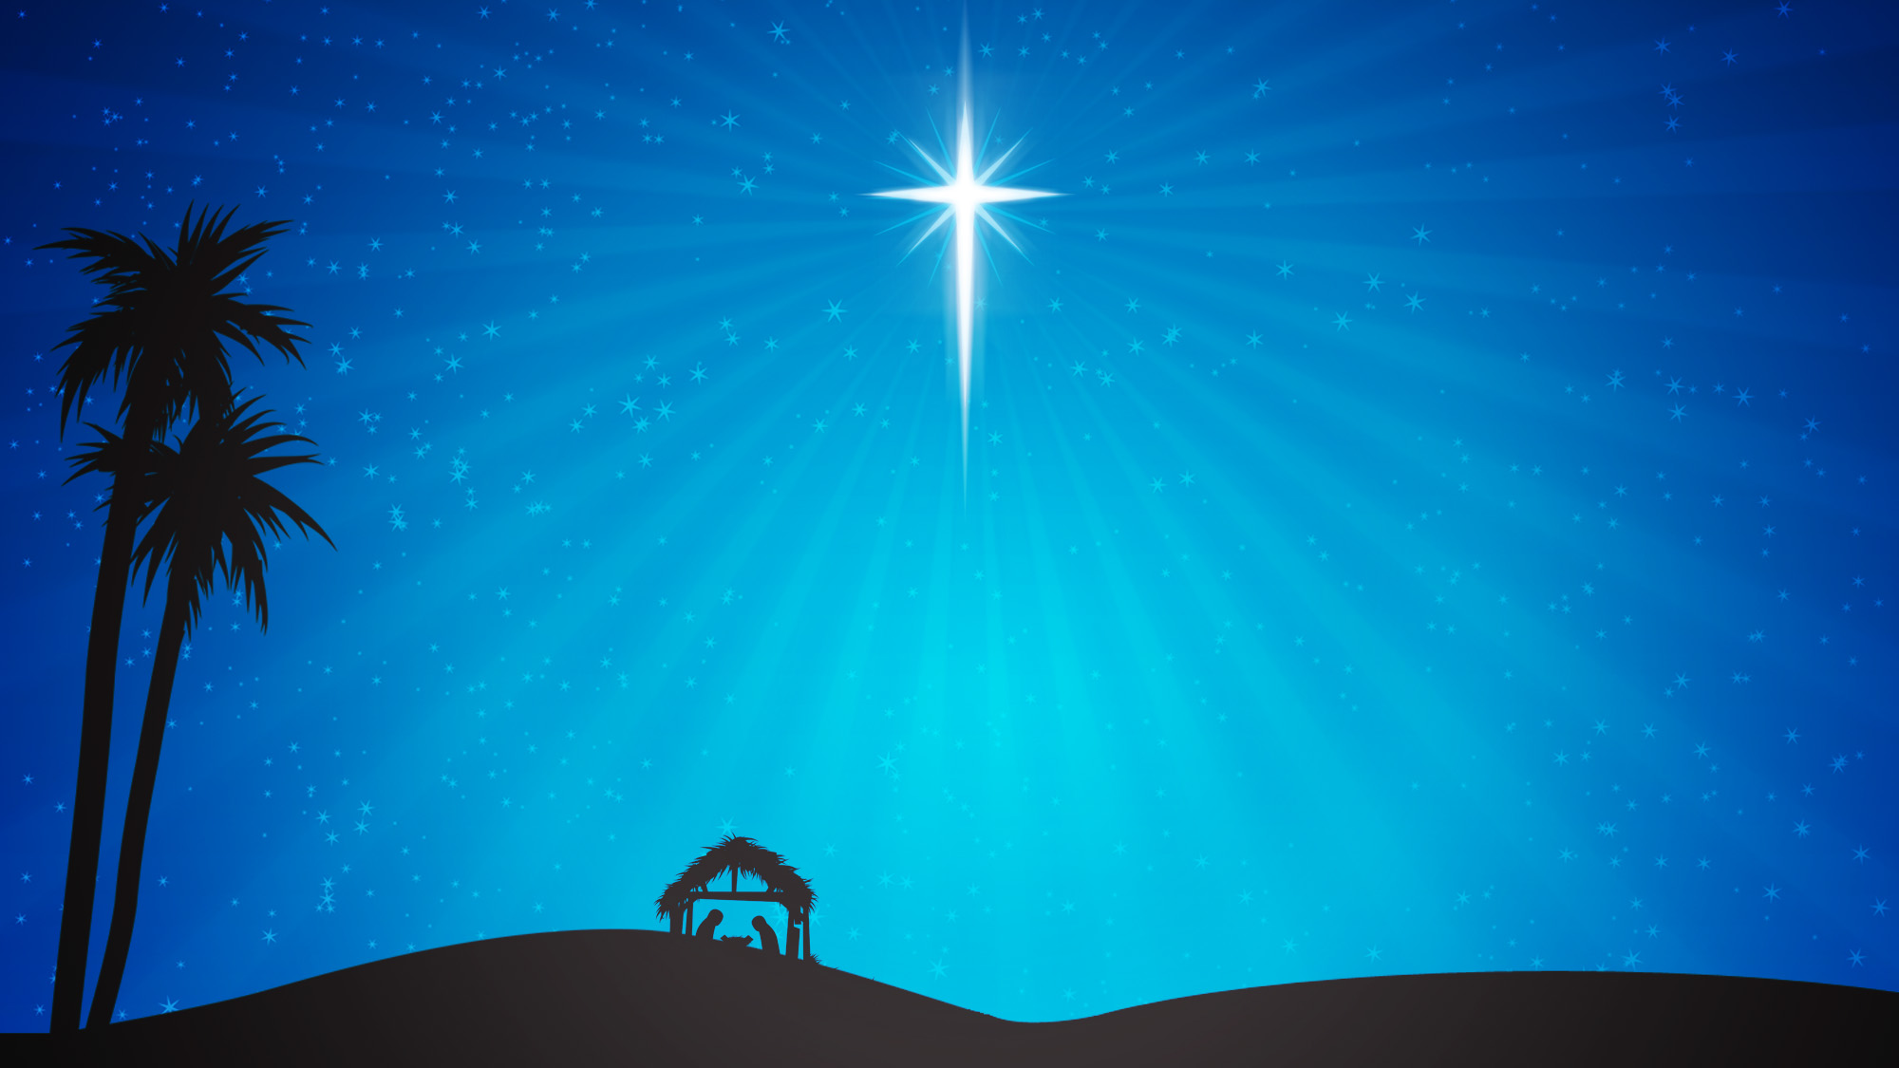

Slide 48
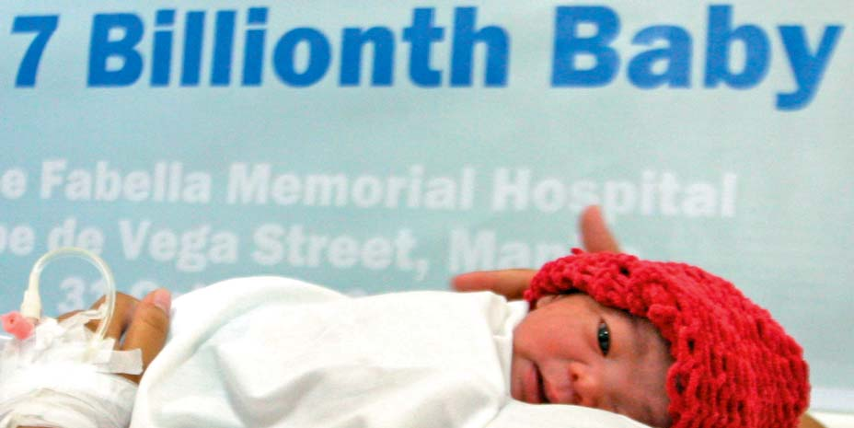
Danica May Camacho
October 31, 2011

Slide 50
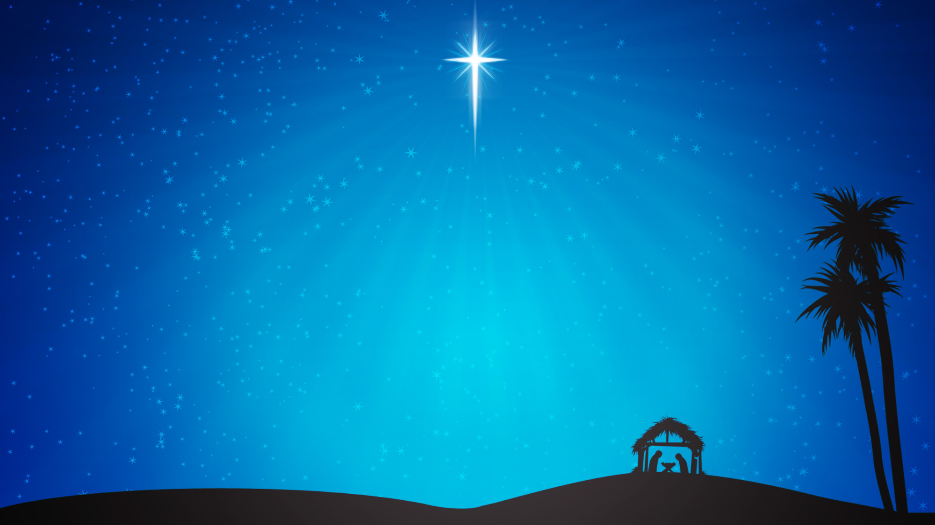
Sociological…
Social Darwinism/Survival of the Fittest

Slide 51
At the level of insects social Darwinists might be able to say some things, at the level of mammals its mostly just guess work and the level of human beings they’re just saying whatever comes into their heads.
- Noam Chomsky Philosopher and Atheist

Slide 52
Sociological…
Social Darwinism/Survival of the Fittest
Psychological…
Humanity reduced to sexuality
Existential…
No essential human nature
Economic…
Human as consumer

Slide 53
Ruthless Shopper Pepper Sprays Rivals in LA Wal-Mart
Buckeye Police “Body-Planted” Grandpa in Black Friday Mayhem
Girl trampled in Black Friday rush prayed
'Please get me out!'
Riot over $2
Waffle Maker

Slide 55
²⁶ Then God said,
“Let us make mankind in our image, in our likeness…
²⁷ So God created mankind in his own image, in the image of God he created them; male and female
he created them.

Slide 57
²⁶ Then God said, “Let us make mankind in our image, in our likeness, so that they may rule over the fish in the sea and the birds in the sky, over the livestock and all the wild animals, and over all the creatures that move along the ground.”

Slide 59
One of the primary laws of human life is that you become like what you worship;
what’s more, you reflect what you worship not only back to the object itself but also outward to the world around.
~ Those who worship power define themselves in terms of it and treat other people as collaborators, competitors or pawns.

Slide 60
~ Those who worship sex define themselves in terms of it (their preferences, their practices, their past histories) and increasingly treat other people as actual or potential sexual objects.
~ Those who worship money, increasingly define themselves in terms of money and increasingly treat other people as creditors, debtors, partners, or customers rather than as human beings.

Slide 61
~ Those and many other forms of idolatry combine in a thousand ways, all of them damaging to the image bearing quality of the people concerned and of those whose lives they touch.

Slide 63
“Therefore, if anyone is in Christ , he is a new creation; the old has gone, the new has come!
2 Corinthians 5:17

Slide 65
We Are
Every secret, every shame
Every fear, every pain
Live inside the dark
But that’s not who we are
We are children of the day

Slide 66
So wake up sleeper, lift your head
We were meant for more than this
Fight the shadows conquer death
Make the most of the time we have left

Slide 67
We are the light of the world
We are the city on a hill
We are the light of the world
We gotta, we gotta
We gotta let the light shine
(repeat)

Slide 68
Let the light shine
Let the light shine
Let the light shine
Let the light shine

Slide 69
We are called to spread the news
Tell the world the simple truth
Jesus came to save
There’s freedom in His Name
So let His love break through

Slide 70
We are the light of the world
We are the city on a hill
We are the light of the world
We gotta, we gotta
We gotta let the light shine
(repeat)

Slide 71
We are the light, we are the light
We are the light
So let your light shine brighter
We are the light, we are the light,
we are the light
Jesus

Slide 72
You are the light, You are the light
You are the light
We will lift you higher
Shine, shine, shine

Slide 73
We are the light of the world
We are the city on a hill
We are the light of the world
We gotta, we gotta
We gotta let the light shine
(repeat)

Slide 74
Let the light shine
Let the light shine
Let the light shine
Let the light shine
Kari Jobe

