Slide 2
Reaching For You
You created me inside
Your great imagination You're the One who gave me my First breath

Slide 3
You have overseen my life And brought me to redemption And I know that You're not Finished with me yet

Slide 4
I'm reaching for You I'm singing to You I'm lifting my hands to praise You I'm lifting my voice to thank You

Slide 5
I'm reaching for You,
Jesus I need You I'm giving my heart to know You I'm living my life to serve You I'm reaching for You

Slide 6
You're the one who spoke
The word of life to light
my darkness You opened up my eyes
'til I could see

Slide 7
Jesus You have promised to Complete the work You started Faithful to fulfill Your grace in me

Slide 8
I'm reaching for You I'm singing to You I'm lifting my hands to praise You I'm lifting my voice to thank You

Slide 9
I'm reaching for You,
Jesus I need You I'm giving my heart to know You I'm living my life to serve You I'm reaching for You

Slide 10
Pour out Your love from heaven Fill me until I overflow
Lord I want more Reach down Your hands from heaven Pull me closer than ever before
Lord I want more
(repeat)

Slide 11
I'm reaching for You I'm singing to You I'm lifting my hands to praise You I'm lifting my voice to thank You
TEMPLE BIBLE CHURCH Used by Permission CCLI#78316

Slide 12
I'm reaching for You,
Jesus I need You I'm giving my heart to know You I'm living my life to serve You I'm reaching for You

Slide 13
Our God
Water You turned into wine Opened the eyes of the blind There's no one like You,
none like You

Slide 14
Into the darkness, You shine Out of the ashes, we rise There's no one like You,
none like You

Slide 15
Our God is greater Our God is stronger God, You are higher than any other Our God is healer,
awesome in power Our God, our God

Slide 16
Into the darkness, You shine Out of the ashes, we rise There's no one like You,
none like You

Slide 17
Our God is greater Our God is stronger God, You are higher than any other Our God is healer,
awesome in power Our God, our God

Slide 18
And if our God is for us then Who could ever stop us And if our God is with us Then what could stand against

Slide 19
Our God is greater Our God is stronger God, You are higher than any other Our God is healer,
awesome in power Our God, our God

Slide 20
And if our God is for us then Who could ever stop us And if our God is with us Then what could stand against

Slide 21
Our God is greater Our God is stronger God, You are higher than any other Our God is healer,
awesome in power Our God, our God
Jonas Myrin, Matt Redman, Jesse Reeves, Chris Tomlin
2010 SHOUT! Publishing, worshiptogether.com songs, sixsteps Music, Vamos Publishing, Said and Done Music, Thankyou Music
CCLI 78316

Slide 24
The Stand
You stood before creation Eternity in Your hand You spoke the earth into motion My soul now to stand

Slide 25
You stood before my failure And carried the cross for my shame My sin weighed
upon Your shoulders My soul now to stand

Slide 26
What can I say
What could I do But offer this heart O God Completely to You

Slide 27
I'll walk upon salvation Your Spirit alive in me This life to declare Your promise My soul now to stand

Slide 28
What can I say
What could I do But offer this heart O God Completely to You

Slide 29
I'll stand with arms high And heart abandoned In awe of the One who gave it all I'll stand my soul, Lord To You surrendered All I am is Yours
Joel Houston
2005 Hillsong Publishing
CCLI 78316

Slide 30
Reign in Us
You thought of us
Before the world began to breathe
You knew our names
Before we came to be

Slide 31
You saw the very day
We’d fall away from you
How desperately
We need to be redeemed

Slide 32
Lord Jesus come lead us We're desperate for Your touch

Slide 33
Oh great and mighty One
With one desire we come That You would reign that You Would reign in us
CCLI 78316

Slide 34
We're offering up our lives a Living sacrifice That You would reign that You Would reign in us
CCLI 78316

Slide 35
Spirit of the living God
Fall fresh again Come search our hearts And purify our lives

Slide 36
We need Your perfect love we Need Your discipline We're lost unless You guide us With Your light

Slide 37
Lord Jesus come lead us We're desperate for Your touch

Slide 38
Oh great and mighty One with One desire we come That You would reign
that You would reign in us

Slide 39
We're offering up our lives a Living sacrifice That You would reign
that You would reign in us

Slide 40
We cry out for Your life to refine us Cry out for Your love to define us Cry out for Your mercy to keep us Blameless until you return

Slide 41
Oh great and mighty One with One desire we come That You would reign
that You would reign in us

Slide 42
We're offering up our lives
A living sacrifice That You would reign
that You would reign in us

Slide 43
Oh great and mighty One with One desire we come That You would reign
that You would reign in us

Slide 44
We're offering up our lives a Living sacrifice That You would reign
that You would reign in us
CCLI#78316

Slide 45
HOW GREAT THOU ART
Then sings my soul
My Savior God, to Thee
How great Thou art
How great Thou art
(repeat)
Ben Glover, Jon Neufeld, Tim Neufeld
2008 Birdwing Music, Screaming Norman Music, WB Music Corp., Fieldstar Music
CCLI 78316

Slide 48
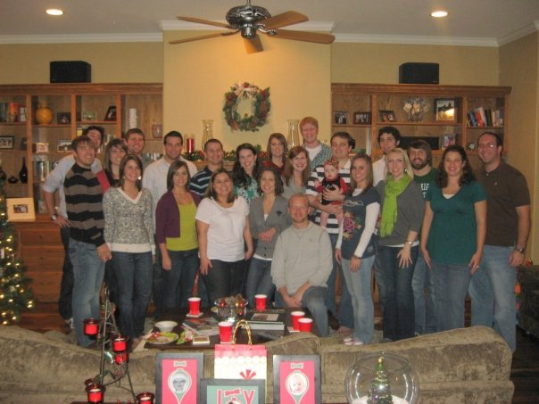
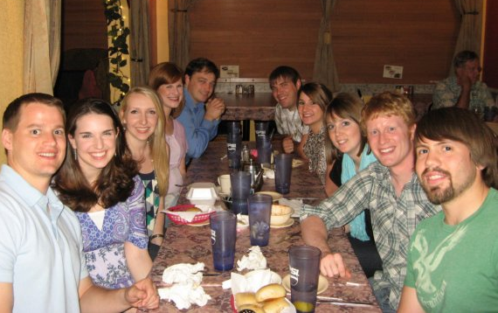
Couple’s Community Kick Off Lunch TODAY!
Come join
us for
lunch and fellowship.
11:00am to
12:15pm
Rm 303

Slide 50
A Letter from Prison
Acts 19:8-41

Slide 51
EPHESIANS
DOCTRINE
DUTY
WEALTH IN CHRIST
WALK IN CHRIST
CALLING OF THE CHURCH
CONDUCT OF THE CHURCH

Slide 52
a TOUGH START…FAITHFUL PEOPLE…
a SAD ENDING
a TOUGH START

Slide 58
a TOUGH START…FAITHFUL PEOPLE…
a SAD ENDING
a TOUGH START
the POWER of GOD on DISPLAY

Slide 59
¹² Dear friends, do not be surprised at the fiery ordeal that has come on you to test you, as though something strange were happening to you. ¹³ But rejoice inasmuch as you participate in the sufferings of Christ, so that you may be overjoyed when his glory is revealed.
1 Peter 4:12-13

Slide 60
² Consider it pure joy, my brothers and sisters, whenever you face trials of many kinds…
James 1:2

Slide 61
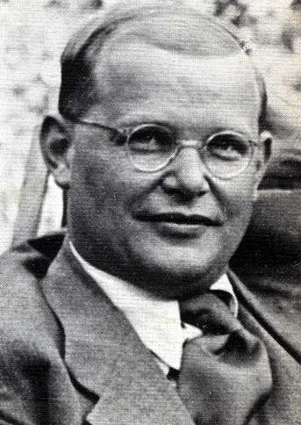
The call to serve Christ includes the call to suffer for Christ.
Dietrich Bonhoeffer

Slide 62
a TOUGH START…FAITHFUL PEOPLE…
a SAD ENDING
a TOUGH START
the POWER of GOD on DISPLAY
the OPPOSITION to TRUTH

Slide 64
a TOUGH START…FAITHFUL PEOPLE…
a SAD ENDING
a TOUGH START
the POWER of GOD on DISPLAY
the OPPOSITION to TRUTH
a FAITHFUL PEOPLE
a SAD ENDING…a WARNING to us

Slide 65
² I know your deeds, your hard work and your perseverance. I know that you cannot tolerate wicked people, that you have tested those who claim to be apostles but are not, and have found them false.
³ You have persevered and have endured hardships for my name, and have not grown weary.

Slide 66
⁴ Yet I hold this against you: You have forsaken the love you had at first.
⁵ Consider how far you have fallen! Repent and do the things you did at first. If you do not repent, I will come to you and remove your lamp stand from its place.
Revelation 2:2-5

Slide 67
DON’T be a person who wants to use JESUS for YOUR GAIN;
be a person who wants to be used by JESUS for HIS GAIN!
Dave Tate

